Slide 1

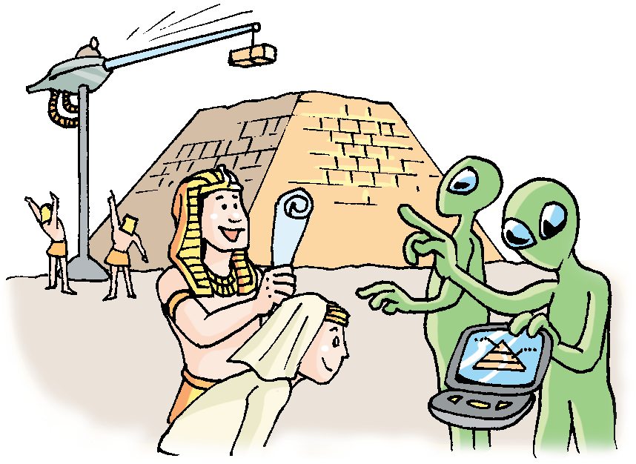
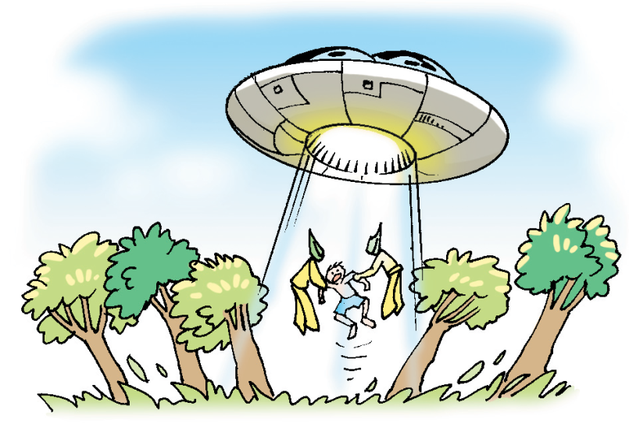
Unit
7
Module 4 Discovery
The unknown world
Speaking

Slide 2






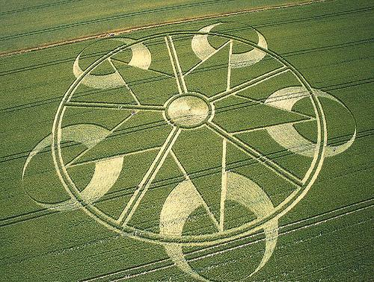
Statements about aliens
Do you agree or disagree…?
麦田怪圈

Slide 3

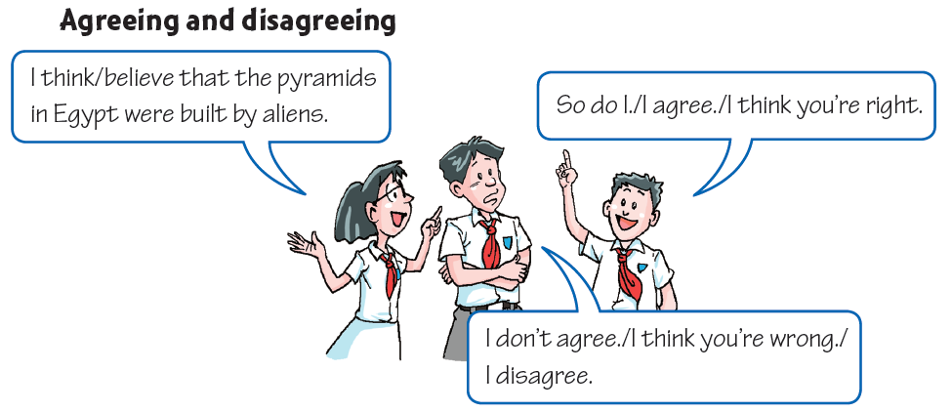
(p106) Talk time

Slide 4
What can we say to express agreement?
  So do I.（我也一样）
  I (totally/completely) agree.
  I agree one hundred per cent.
  I think you are right.
  Yes, indeed(确实如此).
  Yes, that’s exactly what I think.
  That’s just what I was going to say.
  How true! (诚哉斯言！)

Slide 5
What can we say to express disagreement?
  I don’t agree.
  I (totally/completely)disagree.
  I think you’re wrong.
  I’m not so sure about that.
  Do you really think so?
  I’m a bit surprised you said that.
  I wouldn’t say that.

Slide 6

In pairs, make a conversation like the example above. Choose one of the following topics.

Slide 7
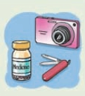
Speak up
Look at B on page 102 again. The two astronauts must get to their mother ship as soon as possible. They have the following things, but they can only take five of them.
a camera 一部照相机
a tent 一个帐篷 10 bottles of water 十瓶水
a knife 一把刀
matches 火柴
25 gold coins 25块金币
a map of Planet X 行星X的地图
medicine 药
6 lunch boxes 6个午餐盒

Slide 8
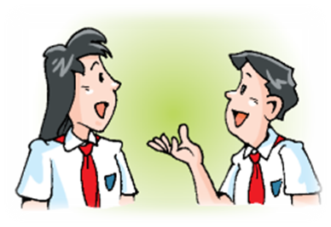
Work in pairs . Imagine you and your classmate are Liz and Gus.
Choose five things to take with you.
Explain why you need these things and
why you agree or disagree with your
classmate;
Tell the class your list and give your
reasons.

Slide 9
Offering suggestions:
Let’s …
I suggest that + 从句用虚拟语气
Why don’t we …?
What about …?
Agree with suggestions:
Disagree with suggestions:

Slide 10

New words and expressions
P106
as soon as possible 尽快 p. 106
tent n. 帐篷 p. 106
knife n. 刀 p. 106
explain v. 解释；说明 p. 106
agree with 同意；赞成 p. 106
disagree with 不同意；持不同意见； 有分歧 p. 106

Slide 11
Notes P106
1. — I think / believe that the pyramids in Egypt
were built by aliens.
— So do I.
——我认为埃及的金字塔是外星人建造的。
——我也是（这样认为的）。
So do I. 我也是。
倒装句结构：So +助动词/be 动词/情态动词+主语
“某人也这样”
表示前面所述的肯定情况同样适用于后面的人或物。
该结构中，助动词和be动词的时态要与_______保持
一致，单复数形式则由__________决定。
前一句
后面的主语

Slide 12
——露西唱歌很好听。
——我也是。/ 莉莉也是。
— Lucy sings beautifully.
— So do I. / So does Lily.
——汤姆昨天去体育馆看足球赛了。
——我也去了。/ 彼得也去了。
— Tom went to the gym to watch the football
match yesterday.
— So did I. / So did Peter.

Slide 13
——乔治擅长画画。
——我也是。/ 汤姆也是。
— George is good at painting.
— So am I. / So is Tom.
——他会游泳。
——我也会。/ 彼得也会。
— He can swim.
— So can I. / So can Peter.

Slide 14
若要表示前面所述的否定情况同样适用于后面的人或物
“Neither +助动词/be 动词/情态动词+主语”
“某人也不这样”
——我不喜欢这种音乐。
——我也不喜欢。
— I don’t like this kind of music.
— Neither do I.
——他们昨晚没去参加那个聚会。
——我也没去。
— They didn ’t go to the party last night.
— Neither did I.

Slide 15
Practice
选择最佳答案填空。
( )1. — I like watching cartoon films.
— ____.
A. So do I B. So I do
C. Neither do I D. Neither I do
( )2. — Tom speaks English well.
— ____.
A. So do Lily B. So does Lily
C. Neither does Lily D. Neither Lily does
( )3. — The food was very delicious. I ate too much.
— ____.
A. So do I B. So did I
C. Neither did I D. Neither I did
( )4. — It’s raining. I don’t want to go out.
— ____.
A. So do I B. So I do
C. Neither do I D. Neither I do
A
B
B
C

Slide 16
“so+助动词+主语” vs “so+主语+助动词”
so +助动词+主语
“某人也这样”
表示前面所述的肯定情况同样适用于后面的人或物。
so+主语+助动词
“某人的确如此”
表示肯定前文的说法。
Tom is hard-working.
Tom学习很勤奋。
So he is.
他确实很勤奋。
So am I.
我也很勤奋。

Slide 17
① ---It’s a bad day today.
---So it is.
② ---John studies English well.
---So he does.

Slide 18

( ) 1.--- I used to go out for a walk after supper.
--- ____.
A.So do I B. So did I C. Neither did I D.So I did
( ) 2. ---She has a nice watch.
---___.
A.So has she B. So she has
C.So does she D.So she does
( )3.---Mary wasn’t invited yesterday.
---___.
A.So was I B. Neither was I C.So did I D. Neither did I
( )4.---Ann has made great progress recently.
---___ and___.
A. So has she;so have you
B. So has she;so you have
C. So she has;so you have
D. So she has;so have you
B
D
B
D
巩固练习

Slide 19
2. I disagree. 我不同意。
1）disagree ：不同意
dis: 否定前缀
dislike“不喜欢”
dishonest “不诚实”
2）disagree with sb=don’t agree with sb
不同意某人的观点
他不同意我（的看法）。
He disagreed with me.
= He didn’t agree with me.

Slide 20
Practice
写出下列单词的反义词，并写出其中文意思。
1. cover _____________
2. appear _____________
3. order _____________
discover; 发现
disappear; 消失
disorder; 混乱

Slide 21
agree with 同意；赞成
辨析：agree with, agree to与agree on
agree with
agree to
agree on
同意某人的观点
agree with sb./
what sb. said
我们同意你所说的话
We agree with what you said.
同意某一计划、建议或决定等
agree to a plan
他同意了我的计划
He agreed to my plan.
双方通过协商就某事
达成一致。
主语一般用表示复数
的词。
他们同意了这些条款。
They agreed on these terms.

Slide 22
Practice
根据中文意思完成句子。
对于这件事，我爸爸和妈妈的意见不一致。所以他
们问我是怎么想的。
My father ________ _______ my mother about this matter.
So they asked me what I thought of it.
我们商定了出发的日期。
We the date to set off.
他同意了我的决定。
He my decision.
disagreed with
agreed on
agreed to

Slide 23
3. The two astronauts must get to their mother
ship as soon as possible.
这两个宇航员必须尽快到达他们的母舰。
as soon as possible 意为“尽可能快地”
= as soon as sb can / could
请你尽快给我回信。
Please write to me _____ _____ _____ ______.
Please write to me ___ ___ ___ ___ ___.
as soon as possible
as soon as you can

Slide 24
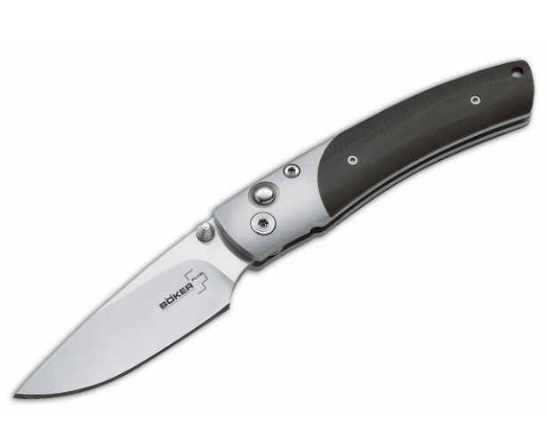
4. knife n. 刀
以f或fe结尾的名词变复数时一般把f或fe变为v，再加-es，如：
wife-______，life-_______，
leaf-______，thief-_______，
wolf-______，shelf-_______
这把刀是干什么用的？
What is the knife used for?
wives lives
leaves thieves
wolves shelves

Slide 25
5. explain v. 解释；说明
n. explanation
explain (to sb.) why/how/what etc.
向某人解释 为什么…/怎么样…/什么…
他向我说明这个机器怎样使用。
He explained to me____ ____ ____ ____ _____.
He explained to me____ ____ ____ ____ _____.
explain sth. to sb.
他向我介绍了这个系统。
He explained the system to me.
how the machine was used
how to use the machine

Slide 26
New words and expressions
(Writing:P107-108)
pleased adj. 高兴；满意；愉快 p. 108

Slide 27
Notes 107-108
1. However, something strange happened.
然而，一些奇怪的事情发生了。
something strange 奇怪的事情
形容词修饰不定代词或不定副词时，须置于
其所修饰的词之后。例如：
我有一些重要的事情要告诉你。
I have something important to tell you.
这里太吵了。我想去个安静的地方。
It’s too noisy here. I want to go somewhere
quiet.

Slide 28
Practice
选择最佳答案填空。
( )1. There is ____ with my watch. It doesn’t
work.
A. nothing wrong
B. anything wrong
C. wrong something
D. something wrong
D

Slide 29
2. pleased adj. 高兴；满意；愉快
be pleased with sb./ sth. 对某人/某物感到满意
be pleased to do sth. 高兴、乐意做某事
be pleased + that 高兴、乐意……
我对自己的考试成绩不太满意。
I wasn't very pleased with my exam results.
见到你很开心。
（I am）pleased to meet you.
如果我们可以做什么，我们会很乐意帮忙。
If there is anything we can do, we would be pleased to help.
你觉得好些了，我很高兴。
I am pleased that you’re feeling better.

Slide 30
2. pleased adj. 高兴；满意；愉快
please v. （使）高兴，（使）满意
他千方百计的讨好自己的女朋友。
He did everything he could to please his girlfriend.
be hard/easy/impossible to please
很难让他满意。一切都要做到完美才行。
She’s hard to please. Everything has to be perfect.
pleasure [C, U] 愉快，快乐，满足
It is a pleasure for sb to do sth.
It is a pleasure for me to write to you.
It is a pleasure/ My pleasure用于回答__________;
with pleasure 用于回答____________。
thank you
别人的请求

Slide 31
Thank you!

