Slide 1
Make sentences in different ways
Monitors | C4091 | C4095
How big | 17 inches | 19 inches
How heavy | 5kg | 4kg
How much | ￥ 1,200 | ￥1,298
How many sold this month | 38 | 50
1 is * inches / is a *-inch monitor
2 is * kilograms / is a *-kg monitor/ weigh * kilograms
3 is * yuan / the price is * yuan / costs * yuan
4 we have sold * ones / we have a sales volume of * /
the grand total of sales is *

Slide 2
Make sentences in different ways
Monitors | C4091 | C4095
How big | 17 inches | 19 inches
How heavy | 5kg | 4kg
How much | ￥ 1,200 | ￥1,298
How many sold this month | 38 | 50
1 is bigger than
2 is heavier than / weighs more than
3 is …than / the price is …than / costs…than
4 we have sold … than / the grand total sales is … than

Slide 3
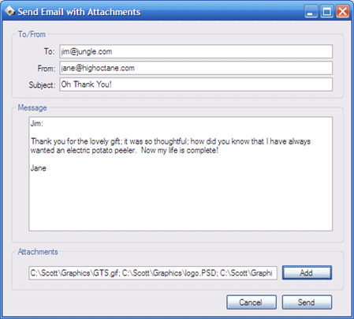
Mabel Wang
Tom Green
An email about monitors
Dear Ms Wang,
You ordered a C4091 monitor yesterday. I am afraid we do not have any now. However, we have another model--- the C4095.
The C4095 is a 19-inch monitor, so it is bigger than the C4091.________________________________________________
____________________________________________________________
The C4095 weighs 4kg and it is lighter than
the C4091. Besides, the C4095 is ￥1298,

Slide 4

.___________________________________________________________________________________________________________________________________________________________________________________________________________________________________________________________________
so it is more expensive than the C4091.
We have sold 50 C4095 monitors this month, and 38
C4091 , so the C4095 is more popular than the other..
Would you like to order a C4095? I look forward to your
reply.
Best wishes,
Tom Green
.

Slide 5
The polite ways to say or write things
Situations | What to say or write
When we give a respond which is unhelpful but the reason is outside our control | I’m afraid that ….
At the end of the letter you want to know what the other side thinks about | I look forward to your reply. I look forward to hearing from you.
At the very last , end your letter | Best wishes. Best regards.

Slide 6

Useful expressions
Chinese | English
在网上 | on the Internet
在过去 | in the past
不停地 | without stopping
用电脑来学习 | use computers for studying
参加会议/演讲 | attend a meeting/ speech
花太多时间玩游戏 | spend too much time playing
一起合作 | all work together
…的不良影响 | the bad effects of

Slide 7
The polite ways to say or write things
Situations | What to say or write
To begin a speech | Good morning / Good afternoon / Good evening, ….. Thank you for attending this ….
To end a speech | Thank you for your time.

