Slide 1
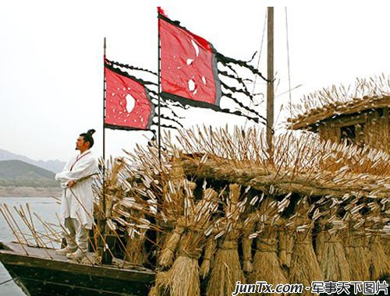
Unit 6 More Practice
The story of 100000 arrows

Slide 2
The English style:
First (Given) Name + Middle Name + Family Name (Surname)
孙权
曹操
刘备
诸葛亮
周瑜
关羽
张飞
司马懿
孙子
中国方式：姓氏 (Family Name) + 名 (Given Name)
Sun Quan
Cao Cao
Liu Bei
Zhuge Liang
Zhou Yu
Guan Yu
Zhang Fei
Sima Yi
Sun Tzu

Slide 3
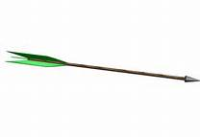
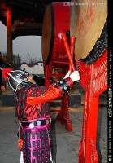
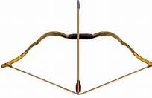
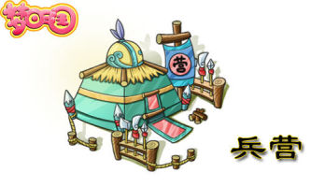
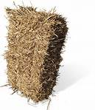
arrow
[ˈærəʊ]
bow
drum
[bəʊ]
straw
[strɔː]
camp

Slide 4
make 100000 arrows within ten days
bring you 100000 arrows in three days
fill 20 large boats with straw men
in the early morning
sail the boats towards the camp
be under attack
see through the thick fog
shoot arrows
turn around
an impossible task
1十天内做10万支箭
2 三天后带给你10万支箭
3 用稻草人装满20艘大船
4 一大早
4 把船驶往营地
5 受到攻击
6 透过浓雾看见
7 射箭
8 转身
9 一个不可能完成的任务

Slide 5
Idioms
a straight arrow
(American)someone who is very honest and careful to behave in a socially acceptable way
Friends describe John as a straight arrow who rarely drank and was close to his family.
under attack / under fire
being attacked or hurt
see through sb or sth
to understand or detect the true nature of someone or something.
You can't fool me anymore. I can see through you and all your tricks. This plan is designed to make money for you, not to help people. I can see through it! I'm not a fool!

Slide 6
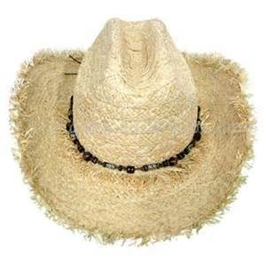
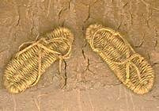
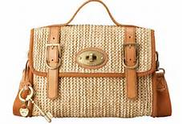

straw hat
straw sandals
straw handbag
drinking straws

Slide 7
周报 P1-P2
1 Come on.
2 is filling with
3 in the early morning
1 turned around
2 is under attack
3 look down
4 think of
10 will have
11 flew
12 will go
13 was filled with
14 filled with
1 a ticket for
2 a ticket to
3 look after
4 busy looking up
5 looked over
6 look down
7 thought of
8 think over
9 thinking about

Slide 8
周报P4
1 impossible 2 beaten ( beat – beat– beaten)
3 loudly 4 shot (shoot – shot – shot )
1 clever / smart / wise 2 thick 3 attack
1 Turn around 2 on the side of 3 saw through
4 sailing away
1 asks us to 2 have moved 3 for many years
4 gave important task ACAB ADDC

Slide 9
Destiny
Artist: Fredrika Stahl
Do you rely on Destiny?
As a god planning in advance?
Or do you believe in your own power?
And hope for a bit of chance?
Do you think some people are born to succeed?
Others cursed to fail
Would you rather believe
That you are the writer of your tale?
Are we hitchhikers on an endless road?
Choosing where to stop, and which paths to go
In that case, I want you to grab my hand
We will no longer have to walk; I promise we will flow
Do you think confrontations pop up
A test for you to pass?
Or do you see them as things to avoid?
And stick to the green grass?
Do you think you beauty is a reflection from within
Or are there just some lucky bastards that can eat and still be thin?
Do you think some folks are meant for each other?
There's a single true match
Are you just someone that passed my way
That I was lucky enough to catch
We will flow

Slide 10
One of Cao Cao’s soldiers told the story to his family. Complete his story below with “be under attack” “shoot arrows” “see through” “lend”
In the early morning that day, most of us were sleeping in our camps. Suddenly we heard some loud noises from the river. We quickly got up and went to look.
However, we couldn’t see through the thick fog on the river and we thought we were under attack. So Cao Cao ordered us to shoot arrows towards the sounds.
In fact, we made a mistake, Zhuge Liang’s boats were soon full of arrows, we lend more than 100,000 arrows to them!

Slide 11
Important Phrases
把……装满
充满
要求某人做……
带来
带去
为了……而感激某人
fill…with…
be full of
ask/order… to do
bring … to …
take … to …
thank sb for …

Slide 12
Exercises
Fill in the blanks.
ask
1.Zhou Yu gave Zhuge liang an important t_____.
2. Zhou Yu asked Zhuge Liang to make 100,000
arrows w_____ ten days.
3. The soliders s_______ and beat their drums
loudly.
4. This story is about two w_____ men—Zhou Yu
and Zhuge Liang
5. He asked his soldiers to f___ 20 large boats with
many straw men.
ithin
houted
ise
ill

Slide 13
1.上学前，妈妈让我把瓶子装满水。
Before going to school, Mother asks me to ____ the bottle ______ water.
2. 这个周日，我会带妹妹去看望奶奶，
This Sunday, I _____ _____ my sister ______ visit Grandma.
3. 非常感谢帮我这么多。
_______ you ______ ______ me a lot.
fill
with
will take to
Thank for helping

