Slide 1
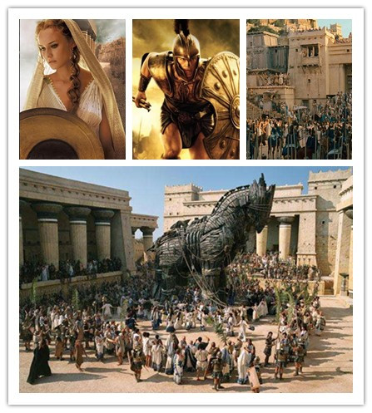
Unit 6 Ancient stories
Writing

Slide 2
目录
Pre-Learning
1
While-Learning
2
Post-Learning
3
4
Review

Slide 3
Part I Pre-Learning

Slide 4

Let’s learn the useful expressions.

Slide 5
Notes (Writing)
Then we thought of a trick.
然后，我们想到了一个计谋。
think of 意为“想到；记起；考虑”。如：
他在考虑出国学习。
He is thinking of studying abroad.
【拓展】think about 意为“思考；考虑”，强
调动脑筋想问题。在作“考虑”这个意思时，
可与think of 互换使用；think over 意为“仔细
考虑”，强调权衡再三；think out意为“想
出”。

Slide 6
Practice
根据中文意思完成句子。
1. 想起她的电话号码了吗？
Have you _______ ______ her telephone number?
2. 请好好想想你妈妈的话吧。
Please ______ ______ your mother’s words.
3. 他正在思考一个数学问题。
He is ________ ______ a Maths problem.
thought of
think over
thinking about

Slide 7
Part II While-Learning

Slide 8
A story about the Trojan War
A After the Trojan War, one of the soldiers inside the wooden horse told his story to his family. Complete the story with the words in brackets and other words if necessary.
We tried to capture Troy for ten years, but did not
succeed. Then we thought of a trick.
We built a huge wooden horse and _______________ __________________________(leave/outside/main gates). During the night, our army disappeared, but ________________________(not go/far away). In the morning, the Trojans ________________(see/horse).
I was inside the horse with another five soldiers, but the Trojans did not know.
left it outside
the main gates
they didn’t go far away
saw the horse

Slide 9
pulled the horse
into the city
The Trojans opened the gates and ___________________
____________(pull/horse/into/city). That night, they
celebrated and __________________ (make jokes /us).
Then they _____________________________________
(lock/gates/go to sleep).
When they were asleep, we _______________________
(climb/horse). We _______________________________
(open/main gates) and ____________________________
(our army/enter/city).
Then we went to the captain’s room. We _____________
(catch).
made jokes about us
locked all the gates and went to sleep
climbed out of the horse
opened the main gates
our army entered the city
caught him

Slide 10

Find the sentences with the words in the box from the story.
· Get some help and pull it into the city.
· The horse was full of Greek soldiers!
· … , all the Trojans celebrated.
· After the party, they locked all the gates of the city
and then all went to sleep.
· They quietly climbed out of the horse one by one.
· The Greek army entered the city.

Slide 11
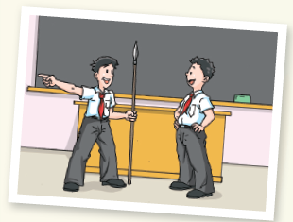
Role-play. One acts as the Trojan captain(S2) and the other as his son(S1). Make a conversation to talk about the story of the Trojan horse.

Slide 12
S1: What happened first?
S2: One of my soldiers found a huge wooden horse outside the main gates. I ordered them to pull it into the city. But it was a big mistake.
S1: Why?
S2: Because the horse was full of Greek soldiers!
S1: What happened next?
S2: We thought we had won the war. That night we celebrated in the main square. Then we locked all the gates and went to sleep.
S1: What about the Greek soldiers in the horse?
S2: At midnight, they climbed out of the horse, opened the main gates and let the Greek army enter the city.
S1: What happened to you, father?
S2: They came into my room and caught me. The Greeks won the war. We lost everything. Remember, son, never trust your enemy.

Slide 13
B Years later, the captain told his son what happened that
night. Complete his story. Use the words from the box to
help you.
pull … into … be full of lock climb out of a big mistake celebrate go to sleep enter the city
The Greeks left a huge wooden horse outside our main gates…

Slide 14
The Greeks left a huge wooden horse outside our main gates…
I ordered some soldiers to pull it into the city. However, it was a big mistake because the horse was full of Greek soldiers. That night, we celebrated happily in the main square. Then we locked all the gates and went to sleep. When we were all asleep, the Greek soldiers climbed out of the horse. They opened the main gates and let their army enter the city. I remember a group of Greeks came into my room and caught me. The Greeks won the war. We lost everything just because we pulled the wooden horse into the city!

Slide 15
Part III Post-Learning

Slide 16
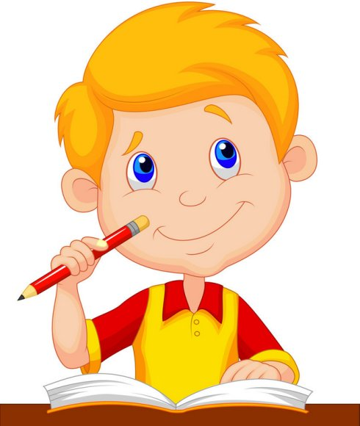
请根据下面的故事梗概，用英语编写故
事。词数：80~130。

Slide 17
故事梗概：
有一次，孙权送给曹操一头大象。曹操想
知道大象的重量，但大象太大，大臣们无法
称重。这时曹操的儿子曹冲走过来说他能称
大象。他使大象上了船，看船身沉入水里多
少，并在船身上做了一个记号。然后把大象
赶上岸，再叫人把一筐筐的石头放上船，直
到船下沉到刚刚画的那个记号为止。最后他
让人称船上的石头。他成功地称出了大象的
重量。

Slide 18
Long long ago, Sun Quan gave an elephant to Cao Cao. Cao Cao wanted to know the weight of the elephant. But it was so big that his ministers
could not weigh it. Just then, his son, Cao Chong,
came up and said that he could do it. He made the
elephant get on a boat and made a mark on the boat when the boat stopped sinking. Then he drove the elephant back to the bank and asked some people to put some baskets of stones into the boat until the surface of the water reached the mark. In the end, he asked people to weigh the stones in the boat. In this way, he succeeded in weighing the elephant. How clever Cao Chong was!

Slide 19
Part IV Review

Slide 20
Exercises
翻译下列句子。
1. 汤米是一个很努力工作的人。
2. 他很累，但是他并没有放弃。
3. 小港口里满是船只。
Tommy is a hard-working man.
He was tired, but he didn’t give up.
The small port is full of / filled with ships.

Slide 21
Thank you!

