Slide 1
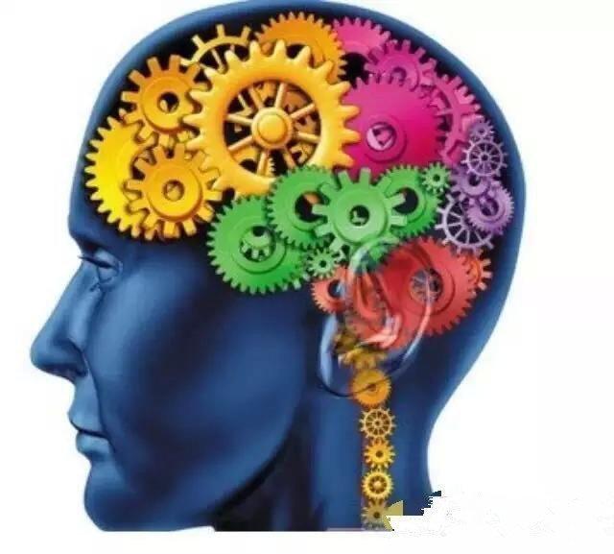
Unit 7 Memory
Grammar

Slide 2
目录
Review
1
2
While-Learning
Review
3

Slide 3
Part I Review

Slide 4

Grammar A Conditional sentences (2)
Read the sentence below to review the use of conditional sentences.
the simple present tense
If you make the picture big, strange or silly, you will remember it better.
the simple future tense

Slide 5
Some students are asking for advice for their problems. Discuss their problems in pairs and give your suggestions.
I was away from school today. I don’t know what homework I should do.
If ______________________, they will tell you what homework you should do.
I sometimes forget what things to buy at the supermarket.
If , you will remember what things to buy.
I don’t know what this word means.
If , you will find out its meaning.
I hate getting up! I always feel tired in the morning.
If , you won’t feel tired.
you telephone your friends

Slide 6
条件状语从句的概念
在句子中表示时间、地点、原因、方式、条件等部
分被称为状语。如果句中表示条件的部分是一个句
子，这个句子就叫条件状语从句。例如：
如果明天早上我起得早，我会给你打电话的。
If I get up early tomorrow morning, I will call you.
句中“明天早上我起得早”是“我给你打电话”的
一个条件，所以这里的“ If I get up early”就是条件
状语从句，而“I will call you” 是这个句子的主句。
条件状语从句的引导词常见的有：if (如果)，
unless(除非)，as long as(只要)等，初中阶段最常见的
是由if 和unless引导的条件状语从句。

Slide 7
Part II While-Learning

Slide 8


We can also use conditional sentences to talk about results that will certainty happen.
The if-clause talks about a possible action.
If you put salt into water, it disappears.
The main clause talks about the result that will certainly happen.

Slide 9
Things to remember
Work out the rule
When we use a conditional sentence to talk about something that will certainly happen, both verbs should be in( the simple present tense/the simple future tense).
We can also put the if-clause after the main clause.
Salt disappears if you put it into water.

Slide 10
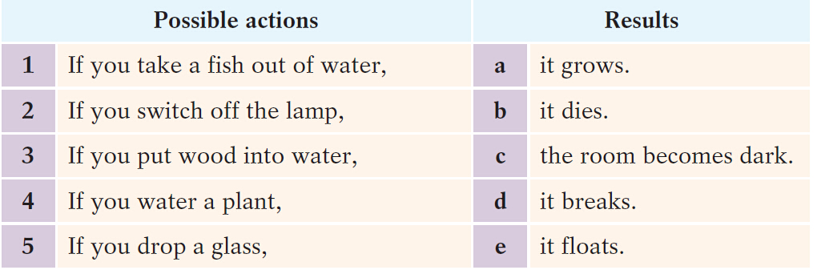
A1 Read these if-clauses and draw lines to match them with the results.

Slide 11

A2 In pairs, make conversations about the sentences in A1 on page 103. Follow the example.
S1: What happens if you take a fish out of water?
S2: It dies.
S1: Are you sure?
S2: Of course. I’m sure. If you take a fish out of water,
it dies.

Slide 12

A3 Complete these sentences with the words in brackets.
1 If you___________ ice, __________water.
(turns/heat/it/into)
2 If you _____________ steam, ___________ water. (into/cool/turns/it)
3 Oil ___________________________water.
(on/floats/pour/it/you)
4 Water ___________________it. ( your/heat/boils/if )
heat
it turns into
cool
it turns into
floats if you pour it into
boils if you heat

Slide 13
如何使用if ... not和unless
unless 作“除非”解时相当于if ... not，其引导的条
件状语从句与if 引导的条件状语从句用法一样，
unless 与if ... not 常常可以互换使用。例如：
如果你不努力学习，你就会考试不及格。
If you don’t study hard, you will not pass the exam.
= Unless you study hard, you will not pass the exam.
如果你不努力工作，你就不会得到高薪。
If you don’t work hard, you will not get high salary.
= Unless you work hard, you will not get high salary.

Slide 14
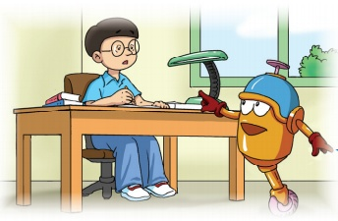
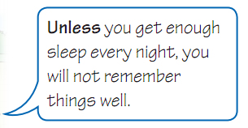
Grammar B if …not and unless
The word unless can mean if ... not

Slide 15
Things to remember
We can also put the if-clause and the unless-clause after the main clause.
You will be late for school
if you do not leave now.
unless you leave now.

Slide 16
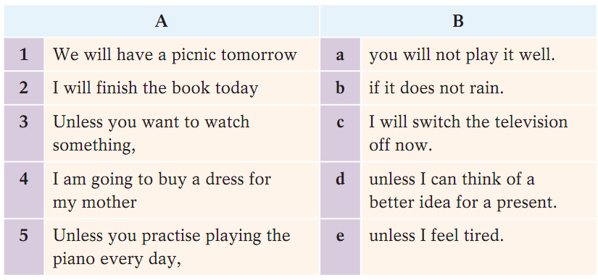
B1 Draw lines to match the beginnings of the sentences in Column A with the endings in Column B.

Slide 17
B2 Rewrite the following sentences with unless.
If you do not improve your handwriting, you will lose marks in the exam.
Unless you improve your handwriting, you will lose marks in the exam./ You will lose marks in the exam unless you improve your handwriting.
2 You will get a toothache if you do not brush your teeth every day. ___________________________________
__________________________________________
__________________________________________
Unless you brush your teeth every day, you will get a toothache./ You will get a toothache unless you brush your teeth every day.

Slide 18
3 This room will get very hot if you do not open the window.
__________________________________________________________________________________________
4 If you do not close that window, flies will get in.
__________________________________________________________________________________________
5 I will leave this restaurant if the waiter does not come
soon.
__________________________________________________________________________________________
Unless you open the window, this room will get very hot.
/This room will get very hot unless you open the window.
Unless you close that window, flies will get in.
/ Flies will get in unless you close that window.
Unless the waiter comes soon, I will leave this restaurant.
/ I will leave this restaurant unless the waiter comes soon.

Slide 19
Part III Review

Slide 20
一、选择最佳答案填空。
Exercises
( )1. Peter _____ angry if you break his toy.
A. gets B. will get
C. get D. got
( )2. If you _____ salt into water, it _____.
A. put; disappears
B. will put; disappears
C. put; will disappear
D. will put; will disappear
( )3. Jim won’t get happy _____ you return the
book to him.
A. if B. so C. unless D. until
B
A
C

Slide 21
二、根据题目要求，完成下列句子。
1. If you are not brave, you’ll lose your last chance. （改为同义句）
______ you are ______, you’ll lose your last chance.
2. Unless you go to bed early, you will feel tired. (改为同义句)
______you ______ go to bed early, you will feel tired.
3. If you don’t improve your handwriting, you’ll lose marks in the exams. (改为同义句)
______you ______ your handwriting, you’ll lose marks in the exams.
Unless brave
If don’t
Unless improve

Slide 22
Thank you!

