Slide 1

Unit 8 English Week
Writing

Slide 2
目录
Review
1
Pre-Learning
2
While-Learning
3
Post-Learning
4
5
Review

Slide 3
Part I Review

Slide 4

Show time
Act it out.
Robin Hood

Slide 5
Part II Pre-Learning

Slide 6

Let’s learn the new words and expressions.

Slide 7

New words
else
choose
adv. 其他的；别的 p.123
v. 选择；挑选 p.124

Slide 8
Notes (Writing)
1. else adv. 其他的；别的
else 与 somebody, anybody, something等复
合不定代词连用时，要位于这些词之后，
else还可以用在特殊疑问词之后，表示强调。
除了Tina以外没有人知道这个问题的答案。
Nobody else except Tina knew the answer to
this question.
这间酒店住满了，所以我们就到别处去住了。
This hotel was full, so we stayed somewhere
else.

Slide 9
Practice
根据中文意思完成句子。
1. 你什么时候还有空？
________ _____ are you free?
2. 我们还能做些什么？
______ _____ can we do?
3. 你在别的地方买不到。
You can’t get it __________ ______.
4. 我还有别的东西吃。
I have __________ ______ to eat.
When else
What else
anywhere else
something else

Slide 10
2. choose v. 选择；挑选
choose 含有无论喜欢与否都明智地“挑选”，
或选择后坚持不变之意。过去式为chose, 过
去分词为chosen。
安挑了一个最大的蛋糕。
Ann chose the biggest cake.
Sarah 18岁时选择在英国读书。
Sarah chose to study in the UK when she
was 18.

Slide 11
3. Miss Li, our English teacher, will give a talk
on how to choose good English books.
我们的英语老师李老师将作一个关于如何选择好的英语书的报告。
give a talk 意为“作报告”，可与give a speech 互换使用，后面常接介词短语on ,表示“就……作报告”。例如：
汤姆很紧张，因为他即将要在全班同学面前作报告。
Tom is nervous because he is going to give a talk before all his classmates.

Slide 12
Practice
选择最佳答案填空。
( )1. — Do you know Cai Kangyong will come to
Guangzhou to give us a talk ____ how to
speak in a wise way?
— Yes, I have already got the ticket!
A. to B. at C. on D. of
根据中文意思完成句子。
2. 你认为谁就这个问题作的报告最好？
Who do you think is the best man to _____ ___ ___________ _____ this problem?
C
give a
talk / speech on

Slide 13
Notes (More practice)
This castle and all your gold now belong to the
poor!
现在，这城堡和你所有的黄金都属于穷人！
belong to 意为“属于”。注意这里的to是介词，
后面接名词或代词宾格形式。belong to不用于
进行时或被动语态。例如：
这本书是属于我的。
The book belongs to me.
这盖子是配这个瓶子的。
The lid belongs to the bottle.

Slide 14
Practice
根据中文意思完成句子。
1. 这只鸟属于哪一科的？
What family does the bird _______ _____?
2. 这间木屋一年前是一位老人的。
The wooden house ________ _____ an old man a year ago.
3. 那些书是图书馆的。
Those books ________ _____ the library.
belong to
belonged to
belong to

Slide 15
Part III While-Learning

Slide 16
Brainstorm
Discuss the basic elements of a notice.
activities
notice
time
place
heading

Slide 17
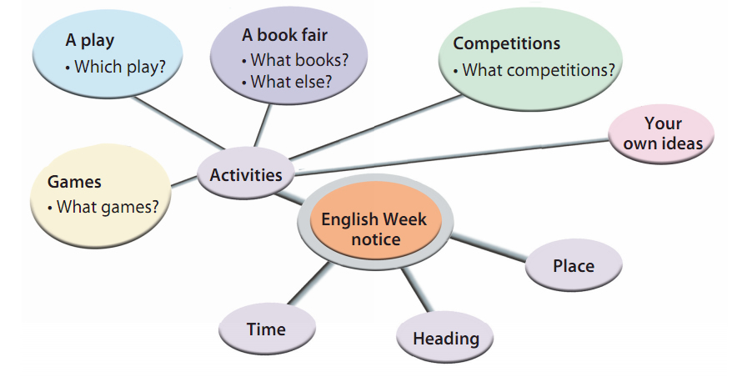
In groups of four, discuss the kinds of activities you can have during English Week. Use the spidergram below to help you.

Slide 18
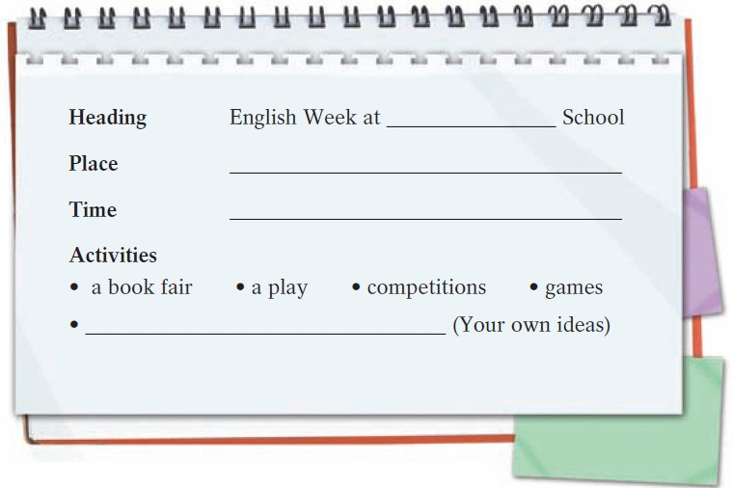
Write notes for your notice.
Sunflower Junior High
No. 55 Garden Street, Beijing
from 12 November to 16 November
an English evening

Slide 19
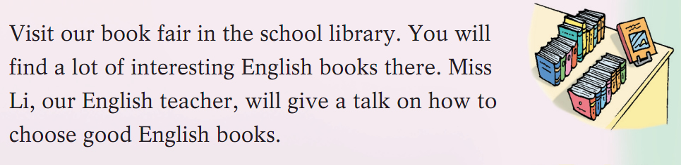
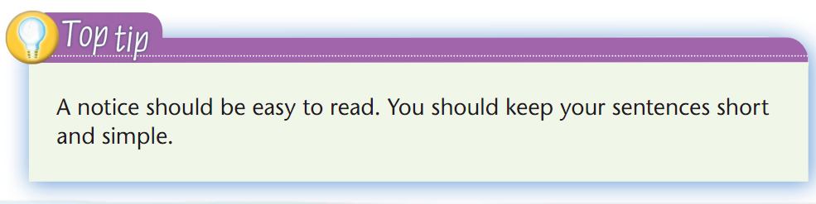
Read the sample paragraph on page 124.

Slide 20
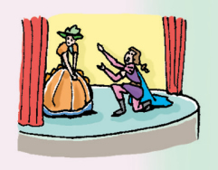
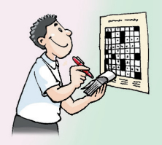

Discuss the activities in the pictures in groups of four.
an English play
crossword puzzles
纵横字谜；填字游戏
an English singing competition

Slide 21
B Write your notice.
English Week at __________________________ School
Address: _______________________________
Come to our English Week from ____________
to ____________.
Visit our book fair in the school library. You will find a lot of interesting English books there. Miss Li, our English teacher, will give a talk on how to choose good English books.
Sunflower Junior High
No. 55 Garden Street, Beijing
12 November
16 November

Slide 22
Some students will put on __________________
_______________________________________
________________.
If you are a good singer, you should
________________________________________
________________________________________.
A lot of students like games, so we have lots of
them! ___________________________________
________________________________________
Come and take part in English Week!
Have fun and enjoy English!
an English play. They will act out the famous English play Romeo and Juliet.
take part in the English singing competition. You can sing your favourite English songs
You can have fun with crossword puzzles. You will love them!

Slide 23
Part IV Post-Learning

Slide 24



Suppose your school is going to have a sports meeting. Write a notice for it.
What activities can we have at a sports meeting?
playing football
playing basketball
playing table tennis
running
playing badminton
playing volleyball

Slide 25



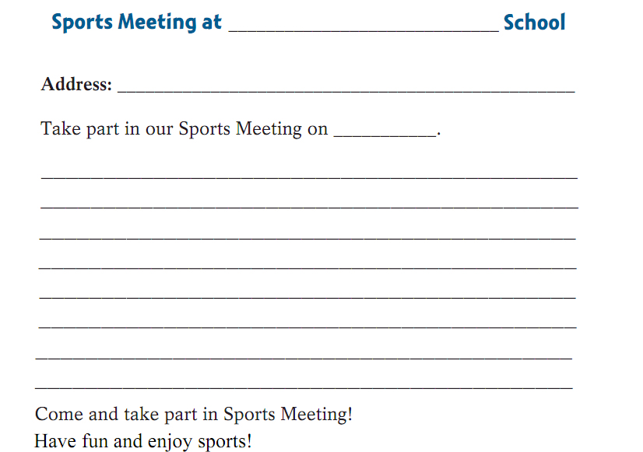





Slide 26

华南师范大学（SCNU）定期举办英语
角。请你根据下面的内容提示写一篇有
关英语角的介绍，推荐给同学们去练习
口语。词数80 左右。

Slide 27
【内容提示】
1. 时间：周二和周五晚上八点至十点；
地点：图书馆前面的广场。
2. 英语角的特点：
（1）不收费，参加者都是英语爱好者；
（2）话题多样，如：电影、音乐、学习方法
或日常生活；
（3）自己先准备一个话题，然后选择该话题
小组进行交流。

Slide 28
SCNU English Corner
Do you want to improve your oral English? Why not
go to SCNU English Corner?
SCNU holds English Corner every Tuesday and Friday
evenings from 8 o’clock to 10 o’clock at the square in
front of the school library. It is for English lovers and
free for everyone. You can talk about different topics
there, such as films, music, learning methods and daily
life. If you would like to go to SCNU English Corner,
you’d better prepare a topic first and then join a group
with the same topic.
Hope you enjoy yourself in SCNU English Corner and
speak English better and better!

Slide 29
Part V Review

Slide 30
Dictation
adv. 其他的；别的
v. 选择；挑选
else
choose

Slide 31
翻译下列句子。
1. 多读英文报刊杂志是必要的(necessary)。
2. 你最好尽可能经常地看看英语节目和听英语歌曲。
3. 这对于提高你的听力技巧很有帮助。
4. 最重要的是，你应该随时用英语和朋友交流。
5. 这会给你一个锻炼英语口语的机会。
It’s necessary to read more English newspapers and magazines.
You’d better watch English programmes and listen to English songs as often as possible.
It’s a great help to improve your listening skills.
Most importantly / Above all, you should communicate in English with your friends whenever you can.
It gives you a chance to practise your spoken English.

Slide 32
Thank you!

