Slide 1

Unit One
Making friends

Slide 2

Writing : An email

Slide 3

Writing
An email
Bobby is writing an email to his new
e-friend, Anna. Help him finish his email. Use the pictures to help you.

Slide 4
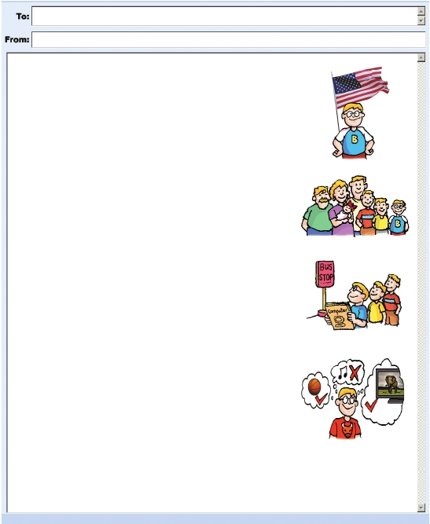
Anna
Bobby
How to introduce yourself
Dear Anna,
My name is Bobby. I’d like to be your e-friend. I’m from the US . I’m short. I have(1)_________________ hair.
I have a big family. My grandfather lives with us. I have two (2)__________________________ and one (3)__________________________.
We live in a house near New York City.
My school is very big. It’s far from our house. I take the (4)_________________ to
school every day with my brothers. I like my school. My (5)_________________ is
to be a computer engineer.
My favourite sport is (6)____________________. I like swimming too.
My other hobbies are watching (7)_________________ and reading
books. I don’t like (8)______________________.
Best wishes,
Bobby
short
About yourself
(elder) brothers
(younger) sister
About your family
bus
dream
About your school and dream
(playing) basketball
TV
(listening to) music
About your hobbies

Slide 5
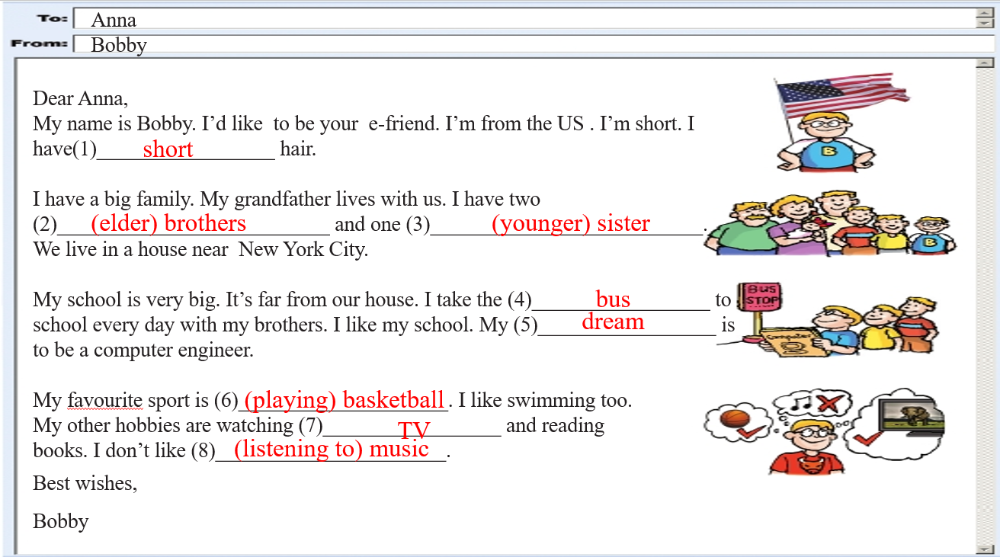
To 后面填的是收件人
邮件格式
From后面填的是发件人
称呼：Dear
邮件主体部分
常用结语：Love/ Best wishes/ Yours/ Your friend
邮件末要署名

Slide 6
Culture corner
Addresses in English
We write addresses in English like this:
117 High Street, Oxford OX1 4BZ, UK
or
117 High Street, Oxford
OX1 4BZ,
UK
House number and street
Town or city
Postcode
Country

Slide 7


How do you write your address in Chinese and in English?
My address in Chinese
My address in English
The Middle School Attached to Sun yat-sen University
Xingang West Road No 135
Haizhu District
Guangzhou
P.R. China
510275
广州市海珠区新港西路135号中山大学附属中学
510275

Slide 8
Key phrases
美国
一个大家庭
与...住在一起
坐校车
看书
听音乐
the US
a big family
live with
take the school bus
read books / read a book
listen to music

Slide 9
Key sentences
我愿意成为你的网友。
我住在纽约市附近的一座房子里。
我每天和我哥哥们坐校车去学校。
我最喜欢的运动是打篮球。
I'd like to be your e-friend.
I live in a house near New York City.
I take the school bus to school with my brothers.
My favorite sport is playing basketball.

Slide 10

写作专练
假设你是Mike, 你愿意和Anna交朋友，请根据以下信息提示给Anna写一封完整的电子邮件介绍自己。
名字：Mike
国籍：中国
年龄：12
外貌：高个儿，黑色短发
家庭成员：爷爷奶奶，爸爸妈妈
最喜欢的科目：语文，英语，历史
爱好：游泳，阅读，放风筝
梦想：成为一名作家。

Slide 11
写作三步走
Step1: 重点单词、短语、句型
来自
我12岁了。
黑色短发
历史
阅读
放风筝
我的爱好是...
我的梦想是...
be from、come from
I am 12.
I am a 12-year old boy.
My age is 12.
short,black hair
history
read books
fly kites
My hobbies are doing...doing...
My dream is to be a/an...

Slide 12
Step2: 人称:____________
时态:____________
Step3: 连接词：________________
分段：_____________________
第一人称
一般现在时
and, but,first, second,...At last
总分总

Slide 13
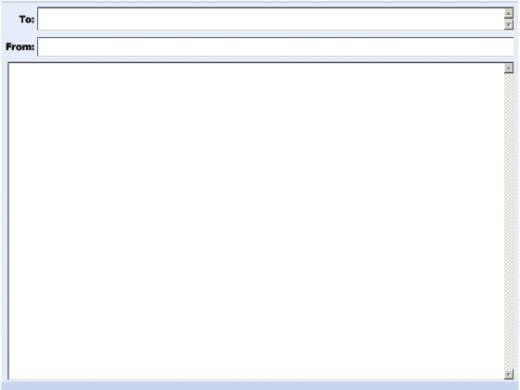
连词成句，连句成文
______________________________________________________________________________________________________________________________________________________________________________________________________________________________________________________________________________________________________

Slide 14
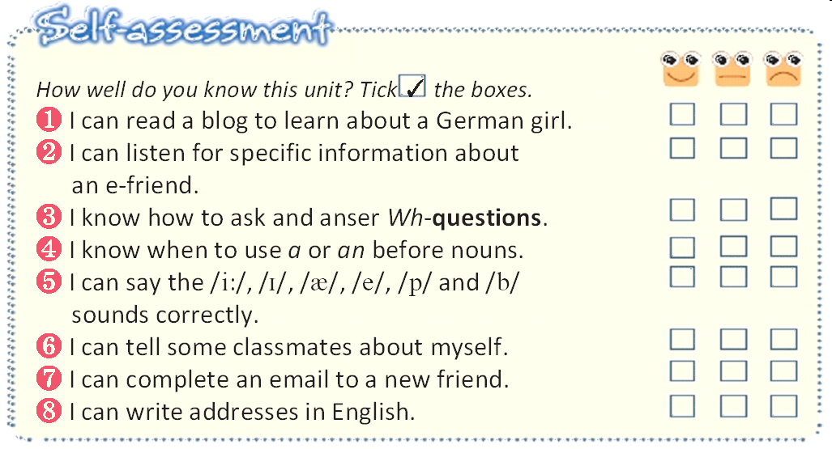

Slide 15


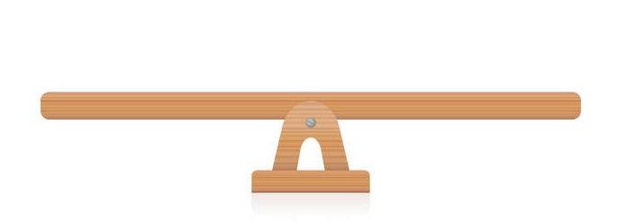



“双减”背景下，作业如何合理分层
Notes:
单击“同步练习题”字样，即可打开本课时同步练习题的Word文档。

Slide 16

⭐可参考作业布置如下：
Homework
Samples:
作业类型多样性
个人作业（可选） | 小组作业（可选）
1.背诵本篇作文，将其抄入作文集锦中。 | 1.小组任务：完成《双语报》N4版第五课时writing部分。
2.找出作文中重点词组和句型，并模仿造句。 | 2.完成《阳光学业评价》Writing部分练习。
Notes:
单击“同步练习题”字样，即可打开本课时同步练习题的Word文档。

Slide 17

THANKS

