Slide 1
Unit 2
Daily life
广州牛津版七年级上册
Grammar

Slide 2
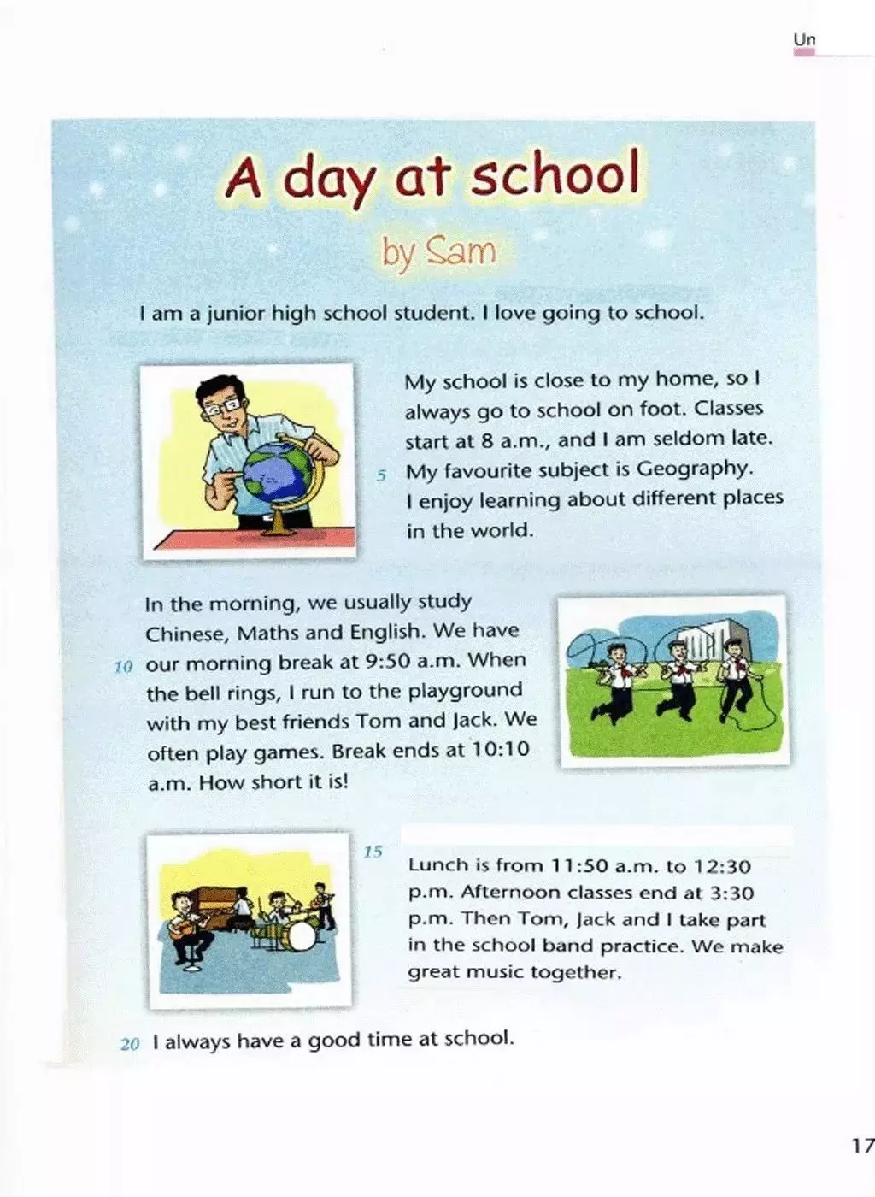
圈出课文中的动词
想一想：这些动词有哪几种形式呢？它们的主语是什么？这些句子描述的事情是在什么时候发生的呢？
the simple present tense
一般现在时

Slide 3
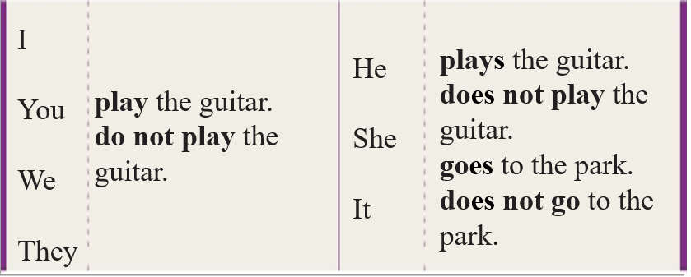
A The simple present tense
We use the simple present tense to talk about regular actions

Slide 4
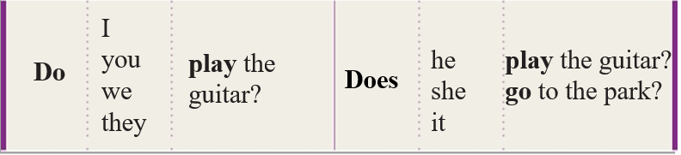
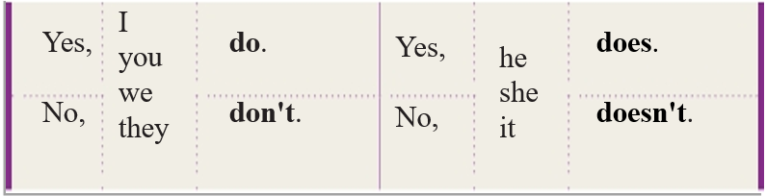

Slide 5
Work out the rule
*In statements, we add –s or ______ to verbs after he/ she/ it.
* In questions, we use ______ before I/ you/ we / they and _______ before he/ she it.
-es
do
does

Slide 6
一般现在时的定义
一般现在时通常可以用于
（1） 表示目前阶段经常发生的动作或存在的状态。
e.g. She keeps a diary every day. ( 动作）
I enjoy learning about different places in the world. (状态）
（2） 表示客观真理
The Sun rises in the east.
The Earth goes around the Sun.

Slide 7
一般现在时的构成
I 用am, you用are,
is连着他她它；
单数is；复数are。
be动词：
肯定句：主语+ be（am/is/are）+其他.
否定句：主语+ be（am/is/are）+not+其他.
一般疑问句：Be (Am/Is/Are)+主语+其他？
--Yes, 主语+ be（am/is/are）.
--No, 主语+ be（am/is/are）+not.
特殊疑问句：特殊疑问词+ be（am/is/are）+主语+其他？
My mother is a nurse.
My mother is not / isn’t a nurse.
Is your mother a nurse --- Yes, she is./ No, she isn’t.
What is your mother? --- A nurse.

Slide 8
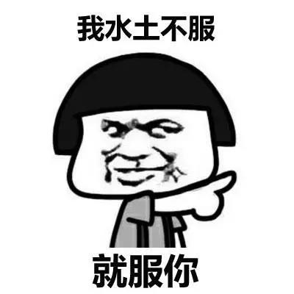
一般现在时的构成
当主语是第三人称
单数时，谓语动词用单三形式。
b. 实义动词：
肯定句：主语+ 谓语动词+其他.
否定句：主语+ don’ t/doesn’t+动词原形+其他.
一般疑问句：Do/Does+主语+动词原形+其他？
--Yes, 主语+ do/does.
--No, 主语+ don’t/doesn’t.
特殊疑问句：特殊疑问词+ do/does +主语+动词原形+其他？
Tips：I复you, 用动原
Mary goes to school by bike.
Mary doesn’t go to school by bike .
Does Mary go to school by bike --- Yes, she does./ No, she doesn’t.
How does Mary go to school? --- By bike.

Slide 9
动词一般现在时第三人称单数变化
Tips：清清浊浊元也浊
（1） 通常在动词词尾加-s ;
在元音和浊辅音后发/z/，在清辅音后发/s/。
play---plays /z/ visit --- visits /s/
(2)以-s,-x, -sh或-ch结尾的动词后加-es；发/iz/。
watch --- watches /iz/ discuss--- discusses /iz/
(3) 以辅音字母y 结尾的词,先变y 为 i, 再加-es;发/iz/。
study --- studies /iz/ carry--- carries /iz/
特殊变化：
have — has go — goes do — does

Slide 10
写出下列动词的第三人称单数形式。
1.teach________ 2.wash__________ 3.guess__________
4.watch________ 5.go_____________ 6.do____________
7.stop___________ 8.study__________ 9.work__________
10.write__________ 11.fly_____________ 12.cry__________
13.play____________ 14.have___________ 15.fix___________
teaches
washes
guesses
watches
goes
does
stops
studies
works
writes
flies
cries
plays
has
fixes

Slide 11
A1 Use the information in the article on P17 to complete the conversation below.
go
S1: (1) ________ Sam _______ (go) to school by bus?
S2: No, he (2) _________. He (3) ______ (go) to school on foot.
S1: (4) _______ Sam and his friends ______ (play) games during
the morning break?
S2: Yes, they (5) ________.
S1: What (6) _______ Sam ______ (do) after school?
S2: He (7) ________ (take) part in the school band practice.
Does
doesn’t
goes
Do
play
do
does
do
takes

Slide 12
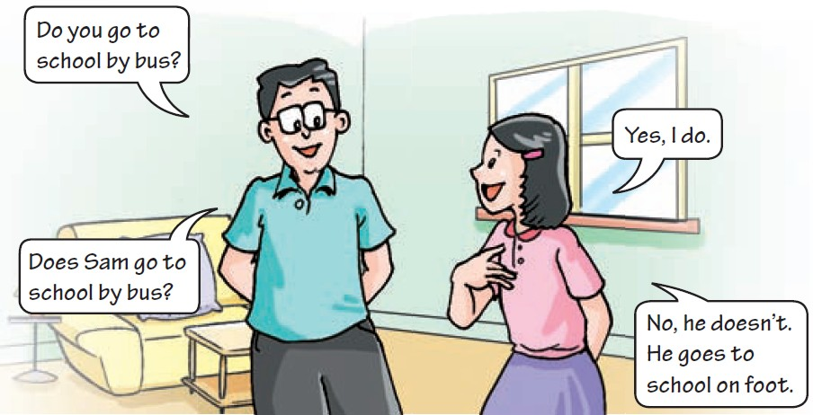
A2 In pairs, talk about the things in the box. Follow the example.
go to school by bus
study Chinese, Maths and English in the morning
take part in after-school activities

Slide 13
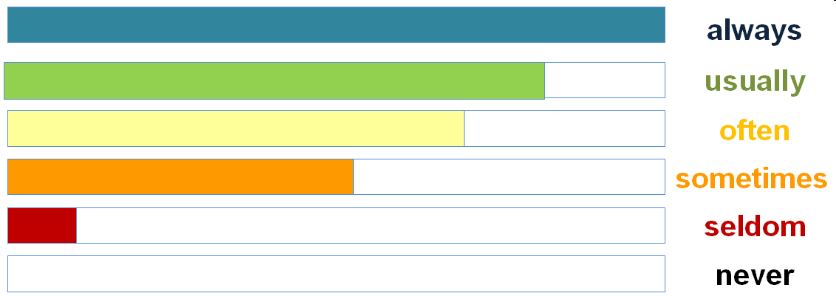
B Adverbs and adverbial phrases of frequency
We use adverbs and adverbial phrases of frequency to talk about how often things happen.
Adverbs of frequency (频度副词)
I
always/ usually/ often
sometimes/ seldom/ never
go to school on foot.
always, usually, often, sometimes, seldom, never 等频度副词用于描述动作或事件发生的频率,它们表示的频率依次递减.

Slide 14
Adverbial phrases of frequency (频度副词短语)
I go to the English Club
every day.
twice a week.
On Saturdays,
Once a month,
I go to the park.
Work out the rule
1. Adverbs of frequency come (before/after) the main verbs.
2. Adverbial phrases of frequency often come (in the middle/at the end) of a sentence. Sometimes they come at the beginning.

Slide 15
1. 频度副词用于be动词、情态动词及助动词之后，行为动词之前。
She is never late for school.
I sometimes go to school by bus.
2. 频度副词短语常置于句末,有时也置于句首。
We go to the cinema once a month.
Every Saturday afternoon, I play basketball with my friends.

Slide 16
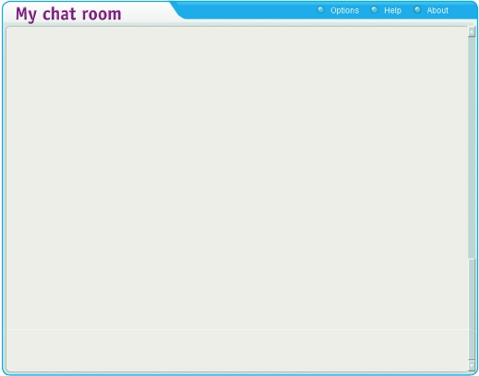
Mandy meets Sam on the Internet again. She is asking Sam some questions about his life. Write Sam’s answers in complete sentences.
Mandy:
Sam:
Mandy:
Sam:
Mandy:
Sam:
Mandy:
Sam:
Mandy:
Sam:
Mandy:
Sam:
How often do you watch television?
(1)_______________________________________(every night)
How often do you eat out?
(2) _______________________________________ (sometimes)
How often do you play table tennis with your father?
(3) _______________________________________ (once a week)
How often do you win?
(4) _________________________________________ (seldom)
How often do you visit other cities?
(5) __________________________________ (four times a year)
How often do you play computer games?
(6) __________________________________________ (never)
I watch television every night.
I sometimes eat out.
I play table tennis with my father once a week.
I seldom win.
I visit other cities four times a year.
I never play computer games.

Slide 17


Slide 18
一、选择题。
1. Mary ________ to work by car.
A. usually go B. go usually C. usually goes D. goes usually
2. ________ your e-friend _______ in Beijing?
Do; live B. Do; lives C. Does; live D. Does; lives
3. Light ________ much faster than sound.
travel B. travels C. travelled D. is travelling
4. Tom gets up early every day. He is ________ late for school.
sometimes B. always C. often D. never
5. ______ your sister good at ________?
A. Is; dance B. Is; dancing C. Does; dance D. Do; dancing

Slide 19
二、根据中文意思完成句子。
never
1. 我从不撒谎。 I ______ tell lies.
2. 他很少参加活动，因为他总是忙于学习。
He ______ ______ part in the activities, because he _______ _______ busy studying.
3. 王先生每个月去爬山一次。
Mr. Wang ______ climbing ______ ______ ______.
4. 小汤姆每晚睡觉前都刷牙。
Little Tom _______ ______ ______ before going to bed every night.
5. 我们经常步行去上学。
We often ______ to school _____ ____.
seldom takes
is always
goes
once a month
brushes his teeth
go
on foot

Slide 20
Summary
In this class, we have learned
the use of the simple present tense.
the strutures of the simple present tense.
the adverbs and adverbial phrases of frequency.

Slide 21



Self-assessment
How well do you know about this lesson? Tick the boxes.
① I know how to use the simple present tense. 口 口 口
② I know how to use adverbs and adverbial phrases of frequency.
口 口 口
③ I can make setances with them correctly. 口 口 口

Slide 22


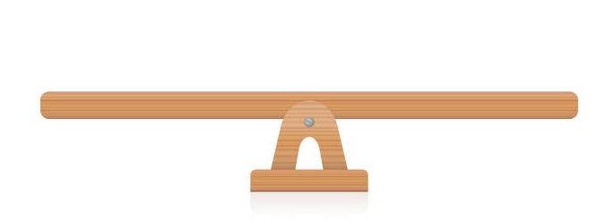

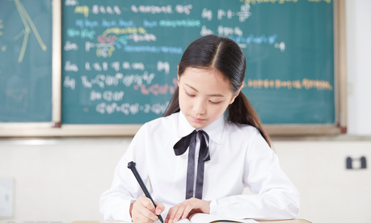
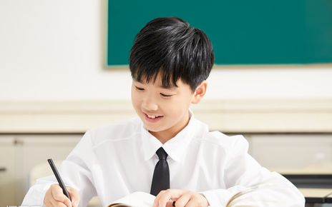
“双减”背景下，作业如何合理分层
Notes:
单击“同步练习题”字样，即可打开本课时同步练习题的Word文档。

Slide 23

⭐可参考作业布置如下：
Homework
Samples:
作业类型多样性
书面作业（可选） | 创新探究性作业（可选）
1.完成《双语报》第二期N2版Grammar跟踪练习。 | 1.小组竞赛，参加你问我答游戏，组1说一般现在时的句子，组2用英语翻译句子。
2.完成《双语报第二期N3版第四课时Grammar练习。 | 2.小组合作，用思维导图总结本节课语法点，比比哪一组做得最好。
3.完成《阳光学业评价》Grammar部分练习。 | 3.整理错题本，将仍存在疑惑的地方以及易错点记入错题本。

Slide 24

THANKS

