Slide 1
Unit 2
Daily life
广州牛津版七年级上册
Writing & Culture corner
& Self-assessment

Slide 2
Writing
Fang Fang’s daily life
Read Fang Fang’s daily schedule below and complete the article about her daily life.
6:30 a.m. | get up | 4 — 4:30 p.m. | play basketball with Friends (twice a week)
7a.m. | have breakfast | 4:45 p.m. | go home
7:30 a.m. | go to school | 6:30 p.m. | have dinner
8:30 a.m. — 4 p.m. | have classes | 9 p.m. | go to bed

Slide 3
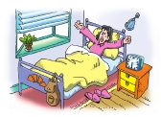
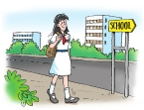
Fang Fang is a Grade 7 student. She (1)___________ at 6:30 a.m. Then she washes her face and brushes her teeth. At 7 a.m., she (2)_____________. She often eats some bread and drinks a glass of milk.
gets up
has breakfast
Fang Fang lives close to school, so she always (3)_____________ on foot at 7:30 a.m. She (4)____________from 8:30 a.m. to 4 p.m.
goes to school
has classes

Slide 4
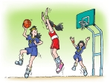
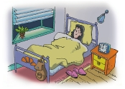
After school, she (5)____________________________________.
She (6)_________________ at 4:45 p.m.
plays basketball with friends twice a week
goes home
Fang Fang usually (7)______________ at 6:30 p.m.
She sometimes watches TV in the evening. She always (8)____________________.
has dinner
goes to bed at 9 p.m.

Slide 5
Fill in your daily schedule below and share it with your partner.
_______ daily life
Time | Activity

Slide 6
写作训练
假如你是Peter，你的网友Susan想了解你一天的生活。请根据以下表格内容，用英文给Susan写一封电子邮件，向她讲述你的日常生活。
时间 | 活动
6:30 a.m. | 起床,吃早餐
7:30 a.m. | 去学校
8:20 a.m. | 开始上课,上五节课
12:10 p.m. | 在学校吃午餐
4:30 p.m. | 上完三节课后放学,和朋友一起打篮球
5:30 p.m. | 回家
6:30 p.m. | 吃晚餐
7:30 p.m. | 做作业,有时看电视
9:30 p.m. | ?(请你补充)

Slide 7
1）词数60左右(文章的开头和结尾已给出，不计入词数)
2）在作文中不得出现学校的真实名称和学生的真实姓名
Dear Susan,
I'm glad to tell you something about my daily life. _______________________________
_______________________________________________________________________________________________________________________________________________________________________________________________________________________________________________________________________________________________________________________________________________________________________________________________________________________________________________________________________________________________________________________
That's my daily life. What about yours?
Best wishes
Peter

Slide 8
参考范文
Dear Susan,
I'm glad to tell you something about my daily life. I'm glad to tell you something about my daily life. I usually get up at 6: 30 a. m. Then I have breakfast. I go to school at 7: 30 a. m. My school starts at 8: 20 a. m. I have five lessons in the morning. At 12: 10 p. m. , I have lunch at school. In the afternoon. I have three lessons. School ends at 4: 30 p. m. After school, I usually play basketball with my friends for about an hour. At 5. 30 p. m. , I go home. I have dinner at 6: 30 p. m. After dinner, I begin to do my homework at 7: 30. I sometimes watch TV in the evening. At about 9: 30 p. m. , I go to bed.
That's my daily life. What about yours?
Best wishes,
Peter

Slide 9
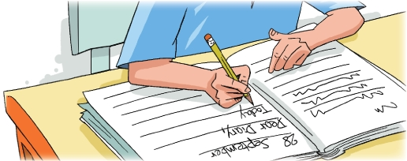
Culture corner
Dear Diary
Many people around the world keep a diary. They write in it every day. In a diary, you can write about your daily life.
People often start by writing “Dear Diary”. They think of the diary as a friend.

Slide 10

Do you keep a diary?
Would you like to keep one?
What things do / would you write about?

Slide 11
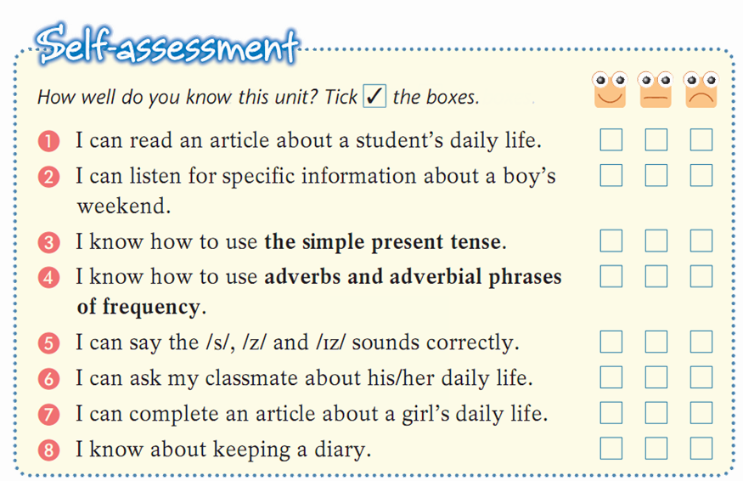

Slide 12




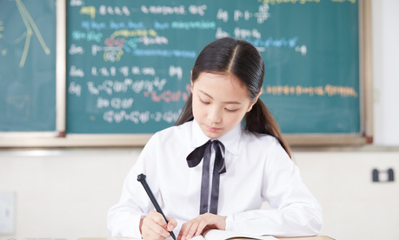
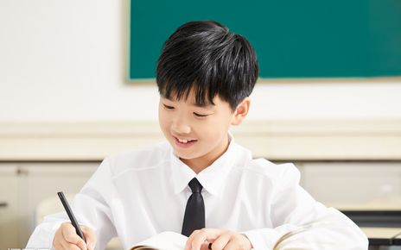
“双减”背景下，作业如何合理分层
Notes:
单击“同步练习题”字样，即可打开本课时同步练习题的Word文档。

Slide 13

⭐可参考作业布置如下：
Homework
Samples:
作业类型多样性
个人作业（可选） | 小组作业（可选）
1.背诵本篇作文，将其抄入作文集锦中。 | 1.小组任务：完成《双语报》N4版第五课时writing部分。
2.找出作文中重点词组和句型，并模仿造句。 | 2.完成《阳光学业评价》Writing部分练习。
Notes:
单击“同步练习题”字样，即可打开本课时同步练习题的Word文档。

Slide 14

THANKS

