Slide 1

Unit 5
Visiting the Moon
广州牛津版七年级上册
Words and expressions

Slide 2

Read the words loudly and tell their Chinese meaning.
diary
space
spaceship
spacesuit
nervous
leave
*gravity
able
*float
tie
n. 日记，日记簿
n. 太空
n. 宇宙飞船
n. 宇航服；航天服
adj. 紧张的
v. 离开
n. 重力；地球引力
adj. 能；能够
v. 漂浮；浮动
v. 捆绑

Slide 3
ourselves
without
weak
breathe
if
camera
work
garden
rock
postcard
machine
return
pron. 我们自己
prep. 没有，缺乏
adj. 虚弱的，无力的
v. 呼吸
conj.如果
n. 照相机
v. 运转；运行
n. 花园
n. 岩石
n. 明信片
n. 机器
v. 返回

Slide 4
Match the phrases with their Chinese meaning.
如同，像……一样
拍照
以便
不得不，必须
多于
例如
能够
也就是说；即
more than
be able to
have to
so that
take photos
as … as
that is
such as

Slide 5
Match the phrases with their Chinese meaning.
在学校门口
带回
对……感到很兴奋
在月球上
变得虚弱
大量
帮助某人做某事
目前
get weak
help sb. do sth.
on the Moon
be excited about
bring back
at the school gate
at the moment
a large amount of

Slide 6


Exercise time.
In this unit, we are going to learn something about the Moon. Jerry will be one of the first students to travel into s________. They will go to the Moon by spaceship.
Since there is no gravity, they will be a______ to float in the spaceship. In order not to get w_______, they will also have to do exercises every day. Jerry hopes that his c________ can work there so that he can take photos.
Jerry feels excited about the trip for everything will be different after l_______ the Earth.
space
able
weak
camera
leaving

Slide 7
Exercise time.
1. 他会在月球上呆多于三天的时间。
He will stay on the Moon for ______ ________ two days.
2. Lucy不得不说出事实。
Lucy _______ _________ tell the truth.
3. 她像她妈妈一样漂亮。
She is ______ _______ _______ her mother.
4. 穿着宇航服，我们将能够在月球上行走。
We will ______ _______ _______ walk on the Moon in spacesuit.
more than
has to
as beautiful as
be able to

Slide 8
Exercise time.
5. 请带上足够的水，以便你渴了可以喝。
Please bring enough water ______ ______ you can have a drink when you feel thirsty.
6. 我喜欢在旅行的时候拍照。
I like _______ _________ while traveling.
7. 也就是说，这本书本来就是我的。
______ _______, this book belongs to me.
8. 你可以买很多有用的东西，例如书和笔。
You can buy a lot of useful things, ______ _______ books and pens.
so that
taking photos
That is
such as

Slide 9


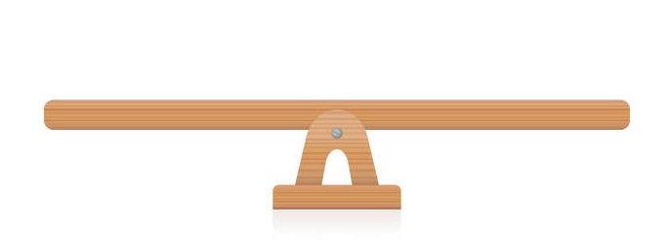
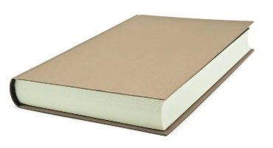
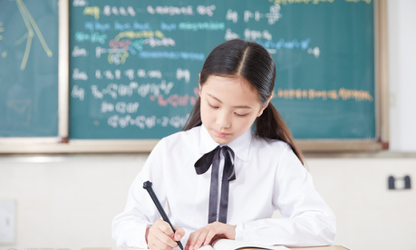
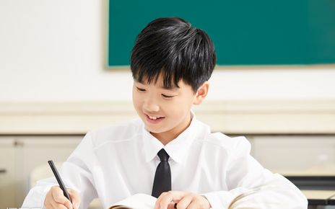
“双减”背景下，作业如何合理分层

Slide 10

⭐可参考作业布置如下：
Homework
Samples:
作业差异性Differentiating homework
基础作业 | 拓展作业
1.完成《双语报》1期N3版第一课时Ⅰ、Ⅱ练习。 | 1.完成《双语报》1期N3版第一课时Ⅲ、Ⅳ练习。
2.抄写并背默《阳光学业评价》高频词和高频词组各6个。 | 2.抄写并背默《阳光学业评价》高频词和高频 词组。
3.跟录音读单词两遍，注意单词发音和重读音节。 | 3.使用以下所给单词或词组造句。 leave, if, return, be able to, so that, such as...

Slide 11
THANKS

