Slide 1
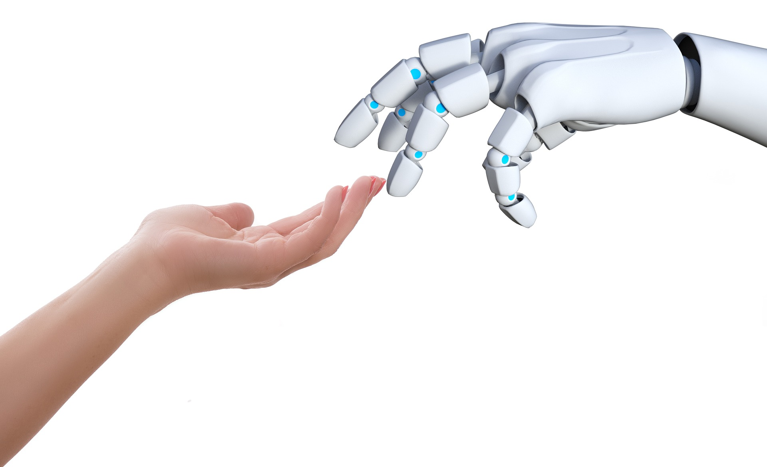
Unit 2
LOOKING INTO THE FUTURE

Slide 2
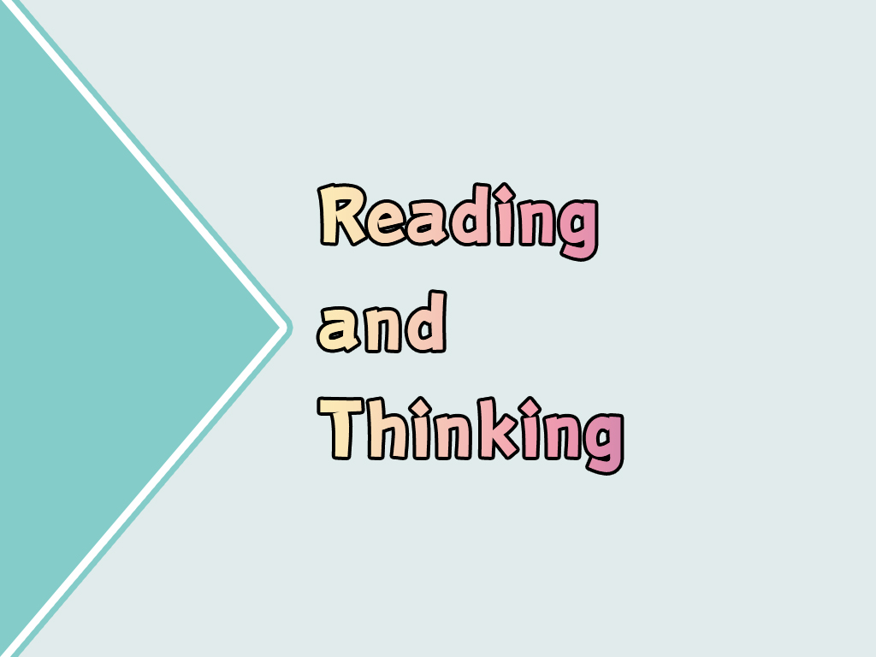

Slide 3


To learn to describe a picture and express ideas about the information you get from the picture;
To read and learn how smart homes make life easier;
To learn to collect information from a practical writing;
To express your opinions on advantages and disadvantages of smart homes.

Slide 4

Look and discuss
Look at the picture on page 13 and discuss the following questions.
1. What might the picture be about?
2. What are your predictions about the future?

Slide 5
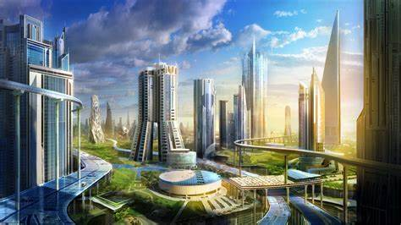


Slide 6
3. What might be some of the advantages and disadvantages of life in the future?
Advantages
convenient
…
Disadvantages
high cost
…

Slide 7
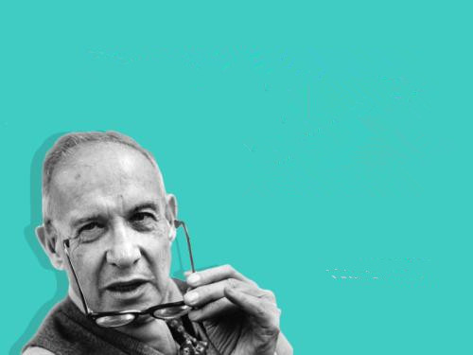
The best way to predict the future is to create it.
— Peter Drucker

Slide 8
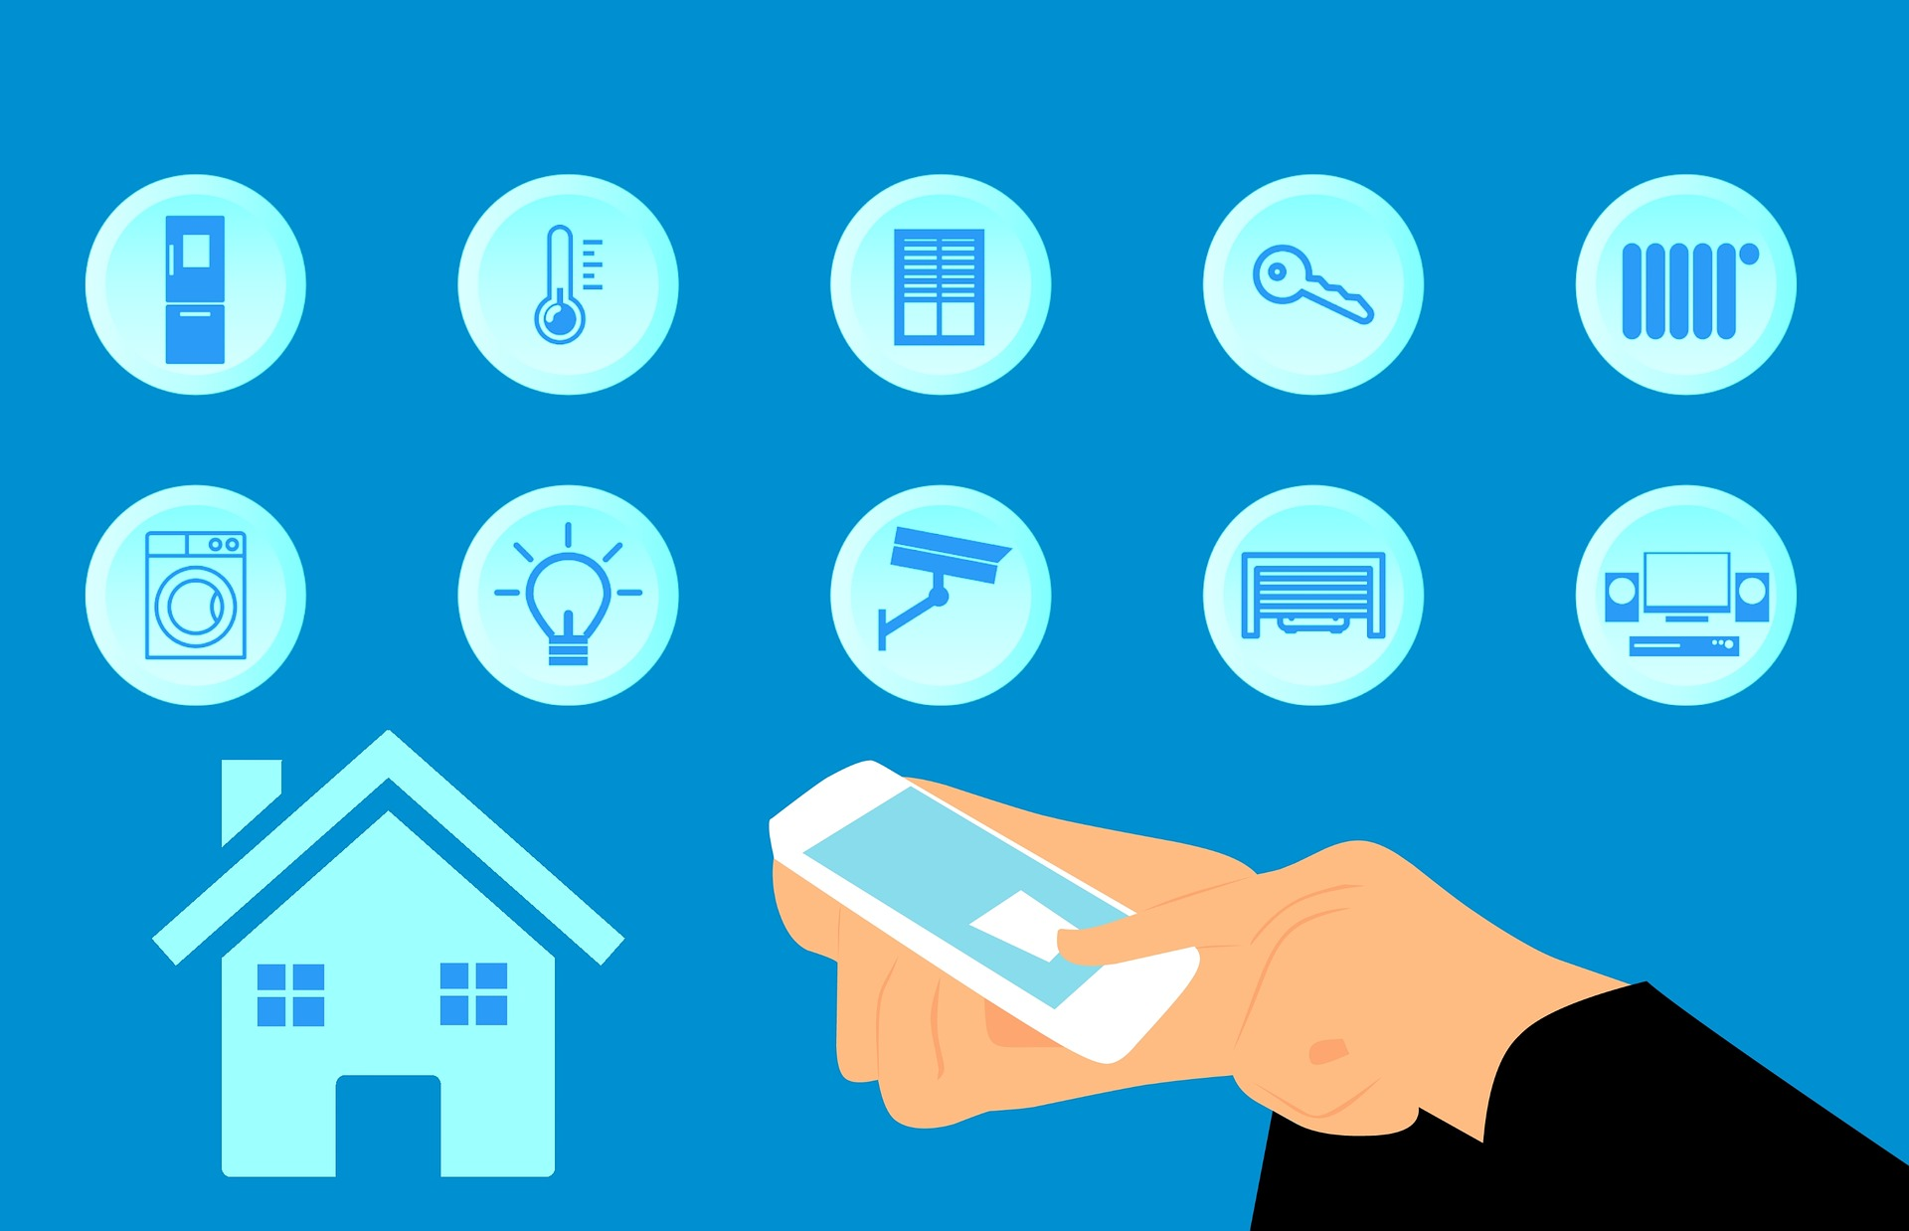
Live in a futuristic house

Slide 9

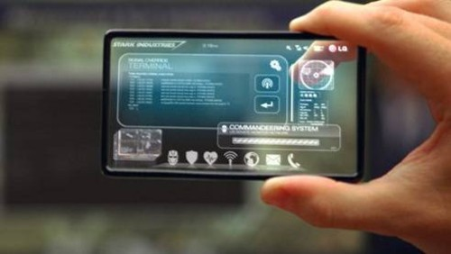
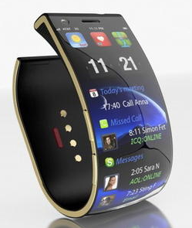
Before you read, discuss these questions in groups.
1. What does it mean when we say that something such as a phone is “smart”?
Something has a “brain” like a human being. It can “think” and do what its owner commands to do.

Slide 10
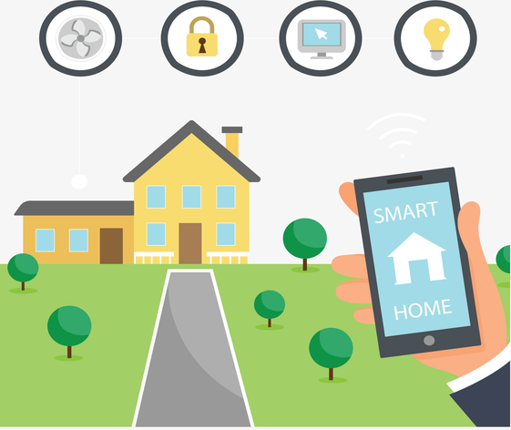
2. What do you think a “smart” house can do that other houses cannot?

Slide 11
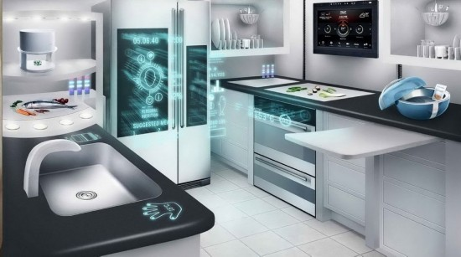

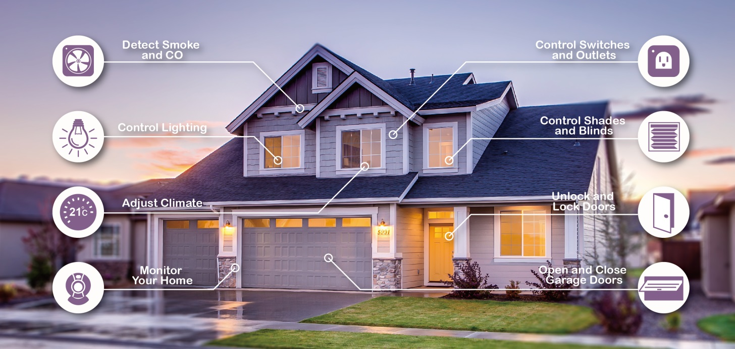

Slide 12


Identify purpose and audience
The types of phrases used in a passage help identify its purpose. For example, the phrase in my opinion tells us that place emphasis onthe passage is likely meant to persuade. And a text that uses imperatives is likely meant to instruct. A passage’s content helps identify its audience. For example, a passage that gives tips on looking after pets would have pets owners as its audience.

Slide 13
Skim the text and answer these questions.
1. What’s the purpose of the text?
To tell / inform people how smart homes make life easier.
2. Who is the intended audience of the text?
The text is for those who need new technology to help them solve problems in daily house life.

Slide 14
What can we learn from the title?
Smart homes to make life easier
focus
topic
more comfortable
more quickly
more convenient
…

Slide 15
Read the text quickly and get the main idea of the text.
tips:
The writer will tell readers’ the main idea of his passage at the beginning. So usually, we can get it from the first paragraph.
These smart homes will keep us secure, save our energy, and provide a more comfortable environment to live in.

Slide 16
Draw the simple outline of the text.
This text has several sub-titles. They will help us get what the writer wants to tell us more quickly. From the sub-titles, we can know the structure of the text easily.
sub-titles of the text
Intelligent control
Regular health checks
No more disasters

Slide 17
Smart homes to make life easier
These smart homes will keep us secure, save our energy, and provide more comfortable environment to live in.
Intelligent control
Regular health checks
No more disasters

Slide 18


Read the text again and fill in the table below.
In the future, what will smart homes do about…?
doors | dinners
TVs, computers | beds
water pipes, electrical wires | toilets
lights, favourite music, or TV programmes

Slide 19
doors | dinners
TVs, computers | beds
water pipes, electric wires | toilets
lights, favourite music, or TV programmes
automatic control
already prepared
record how well you sleep；
check your body weight
energy-efficient mode
detect the problem and provide you with relevant information
keep constant track and warn you early about something abnormal
be ready for you

Slide 20
Intelligent controls
According to Para. 2, How does the intelligent or automatic control function?
Go into an energy-efficient mode automatically.
Response according to your routine and preferences.
Response to voice commands.

Slide 21
Regular health checks
How does the smart homes check your general health?
Monitor your health with beds and toilets.
Give you suggestions on health problems.

Slide 22
No more disasters
How dose the smart homes make sure that no more disasters happen in your home?
Detect problems with devices in the home, like a water pipe and the electrical wiring.
Provide with the relevant information.
Fix the problem.

Slide 23
Complete the summary using the correct forms of the words from the text.
tips
Think over the key information in the text and then read the summary, paying attention to the beginning letter. The beginning letter can give you a clue to choose the right word.

Slide 24
A smart home is one that i_________ computers into the structure of the building itself. In this way, many of the things that we now do ourselves will become a_________. For example, the smart home could control the air conditioning and lights so that you would no longer have to turn s_________ on and off, making your home more energy-e_________. The smart home could also m________ itself to make sure that everything is working as it
ntegrates
utomatic
witches
fficient
onitor

Slide 25
should, and send you w_________ if there is a problem. Such smart homes could even be programmed to d_______ your health problems, and then give you r________ advice as to the food you should eat or if you should see a doctor. So in a sense, smart homes will lead us to living smarter lives.
arnings
etect
elevant

Slide 26


Work in groups. Discuss these questions.
1. In what way is the home of tomorrow already the home of today?
You can compare the home today and that of tomorrow. Then you can find out the things that have been in today’s home.

Slide 27
2. What might be some of the disadvantages of smart homes?
Does it have anything unsecure?
Will your information be known by others?
What if there is something wrong with your smart phone?
…

Slide 28
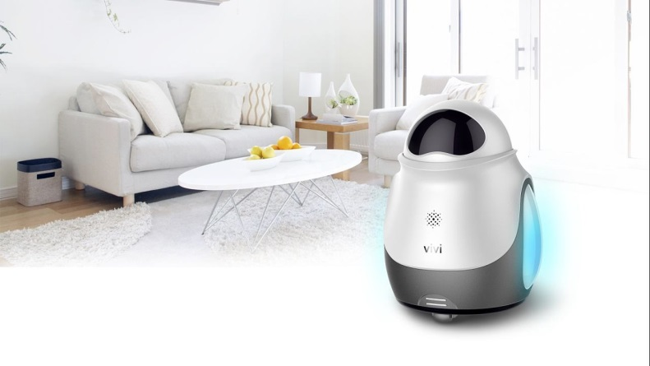
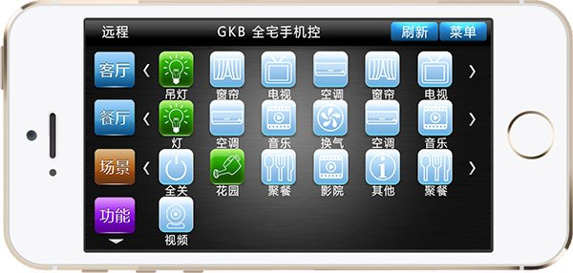
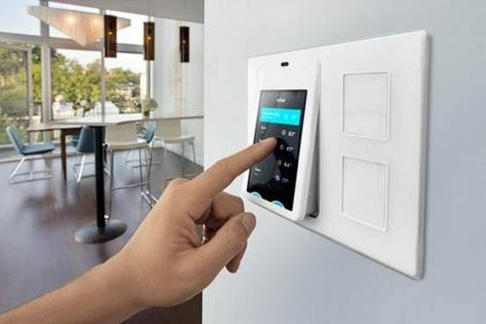
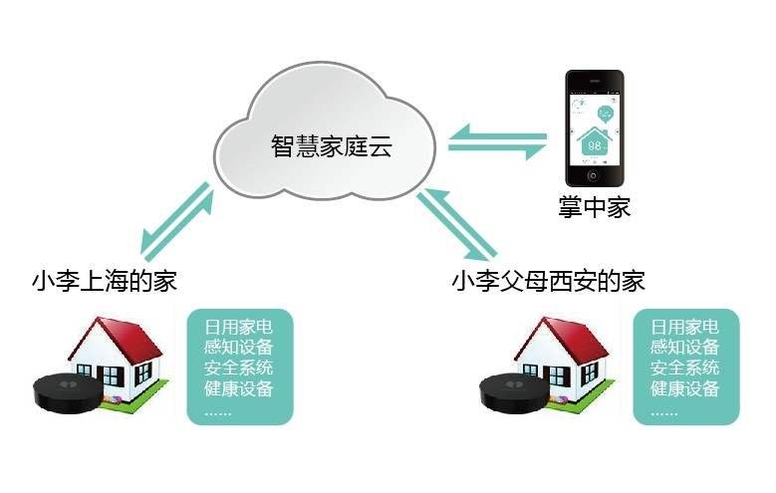
Think of the items you use in your home now and what they may be better used in the future. Show your ideas to the other group members.
The following may help you：

Slide 29


Read the passage several times and underline the language points that you are not familiar with.
What may the future car look like? Write a passage to describe it.

Slide 30


