Slide 1
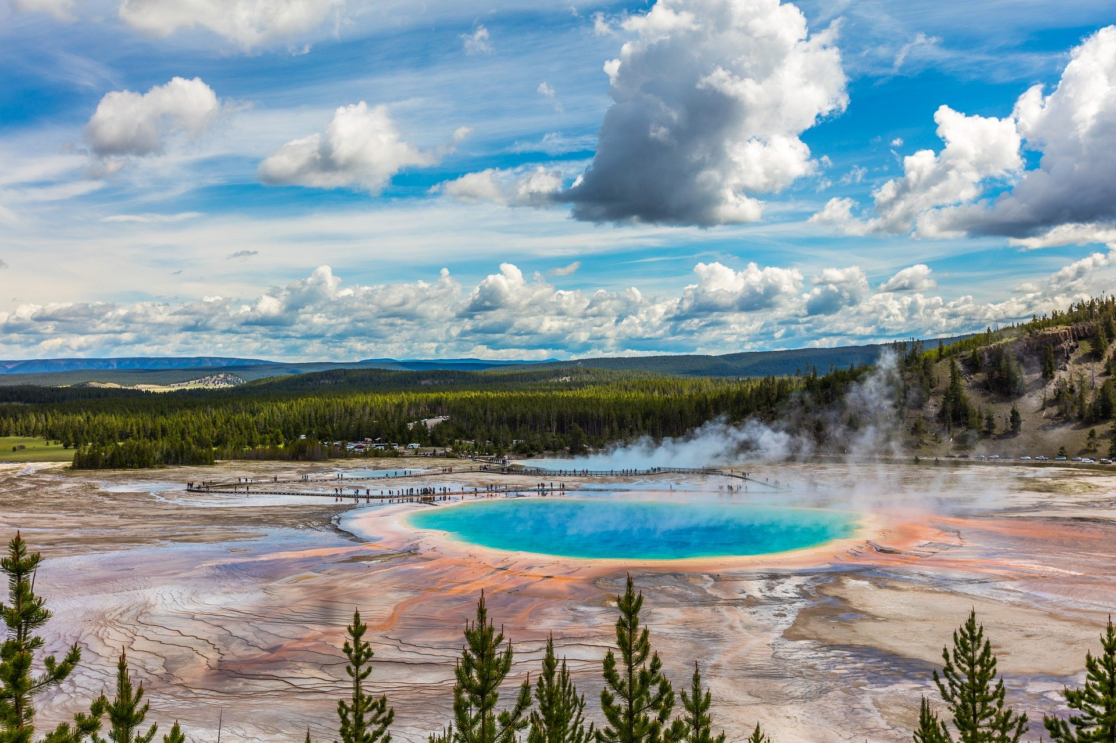
Unit 3
FASCINATING PARKS

Slide 2


Slide 3


To learn and practise the -ing form used as subject.

Slide 4




Have you ever seen these signs?
the –ing form

Slide 5
Identify the function of the -ing form in the sentence below.
作主语
Getting here is quite difficult.
Being in such a beautiful and wild place makes me feel blesses to be alive.
作主语

Slide 6
Find more sentences with the –ing form as the subject from the reading passage.
For hundreds of years, looking after reindeer was a way of life for the Sami.

Slide 7


1. (读书) is her hobby.
Reading

Slide 8

2. is a waste of time. (玩电脑游戏)
Playing computer games

Slide 9

3. is dangerous.
(开车开得太快)
Driving too fast

Slide 10
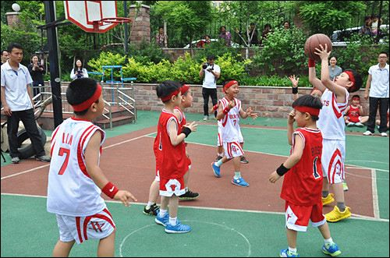
4. makes me happy.
(打篮球)
Playing basketball

Slide 11
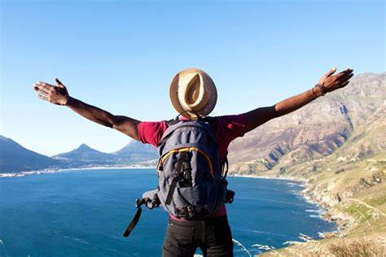
5. is a good way to relax.
(旅游)
Travelling

Slide 12

6. can bring you into different world. (参观主题公园)
Visiting theme parks

Slide 13
动词-ing形式作主语
1. 动词-ing形式作主语，表示一般或抽象的习惯性行为，谓语动词用单数。如：
Reading aloud is very important for us to learn a foreign language.
Going to bed early and getting up early is considered to be a good habit.

Slide 14
2. 在一些句子中，常用it作形式主语放在句首，而把真正的主语放到句末。 如：
It is no use crying over spilt milk.

Slide 15
常用-ing形式作主语的句型有：
It + be + a waste of time doing …
做……是浪费时间的
It is / was no good / use doing …
做……是没益/用处的
It is / was hardly / scarcely worth doing …
做……不值得
It is / was worth / worthwhile doing …
做……是值得的
There is no sense in doing …
做……没有道理

Slide 16

Rewrite each of the following sentences using the -ing form as the subject.
EXAMPLE
It is challenging yet really fascinating to hike through the mountains in the pathless Sarek.
Hiking through the mountains in the pathless Sarek is challenging yet really fascinating.
Notes:
Passagetiona

Slide 17
1 It is both challenging and rewarding to study abroad.
2 It would hardly be possible to go on a hiking tour in Sarek in winter due to the extreme cold.
Studying abroad is both challenging and rewarding.
Going on a hiking tour in Sarek in winter would hardly be possible due to the extreme cold.

Slide 18
3 Honestly, it can be both exciting and terrifying to explore a vast unknown land.
4 It is good to adopt a positive attitude, even when things are difficult.
Honestly, exploring a vast unknown land can be both exciting and terrifying.
Adopting a positive attitude is good, even when things are difficult.

Slide 19
5 It is strongly advised to hire local guides, because they can offer accurate knowledge of Sarek culture and history.
Hiring local guides is strongly advised because they can offer accurate knowledge of Sarek culture and history.
Discuss: How does the sentence focus change.

Slide 20

Fill in the blanks using the -ing form of a verb from the box and state its function. One word will be used twice.
combine cover grow take limit
walk experience
covering
Xixi National Wetland Park, 10 square kilometres in western Hangzhou, is the first national wetland park in China. city life, nature, and wetlands makes the park a popular destination both for tourists and local residents. At Xixi, a boat tour,
Combining
taking
Notes:
Passagetiona

Slide 21
combine cover grow take limit
walk experience
walking
along paths, and local customs and traditions of the villages in this park are at the top of the list of people’s favourite activities. With trees, bushes, and colourful flowers along the riversides, the park shows different sides of beauty in different seasons. In order to better develop as well as preserve this place, human impact on Xixi Wetland was considered by the
experiencing
growing
limiting
Notes:
Passagetiona

Slide 22
combine cover grow take limit
walk experience
park designers. All the new buildings were designed in a traditional way to fit into the natural environment. This green, watery world is home to many birds and fishes. With trees
in the shallows, the wetland is a natural system for providing clean water and producing oxygen, which makes it the “green lungs of Hangzhou”.
growing
Notes:
Passagetiona

Slide 23


Choose a place in your city or town as a destination for a school trip. Use the passage above as an example and write about your choice.

Slide 24


