Slide 1

Unit 4
BODY LANGUAGE

Slide 2
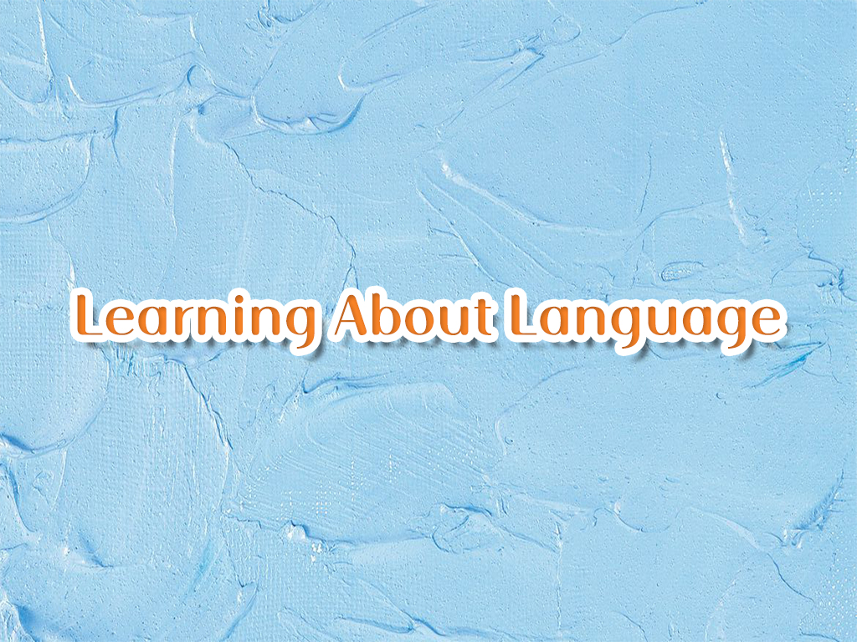

Slide 3

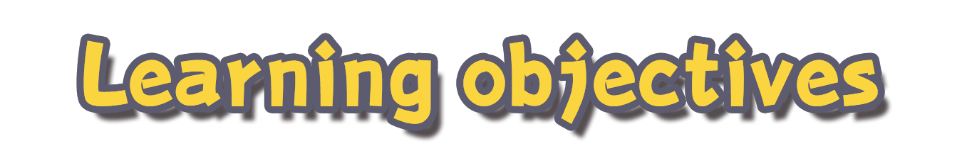
To learn some words formed by derivation and conversion.
To complete a passage about body language.

Slide 4

Fill in the table with different forms of the words. Refer to a dictionary if necessary.
Noun | Verb | Adjective | Adverb
 | differ
 | vary
 | rely
 | interact
 | approve
 | embarrass
difference
different
differently
variety
various
variously
reliability
reliable
reliably
interaction
interactive
interactively
approval
approved
approvingly
embarrass-ment
embarrassed
embarrass-edly
embarrassing
embarrass-ingly

Slide 5
Work out the meanings of the underlined words in the sentences below. In pairs, list more words of the same kind.
1. I rest my head on the desk to get some rest.
2. The child displayed great interest in the huge fireworks display.
3. Most students favour the plan, while their teachers are not in favour of it.
v. 依靠
n. 休息
v. 显露
n. 表演
v. 较喜欢
n. 赞同，支持

Slide 6
v. 目睹
4. Jeremy witnessed the whole incident and was expected to be the key witness at the trial.
5. His lack of eye contact when talking with people shows that he lacks confidence.
6. When he noticed a slight frown on his twin sister's face, he frowned as well.
n. 缺乏
n. 目击者
v. 缺乏，不足
n. 皱眉
v. 皱眉

Slide 7

Read the passage about body language. Fill in the blanks with the correct forms of the words and phrases in the box.
by contrast, by comparison, break down, clue, interaction, demonstrate, approve of, gesture
When we think about nonverbal behaviour, or body language, we think about communication. When we think about communication, we think about __________. So what is our body language _____________ to others? Social scientists have spent a lot of time looking at the effects of our body language. We make assessments and inferences from body language. And according to
interaction
demonstrating

Slide 8
by contrast, by comparison, break down, clue, interaction, demonstrate, approve of, gesture
those judgements we __________ one person and dislike another. So body language provides external _______ that are influenced by internal thoughts and feelings. Scientists have found that when we feel proud and powerful, we usually straighten up to make ourselves bigger. _________, when we feel powerless, we tend to slump, making ourselves smaller. It is obvious that our minds can influence our bodies.
approve of
clues
By contrast

Slide 9
by contrast, by comparison, break down, clue, interaction, demonstrate, approve of, gesture
But is it also true that our bodies can affect our minds? Scientific experiments show that if we make powerful __________ long enough, we may actually feel more powerful. People who remember to use positive body language are more likely to feel positive _____________, so some scientists suggest that we use our bodies to try power posing to help ___________ our feelings of shyness and powerlessness.
gestures
by comparison
break down

Slide 10

In pairs, discuss how people shape their future by using proper body language.

Slide 11


1. Review the words, expressions and sentences we have learned in the reading part.
2. Finish the exercises in the workbook.

Slide 12


