Slide 1
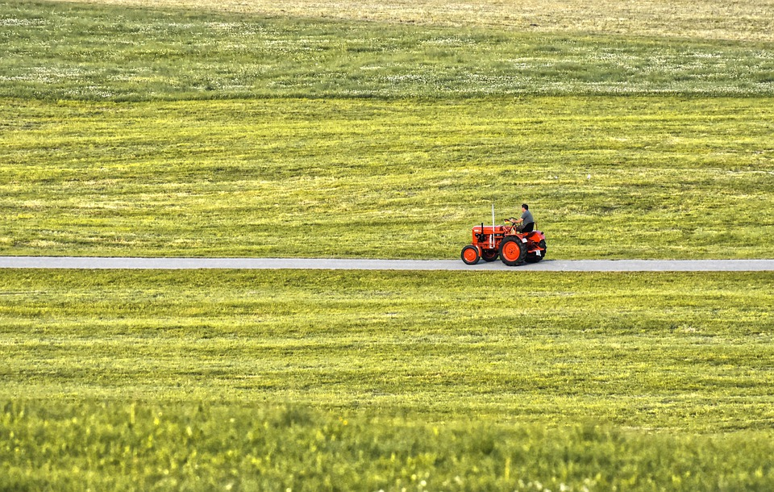
Unit 5
WORKING THE LAND

Slide 2


Slide 3


To understand the differences between chemical and organic farming and their advantages and disadvantages;
To learn about the author's writing techniques;
To learn about the structure of argumentative essay;
To write an essay to express your views on chemical farming or organic farming.

Slide 4



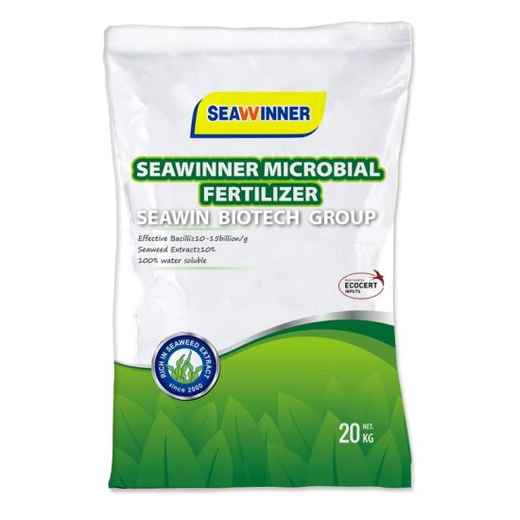
What is the substance that is put on the soil to make plants grow?
It is fertilizer.

Slide 5
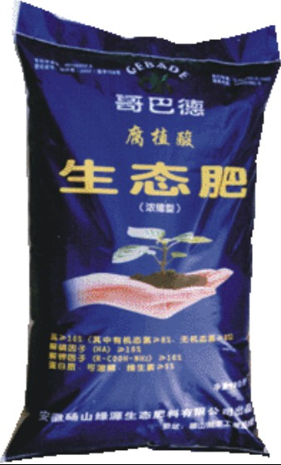
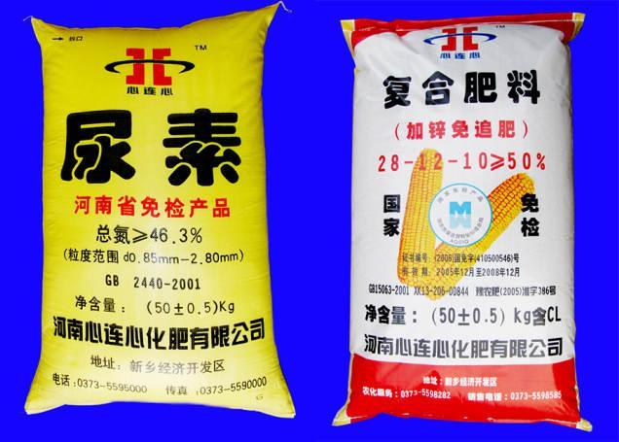
What kind of fertilizers do farmers use?
Chemical fertilizers
Natural waste from animals

Slide 6
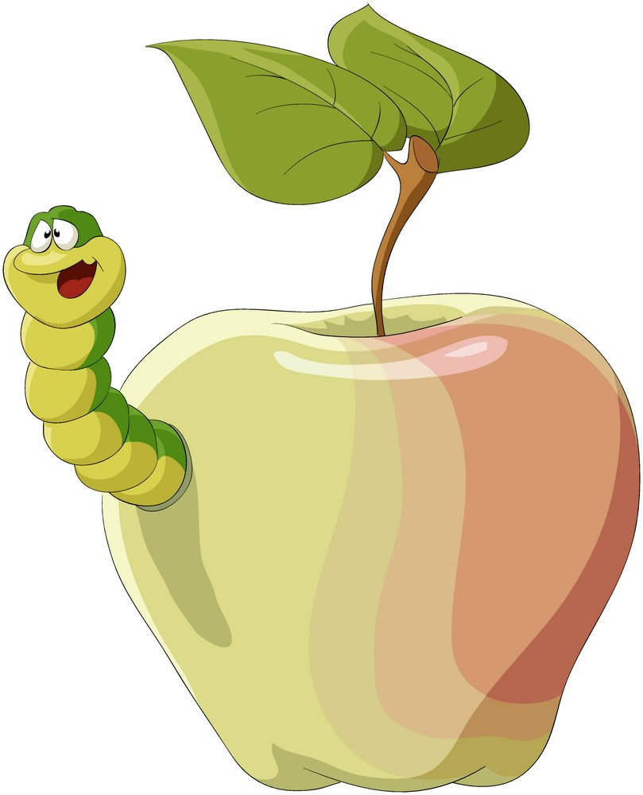
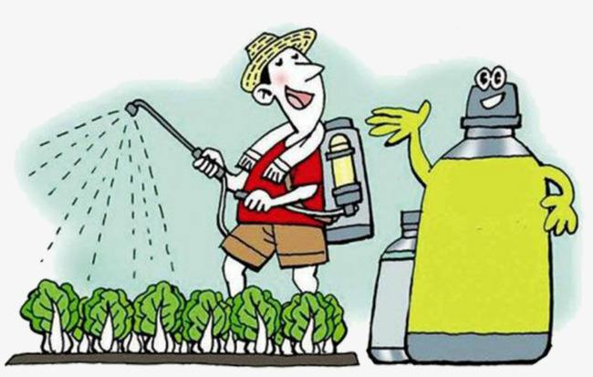
To protect the crops, farmers have to kill off the harmful pests.
What is the chemical used for killing pests, especially insects?
Pesticides.

Slide 7
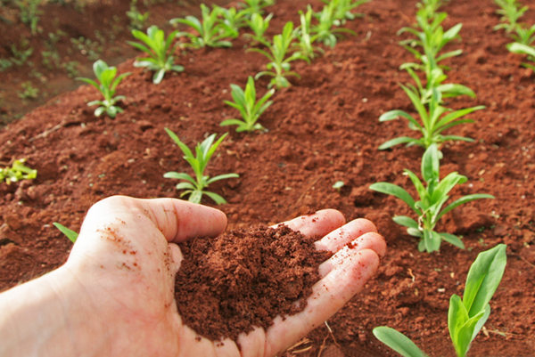
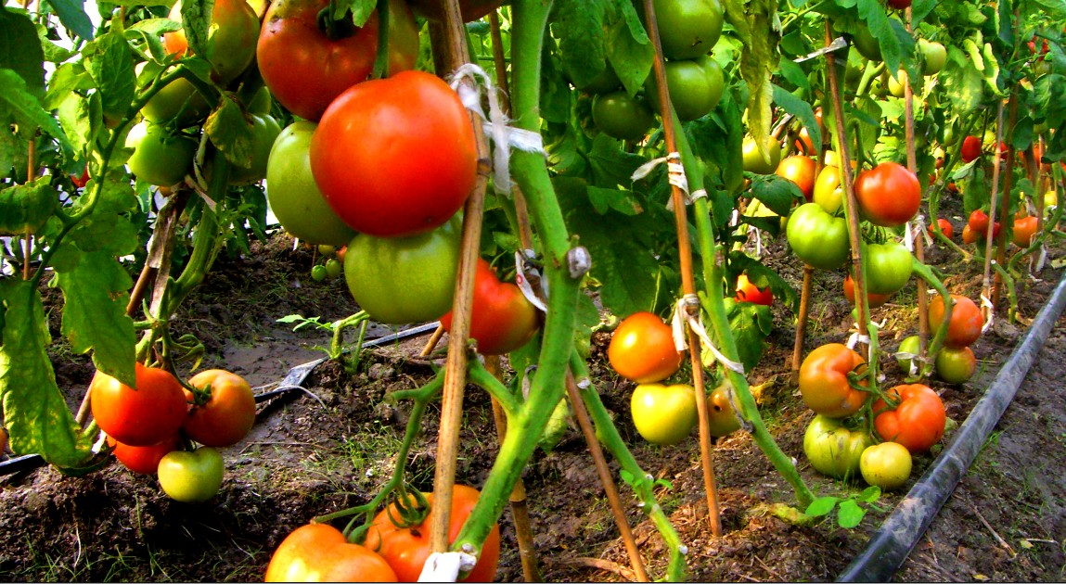
Organic Farming

Slide 8
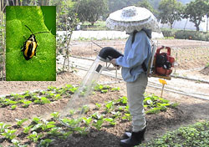
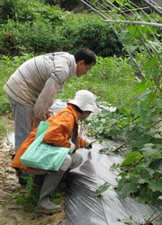
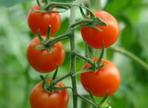
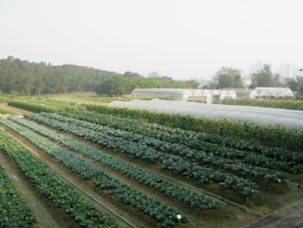
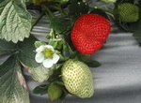
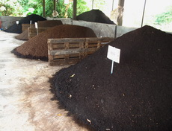
Organic farming is simply farming without using any chemicals.

Slide 9
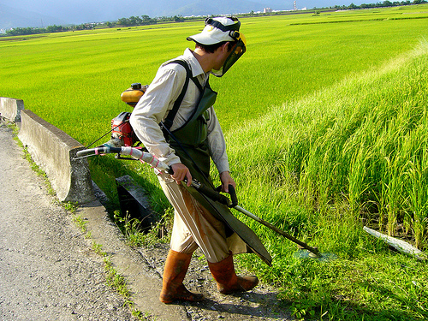
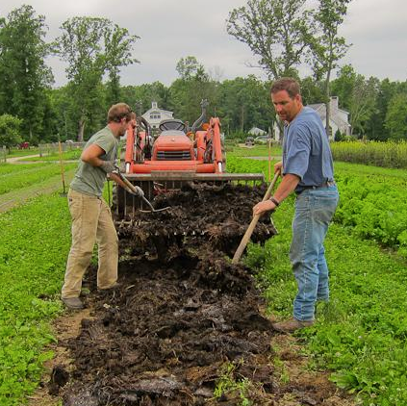
Chemical or organic farming?

Slide 10
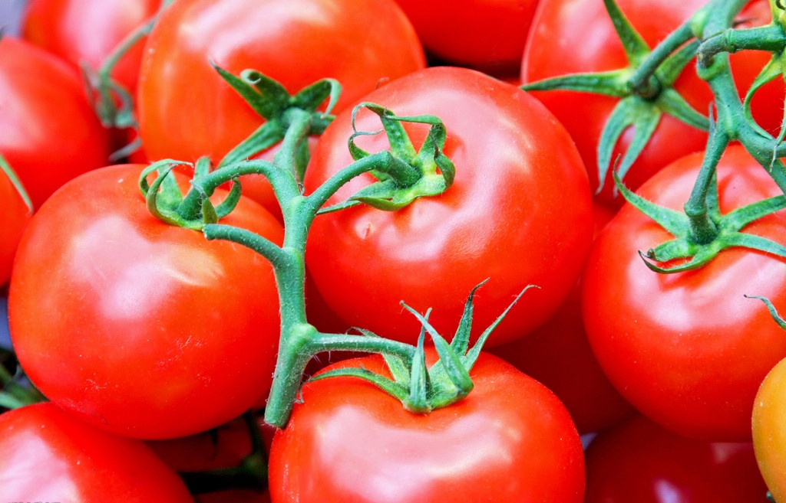
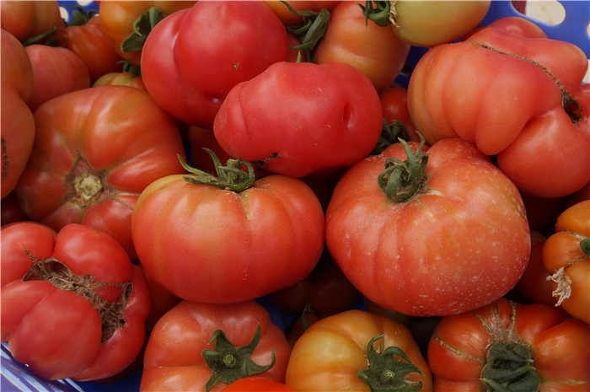
Which tomatoes do you prefer?
Normal tomatoes
Organic tomatoes
5 yuan / kg
30 yuan / kg

Slide 11


Read the text “Chemical versus organic farming” and then answer the following questions.
1. Why did many farmers welcome the introduction of chemical farming?
Because it is a great way to fight crop disease and increase production.

Slide 12
2. What concerns many people about the use of pesticides?
Pesticides can damage the land by killing not only harmful bacteria and insects, but also helpful ones. In addition, these chemicals can stay in the soil and underground water sources for a long time, which affects the crops grown on the land and animals and humans who digest them.

Slide 13
3. What is one problem with the use of chemical fertilisers?
Crops grown with chemical fertilisers usually grow too fast to be rich in nutrition and they often have less flavor as well.
4. How is organic farming different from chemical farming?
Organic farming is simply farming without using any chemicals.

Slide 14
5. Why do organic farmers change the kind of crop grown in a field every year?
Because different kinds of crops put important minerals back into the ground, making it ready again for the next batch of crops.

Slide 15
6. What is the goal of using organic farming methods? Do you think it can be reached? Why or why not?
The goal of using organic farming methods is to grow good food while avoiding damage to the environment or to people’s health.
There is still a long way to reach the goal because organic farming cannot serve the high demand for food around the world.

Slide 16
Match the main ideas (A-D) below with the paragraphs.
A What organic farming is
B Why man-made chemicals are still used in farming
C Organic methods for producing rich soil
D The problems with chemical farming
Para. 1-2
Para. 3
Para. 4
Para. 5
D
A
C
B
Notes:
Passagetiona

Slide 17
Complete the sentences in the tables.
Para. | Main Idea | Detail
1-2 |  | Pesticides can kill helpful _____________
 |  | Some pesticides have been _______ because of the ________________
 |  | Crops grown with chemical fertilisers usually _____________ to be full of _________.
bacteria and insects
D
prohibited
damage they cause to people and the environment
grow too fast
nutrition
Notes:
Passagetiona

Slide 18
Para. | Main Idea | Detail
3 |  | Many organic farmers use __________________ as fertiliser.
4 |  | They often __________________ grown in each field ___________.
 |  | They also plant crops that use ______________ of the soil to help keep it rich.
5 |  | Organic farming is nowhere near able to meet the high ___________ ____________________
natural
A
waste from animals
change the kind of crop
every year
C
different depths
B
need/demand for food around the world
Notes:
Passagetiona

Slide 19
The author uses some connectives when explaining the details. Find and underline them. Then think about what they add to the text. Can you name more connectives according to different classes?
Connectives in the text: and, also, but, while, however, for example, for instance, in addition, in fact, as for, because, therefore
Notes:
Passagetiona

Slide 20
Find the subject clauses used in the text and underline them. Then make your own sentences on the theme of chemical and organic farming .
① Over time, however, what some scientists have found is that their long-term use can sometimes harm both the land and people’s health.
② Why different crops are grown is because they put important minerals back into the ground, making it ready again for the next batch of crops.
Notes:
Passagetiona

Slide 21
③ What keeps them from doing so is the fact that chemical farming serves the high demand for food around the world.
Notes:
Passagetiona

Slide 22


Write an argumentative essay giving your opinion on chemical or organic farming.
Discuss these questions in groups:
• Is the author of the passage for or against organic farming? How do you know?
• What other disadvantages of chemical farming did the author not list？
Notes:
Passagetiona

Slide 23
Discuss these questions in groups:
• How might the following items be problems and how important are they for organic farming?
natural animal waste used as fertilizer
higher cost of producing food
greater effort required to farm
• What other disadvantages of organic farming can you think of?
Notes:
Passagetiona

Slide 24
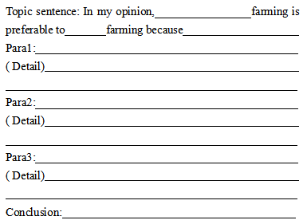
Decide topic and come up with three main points to support your opinion, and then add at least one detail to support each main point. Complete the outline below.
Notes:
Passagetiona

Slide 25
Use your outline to write a short essay giving your opinion on the topic.
Notes:
Passagetiona

Slide 26
Exchange your draft with a partner.
1. Use the checklist to help you review your partner’s draft.
√ Does the writer do a good job of expressing his/her opinion?
√ Does each paragraph have one main idea?
√ Does each paragraph have at least one detail to support its main idea?
√ Does the writer sequence the points in a logical order? Are there any connectives in the essay?
Notes:
Passagetiona

Slide 27
√ Does the writer do a good job persuading you to accept his / her opinion？
√ Does the writer use correct grammar, punctuation, and spelling?
Notes:
Passagetiona

Slide 28

2. Take your draft back and revise it.
3. Share your essay with the rest of the class.
Notes:
Passagetiona

Slide 29


Finish your essay and revise it based on the feedback.

Slide 30


