Slide 1

Unit 4

Slide 2
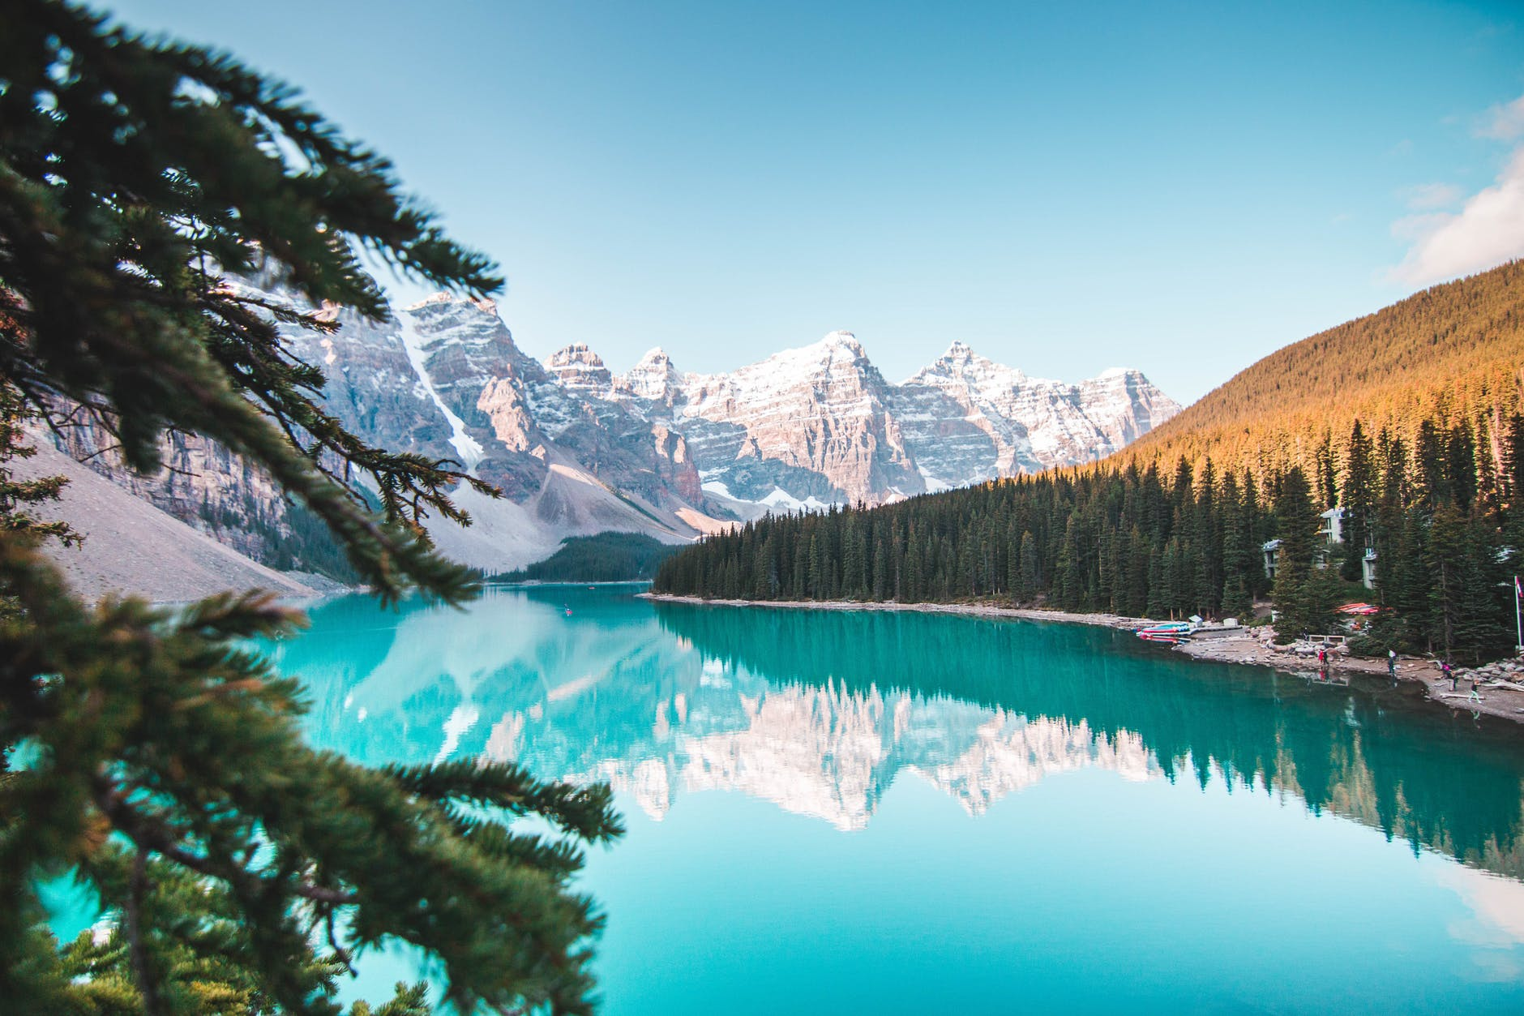
UNIT 4
JOURNEY ACROSS A VAST LAND

Slide 3


Slide 4


To review the key words and chunks
To be able to use the key words and chunks in different contexts

Slide 5


Go through the words in Activity 1 and say as many chunks as you can.
draw/ close/ pull/ raise the curtain, draw /pull back the curtain, a shower curtain
buy/ sell antiques, genuine/ fake antiques, antique shop, antique furniture
take a deep breath, out of breath, take one’s breath away, catch one’s breath, save one’s breath

Slide 6
form a bay, a deep bay (深海湾), a city on a bay, bay area
protect a creature, living creatures, strange creatures, shy creatures
radio highlights, the highlight of…
domestic airline, international airlines, airline meal, airline pilot
beauty and charm, natural beauy, inner beauty, physical beauty, sleeping beauty
climb the peak, reach a new peak, flood peak, mountain peak
long duration, in duration, duration of work
covered with frost, frost over the trees, heavy frost, frost damage

Slide 7

Complete the sentences using suitable nouns in their correct forms and circle the words which collocate with them.
curtain antique breath bay creature highlight
airline beauty peak duration frost
1. After arising in the morning, the first thing he does is to
draw the ________.
2. He was impressed by her ______ and charm.
3. The visitors were admiring the ________ dating back to the 17th century.
curtain
beauty
antique

Slide 8
curtain antique breath bay creature highlight
airline beauty peak duration frost
4. We all remember the __________ of the trip–visiting the Huanguoshu Waterfall.
5. Protect the __________ which are unique to Australia and their natural habitats.
6. What __________ did you fly?
7. It is one of the most difficult _________ to climb in the Rocky Mountains.
8. The beauty of Qinghai Lake took the visitors’ ________ away.
highlight
creatures
airline
peaks
breath

Slide 9
curtain antique breath bay creature highlight
airline beauty peak duration frost
9. In freezing cold winter, windows are often
covered with _________.
10. We sailed into a beautiful __________ in the southwest of Canada.
11. Judy enrolled in a programme of study that was eight months in __________, but she completed it in only six months.
frost
bay
duration

Slide 10
Judy enrolled in a programme of study that was eight months in duration, but she completed it in only six months.
朱迪参加了一个为期八个月的研究项目, 但她只用了六个月就完成了。
enrol vi.& vt. to officially arrange to join a school, university, or course, or to arrange for someone else to do this (使)加入; 注册; 登记
e.g. You may want to enrol your child in a nearby school.
你可能想让你的孩子在附近的学校上学。

Slide 11
You can come and enrol your children in the school.
你可以送你的孩子来学校登记。
I enrolled for/in/on the modern art course.
我参加了现代艺术课程。

Slide 12
Match the phrases with their English interpretations.
world that is more concerned with profit
a great deal of
towns and cities
travelling to
bound for
urban areas
commercial world
a massive amount of

Slide 13
Complete Samuel’s story with the correct phrases.
bound for commercial world urban areas
a massive amount of money
1. In Canada, _______________________ has been spent on preserving the forest, and the country’s deforestation rate is among the world’s lowest.
2. A growing number of woodworkers have decided to move to the __________________________ for better jobs.
a massive amount of money
urban areas

Slide 14
bound for commercial world urban areas
a massive amount of money
3. Aboard the plane __________________ Toronto, Samuel, a young woodworker, began imagining a whole new life in the big city.
4. However, he also had some worries. Ideally, he wanted to make a living in the arts, but he also knew well that it was somewhat a ___________________.
bound for
commercial world

Slide 15
Suppose you were talking to your friend Jane. Choose the suitable adjectives to comment on the situations. Then read the dialogue in pairs.
awesome mild pleasant
1. Jane: The welcome party at the University of Oxford helped many students to make new friends.
You: They must have spent a(n) __________ evening together.
pleasant

Slide 16
awesome mild pleasant
2. Jane: We’re surprised to find that it is warmer than usual this winter in London.
You: You’re so lucky to have a(n) ________ winter here.
3. Jane: We visited a famous tourist site in Scotland: the beautiful coastline and breathtaking landscape of St Andrews.
You: How wonderful! You must have had a(n) ________ experience.
mild
awesome

Slide 17


These adjectives (exciting, breathtaking, surprised) are from the dialogue. Use them to write small dialogues.

Slide 18


