Slide 1
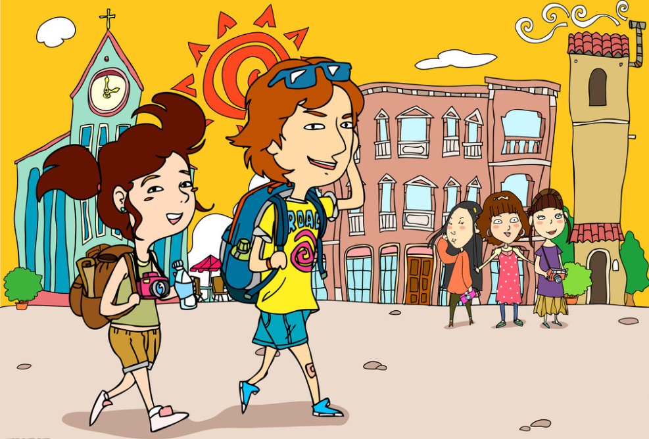
Unit 1 Great explorations
Writing

Slide 2
目录
Review
1
Pre-Learning
2
While-Learning
3
Post-Learning
4
5
Review

Slide 3
Part I Review

Slide 4
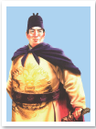
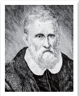
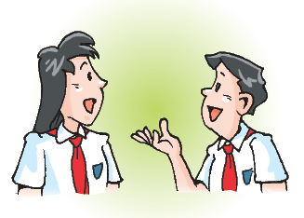
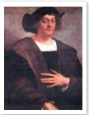
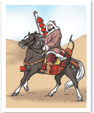
Show time
Act out your conversation about a great explorer.

Slide 5
Part II Pre-Learning

Slide 6

Let’s learn the new words and expressions.

Slide 7

New words and expression
Writing
compare...with... 把……与……对比

Slide 8
Language points
compare...with... 把……与……作对比
Let's compare this article with that one.
让我们把这篇文章和那一篇作一下比较。
【注意】我们还可以用compare……to…… 表示“把……与……作对比”。除此以外，compare……to…… 还可以表示“将……比作……”。
如：
The heart is often compared to a pump.
心脏常被比作水泵。

Slide 9
Part III While-Learning

Slide 10
A famous travel writer
A James Turner is a famous travel writer. Here is part of an interview with him. Work in pairs to match the answers with the questions. Write the letters in the boxes.
When and where were you born?
What did your parents do?
What did you do when you left school?
How did you start writing your first book?
What do you like to write about?
What’s your next book about?

Slide 11
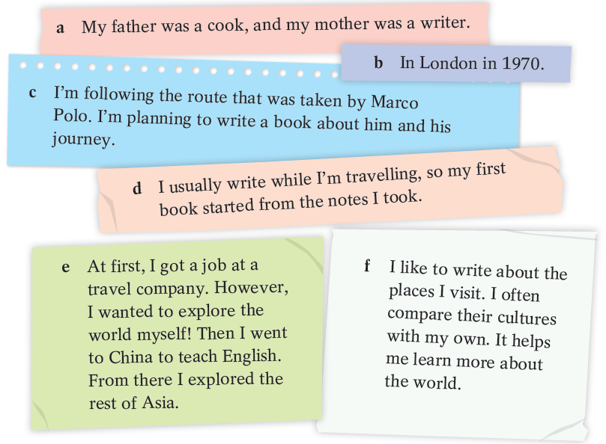

Slide 12
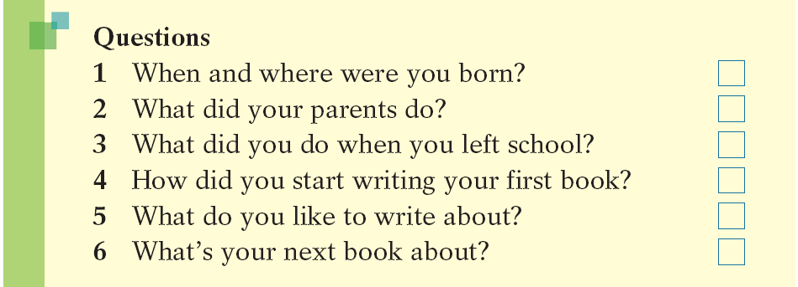
Writing
A famous travel writer
a
a My father was a cook, and my mother was a writer.

Slide 13
b
a
b In London in 1970.

Slide 14
b
a
c
c I’m following the route that was taken by Marco Polo. I’m planning to write a book about him and his journey.

Slide 15
b
a
d
c
d I usually write while I’m travelling, so my first book started from the notes I took.

Slide 16
b
a
e
d
c
e At first, I got a job at a travel company. However, I wanted to explore the world myself! Then I went to China to teach English. From there I explored the rest of Asia.

Slide 17
b
a
e
d
f
c
f I like to write about the places I visit. I often compare their cultures with my own. It helps me learn more about the world.

Slide 18
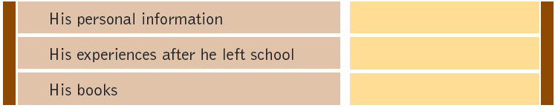
B Which of the questions in A are about James Turner’s personal information, his experiences after he left school and his books？ Write the numbers 1-6 in the boxes.
When and where were you born?
What did your parents do?
What did you do when you left school?
How did you start writing your first book?
What do you like to write about?
What’s your next book about?
1
2
3
4
5
6

Slide 19
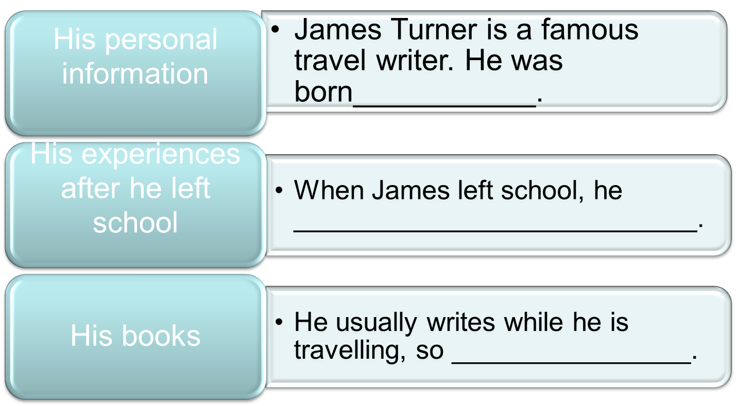
Work on your own. Write an article about James Turner in three paragraphs.
Use James’s answers and the outline below to help you.
James Turner — a famous travel writer

Slide 20
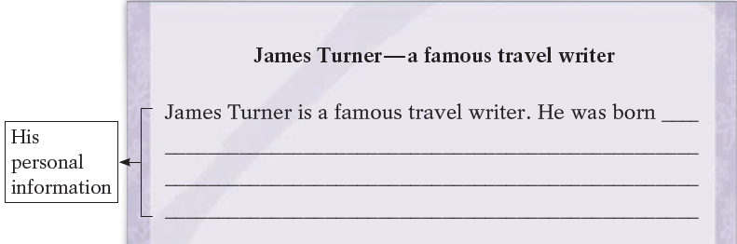
C Work on your own. Write an article about James Turner in three paragraphs. Use James’s answers and the outline below to help you.
in London in 1970. His father was a cook, and his mother was a writer.

Slide 21
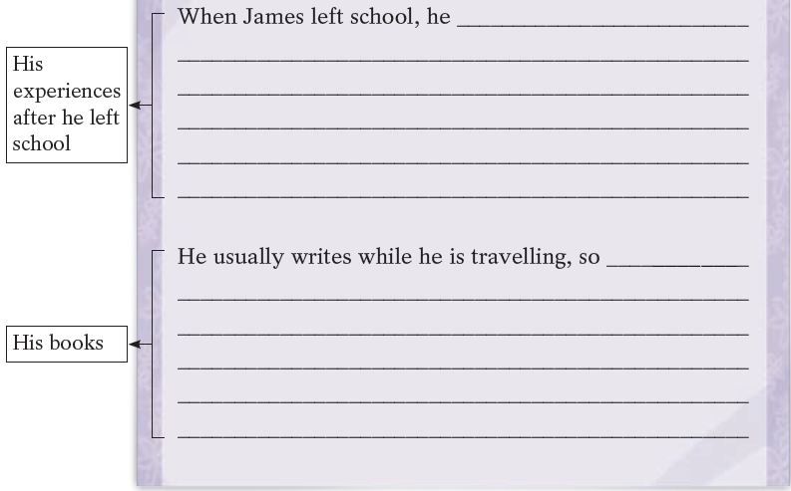
got a job at a travel company. However, he wanted to explore the world himself. Then he went to China to teach English. From there he explored the rest of Asia.
his first book started from the notes he took. He likes to write about the places he visits. He often compares their cultures with his own. It helps him learn more about the world. He’s planning to write a book about Marco Polo and his journey.

Slide 22
Part IV Post-Learning

Slide 23
Practice
Jack likes travelling very much. He makes his living by writing travel writing for several websites .Think about some questions to interview him.

Slide 24
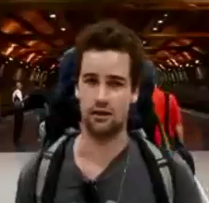
Questions for interviewing Jack:
How many countries have you been?
How old are you?
Which country do you like best?
Where are you from ?
How many words do you write every day?
…

Slide 25
Suppose your partner is Jack, interview him and write down his answers, then write an article about Jack.
Questions
Answers.
Where are you from ?
I come from London, England.
How old are you?
…
How many countries have you been?
…

Slide 26
Part V Review

Slide 27
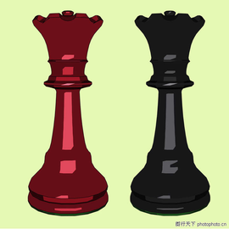
Dictation
把……与……对比
compare...with

Slide 28
Thank you!

