Slide 1

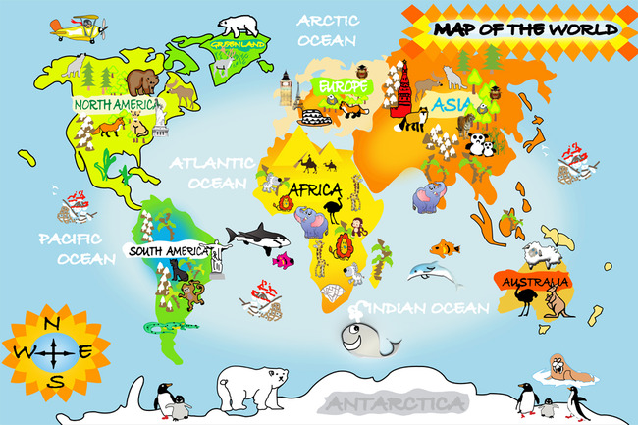
Unit 2 Travelling around the world

Slide 2

About postcards
When do people send postcards?
People usually send postcards when they go travelling!

Slide 3

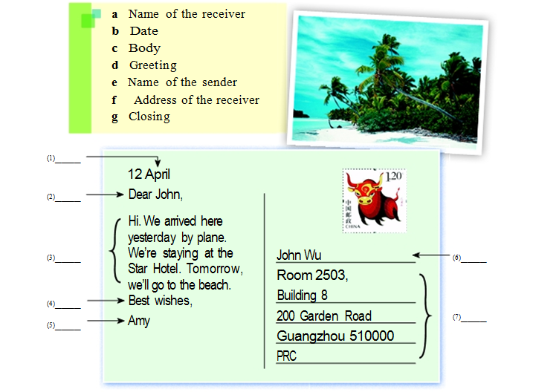

1.Who wrote the postcard?
2.Who did Amy write to?
3 .Where is the receiver?
4. When did Amy write the postcard?
b
Date
a
Greeting
Name of the receiver
c
a
Closing
d
Address of the receiver
f
Name of the sender
Notes:
Look at this postcard. Think about these four questions. For the first question, you need to pay attention to the name of the sender. For the second question, you need to pay attention to the name of the receiver. Please read the word receiver. Receiver means ….? Where is the receiver? Pay attention to the address of the receiver. When did Amy write the postcard? Date. There are two parts you need to pay attention to. Greeting(问候) – Dear John… closing part （结束语） Best wishes/ Love / yours sincerely……

Slide 4

Writing
A postcard
A What does a postcard include? Look at the postcard below and fill in the blanks with the letters of the correct labels from the box.
p25
A. Name of the receiver
B. Date
C. Body
D. Greeting
E. Name of the sender
F. Address of the receiver
G. Closing

Slide 5
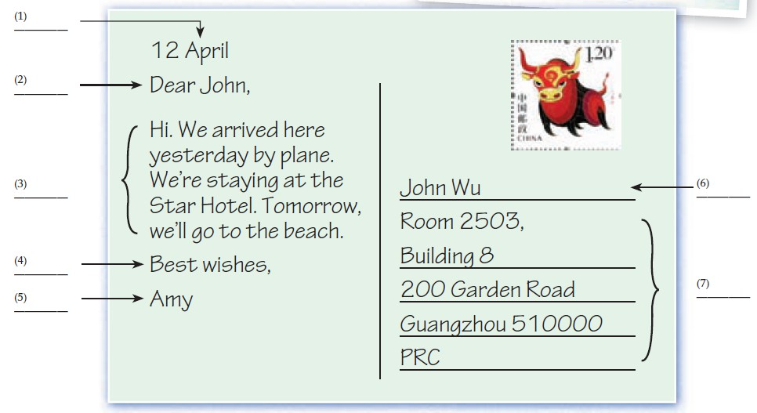
b
d
c
a
g
f
e

Slide 6

Let’s learn the new words and expressions.

Slide 7
New words and expressions
P25
receiver n. 接收者
date n. 日期
greeting n. 问候
address n. 地址

Slide 8
Notes P25
1. receiver n. 接收者
receive + r = receiver
v. + er/or = the person who do the job (n.)
some more examples:
play --- player（队员，运动员）
sing --- singer（歌唱家，歌手）
write --- writer（作家）
act --- actor（演员）
visit --- visitor（参观者，访问者）
invent --- inventor（发明家）

Slide 9
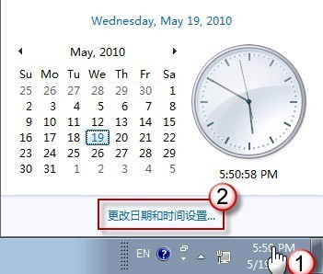
2. date n. 日期
v. 加日期于
out of date 过时的，陈旧的
What's the date today?
今天几号？
It’s March 21st.(直接说出日期)
What day is it today?
今天星期几？
It’s Wednesday.(直接说出星期几)
Much of the information in the book is now out of date.
这本书中的很多信息现在已经过时了。

Slide 10

3. greeting [C] n. 问候
My mother sends her greetings to all of you.
我母亲向你们大家问好。
4. address [C] n. 地址
Write down your name and address here.
在这儿写下你的姓名和地址。

Slide 11

5. name of the sender 发信人姓名
sender n. 发信人
send + er = sender

Slide 12
6. We arrived here yesterday by plane.
我们昨天乘飞机到达这里。
arrive 作为不及物动词，不可以直接加宾语。
用法如下：
单独使用：
When did you arrive ?
与in或at连用，相当于get to：
arrive in + big place (Tokyo)
arrive at + small place (airport)

Slide 13
7. PRC 中华人民共和国
PRC是People’s Republic of China的缩写，
常见缩略词要大写。如：
世界贸易组织
光盘
美国
不明飞行物
WTO
CD
USA
UFO

Slide 14
一、选择最佳答案填空。
( )1. Can you tell me when you can ____?
A. get to B. arrive C. reach D. arrive in
( )2. When you ____ your school, please give me a
call.
A. get B. arrive C. reach at D. arrive at
B
D

Slide 15
二、根据中文意思完成句子。
1. 史密斯先生每天早上9点到达办公室。
Mr Smith _______ _______ the office at 9 a.m. every day.
2. 你们什么时候到上海？
When will you _______ _______Shanghai?
gets to /arrives at
get to / arrive in

