Slide 2
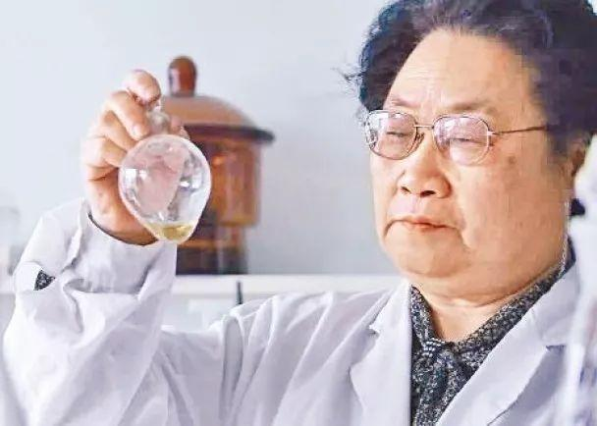
Unit 1
PEOPLE OF ACHIEVEMENT

Slide 3


Slide 4


To learn and practice some words and expressions in the reading part.
Key words: vital, commit, evaluate, acknowledge
Key expressions: with the objective of, insist on

Slide 5

1. Artemisinin has become a vital part of the treatment for malaria, …
青蒿素已成为治疗疟疾的重要组成部分，…
vital adj. 必不可少的; 极其重要的; 充满生机的
★ become / be a vital part of…
……重要组成部分
★perform / play a vital role in
在……中起着极其重要的作用
★be of vital importance (to sb.)
（对某人来说）极其重要的
★It is vital that……是极其重要（should+动词）

Slide 6
This matter is of vital importance to us.
这件事对我们来说至关重要。
Richardson played a vital role in the team's success.
理查森对球队的成功起了极重要的作用。
It is vital that the patient (should) take in enough nutrition every day.
病人每天吸收足够的营养是极其重要的。

Slide 7
2. Tu Youyou, a committed and patient scientist, was born in Ningbo, China, on 30 December 1930…
屠呦呦，一位坚定而耐心的科学家，1930年12月30日出生于中国宁波……
☆ a committed scientist 一位坚定的科学家
committed adj. 尽心尽力的，坚定的，坚信的
If you want a committed man, keep your promise.
如果你想要一个忠诚的人，就要信守诺言。

Slide 8

commit
★承诺，保证。常用搭配commit sb. / oneself to (doing) sth.。如：
The president is committed to improving health care.
Both sides committed themselves to settling the problem peacefully.
★ 忠于；全心全意投入（工作、活动等）
Anna wants to get married, but Bob's not sure he wants to commit. 安娜想结婚，但鲍勃却不能肯定自己是不是想作出承诺。

Slide 9
commit
★干（错事，坏事），犯罪。如：
The murder was committed on New Year’s Eve.
★投入（时间、钱、人力等）。如：
They called on Western nations to commit more money to the poorest nations.

Slide 10
【语境运用】完成句子。
1) When taken to the police station for questioning, the man said, “I have never ________ ________ ________ (犯任何罪).”
2) She has ________ ________ _______ ________ ________ (答应去) the doctor’s at once.
3) He was a __________ (commit) internationalist in foreign policy.
committed any crime
committed herself to
go / going to
committed

Slide 11
3. In 1967, the Chinese government formed a team of scientists with the objective of discovering a new treatment for malaria, and Tu Youyou was among the first researchers chosen.
1967年中国政府组建了一支科学家队伍，目的是发现一种治疗疟疾的新方法，屠呦呦是首批入选的科学家之一。

Slide 12
☆ with the objective (/ aim / purpose / goal) of…
目的是……。在句中作状语。
In 1904, he went to Japan and became a medical student, with the objective of improving people's health and saving lives.
1904年，他去了日本，成为一名医科学生，目的是改善人们的健康，挽救生命。
He tried a second time with the aim of being chosen. 他又试了第二回，希望能被选上。
He came here with the purpose of carrying out an important task. 他来这里是为了执行一项重要的任务。

Slide 13
4. Her team examined over 2,000 old medical texts, and evaluated 280,000 plants for their medical properties.
她的团队检查了2000多本古老的医学文献，并对280,000种植物的药用性能进行了评估。
☆ evaluate vt. 评价，评估
Let's evaluate the evidence.
让我们评定一下此证据的价值。
By marks in numbers or letters, the teacher evaluates a student’s work.
老师用数字或字母的符号来评价学生的作业。

Slide 14
【语境运用】完成句子。
1) It can be difficult ___________ (evaluate) the effectiveness of different treatments.
2) He does this by ___________ (evaluate) the strength of the evidence for each category.
3) We need to carry out a proper _________ (evaluate) of the new system.
to evaluate
evaluating
evaluation

Slide 15
5. However, Tu Youyou would not acknowledge defeat. 然而，屠呦呦并不承认失败。
☆ acknowledge vt. 承认（属实、权威等），（公开）感谢
I acknowledge that her criticism is just.
我承认她的批评是公正的。
His long service with the company was acknowledged with a present.

Slide 16
☆ acknowledge … as/to be…
承认 / 公认……是……
He is widely acknowledged as / to be the best player in the world.
☆ acknowledged that … 承认是……
Do you acknowledge that you've been wrong?

Slide 17
【语境运用】完成句子。
1) They refused _______________ (acknowledge) that they were defeated.
2) In China, it is a generally _______________ (acknowledge) fact to take care of our parents.
3) He _________________ (acknowledge) to be the finest poet in the world.
to acknowledge
acknowledged
was acknowledged

Slide 18
6. Tu Youyou and her team members even insisted on testing the medicine on themselves to make sure that it was safe.
屠呦呦和她的团队成员甚至坚持在自己身上测试药物，以确保它是安全的。
☆ insist on sth. / doing sth. 坚持（干）……，坚决主张，一定要……
They insisted on my staying there for supper. The man insisted on a taxi for me even though I told him I lived nearby.

Slide 19
☆ insist that…坚持让某人做…；坚持认为…
He insists that she (should) not be invited to our party.
She insisted that she didn’t tell a lie.
I insisted that I hadn’t seen the wallet.

Slide 20
【语境运用】完成句子。
1) I insist on your _______ (take) immediate action to put this right.
2) I insisted that a doctor _______________ (send) for immediately.
3) Jane insisted that she _________ (do) nothing wrong.
taking
(should) be sent
had done

Slide 21


1. Review the words, expressions and sentences we have learned.
2. Finish the exercises in the workbook.

Slide 22


