Slide 1
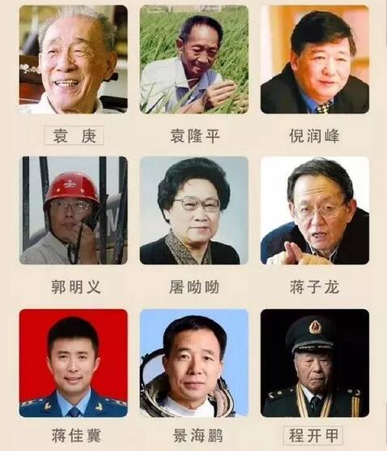
Unit 1 People of achievement

Slide 2

Introduce someone you admire

Slide 3


1. To learn Einsteins life story.
2. To learn to write an introduction about
some one you admire.

Slide 4


What do you know about Albert Einstein? Let’s watch a video.
Albert Einstein

Slide 5

Read the text and complete the timeline.
01
Born in Germany
1879
failed to enter university
1895
02
entered university
03
1896
graduated from university
04
1900
worked as a cleark
05
1902
earned a doctorate in physics and published four physics papers
06
1903

Slide 6
quitted job and entered research
07
1909
was awarded Nobel Prize
08
1922
09
fled Germany
1933
10
passed away
1955

Slide 7

In pairs, discuss the following questions.
1. Apart from his remarkable
achievements, what does the passage
tell us about Einstein’s life?
2. What impressed you most about
Einstein? State your reasons.

Slide 8
Study the organisation and language features.
Writing style
1. What type of writing is this text? How
does the writer develop the text?
It is a biography. The text is developed in chronological order.

Slide 9
2. Find the descriptions that tell us what
Einstein looked like and what kind of
person he was.
He was seen as a slightly odd-looking but kind and funny man.
He had a thick moustache and long white hair, which sometimes stood on end as though he had just received an electric shock.
He was a conregeous and kind figure loved by many people.
Although he was a genius, he sometimes forgot things.

Slide 10
3. What rhetorical devices are used in the
passage? Give examples.
Simile (明喻)
e.g.
Following this, he gradually became famous throught the world as the new Isaac Newtown.
He had a thick moustache and long with white hair, which sometimes stood on end as though he had just received an electric shock.

Slide 11


talent & genius
talent和genius均为名词，意为“天赋，才智”时，常和介词for搭配，可作可数名词，也可作不可数名词；
e.g. She is proud that both her children have a
talent / genius for music.
He has a lot of talent / genius, and his work
is fresh and interesting.
意为“有才能的人，天才”时，talent既可作可数名词，也可作不可数名词，而genius只作可数名词。
【即学即练】根据括号内所给的汉语提示补全下列句子（每空一词）。
1. This girl ________ ________ _______ ________ ________ (有语言天赋). Now she can speak three foreign languages.
2. He was not just ________ ________ ________ (音乐天才), he was among the most influential figures in film history.

Slide 12
e.g. He’s an exciting new talent on the
classical music scene.
There is a wealth of young talent in
British theatre.
Einstein was a mathematical genius.
【拓展】talented adj. 有天赋的，天才的。

Slide 13
【语境应用】根据括号内所给的汉语提示补全下列句子（每空一词）。
1. This girl ________ ________ __________
________ ________ (有语言天赋). Now she
can speak three foreign languages.
2. He was not just ________ ________
________ (音乐天才), he was among the
most influential figures in film history.
has a talent / genius
for language
a musical
genius

Slide 14

make contributions to 做贡献
due to 由于；归功于
come to power （开始）掌权；上台
as a consequence 因此，结果
take up a position 担任；任职
be mistaken for 被误认为
pass away 逝去

Slide 15


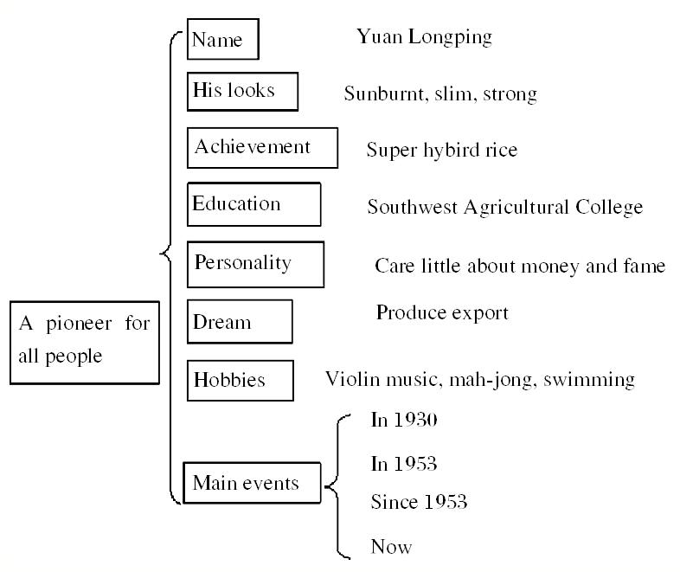
Write an introduction about someone you admire.

Slide 16
写作指导
1. 人物传记是记叙文体的一种，但人物
传记主要是写名人或伟人的生平事迹，
因此写人物传记时，要抓住其出生年
月、主要事迹、人们的评论等进行叙述。
2. 时态多为一般过去时，主要人称为第三
人称。
3. 把握人物传记的首要特征—真实性，
对人物的介绍要实事求是。

Slide 17
常用词汇：
动词（短语）：pass away, graduate from, go to, return, devote, award, remember ...
名词（短语）：scientist, doctor’s degree, difficulty, institute, technology, research, achievement
形容词：famous, well-known, great, modern, outstanding ...
副词（短语）：at home and abroad, first, then, there, always, all the time ...
连接词：when, and, where, though ...

Slide 18
句型应用：
... be born in ...
... first to ... and then to ...
Though faced with sth., sb. ...
... devote oneself to sth.
... be remembered by sb. as ...

Slide 19
You may follow the steps:
1. Choose the person you are going to write
about. It should be someone you think is
great in some way. It can be an ordinary
person, such as a parent, a relative, or a
friend.
2. Make a list of things that need to be
included in your introduction.
3. Use your notes to write your introduction
and sum up how you feel about this person.

Slide 20


Finish your introduction about someone you admire.
Use the checklist to help you review your draft.
✓Do you describe the person’s appearance and
personality?
✓Do you tell an impressive story of the person’s
life?
✓Do you say why the person is great?
✓Do you sum up how you feel about this person?

Slide 21
Share your introduction with the class
next time.

Slide 22


