Slide 1
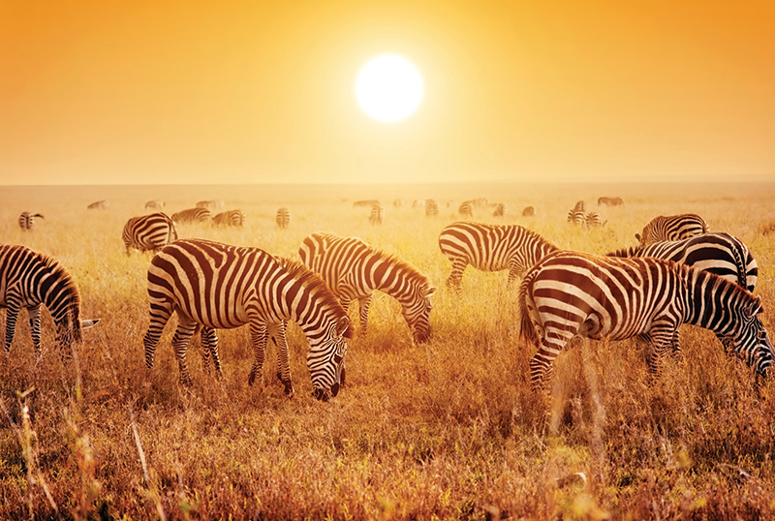
Unit 3
Fascinating parks

Slide 2


Slide 3


1. To obtain and integrate information about
the Sami People’s homes, food, tools,
clothing, traditions, customs, lifestyle and
so on.
2. To describe the beauty of Sarek National
Park.
3. To discuss on whether the establishment of
Sarek National Park is worth.

Slide 4


buffet
edge
glacier
reindeer
territory
ban
boundary
vt. 连续猛击；打来打去
n. 边；边缘；边线；刀刃
n. 冰川
n. 驯鹿
n. 领土；版图；领域
n. 禁令
vt. 明令禁止；取缔
n. 边界；界限；分界线

Slide 5
cottage
visible
accompany
adopt
sour
bless
n. 小屋；村舍；小别墅
adj. 看得见的；可见的
vt. 陪同；陪伴；伴随
vt. 采用；采取；采纳
vt.＆vi.领养
adj. 酸的；有酸味的
vt. 祝福

Slide 6
on the move
a small number of
set out
在行进中；在移动中
少数的……
出发；启程

Slide 7



What is a national park?
A national park is not a playground. It’s a sanctuary for nature and for humans who will accept nature on nature’s own terms.

Slide 8
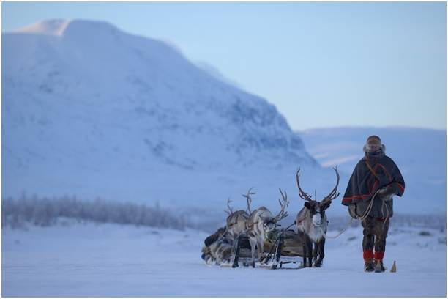
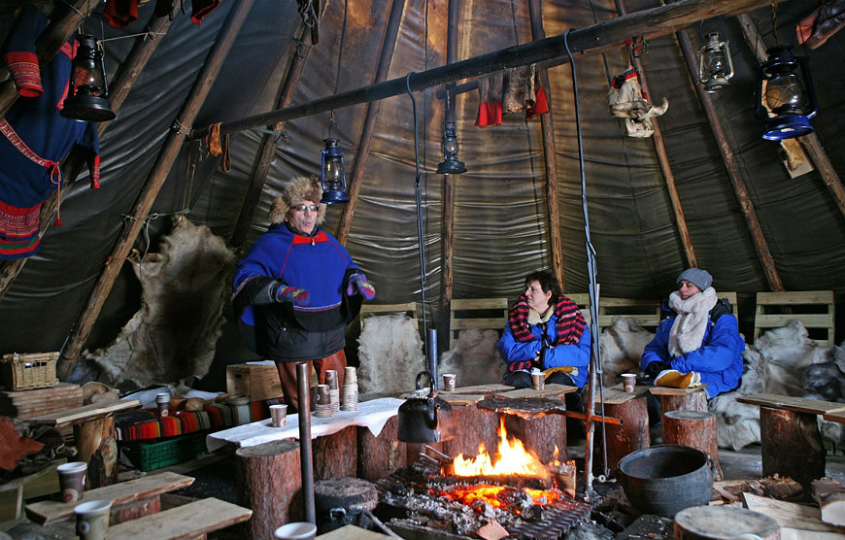
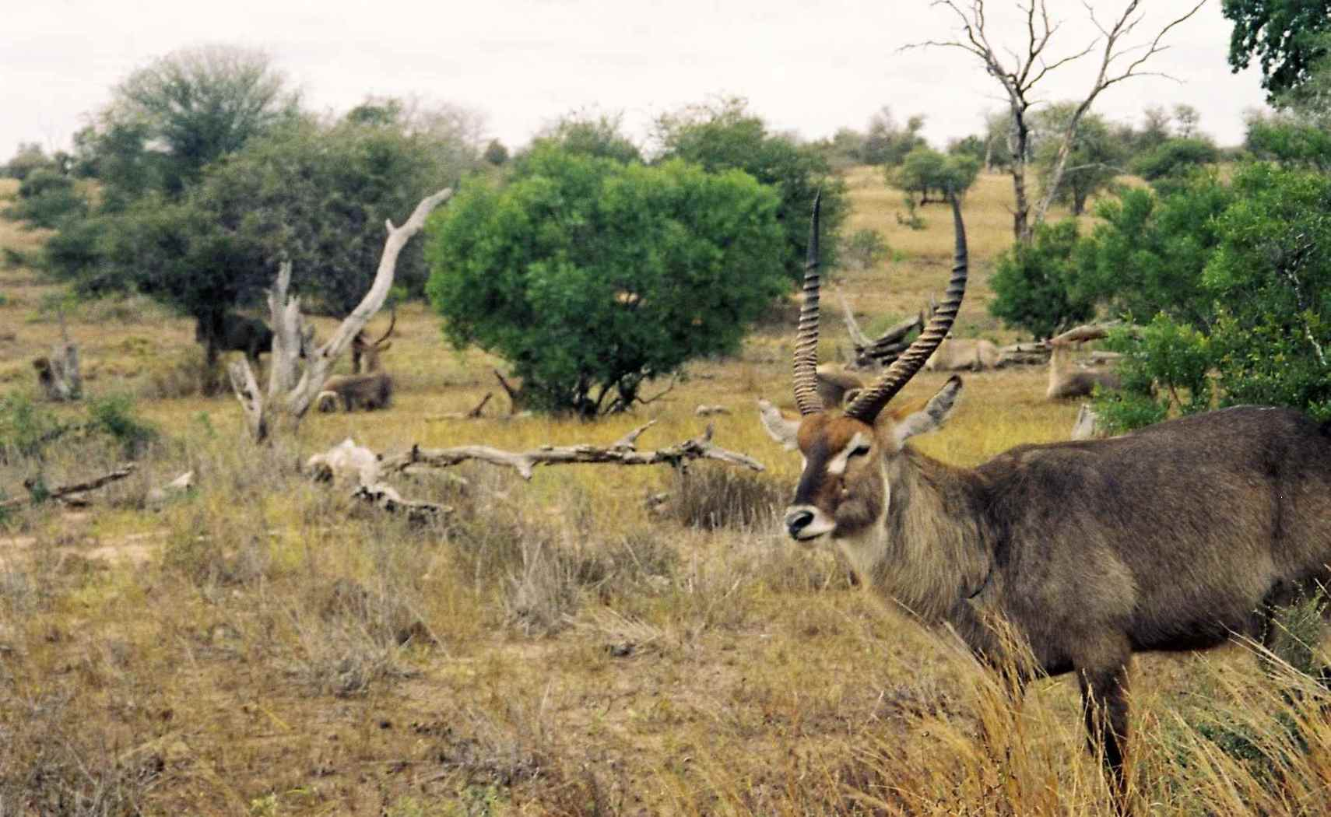
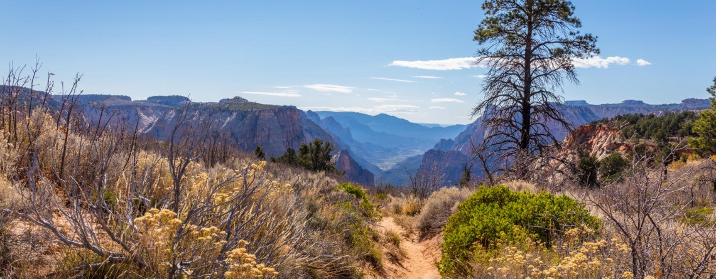

Slide 9

1. What kinds of parks have you been to?
What were they like?
2. When you think of a national parks, what
comes to mind first?

Slide 10


Skim the text and match the subheadings with the paragraphs.
Para. 1:
Para. 2:
Para. 3:
Para. 4:
A summer where the sun never sleeps
A land of mountains and ice
Man at peace with nature
A land of adventure

Slide 11

Read the text and answer these questions.
1. How many hours a day does the sun shine in
summer in Sarek?
2. What steps has the Swedish government
taken to keep Sarek in its natural state?
24 hours.
1) Made Sarek a national park.
2) Bannned new development within
park boundaries.
Notes:
Passagetiona

Slide 12
3. How has life changed for the Sami? Why
might so few Sami want to live in Sarek?
4. Why does the writer think the sweat and
hard work is worth it?
They have houses in village near Sarek and live a modern life like their neighbours.
They still want to follow the reindeer and enjoy their traditions.
The beautiful and wild place makes him feel lucky. And nothing could be better than breathing the fresh air and enjoying the great adventure.
Notes:
Passagetiona

Slide 13
Read and get to know about the Sami.
People | the Sami people
Place of Residence
 | Around 9,000 years ago
In the past |  | looking after reindeer
 | food
 |  | the reindeer’s bones
 | clothes
 | where to live
Sarek moutains near the Arctic Cirle
First time to arrive
a way of life
the reindeer’s meat
tools
the reindeer’s skin
tents or cottages
Notes:
Passagetiona

Slide 14
Today | breakfast
 | living place
 | way of life
flat bread warmed over a fire; dried reindeer meat; some sweet and sour berries
houses in the villages near Sarek
most live a modern life; a small number of Sami still follow their reindeer into the valleys of Sarek and live in tents or old cottages
Notes:
Passagetiona

Slide 15
1. Discuss the question
Are these senses used to describe Sarek in the text? If so, explain how.
Sight Touch Smell Taste Sound
2. Describe
Describe the views of Sarek National Park in your own words.
Notes:
Passagetiona

Slide 16


Complete the summary of the passage using the correct forms of the words from the text.

Slide 17
In the remote far north of Sweden. in Sarek National Park above the Arctic Circle I wakeup to the sound of the wind b________ the cloth of my tent. Standing at the e______ of the mountain, watching the Rapa River f_______ through the valley below, I feel so b_______ to be alive and have this rare opportunity to explore this unique t________, which is almost unknown to the outside world.
buffeting
edge
flow
blessed
territory
Notes:
Passagetiona

Slide 18
Once covered by v_______ sheets of ice, Sarek’s mountains are home to the Sami, the native residents of the park. The Sam lived off reindeer, moved with them, and a___________ them for hundreds of years. Today, most Sami have left their ancient c_______ in the mountain valleys and live a modern life in villages near Sarek instead.
vast
accompanied
cottage
Notes:
Passagetiona

Slide 19
To keep its natural state, except for the Sam, no one is allowed to live in Sarek, and all new development is b________ within the park b________. It is hoped that Sarek National Park will always remain as it is, natural and beautiful.
banned
boundary
Notes:
Passagetiona

Slide 20

Would you like to visit Sarek? Why or
why not?
Share your feelings about the Sarek National Park with your partner.
Notes:
Passagetiona

Slide 21
1. Is it worth making a place like Sarek a
national park? Give your reasons.
2. Do you think setting up national parks is an
effective way to balance development and
the protection of nature? Why or why not?
Notes:
Passagetiona

Slide 22
Creative Thinking
1. What is the purpose of the text?
2. Who is the intended audience of this text?
3. Which part of the passage impresses you
most? Why?
4. Which paragraph or sentence do you like
most? Give your reasons?
6. How do you like the picture of the passage?
Can you add some more pictures to the passage
and make the passage better understood?
Notes:
Passagetiona

Slide 23


1. Learn about China’s National Parks on
the Internet.
2. Try to write a short passage to recommend
one of the China’s National Park to
foreigners.

Slide 24


