Slide 1
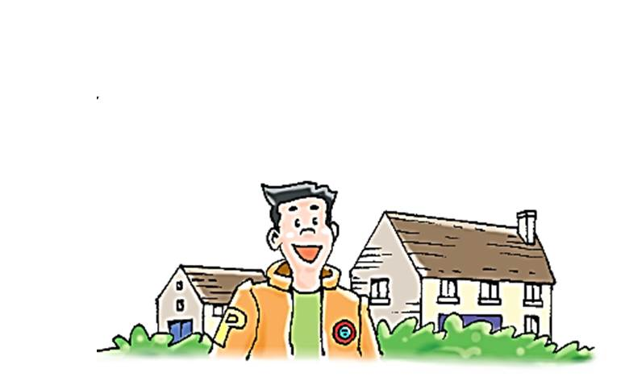
Unit 2 Culture shock
Grammar

Slide 2
目录
Lead-in
1
While-Learning
2
Post-Learning
3
Review
4

Slide 3
Part I Lead-in

Slide 4
请将A、B两栏的分句配对，构成含有目的状语从句的复合句，然后口头说出完整的句子。
A | so that | B
1. Factories should not throw rubbish into rivers |  | a. there will be less rubbish.
2. We should walk or ride bikes more often instead of driving a car |  | b. we can save electricity.
3. We should go shopping with our own shopping bags |  | c. the air will be cleaner.
4. We should turn off the lights when we leave a room |  | d. there will be less water pollution.
d
c
a
b

Slide 5
Part II While-Learning

Slide 6

Grammar A
Adverbial clauses of purpose

Slide 7

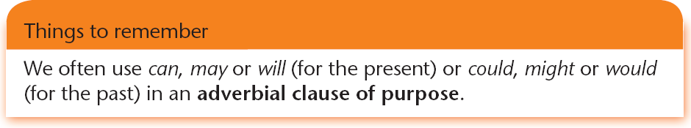
We can use so that + a clause to talk about purpose. This is called an adverbial clause of purpose.
They organized a lot of activities for me in my spare time
so that I wouldn’t miss home or feel lonely.
Mary lent me this book so that I could read about Chinese history.
I exercise every morning so that I will stay healthy.

Slide 8
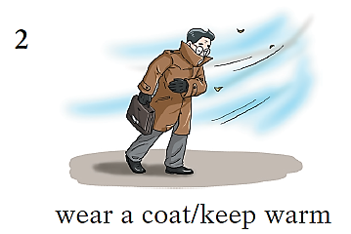
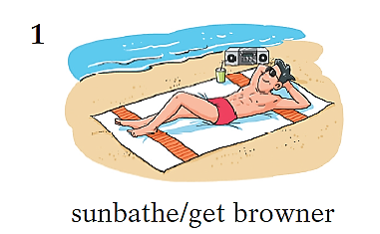
In pairs, ask and answer questions about the pictures below. Follow the example.
When we ask about the purpose, we can use why.
S1: Why is he sunbathing?
S2: He’s sunbathing so that
he can get browner.
S1: Why is he wearing a coat?
S2: He’s wearing a coat so that
he can keep warm.

Slide 9
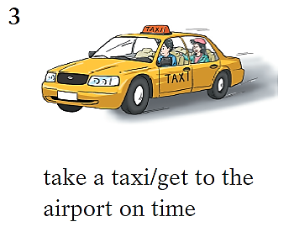
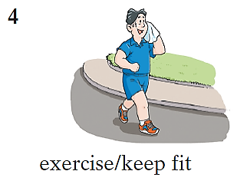
S1: Why is he exercising?
S2: He’s exercising so that
he can keep fit.
S1: Why is she taking a taxi?
S2: She’s taking a taxi so that
she can get to the airport
on time.

Slide 10

We can use in order to, so as to or to to change a complex sentence with the adverbial clause of purpose into a simple sentence.
We practise every day so that we can win the match.
We practise every day in order to win the match.
/In order to win the match, we practise every day.
We practise every day so as to win the match.
We practise every day to win the match.
Things to remember
So as to cannot be put at the beginning of a sentence.

Slide 11
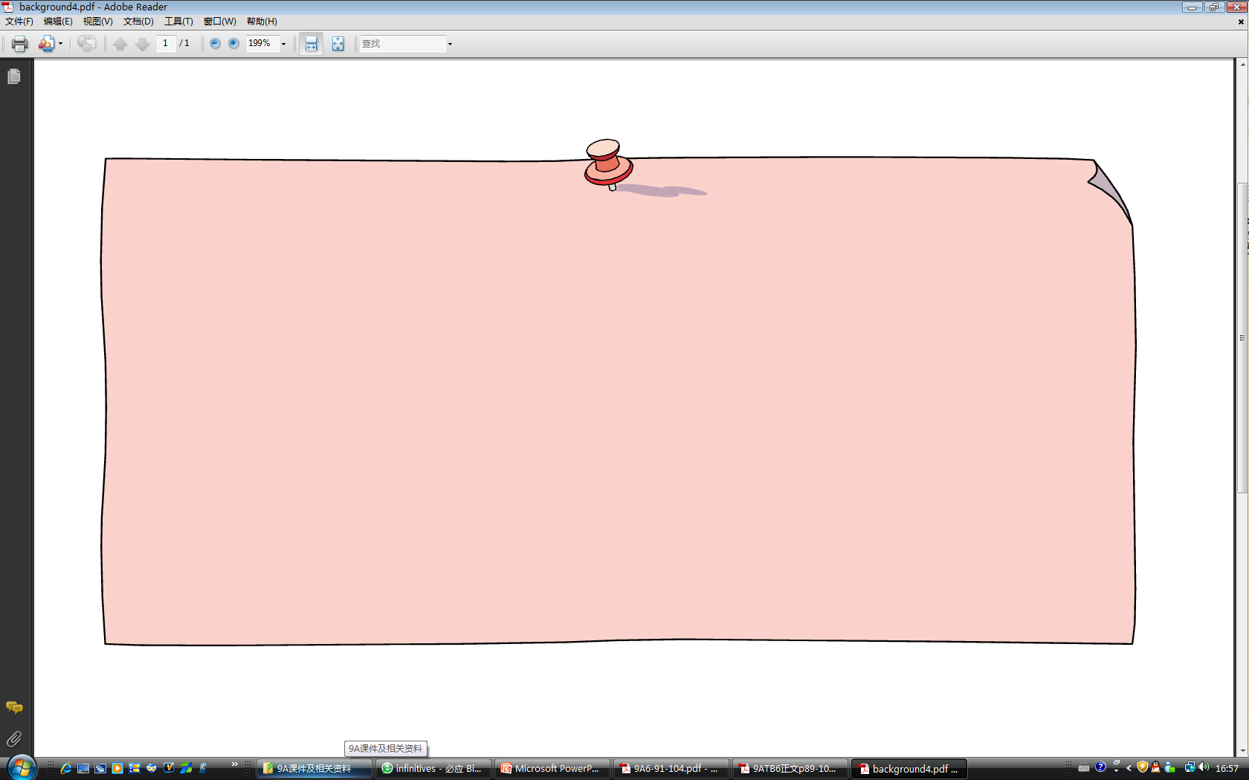
Rewrite the sentences using in order to, so as to or to.
1 He is sunbathing so that he can get browner.
2 He is wearing a coat so that he can keep warm.
① He is sunbathing in order to get browner.
② In order to get browner, he is sunbathing.
③ In order to get browner, he is sunbathing.
④ He is sunbathing to get browner.
① He is wearing a coat in order to keep warm.
② In order to keep warm, he is wearing a coat.
③ He is wearing a coat so as to keep.
④ He is wearing a coat to keep warm.

Slide 12
Rewrite the sentences using in order to, so as to or to.
3 She is taking a taxi so that she can get to the airport on time.
4 He is exercising so that he can keep fit.
① She is taking a taxi in order to get to the airport on time.
② In order to get to the airport on time, she is taking a taxi.
③ She is taking a taxi so as to get to the airport on time.
④ She is taking a taxi to get to the airport on time.
① He is exercising in order to keep fit.
② In order to keep fit, he is exercising.
③ He is exercising so as to keep fit.
④ He is exercising to keep fit.

Slide 13

Grammar B
Review of adverbial clauses

Slide 14
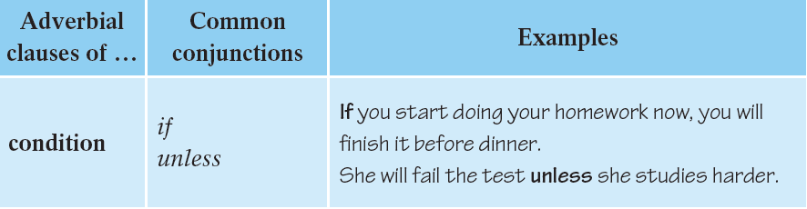
Review of adverbial clauses
So far, we have learnt the following kinds of
adverbial clauses:

Slide 15
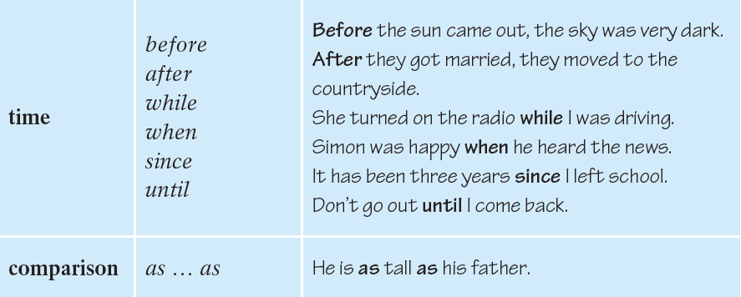

Slide 16
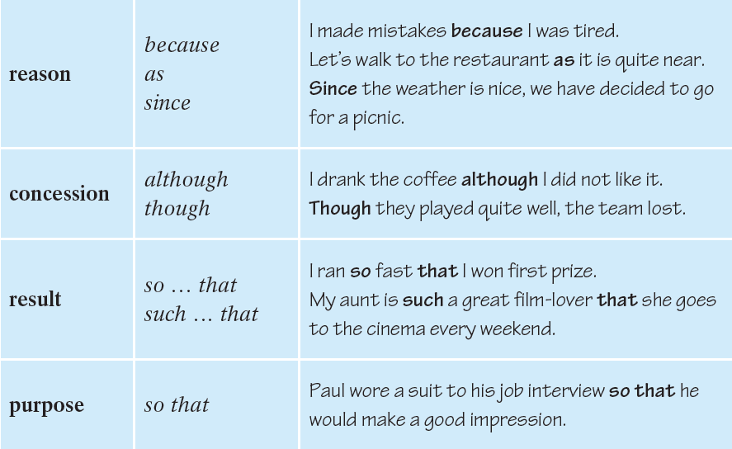

Slide 17
B1 Complete the following sentences with the correct words from the brackets.
You will not pass the test _________ you do not work hard. (unless/if)
You must make sure your tea is not too hot ________ you drink it. (since/before)
You should walk slowly in snowy weather ________ you will not fall over. (so that/although)
_________ it is often cold in the mountains, you need to wear warm clothes. (As/If)
I waited for Tim _________ he was doing his homework. (so that/ while)
if
before
so that
As
while

Slide 18
B2 Join the sentences in column A and column B
with the words from the box.
because if since so … that so that
A B
I exercise a lot. I was three years old.
I have lived in London. I want to lose weight.
Lucy is good at art. Everybody could hear him.
He raised his voice. She won the school painting competition.
Your parents will be proud of you. You win the game.
1. I exercise a lot because I want to lose weight.
2. I have lived in London since I was three years old.
3. Lucy is so good at art that she won the school painting
competition.
4. He raised his voice so that everybody could hear him.
5. Your parents will be proud of you if you win the game.

Slide 19
Part III Post-Learning

Slide 20
the Adverbial
状语
修饰动词、形容词、副词或整个句子，说明动作或状态特征的句子成分，叫做状语。
引导词+句子(在句中作状语)→状语从句

Slide 21
Revision of
the Adverbial Clauses
状语从句
条件状语从句
时间状语从句
比较状语从句
原因状语从句
让步状语从句
结果状语从句
目的状语从句
七种状语从句

Slide 22
判断是什么状语从句？
Last week Grandma forgot to take the book when she left for home.
Although I haven’t got a good job, surfing makes me very fit.
If everyone makes a contribution to protecting the environment, the world will become much more beautiful.
I’ll show them to you as soon as they come out.
(时间)
(让步)
（条件）
（时间）

Slide 23
If you get a chance to go, take it.
As he explored the sea, he took pictures and videos of many things that people had never seen before.
Since water covers most of the earth ,Cousteau knew we should keep the seas clean.
As water is very important to our environment , he encouraged everyone to take part in protecting our lakes ,rivers, seas and oceans.
（条件）
（时间）
（原因）
（原因）

Slide 24
The boy’s father was so thankful that he taught Edison how to send messages by telegragh.
She said she felt as if she was in a storm at sea.
The more trees there are, the better harvests we have.
Miyoko bought a camera so that she could take pictures in Beijing.
（结果）
（方式）
（比较）
（目的）

Slide 25
条件状语从句condition
1. 连接词：
if , unless( if … not), so/as long as,

Slide 26
中考链接——条件状语从句
1. If he ____, his voice will be heard for sure.
A. come B. comes
C. will come D. has come
2. — Are you sure that he ___ tonight ?
—Of course. Don’t worry. I’ll let you know as
soon as he ____ .
A. will come; comes
B. comes; will come
C. will come; will come
D. comes ; comes.
B
A

Slide 27
时间状语从句time
when / while
when 既可指某一时间点,也可指一段时间;
while指“在某一段时间里”，“在……期间”，引导的动作必须是持续性的.
他回来的时候，他妻子正在做饭。
When he returned, his wife was cooking.
在他看书的时候，他妻子正在做饭。
While he was reading, his wife was cooking.

Slide 28
中考链接—— When 从句考点：
1) 当一个动作正在发生的时候另一个动作突然发生----主句用过去进行时，从句用过去式．（不能用while）
e.g. (1) I_____________(watch) TV when I
___________ (hear)a sharp cry yesterday evening.
(2) What _____ you _____ when the teacher
came in just now ?
A. did, do B. were, doing
C. do, do D. are, doing
was watching
heard
B

Slide 29
中考链接——When 从句考点：
2) 当一个动作正在发生时另一动作也相继发生，而且很短暂－－从句用过去进行时，主句用过去式。（也可用while）
(1)A car_______ (hit) a bicycle rider carelessly when it _________(run) past the corner of the street.
(2) I met Mr. Green _____ I was walking across the bridge, but I didn’t say hello to him. A. before B. after C. until D. while
hit
was running
D

Slide 30
中考链接——while从句用进行时
e.g.1) My parents _______________ (read)
some newspapers while I
____________ (play) with my e-dog this
time yesterday.
2) While we ____________ (travel) in
Australia last year, I visited Lucy who
once taught English in our school.
were readinng
was playing
were travelling

Slide 31
比较状语从句comparison
as … as
否定结构常用so … as，也可用as … as
他醒来得和入睡时一样突然。
He woke up as suddenly as he had fallen asleep.
我从未见过这么多雨的二月。
I have never seen so much rain as fell that
February.

Slide 32
中考链接
( ) 1.There are ___ many league members in
class 2 ___ in Class 4.
A. both; and B. so; as C. either; or D. as; as
( ) 2 -Do you have a big library?
-No, we don't. At least, not ___ yours.
A. as big as B. as big than C. as bigger than D. bigger as
D
A

Slide 33
中考链接
( ) 3. Suzhou is not ____ beautiful ____
Hangzhou.
A. as; than B. so; as
C. even; than D. /; than
( ) 4 Iron is more useful ___ any other metal.
A. as B. than C. then D. so
B
B

Slide 34
原因状语从句reason
because / as / since
原因状语从句主要表原因或理由。
他心情不好，因为他母亲生病了。
It was because his mother was badly ill that he was unhappy.
第二天早晨我们起得很早，因为要不迟于下午到达牛津市。
We were up early the next morning, as we wanted to be in Oxford by the afternoon.
由于我们没有钱，我们不能买它。
Since we’ve no money, we can’t buy it.

Slide 35
原因状语从句reason
because
because, as, since均表示“因为”，“由于”，because 语气最强，用来回答why提问，可表示已知或未知的事实。
你不该仅仅因为有些人说了你的坏话就发怒。
You shouldn’t get angry just because some people speak ill of you.
because引导的从句通常置于主句之后，只有在强调时才置于主句之前。
因为他们挣钱比我多，所以他们认为自己高人一等。
Because they make more money than I do, they think they’re so superior.
because引导的从句还可用于强调结构。
我昨天是由于要去看我的叔叔而去城里的。
It was because I wanted to see my uncle that I went to the town yesterday.

Slide 36
原因状语从句reason
as
as语气较弱，较口语化，所表的原因比较明
显，或是已知的事实，所以不需要强调。
as引导的从句之前不可用强调词和否定词not,也不可用于强调结构。
as引导的从句多置于主句之前。
由于所有的座位都坐满了，他只好站着。
As all the seats were full, he stood up.

Slide 37
原因状语从句reason
since
since语气比较弱，常用来表示对方已知的事实。
它和as一样，前面不可用强调词和否定词not
since往往相当于汉语中的“既然”。
既然你要去，我也去吧。
Since you are going, I will go too.

Slide 38
让步状语从句concession
让步状语从句表“虽然”，“尽管”，“即使”等概念。可置于主句之前或之后。
虽然时间才九点钟，可街上已没什么人了。
Though it was only nine o’clock, there were few people in the streets.
though/although不能与but连用, 但可与yet或still连用。
尽管他已经六十岁了，但他才开始学习法语。
Although (Though) he was over sixty, (yet) he
began to learn French.

Slide 39
结果状语从句result
结果状语从句表结果，其关联词主要有so … that, such … that等。
结果状语从句皆置于主句之后。
她坐在我身后，所以我看不见她脸上的表情。
She sat behind me so that I could not see
the expression on her face.
他勃然大怒，以至不能自制。
His anger was such that he lost control of
himself.

Slide 40
结果状语从句考点:
(1) so + 形容词（副词）+ that 从句”
(2) So + many/much/few/ little(数量形容词）
+n.(复数/不可数)＋that从句
(3) Such + 其他形容词+n.(复数/不可数)＋that
从句
(4) such + a +adj. +n. +that从句
(5) so + adj. + a + n. + that从句
Notes : little 有两个意思，小的和少的。

Slide 41
中考链接
( ) 1. I got there ___ late ___ I didn't see him.
A. too; to B. such; that C. so; that D. so; as
( ) 2. It is ___ hot in the room ___ we have to go
out for a walk.
A. such; that B. so; that C. as; as D. such; as
( ) 3. He has___ an interesting book that we
want to read it.
A. so B. such C. the same D. as
C
B
B

Slide 42
目的状语从句purpose
目的状语从句表目的，常用情态动词may (might)，有时也用shall (should)和will (would)。
目的状语从句多置于主句之后。
为了让每个人都能听到我的声音，我提高了音量。
I raised my voice so that everyone could hear
me.

Slide 43
so that
以便…… ,为了…… (目的状语从句)
so … that …
如此……以至于…… (结果状语从句)
比较：
He walked very fast so that he could catch up with us.
He walked so fast that he caught up with us.
(目的状语从句)
(结果状语从句)

Slide 44
中考链接
so that
1. The little boy saved every coin ________
he could buy his mother a present on
Mother‘s day.
为了能够在母亲节给妈妈买一份礼物，小男孩
节省每一分钱。
2. She bought a digital camera online ____ she
would save a lot of time.
A. so that B. as soon as
C. no matter D. such that
A

Slide 45
根据句意，从括号内选择适当的连词填空。
1. The box is ______ heavy ______ the little
girl can’t lift it. (too ... to, so ... that)
2. I went to school ______ (if, though) I had a bad cold.
3. He has lived in Shenzhen ______ (since, after) he was born.
4. ________ (As soon as, Before) Mary opened the door, the dog ran in.
so that
though
since
As soon as

Slide 46
根据句意，从括号内选择适当的连词填空。
5. I am sure that I can speak English ________
well _______ you one day. (as ... as, so ... as)
6. We won’t go out ________ (if, as) it rains
tomorrow.
7. He didn’t say anything _______ (when, while)
the teacher asked why he was late for school.
8. I was busy working ______(when, while) she
was playing board games.
as as
if
when
while

Slide 47
根据句意，从括号内选择适当的连词填空。
9. I run every day _______ (so that, because) I
like running.
10. He didn’t work hard, _______ (so, as) he
didn’t pass the exam.
11. _________ (Although, Since) it is
dangerous, I will try.
12.I study hard _______ (because, so that) I
can catch up with my classmates.
because
so
Although
so that

Slide 48
根据句意，从括号内选择适当的连词填空。
13. Bill won’t make any progress _______ (if, unless) he studies harder than before.
14. You should take a bath ________(after, before) you go to bed.
15. It is _______ (so, such) an easy question that we all know the answer.
16. Nobody knew what happened ______ (when, until) she told us.
unless
before
such
until

Slide 49
Part IV Review

Slide 50
一、单选题：
⑴No matter ____ the weather is like, you can
always find surfers out ____ the waves in
Honolulu.
A. what; riding B. how; riding
C. what; to ride D. how; to ride
⑵I was late for class yesterday ____ there was
something wrong with my bike.
A. when B. that C. until D. because
A
D

Slide 51
⑶ I will let him know if I ___ him.
A. saw B. will see
C. seeing D. see
⑷ Some passengers were walking through one of the big halls at Paris’ Charles De Gaulle Airport ____ the whole roof fell down.
A. while B. as soon as
C. when D. after
D
C

Slide 52
二、 动词的适当形式填空：
1. When his mother got home ,Jimmy _____________(put) the toys together busily.
2. If he __________(work) harder next time . He will catch up with other students.
was putting
works

Slide 53
三、改错题
No matter wherever we are ,we are always
A B
proud of being Chinese.
C D
Although he didn’t feel well ,but he finished his
A B C
work on time.
D
He was drawing quite a nice car on the
A B
blackboard while I entered the classroom.
C D
B. where
C. but
C. when

Slide 54
Thank you!

