Slide 1

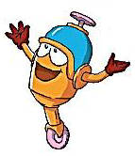
Unit 2 Culture shock
Speaking

Slide 2
目录
Lead-in
1
Pre-Learning
2
While-Learning
3
Post-Learning
4

Slide 3
Part I Lead-in

Slide 4
What is Thanksgiving？
什么是感恩节？
Thanksgiving is a national holiday widely celebrated in North America. In the US, many are taught at school that the First Thanksgiving Dinner was held in 1621 Massachusetts.
Thanksgiving is a national holiday widely celebrated in North America. In the US, many are taught at school that the First Thanksgiving Dinner was held in 1621 Massachusetts.

Slide 5
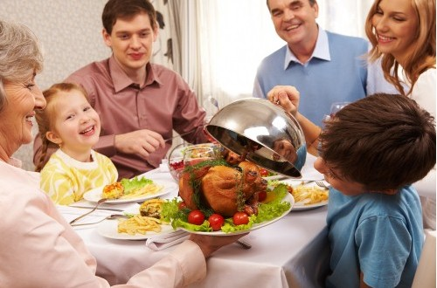
1. When is Thanksgiving?
In the States, Thanksgiving is usually the fourth
Thursday in November. And in many states, the
Friday after Thanksgiving Thursday is also a
holiday. This is called Black Friday. Many people
choose to have a long weekend break, spend time
with their family or shop for Christmas presents on
Black Friday. Many stores offer special discounts.

Slide 6
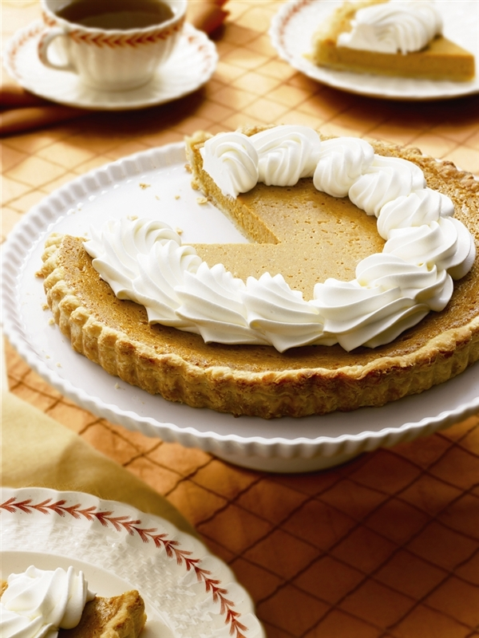
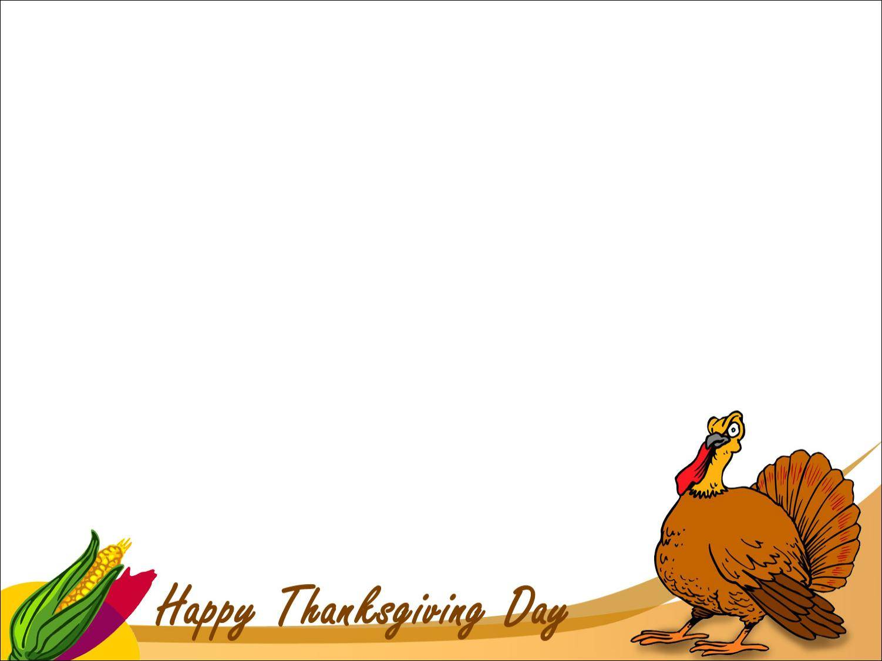
2. What is the most traditional and favorite food on Thanksgiving Day?
Roast turkey and pumpkin pie have been the most traditional and favorite food on Thanksgiving Day throughout the years.

Slide 7
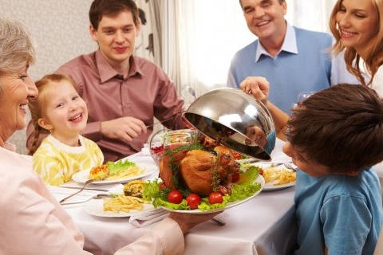
3.What is Thanksgiving Day in America?
Thanksgiving Day in America is a time to offer thanks, of family gatherings and holiday meals. A time of turkeys, stuffing, and pumpkin pie. A time for Indian corn, holiday parades and giant balloons.

Slide 8
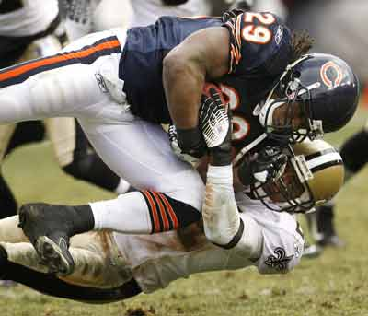
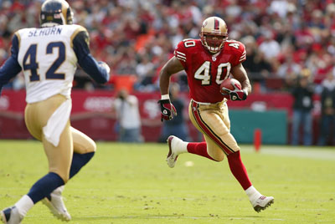
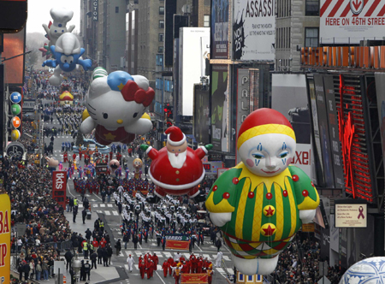
4. Do you know what the traditional celebrations in America are?
Celebration of Thanksgiving Day
Watching NFL football
Thanksgiving Day
Parade

Slide 9
Part II Pre-Learning

Slide 10
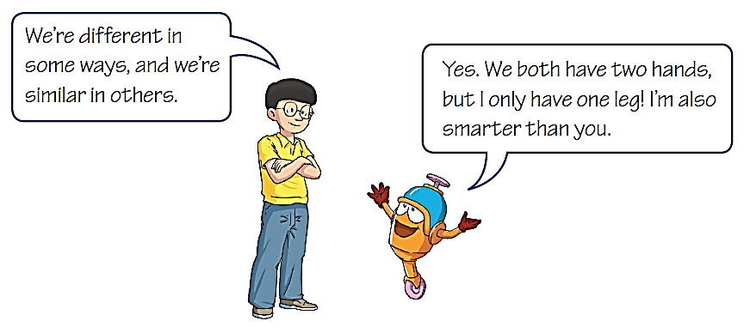


Talk time
Discussing similarities and differences
Look at the cartoon and answer the following question.
They are talking about the similarities and differences between them.

Slide 11
Part III While-Learning

Slide 12
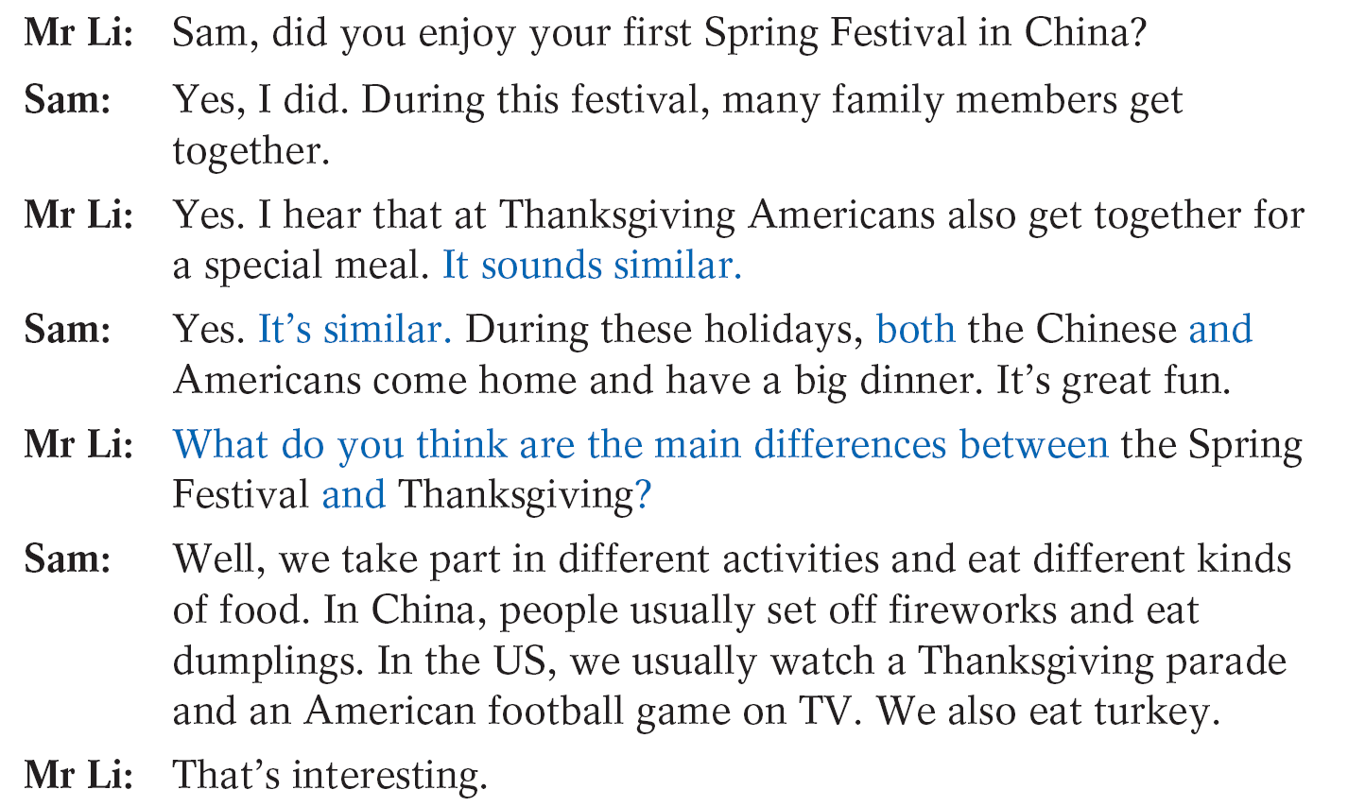
A1 Sam, an exchange student, is discussing festivals in the US and China with his Chinese teacher, Mr Li. Read their conversation and practise it in pairs. Pay attention to the words in blue.

Slide 13


Top tip
I think … is (quite) similar to ...
In my opinion, ... is (nearly/almost) the same as ...
The similarity is ... /The similarities are ...
I think ... is (quite/very/completely) different from ...
In my opinion, the difference is .../the differences
are ...

Slide 14
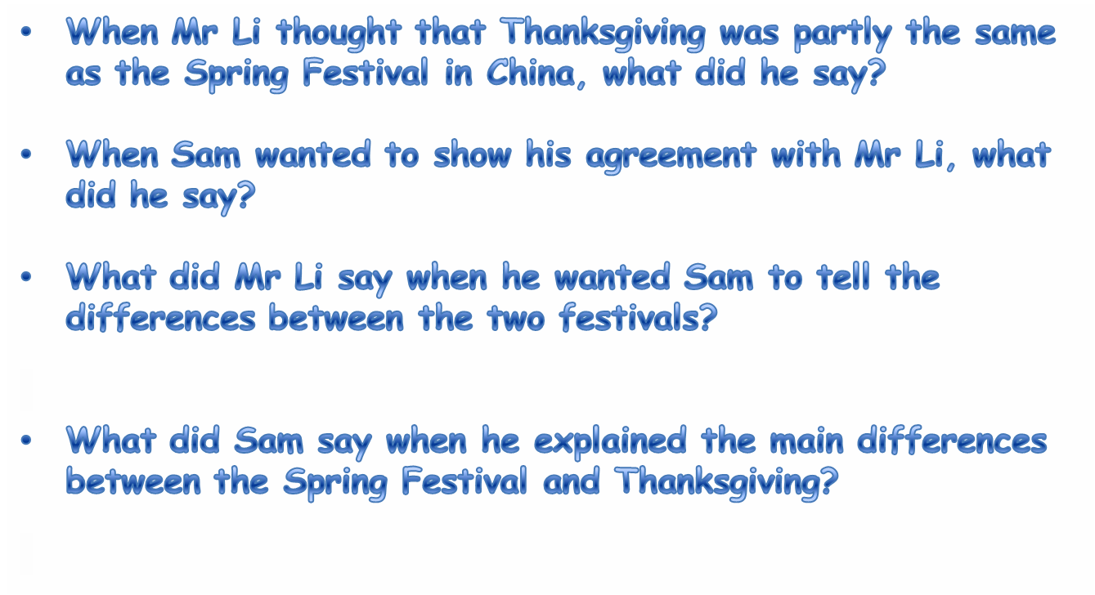
Read their conversation again and answer the following questions.
It sounds similar.
Yes. It’s similar.
What do you think are the main differences between the Spring Festival and Thanksgiving?
Well, we take part in different activities and eat different kinds of food. In China, people usually set off fireworks and eat dumplings. In the US, we usually watch a Thanksgiving parade and an American football game on TV. We also eat turkey.

Slide 15
Keep books closed and talk about
the similarities and differences between Spring Festival and Thanksgiving in pairs.
Spring Festival
Thanksgiving
similarities
1.Eat turkey
2.Watch a Thanksgiving parade
3.Watch an American football game
1.Eat dumplings
2.Set off fireworks
Come home and have a big dinner

Slide 16
A2 In pairs, discuss the similarities and differences between other Chinese and Western festivals.
New Year’s Day 新年
When | on the 1st of January
What to do | have a big lunch, eat a lot of delicious food, go to parties, …
Spring Festival 春节
When | in January or February
What to do | eat a lot of delicious food, visit relatives and friends, play with fireworks, get some red packets, …

Slide 17
Valentine’s Day 情人节
When | on the 14th of February
What to do | Lovers give the candy, the flowers or other gifts to each other, …
Lantern Festival 元宵节
When | on the 15th of the first lunar month
What to do | play with lanterns, eat rice balls, …

Slide 18
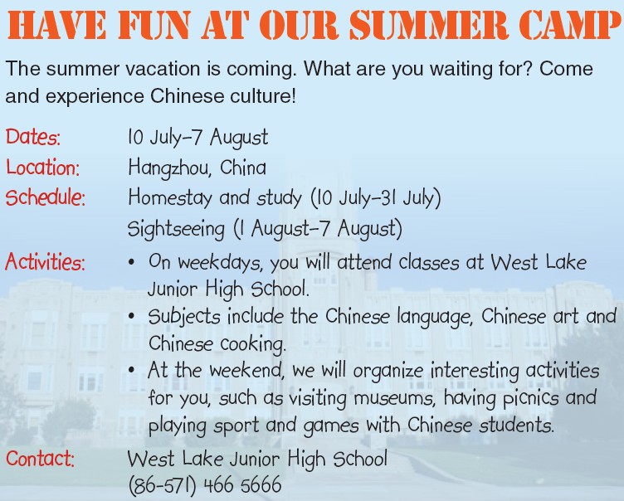
B Speak up
Your American friend wants to take part in a summer camp in China. You find this poster and tell him/her about it. In pairs, ask and answer questions about the summer camp. Use the poster and the questions below to help you.

Slide 19
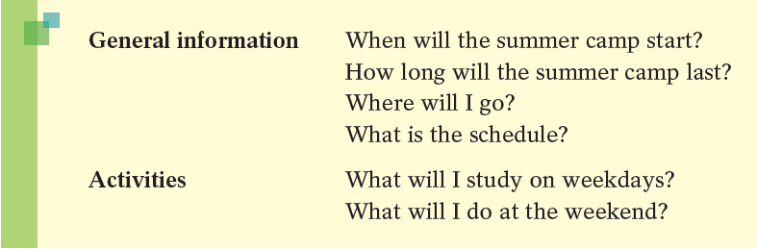
S1: When will the summer camp start?
S2: It’ll start on the 10th of July.
…

Slide 20
S1: When will the summer camp start?
S2: It’ll start on the l0th of July.
S1: How long will the summer camp last?
S2: It’ll last for 28 days.
S1: Where will I go?
S2: You’ll go to Hangzhou.
S1: What is the schedule?
S2: Homestay and study is from the l0th of July to the 31st of
July. And sightseeing is from the 1st of August to the 7th of
August.
S1: What will I study on weekdays?
S2: You’ll study the Chinese language, Chinese art and Chinese
cooking.
S1: What will I do at the weekend?
S2: You’ll visit museums, have picnics and play sport and games
with Chinese students.

Slide 21


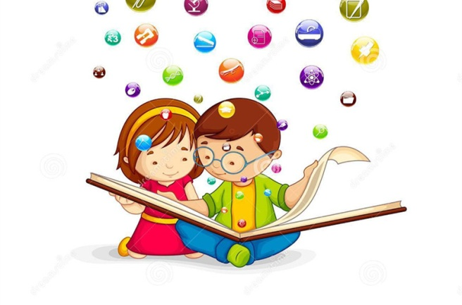
New words
Speaking
vacation n. 假期
schedule n. 日程安排

Slide 22
Part IV Post-Learning

Slide 23
Holidays
Spring Festival | 春节 | Children’s Day | 儿童节
Valentine’s Day | 情人节 | Father’s Day | 父亲节
Lantern Festival | 元宵节 | Dragon Boat Festival | 端午节
Women’s Day | 妇女节 | Mid-Autumn Festival | 中秋节
April Fool’s Day | 愚人节 | Teachers’ Day | 教师节
Easter | 复活节 | National Day | 国庆节
May Day | 劳动节 | Halloween | 万圣节前夕
Mother’s Day | 母亲节 | Thanksgiving Day | 感恩节
 |  | Christmas | 圣诞节

Slide 24
What’s your favourite holiday?
My favourite holiday is .
It’s in/on .
People usually .
I last year.
That’s why I love it.

Slide 25
Thank you!

