Slide 1
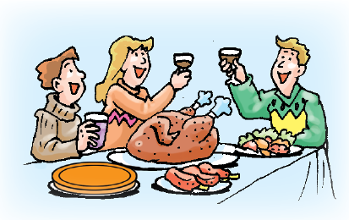
Unit 2 Culture shock
Vocabulary

Slide 2
目录
Words and expressions
1
2
Notes

Slide 3
Part I
Words and expressions

Slide 4
Reading
culture shock n.文化冲击；文化休克 p. 17
camp n. 度假营 p. 17
*firework n. 烟火；烟花 p. 18
*turkey n. 火鸡 p. 18
international adj.国际的 p. 19
admit v.（常指勉强）承认 p. 19
spare adj. 空闲的；空余的 p. 19
degree n. 程度 p. 19
fail v. 失败；未能（做到） p. 19
manage v. 完成（困难的事）；勉力完成 p. 19

Slide 5
Reading
idiom n. 习语；惯用语 p. 19
everyday adj. 每天的；日常的 p. 19
uniform n. 校服 p. 19
whatever pron. 任何事物；一切事物 p. 19
pink adj. 粉红色的 p. 19
purple adj. 紫色的 p. 19
anyway adv. 无论如何；反正 p. 19
especially adv. 尤其；特别 p. 19
baseball n. 棒球运动 p. 19
education n. 有教益的经历 p. 19

Slide 6
Reading
set off 使（炸弹等）爆炸 p. 18
take off 脱下 p. 18
in one’s spare time 在某人的空闲时间里 p. 19
to a certain degree 在某种程度上 p. 19
get used to 习惯于；适应 p. 19
under the weather 略有不适；不得劲 p. 19

Slide 7
Listening
state n. 州 p. 22
national adj. 国家的；民族的；全国的 p. 22
president n. 总统 p. 22
Speaking
vacation n. 假期 p. 27
schedule n. 日程安排 p. 27

Slide 8
Part II Notes

Slide 9

camp n. 度假营
夏令营
他今年夏天在度假营里玩了两个星期。
He spent two weeks at camp this summer.
summer camp

Slide 10
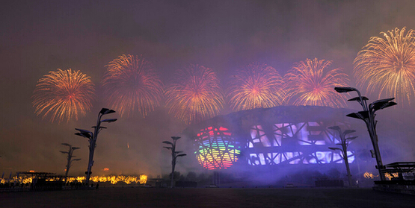
firework n. 烟火；烟花
放烟火
放几个烟火
a firework display
to set off a few fireworks

Slide 11
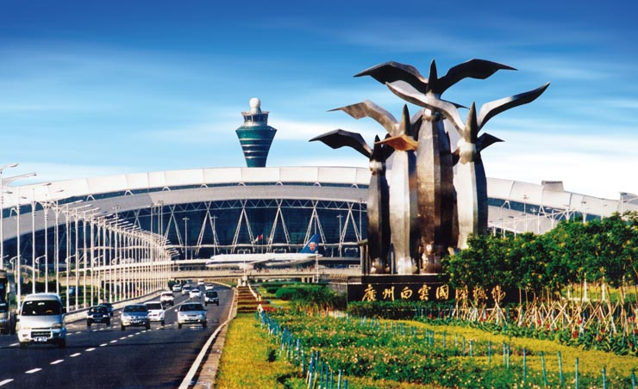
international adj.国际的
国际体育运动
国际机场
international sport
an international airport

Slide 12
admit v.（常指勉强）承认
admit + to sth
不要害怕承认错误。
Don’t be afraid to admit to your mistakes.
admit + to doing sth
她承认对自己的孩子很严厉。
She admits to being strict with her children.

Slide 13
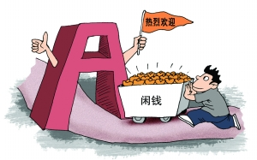
spare adj. 空闲的；空余的
要是愿意你就住下，我们空着一间卧室。
We’ve got a spare bedroom, if you’d like to
stay.
恐怕我手头没有闲钱。
I’m afraid I haven’t got any spare cash.

Slide 14
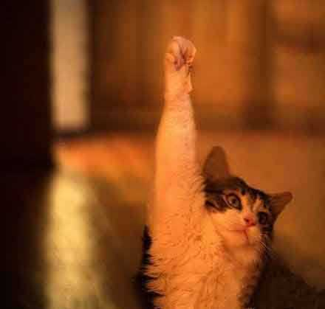
degree n. 程度
我在某种程度上同意你的观点。
I agree with you to a certain degree.
她的工作要求有高超的技能。
Her job demands a high degree of skill.

Slide 15
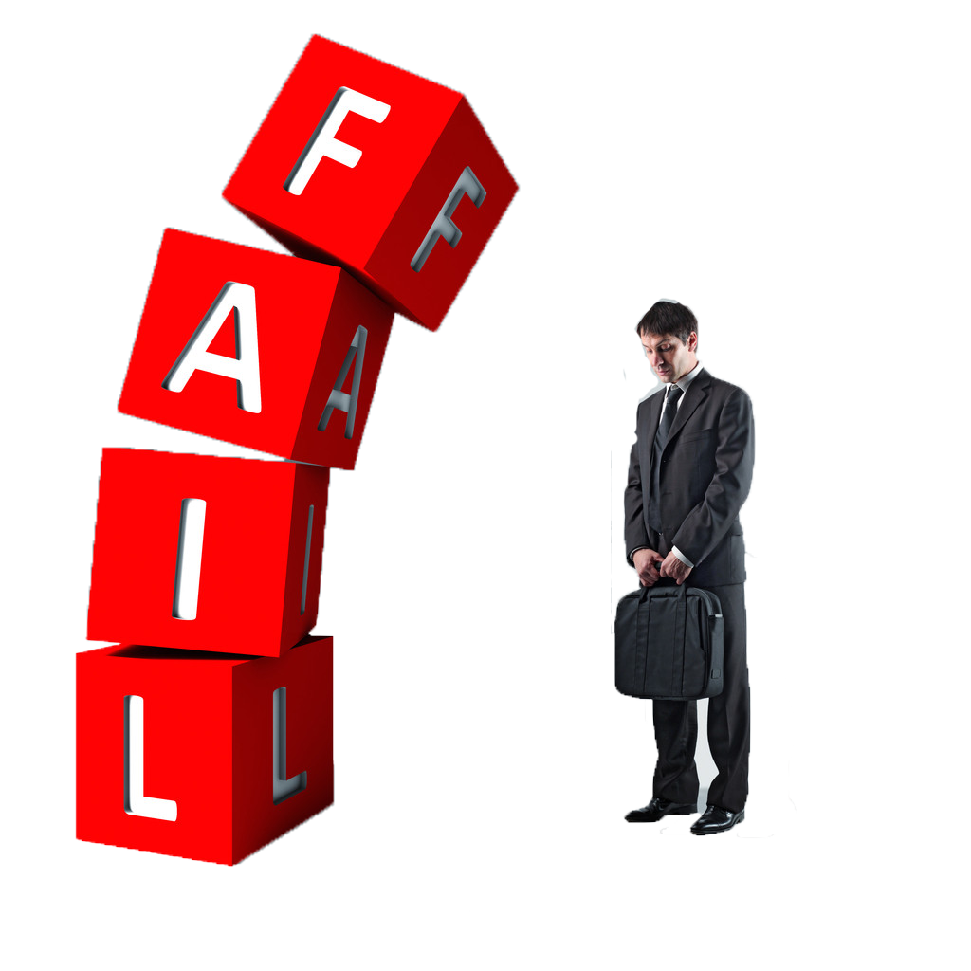
fail v. 失败；未能（做到）
她未能进入艺术学院。
She failed to get into art college.
哪怕失败，我也要试一下。
I will have a try even though I should fail.

Slide 16
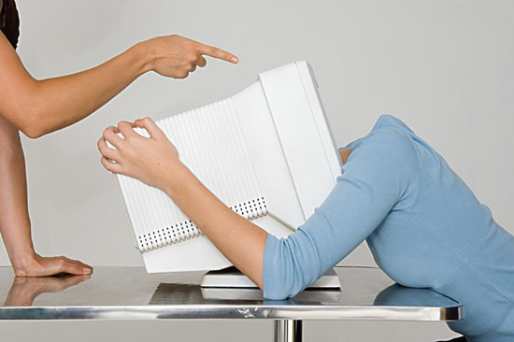
manage v. 完成（困难的事）；勉力完成
你能再吃块蛋糕吗？
Can you manage another piece of cake?
你是怎么说服他的？
How did you manage to persuade him?

Slide 17

idiom n. 习语；惯用语
“让猫从袋子里跑出来”是惯用语，意思是无意
中泄露秘密。
"Let the cat out of the bag" is an idiom
meaning to tell a secret by mistake.

Slide 18

everyday adj. 每天的；日常的
日常用品
互联网已成为日常生活的一部分。
The Internet has become part of everyday life.
everyday objects

Slide 19
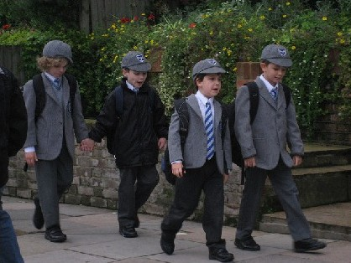
uniform n. 校服
帽子是校服的一部分。
The hat is part of the school uniform.

Slide 20
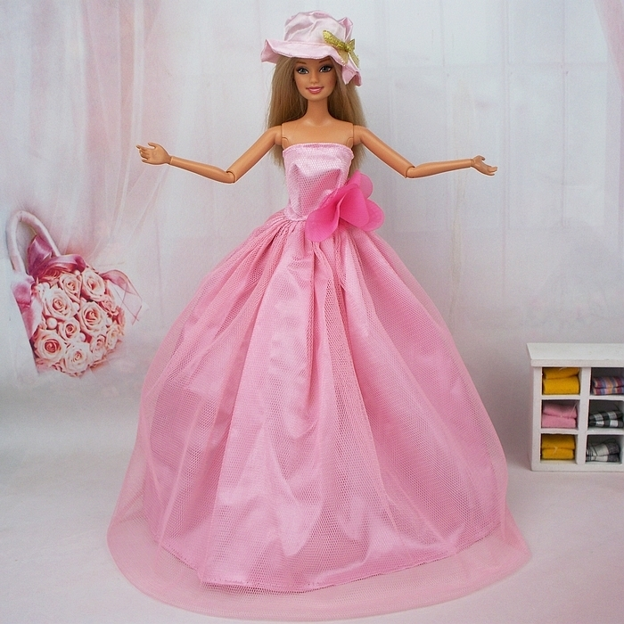
pink adj. 粉红色的
她穿粉红色的衣服很好看。
She looks all right in pink.

Slide 21
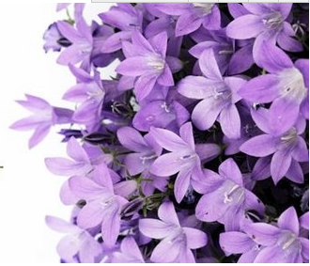
purple adj. 紫色的
老人气得脸都变成紫了。
The old man's face turned purple with rage.

Slide 22
anyway adv. 无论如何；反正
我想我们不一定能成功, 但是不管怎样还是试
试吧。
I don' t think we' ll succeed but let' s try anyway.
whatever pron. 任何事物；一切事物
你不能老是做任何你喜欢的事。
You can't always do whatever you like.

Slide 23
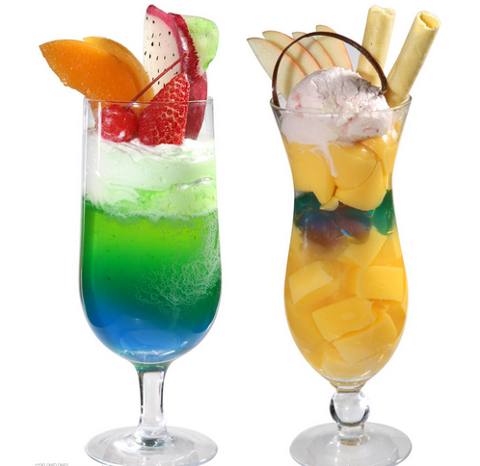
especially adv. 尤其；特别
我很爱喝冷饮，特别是在夏天。
I love cold drinks, especially in summer.

Slide 24
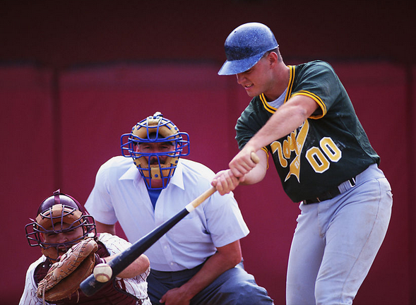
baseball n. 棒球运动
棒球运动很受美国人的欢迎。
Baseball is very popular among Americans.

Slide 25
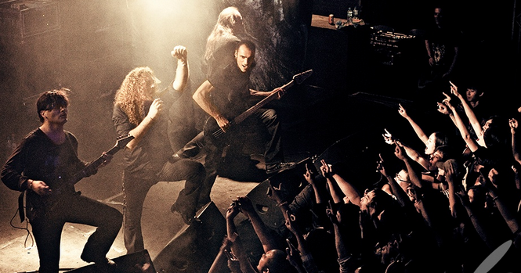
education n. 有教益的经历
这场摇滚乐音乐会真让我父母大受教益。
The rock concert was quite an education for
my parents.

Slide 26
set off 使（炸弹等）爆炸
一帮男孩子正在街上放烟火。
A group of boys were setting off fireworks in the
street.
take off 脱下
他脱下我湿漉漉的鞋子，让我在火炉旁坐下。
He took off my wet shoes and made me sit by the
fire.

Slide 27
in one’s spare time 在某人的空闲时间里
一个人空闲时可以学很多有用的东西。
There are a lot of useful things to learn in one's
spare time.
to a certain degree 在某种程度上
老师在某种程度上同意我的意见。
The teacher agreed with me to a certain degree.

Slide 28
get used to 习惯于；适应
英国食物乍一吃很不习惯, 但不久就能适应了。
The food in England is strange at first but you'll
soon get used to it.
under the weather 略有不适；不得劲
我身体很好，但我的双胞胎弟弟最近有点不舒服。
I’m fine, but my twin brother has been a little
under the weather recently.

Slide 29
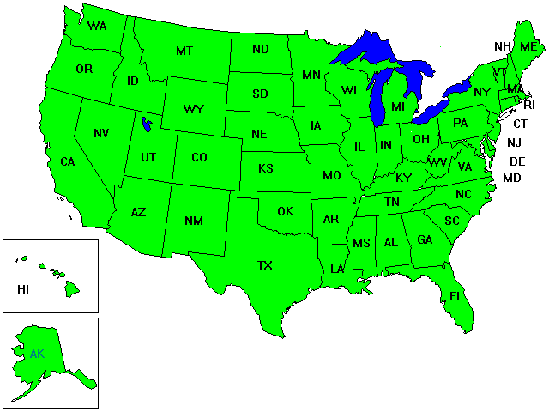
state n. 州
美国每一个州都有一个首府。
Each state of the United States has a capital.

Slide 30
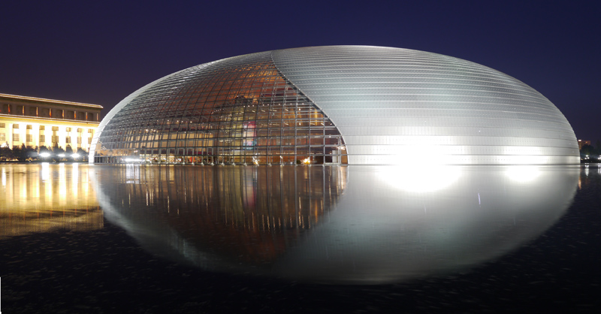
national adj. 国家的；民族的；全国的
一座国家剧院正在北京修建。
A national theatre is being built in Beijing.

Slide 31
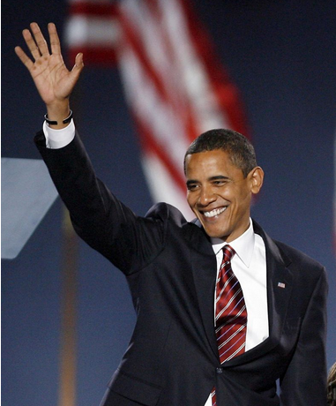
president n. 总统
美国人选举了奥巴马先生任总统。
The Americans chose Mr Obama
as president.

Slide 32
vacation n. 假期
我们今年该去哪里度假？
Where should we go on vacation this year?
schedule n. 日程安排
你明天的日程安排如何?
What's your schedule for tomorrow ?

Slide 33
Thank you!

