Slide 1
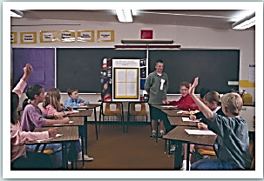
Unit 2 Culture shock
Writing

Slide 2
目录
Review
1
Pre-Learning
2
While-Learning
3
Post-Learning
4

Slide 3
Part I Review

Slide 4
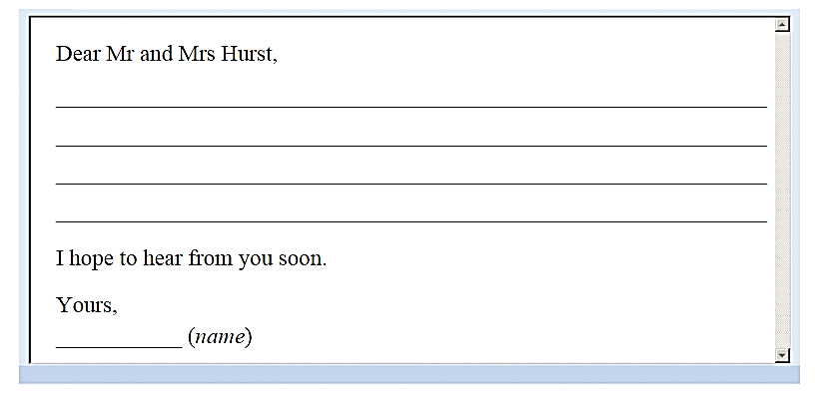

Review the structure of a letter
Read the speech on page 19 again. Imagine you are Brad. Complete a thank-you email to the Hurst family.
Names of your homestay family
Greeting
How are you? /I hope you are well.
Closing
Your name

Slide 5
Part II Pre-Learning

Slide 6
Write the sentences
Think about the contents of your thank-you email. Write the main idea of each paragraph.
what you like best about
the stay
your thanks to the family
what you experienced
during the visit
A thank-you email to the Hurst family
your wish
what you have done since you returned to China
what you miss
about the visit

Slide 7
Write the topic sentence of each paragraph.
your thanks to the family:
Thank you for taking care of me during my stay in the US.
what you like best about the stay:
I had a lot of happy memories with you.
what you experienced during the visit:
I experienced the culture shock during the visit.
what you have done since you returned to China:
I have told my friends about my experience in the US.
what you miss about the visit:
I miss you and the school very much.
your wish:
I would like you to come and visit me in China soon.

Slide 8
Part III While-Learning

Slide 9
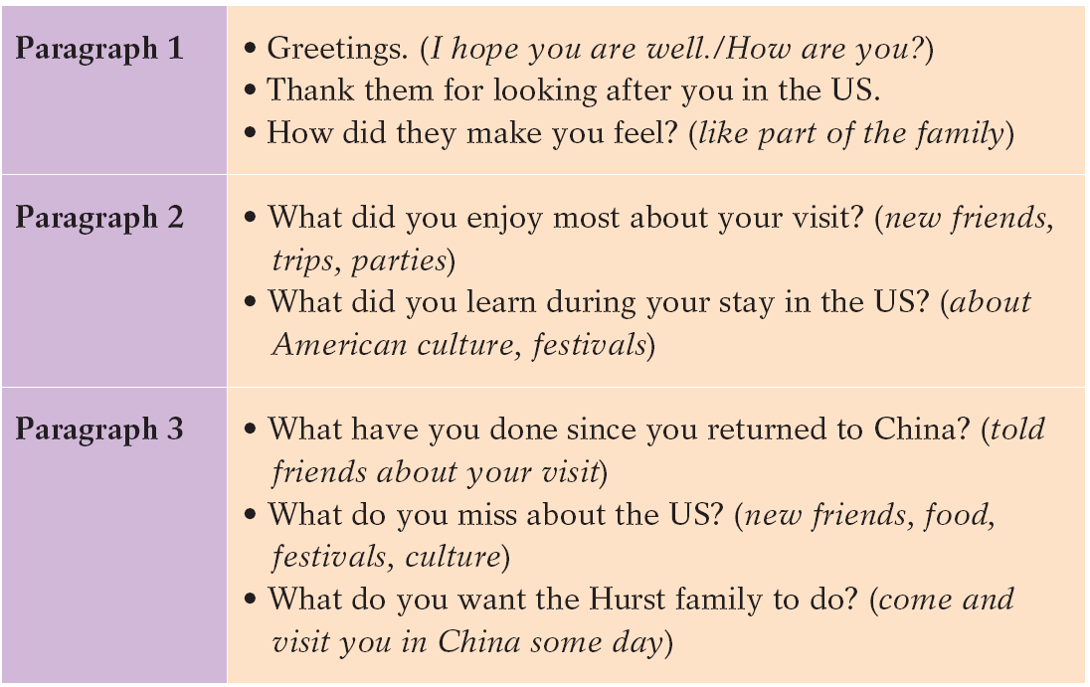
A Read the speech on page 19 again. Imagine you are Brad. Use the following
outline to write a thank-you email to the Hurst family.

Slide 10

In groups, arrange the contents of each paragraph.
Paragraph 1
Thank you for taking care of me during my stay in the US.
Paragraph 2
I had a lot of happy memories with you. I still remember playing in the snow happily in your backyard last winter. … To tell you the truth, I experienced the culture shock during my stay in the US. The language, the food and the school were all quite strange to me. …
Paragraph 3
I have told my friends about my experience in the US since I came back. They were surprised to know that some American students have pink or purple hair. Anyway, I miss you and the school very much. How are my classmates and the teachers in the US? ... I would like you to come and visit me in China soon. I hope to take you to visit some places of interest around my city.

Slide 11
Writing
A thank-you email
B Write the thank-you email according to the outline in A.

Slide 12
Part IV Post-Learning

Slide 13
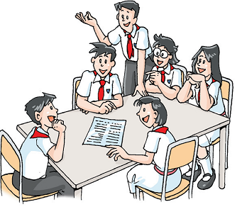
Share your thank-you email with your classmates and improve your email.

Slide 14
Thank you!

