Slide 1


Module 1 Amazing things
Unit
2
Numbers
Grammar

Slide 2
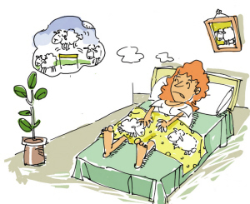
If you can’t fall asleep, what will you do?
Warming-up：
We will count (数数) sheep, such as
one sheep, two sheep, three sheep…
We use cardinal numbers
to _______ things.
count

Slide 3
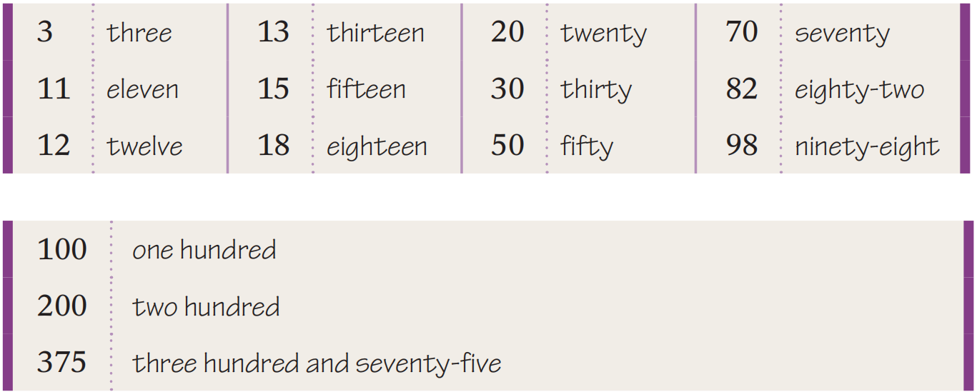
Read the cardinal numbers and find rules
We use cardinal numbers to count things.
“十几 ” teen
“几十” ty
“几十几 ” ty- …
“百位与十位数间用 “and” 连接

Slide 4

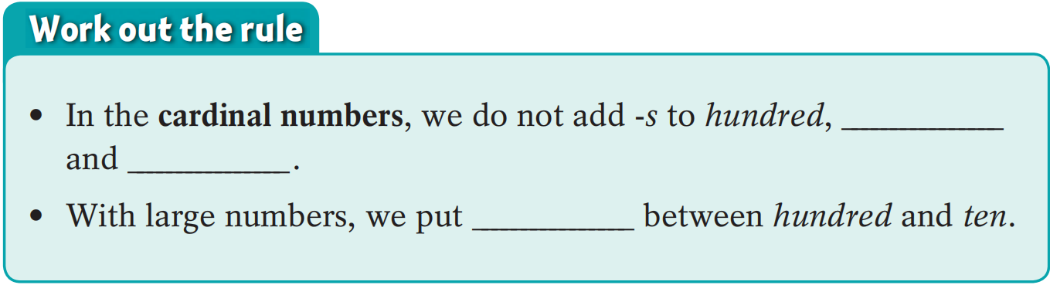
1,000 one thousand
4,189 four thousand one hundred and eighty-nine
15,362 fifteen thousand three hundred and sixty-two
100,000 one hundred thousand
285,643 two hundred and eighty-five thousand
six hundred and forty-three
Read in pairs
Things to remember
hundreds of 成百上千
thousands of 成千上万
millions of 数以万计
thousand
million
and

Slide 5
How to read large numbers
xxx, xxx, xxx, xxx
billion
million
thousand
25,342
twenty-five thousand three hundred and forty-two
2,534,233
two million five hundred and thirty-four thousand two hundred and thirty-three
25,342,330
twenty-five million three hundred and forty-two thousand three hundred and thirty
253,423,300,001 ?
two hundred and fifty-three billion four hundred and twenty-three million three hundred thousand and one

Slide 6
Special Rules
1. 在某些短语中， 基数词要用复数形式。例如：
在某人20 多岁时
在80 年代
in one’s twenties
in the eighties/ 80s

Slide 7
2. use cardinal numbers to show times?
一倍
两倍
三倍
四倍
…
once
twice
three times
four times
…
Some dinosaurs were as big as ten elephants.
=Some dinosaurs were ____ ______bigger than an elephant.
nine times

Slide 8
3. “hundred, thousand, million, billion”前有基数词或several修饰，保持原形。但表不确切数目时，后要接“-s”和“of ”
1. About _____ films were shown during the 15th Shanghai International Film Festival.
A. two hundred of B. two hundreds of
C. two hundred D. two hundreds
2. _____ films were shown during the 15th Shanghai International Film Festival, I’m not sure.
A. Two hundred of B. Two hundreds
C. Hundreds of D. Hundred of
Tips
前有数字，后无s和of
前无数字，后有s和of

Slide 9
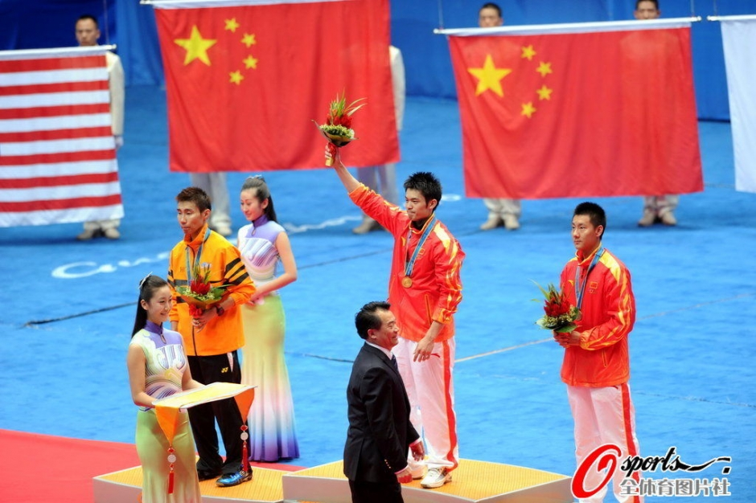
Lin Dan won ___ ____ prize.
Another Chinese won ____ _____ prize.
Ordinal numbers 序数词
order
We use ordinal numbers to show the _______ of things.
the first
the third

Slide 10
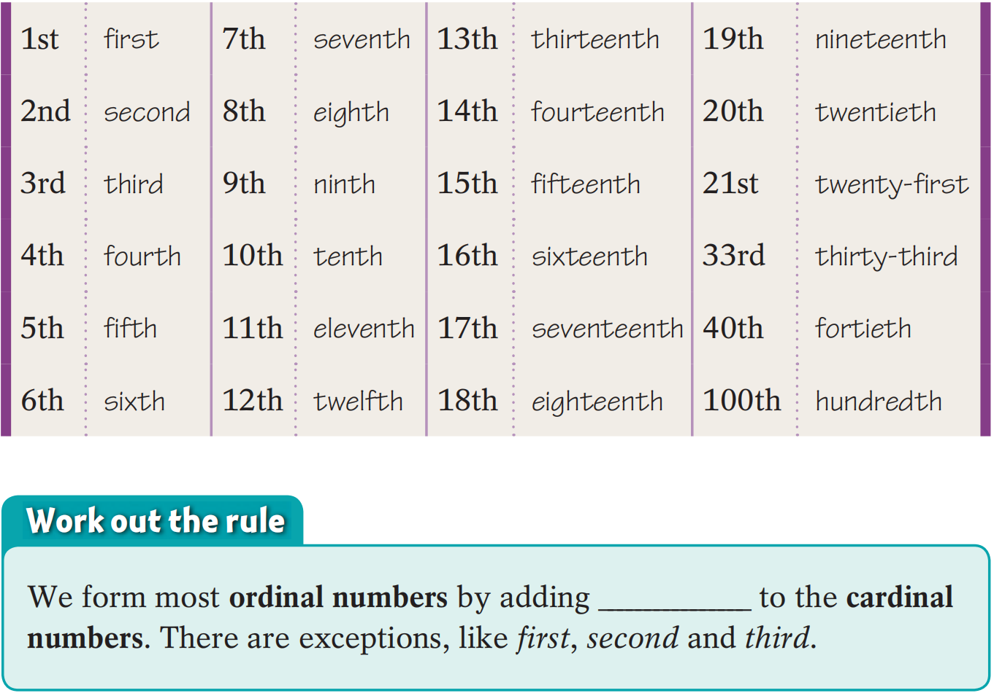
Read the ordinal numbers and find rules
“第几十 ” ty—tieth
_____
____
_____
___
_____
序数词的构成一般是在基数词的后面直接加“th”, 但也有例外.
-th

Slide 11

基础词如何变序数词
基变序，有规律，词尾加上th
一二三，特殊记（first, second,third）
八去t(eighth)，九去e(ninth)
ve要用f替（fifth,twelfth）
整十变y为ie(twentieth)
若遇几十几，只变个位就可以。(twenty-first)

Slide 12
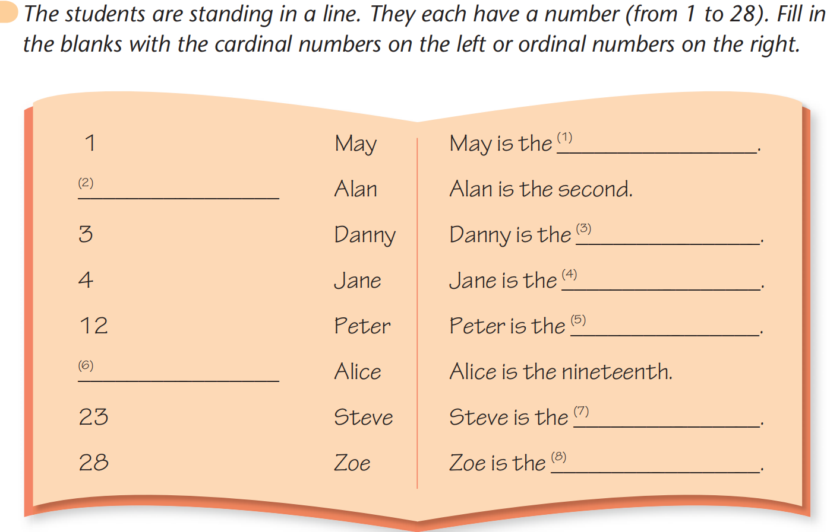
Page 24
first
2
third
fourth
twelfth
19
twenty -third
twenty-eighth

Slide 13
Special Rules
序数词前要加 the ,如果用 a, 则表示 “再一，又一”.
加拿大是世界上第二大国。
Canada is the second largest country in the world.
他们又有一个孩子---一个儿子。
They had a second child---- a son.

Slide 14
编号的表示法：
Lesson One
Lesson Two
Lesson Three
...
the first lesson
the second lesson
the third lesson
…
我住在202房。
I live in __________ 202 .
我住在二楼。
I live on ________________.
Room
the second floor

Slide 15
含数词的复合形容词的构成
“数词+名词(单)”
We’ll have a _____________ holiday.
我们将放9天假。
We wrote an __________________ composition.
我们写了一篇800字的文章。
“数词+名词(单)+形容词”
Mrs. Beet is a _____________ woman.
比特太太是个38岁的妇女。
A _____________ bridge will be built here.
这里将修建一座10米长的桥。
nine-day
eight-hundred-word
38-year-old
ten-meter-long

Slide 16
Practice
1. There are _____ months in a year and the _____ is December.
A. twelve, twelve B. twelve, twelfth
C. twelfth, twelfth D. twelfth, twelve
2. Walt Disney was famous in his _____.
A. twentieth B. twenty C. twenty’s D. twenties
3. The Chinese have ____ National Day holiday.
A. a seven days B. a seven-day
C. seven days D. a seven-days

Slide 17
3.Instructions about numbers
We can use equals or is to express “=”.
3+9=12
9-3=6
3×9=27
9÷3=3
Add 3 and 9.
3 plus 9 equals/is 12.
9 minus 3 equals/is 6.
3 multiplied by 9 equals/is 27.
9 divided by 3 equals/is 3.
/plʌs/
Subtract 3 from 9.
/maɪnəs/
介词
Multiply 3 by 9.
Divide 9 by 3.
Things to remember
Plus and minus are prepositions.

Slide 18
In pairs, complete the sentences.
and
1 S1: A________ 11 ______ 1.
S2: ______ p______ ______ equals/is ______. ( )
2 S1: S________ 5 ______ 13.
S2: ______ m________ ______ equals/is ______. ( )
3 S1: M________ 7 ______ 8.
S2: ____ m________ by ______ equals/is ______. ( )
4 S1: D________ 16 ______ 4.
S2: ______ d________ by ______ equals/is ______. ( )
5 S1: A________ 9 ______ 6.
S2: ______ p________ ______ equals/is ______. ( )
6 S1: A________ 14 and 4 and d______ the answer by 2.
S2: ____ p________ ______ and the answer divided by
______ equals/is ______. ( )
dd
11
lus
1
12
11+1=12
ubtract from
13 inus 5 8 13-5=8
ultiply by
7 ultiplied 8 56 7×8=56
ivid by
16 ivided 4 4 16÷4=4
dd and
9 lus 6 15 9+6=15
dd ivide
14 lus 4
2 9 (14+4)÷2=9

Slide 19
Practice makes perfect!

Slide 20
一、选择题。
1.This is very different from the situation _____ years ago.
A.thousand B. thousands C.thousand of D. thousands of
2. Today is Jack’s birthday.He is _____ years old now.
A.fourteenth B. fourteen C. the fourteenth D. the fourteen
3.—Why must you take a lift?
—Because I live on _____ suefloor. I can't walk to my house.
A. the twenty-three B. the twenty-thirdC. twenty-three D. twenty-third
4. Thirteen _____ seven equals twenty.
A.plus B. divided by C. minus D. multiplied by
5. There are _____ books in his room.
A.three hundred and sixty five B. three hundred and sixty-five
C. three hundreds and sixty five D. three hundreds and sixty-five

Slide 21
二、用正确形式填空。
six
Hello, everyone. I am Amy. I have a big family. There are _________(sixth) people in my family. I study in Grade _________(ninth) in No.9 Middle School. I’m not smart, but I study hard. I have _________ (eighth) lessons every day and I often have lunch after my _________ (five) lesson. Among all the subjects,I like English best.Once I got the_________ (two) prize in an English competition.
How time flies! Next Friday is my_________ (twelve) birthday. My parents will hold a party for me. I will invite some friends to my home. I think we will have a good time. My flat is on the ___________ (twenty-nine) floor so we can enjoy the beautiful stars on a clear night.
Nine
eight
fifth
second
twelfth
twenty-ninth

Slide 22
Summary
In this class, we have learned
how to read cardinal numbers.
how to write and use ordinal numbers.
how to give instructions about numbers.

Slide 23



Self-assessment
How well do you know about this lesson? Tick the boxes.
① I can use cardinal numbers correctly. 口 口 口
② I can use ordinal numbers correctly. 口 口 口
③ I can understand instructions about numbers correctly. 口 口 口

Slide 24






“双减”背景下，作业如何合理分层
Notes:
单击“同步练习题”字样，即可打开本课时同步练习题的Word文档。

Slide 25

⭐可参考作业布置如下：
Homework
Samples:
书面作业（可选） | 创新探究性作业（可选）
1.完成《双语报》N2版Grammar跟踪练习。 | 1.小组合作，用思维导图将本节课不定式的用法总结出来，比比哪一组做得最好。
2.完成《双语报》N4版第四课时Grammar练习。 | 2.整理错题本，将仍存在疑惑的地方以及易错点记入错题本。
3.完成《阳光学业评价》Grammar部分练习。 | 3.结对练习，一方写出数字，另一方英语读数，比比谁更棒。

Slide 26


