Slide 1
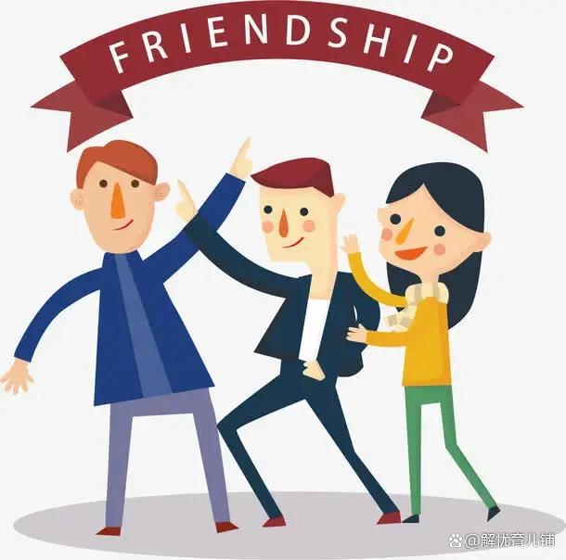
Unit 1 Making friends
Listening

Slide 2

Part I Lead-in
Work in groups, discuss the following questions and then share your answers with the whole class.

Slide 3
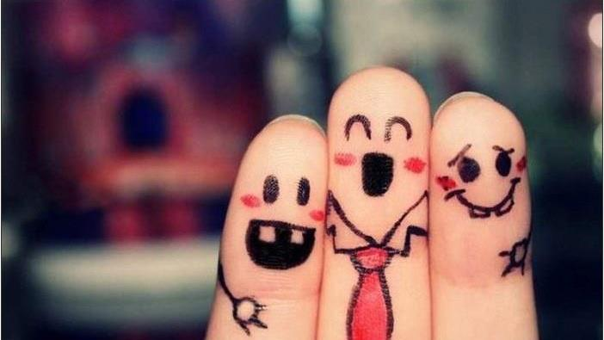
Q1. What kind of friend do you like to have?
A: fair-weather friends
B: true friends

Slide 4
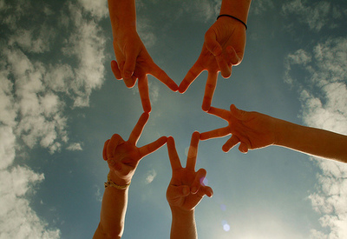
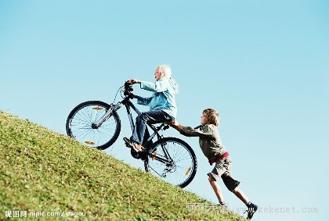
A fair- weather friend is a friend who is only around in good times but not in times of trouble.
A true friend is a person who can share your joys and sorrows with you in any place and at any time.
A friend in need is a friend indeed .

Slide 5
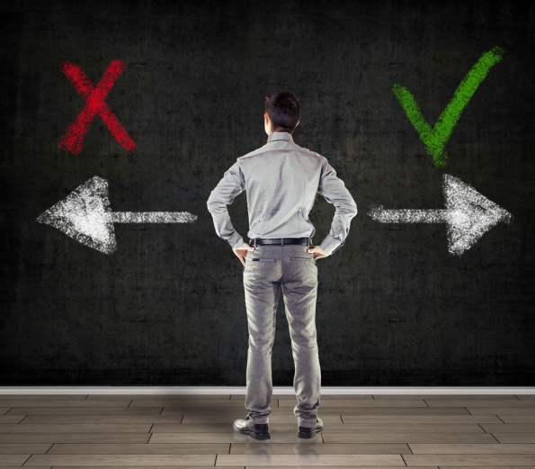
Q2. Should students make friends online? Why?
easily cheated
untrue
same interst
speak out our mind freely

Slide 6
Ask your classmate some questions to know something about his / her e-friend.
look like
age
hobby
what
how old
what
introduction
family member
country
where
how many
name
home
dream
what
where
what

Slide 7
Part II Pre-Listening
An e-friend
Jason is asking Mandy about her e-friend. Listen to their conversation and complete the notes below. Write one word or figure in each blank.
Top tip
When you listen to a conversation, you need to pay
attention to the Wh-questions. You should then listen
carefully for the answers.

Slide 8
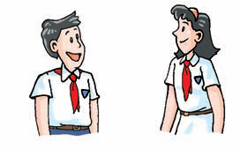
Mandy's e-friend
Name: Yuki
Country: Japan
Age: (1)_________
What she looks like: short, thin; (2)_____ hair
Hobby: drawing (3)_______
Brothers and sisters: one elder (4)_______
Home: a (5)_______ flat in Tokyo
Dream: to be an (6)_______ teacher
观察信息卡中所缺的内容并预测Jason可能会用哪些特殊疑问词提问。
how old
what
what
how many
where
what

Slide 9

Part III While-Listening
Jason is asking Mandy about her e-friend. Listen to their conversation and complete the notes below. Write one word or figure in each blank.

Slide 10
Mandy's e-friend
Name: Yuki
Country: Japan
Age: (1)_________
What she looks like: short, thin; (2)_____ hair
Hobby: drawing (3)_______
Brothers and sisters: one elder (4)_______
Home: a (5)_______ flat in Tokyo
Dream: to be an (6)_______ teacher
12 / twelve
long
pictures
sister
small
Art

Slide 11
短 语 收 藏 夹（Listening）
listen to 听……
pay attention to 注意
look like 看起来像

Slide 12
Notes (Listening)
look like “看起来像…”像（外貌），回答就应说出某人长相的特征。
他长得什么样子？
What does he look like?
他又高又瘦。
He is tall and thin.
be like “像”，“像……一样”。像（性格，行为）
他怎么样？
What's he like?
他很友善。
He is friendly.

Slide 13
选择最佳答案填空。
( )1. What does that cloud ______?
A. like B. look
C. look like D. looks like
( )2. --What is Mike like? --______.
A. He is tall and thin B. He is friendly
C. He likes apples D. He is a student
C
B

Slide 14
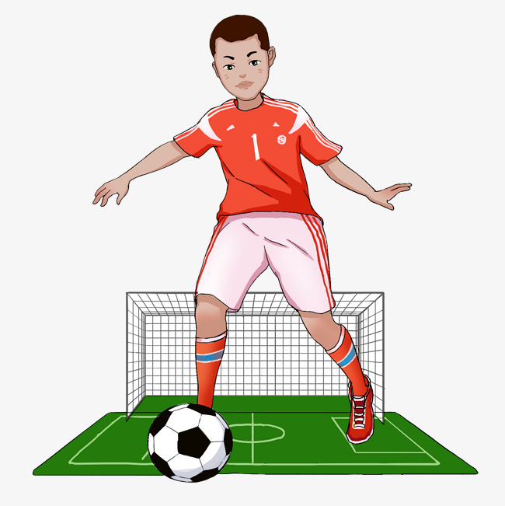
根据中文意思完成句子。
1. 我哥哥的爱好是踢足球。
My ____ _______ hobby is playing football.
2. 陈先生以前住在日本的一所公寓里。
Mr Chen lived in a _____ in _____ before.
3. 你的网友长什么样子？
What _____ your _______ _____ _____?
elder brother's
flat Japan
does e-friend look like

Slide 15
Part IV Post-Listening
Tapescript
Jason: Who's your e-friend, Mandy?
Mandy: Her name's Yuki. She's from Japan.
Jason: How old is she?
Mandy: She's 12.
Jason: What does she look like?
Mandy: She's short and thin. She has long hair.

Slide 16
Part IV Post-Listening
Tapescript
Jason: What's her hobby?
Mandy: She likes drawing pictures.
Jason: How many brothers and sisters does she have?
Mandy: She has one elder sister.
Jason: Where does she live?
Mandy: She lives in a small flat in Tokyo.
Jason: What's her dream?
Mandy: She wants to be an Art teacher.

Slide 17
Dictation
Part V Review
Japan
日本
公寓
听……
注意
看起来像
flat
listen to
pay attention to
look like

Slide 18
Exercises
Hello, everyone. _________ to my blog.
My name is Anna. I'm from _________. I'm 11 years old. I'm tall and ________. I have
long _______. I live with my ________ in a house close to some ________. My mum is
an _______ teacher. My dad is a _______.
Welcome
Germany
thin
hair
family
mountains
Art
doctor

Slide 19
I have an elder sister and an elder _______. Every day, I go to school by school ______. My _________ subjects are Maths, Art and _______. I like my school ________ the teachers are all very _______. My ______ is to be an engineer. I like many _______. I'm good at _________ and playing basketball. These are my favourite ________.
I want to make _______ with young people from all over the _______! Email me, please!
brother
bus
favourite
Science
because
friendly
dream
sports
swimming
hobbies
friends
world

Slide 20
Thank you!

