Slide 1
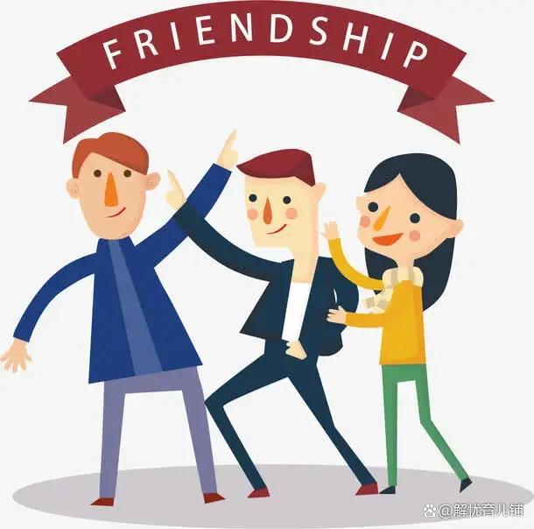
Unit 1 Making friends
More practice
Study skill
Culture corner

Slide 2
Part I Lead-in
假设你是Li Hua，根据以下信息，写一封电子邮件给你的e-friend Mary。
Name: Li Hua
Age: 12
School: No.1 Middle School
Country: China
Family member: father, mother, an elder sister, a younger brother
Parents' job: father-engineer, mother-nurse
Hobby: playing basketball

Slide 3

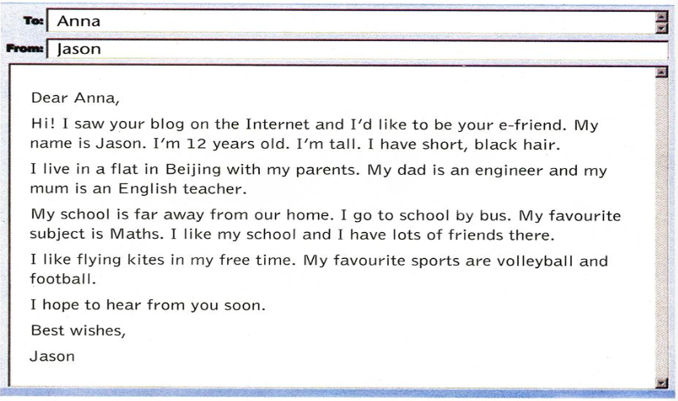
Part II More practice

Slide 4
Read the following email from Jason to Anna. Fill in the table with information about Jason and yourself.
 | Jason | Me
Age
Hair
Favourite subject(s)
Favourite sports
Other hobby/hobbies
12
short, black
Maths
volleyball, football
flying kites

Slide 5
Answer the questions according to the email.
1. How old is Jason?
2. Where does Jason live?
3. What is Jason's dad?
4. How does Jason go to school?
5. What are Jason's favourite sports?
He is 12 years old.
He lives in a flat in Beijing.
He is an engineer.
He goes to school by bus.
Volleyball and football.

Slide 6
短 语 收 藏 夹（More practice）
1. on the Internet 在网上
2. 'd like to 愿意，想要
3. far away from 远离
4. go to school 去上学
5. by bus 坐公交车
6. lots of 许多
7. fly kites 放风筝
8. in my free time 在我的空闲时间
9. hear from 收到来信

Slide 7
Match the phrases with their Chinese meaning.
on the Internet
be far away from
lots of friends
fly kites
in my free time
hope to do
hear from somebody
希望做某事
在我的业余时间
听到某人的信
在互联网上
远离
许多朋友
放风筝

Slide 8
Notes (More practice)
I like my school and I have lots of friends there.
我喜欢我的学校，在那里我有很多朋友。
lots of = a lot of，许多，后加可数名词复数和不可数名词。
张明有很多爱好。
Zhang Ming has lots of / a lot of hobbies.
我每天都花很多时间在我的学习上。
I spent lots of / a lot of time on my study every day.

Slide 9
Notes (More practice)
【辨析】 lots of / a lot of 与 a lot
◆lots of / a lot of 修饰复数可数名词时，相当于many；其修饰不可数名词时，相当于much。
◆a lot是副词词组，不能修饰名词，意为“大量;非常”。

Slide 10

请选用 lots of, a lot of, a lot, many 或 much 填空，可以一空多填。
1. Today, Ben has ___________________ homework to do.
2. Are there _____________________ books in the library?
3. Now _____________________ people would like to travel to other countries for holidays.
4. I don't have _______________ time to talk with you.
5. Babies often sleep _______________.
lots of / a lot of / much
lots of / a lot of / many
lots of / a lot of / many
much
a lot

Slide 11
I like flying kites in my free time.
闲暇时间我喜欢放风筝。
like 意为“喜欢”，后面可以接动词ing形式和动词不定式（to do）
like doing sth和like to do sth，意为“喜欢做某事”。一般况下，两个句型可以通用。如：
哈里周末喜欢待在家里。
Harry likes staying at home at weekends. = Harry likes to stay at home at weekends.

Slide 12
选择最佳答案填空。
( )1. My grandparents like ____ for a walk after supper.
A. go B. goes C. going D. to going
根据中文意思完成句子。
2. 现在越来越多的人喜欢旅游。
Now more and more people _____ _____ _____.
C
like to travel

Slide 13
Interview
Interview two classmates and write down their information.
 | Student 1 | Student 2
Age
Hair
Favourite subject(s)
Favourite sports
Other hobby/hobbies

Slide 14

Practice: How to describe a person?
name
age
height
hair length and colour
eye colour
hobby
family (family members)

Slide 15
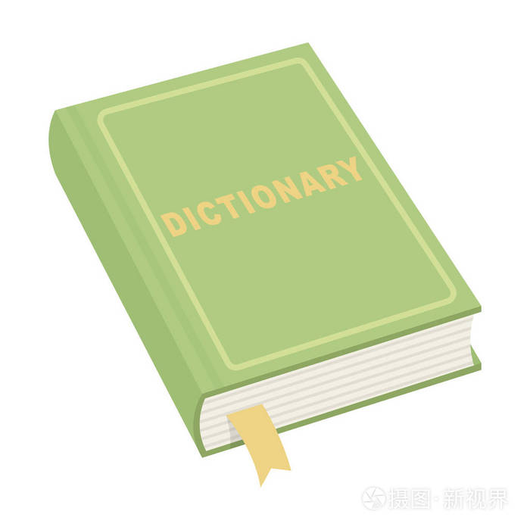
一.选择最佳答案填空。
( )1. Kate likes playing ____ piano, but she doesn't like ____ basketball.
A. /, the B. the, the C. /, / D. the, /
( )2. Guangzhou is ____ city in Guangdong province.
A. a B. the C. / D. an
( )3. --____are you looking for?
-- My dictionary.
A. Who B. What C. Which D. Whose
D
A
B

Slide 16
一.选择最佳答案填空。
( )4. I don't know ____ to learn English well.
A. what B. who C. which D. how
( )5. --Tomorrow is Saturday. Would you like ____?
--Good idea.
A. go shop B. go shopping
C. go to shopping D. to go shopping
D
D

Slide 17

二. 根据中文意思完成句子。
1. 她的新同学来自日本。
Her new classmate ________ ______ ______.
2. 我的家乡离学校很远。
My hometown is_____ _____ _____ school.
3. 我上周收到了一位老朋友的来信。
I _____ _____ an old friend last week.
4. 谢先生有许多书。
Mr Xie has_____ _____ books.
is / comes from Japan
far away from
heard from
lots of

Slide 18
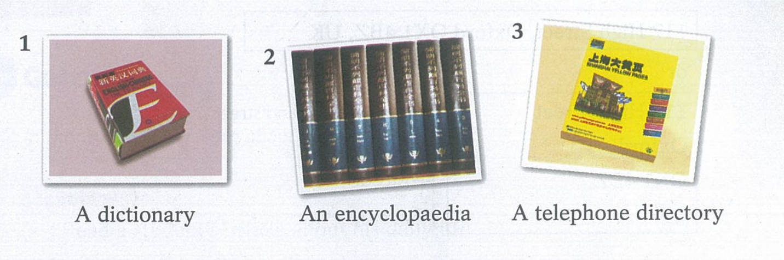
Part III Study skills
Using reference books(1): Alphabetical order
Below are some reference books.

Slide 19
In reference books, words and names are usually in alphabetical order, i.e. from a to z.
A Put these words in alphabetical order.
blog subject draw family vegetable
blog draw family subject vegetable
_________________________________________________

Slide 20
B Put these words in alphabetical order. Then complete the rule.
sport student science Sunday swimming
science sport student Sunday swimming
________________________________________________
second
If words have the same first letter, the _______ letter decides the alphabetical.

Slide 21
C Put these words in alphabetical order. Then complete the rule.
strong still study start story
still study story strong start
_________________________________________________
If words have the same first two letter, the _______ letter decides the alphabetical.
third

Slide 22
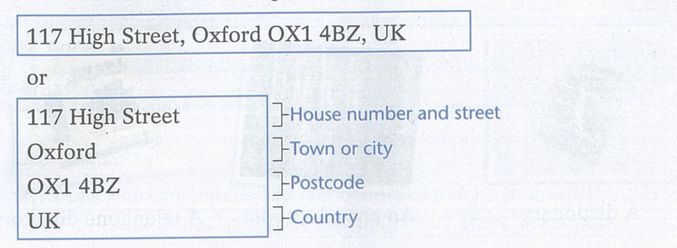
Part IV Culture corner
Addresses in English
We write addresses in English like this:

Slide 23
How do you write your address in Chinese and in English?
My address in Chinese
My address in English

Slide 24
Thank you!

