Slide 1
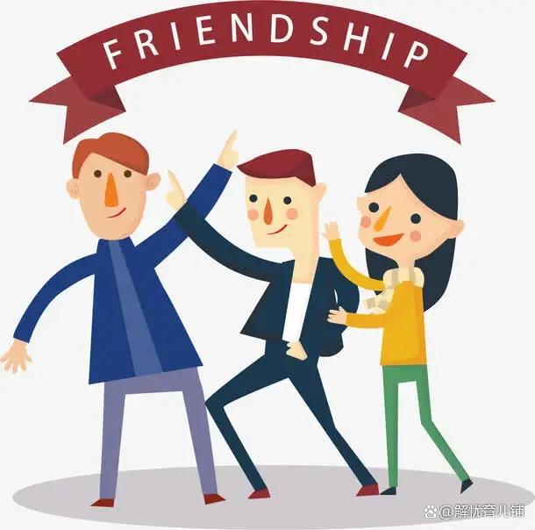
Unit 1 Making friends
Writing

Slide 2
Part I Review
Introduce yourself from the following aspects.
school
parents' jobs
country
introduction
age
height
weight
hair length
favourite
hobbies

Slide 3
Part II Pre-Learning
Notes (Writing)
US n. 美国
是the United State简称 ，解释为联邦。
美国的其它称呼：
1. America 通俗的用法
2. the United States of America美利坚合众国，美国的全称
3. USA 美利坚合众国的简称
4. Uncle Sam 山姆大叔

Slide 4
I'd like to be your e-friend. 我想成为你的网友。
◆would like 常用于口语中，没有人称和数的变化，其后接动词时，必须用动词不定式（to do）形式，即would like to do ... ，缩写形式为 'd like to do ...，意为“愿意做……；想要做……”，可与want to do ... 互换使用。如：
他想和他的父母一起去旅游。
He would like to go travelling with his parents.
= He wants to go travelling with his parents.

Slide 5
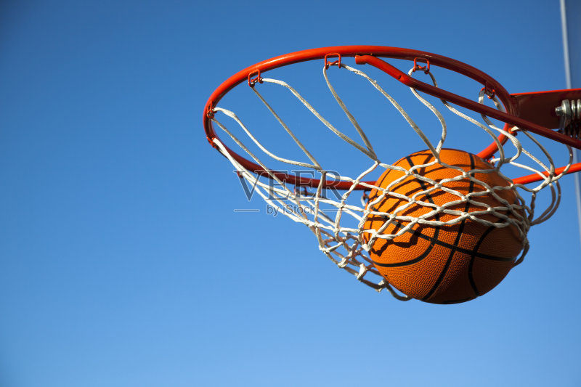
◆ 否定形式：would not / wouldn't like to do ...。如：
他不想和他的父母一起去旅游。
He wouldn't like to go travelling with his parents.
◆疑问形式：Would + 主语+ like to do ...?
肯定回答：Yes, I'd like / love to；
否定回答：I'd like / love to, but ...。如：
放学后你想打篮球吗？
-- Would you like to play basketball after school?
是的，我想去。（肯定回答）
-- Yes, I'd like / love to.
我想去，但我必须先完成我的作业。（否定回答）
-- I'd like / love to, but I must finish my homework first.

Slide 6
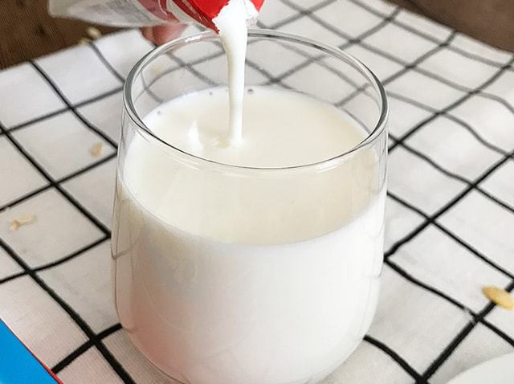
【拓展】由would like 构成的一般疑问句表示“请求”，此时若句中有some 或something，则不需要改为any或anything。如：
早餐你想喝点牛奶吗？
--
你想吃点什么吗？
--
-- 好，请给我来点儿。（肯定回答）
--
不，谢谢。（否定回答）
--
Would you like some milk for breakfast?
Would you like something to eat?
Yes, please.
No, thanks.

Slide 7
根据中文意思完成句子。
1. 我不愿意和那个顽皮的男孩一起踢足球。
I ________ _____ ___ _____ football with the naughty boy.
2. -- 你想来点面条吗？
-- 好，请给我来点儿。
-- Would you like _____ noodles?
-- Yes, ______.
同义句转换。
3. We want to have beef for supper tonight.
We ______ _____ ____ _____ beef for supper tonight.
wouldn't like to play
some
please
would like to have

Slide 8
My other hobbies are watching ... and reading books.
我其他的爱好是看……和读书。
other 在此句中是形容词，意为“其他的；别的”，常修饰复数可数名词或不可数
名词。如果其前面有any 或no 等词时，也可以修饰单数可数名词。如：
我爸爸经常帮助其他人。
My father often helps other people.
她没有别的姐妹。She has no other sister.

Slide 9
根据中文意思完成句子。
1. 她的其他同学都没有来。
Her _____ _________ didn't come.
2. 我朋友有一些别的事情要做。
My friend has _____ _____ _____ to do.
3. 世界上还有很多其他有趣的地方值得去看看。
There are many _____ ________ _______ in the world, and they are worthy of visiting.
other classmates
some other things
other interesting places

Slide 10
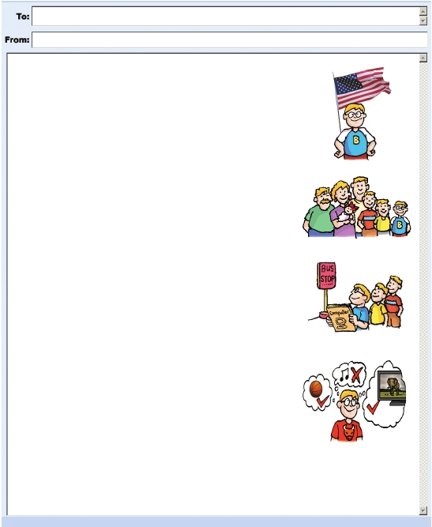
Anna
Bobby
How to introduce yourself
Part III While-Learning
Dear Anna,
My name is Bobby. I’d like to be your e-friend. I’m from the US . I’m short. I have(1)_________________ hair.
I have a big family. My grandfather lives with us. I have two (2)__________________________ and one (3)__________________________.
We live in a house near New York City.
short
About yourself
(elder) brothers
(younger) sister
About your family

Slide 11
Anna
Bobby
How to introduce yourself
Part III While-Learning
My school is very big. It’s far from our house. I take the (4)_________________ to
school every day with my brothers. I like my school. My (5)_________________ is
to be a computer engineer.
bus
dream
About your school and dream

Slide 12
Anna
Bobby
How to introduce yourself
Part III While-Learning
(playing) basketball
My favourite sport is (6)____________________. I like swimming too.
My other hobbies are watching (7)_________________ and reading
books. I don’t like (8)______________________.
Best wishes,
Bobby
TV
(listening to) music
About your hobbies

Slide 13
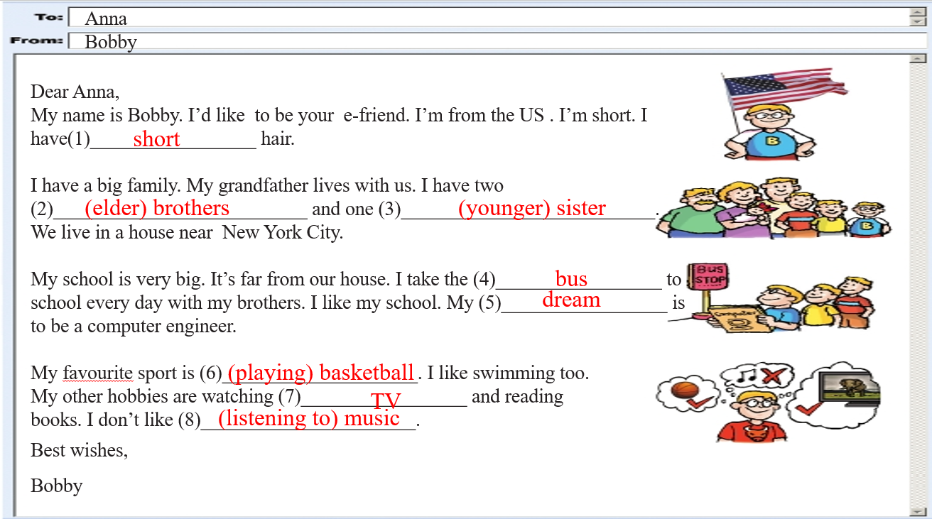
To 后面填的是收件人
邮件格式
From后面填的是发件人
称呼：Dear
邮件主体部分
常用结语：Love/ Best wishes/ Yours/ Your friend
邮件末要署名

Slide 14
Part IV Post-Learning
假设你是李华，你最近新结识了一个外国笔友Peter。请你从以下几个方面向Peter介绍自己。不少于70词。
1. About yourself
2. About your family and home
3. About your school and dream
4. About your hobbies

Slide 15
To: _________
From: _________
Dear ...,
__________________________________________
__________________________________________
__________________________________________
__________________________________________
Best wishes,
_________

Slide 16
参考范文
To: Peter
From: Li Hua
Dear Peter,
Hi. My name is Li Hua. Do you want to know more about me? Well, I am 13 years old. I’m from Guangzhou. I have long hair and I wear glasses.
I live with my parents in a house near my school. I have a big family. I have two elder brothers and one younger sister.

Slide 17
参考范文
I’m in Grade 7. My favourite subject is Chinese. My dream is to be a Chinese teacher when I grow up.
I like listening to music in my free time. I am good at swimming.
I want to make friends with people from all over the world. Please email me.
Best wishes,
Li Hua

Slide 18
Thank you!

