Slide 1



Unit 3 性格、品质与行为
话题写作

Slide 2
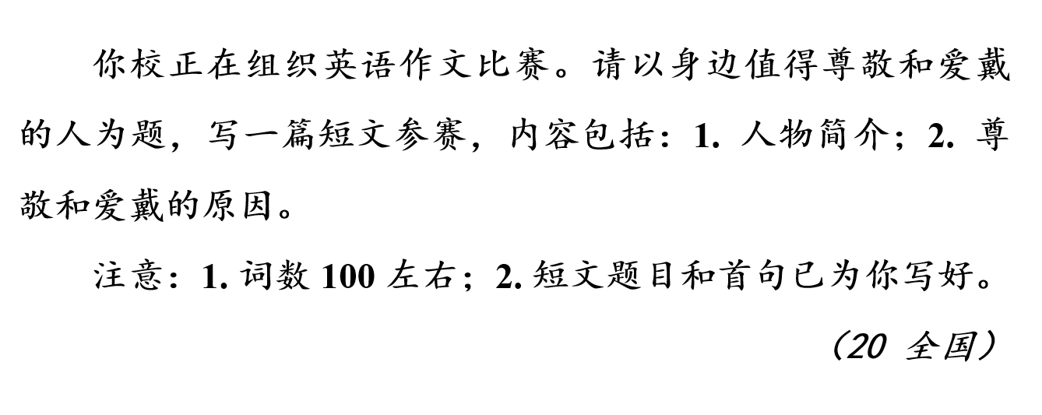
写作提纲
要点一：人物简介（书写对象、人物形象、人物品质）
要点二：尊敬和爱戴的原因（人物事迹、对“我”的影响）

Slide 3
参考词块
1. 以……为傲
be proud of
take pride in
2. 对某人严格
be strict with sb
3. 培养良好的品格
develop one’s character
build character
4. 责任感
a sense of responsibility

Slide 4
参考词块
5. 不依赖某人
be independent of sb
6. 人格魅力
a charming personality
7. 有原则的人
有智慧的人
意志坚定的人
多才多艺的人
a man of principle
a man of wisdom
a man of great determination
a man of many talents

Slide 5
【拓展】性格、品质与行为描写——高级表达
down-to-earth 务实的
conservative personalities 保守的性格
with the virtue of ... 具有……的美德
be armed / equipped with keen insight into ... 对……有敏锐的洞察力
an easy person to deal with 容易相处的人

Slide 6
【拓展】性格、品质与行为描写——高级表达
a good-humored / good-natured person 脾气好 / 和蔼可亲的人
a confident and self-possessed public speaker 自信、镇定的演说家
a scientist bent on making a discovery 专注于探索的科学家
a smooth-spoken man 能说会道的人
a well-informed man 消息灵通 / 见多识广的人

Slide 7
【拓展】性格、品质与行为描写——高级表达
a man of upright character 品格正直的人
an outspoken man 说话直率的人
a quick thinker 思维敏捷的人
a nosy neighbor 爱管闲事的邻居
a courageous individual 勇敢的人
a man of few words 少言寡语的人
a sharp eye / mind 目光敏锐 / 头脑灵活
a homebody 宅男 / 女（喜欢待在家里的人）

Slide 8
实用句式
1. 说到我最尊敬的人，我那热心肠的祖母立刻浮现在我的脑海里。
说到 ……
When it comes to the person I respect most, my warm-hearted grandmother immediately springs to mind.
突然想到/记起(同义表达：cross sb’s mind, flash through sb’s mind, ...come to sb, ...occur to sb)

Slide 9
实用句式
2. 有许多令人钦佩的人，他们身上都有自信、智慧、力量和勇气等特点。
who 引导的定语从句
there be句型
There are many admirable people who display the characteristics like confidence, wisdom, strength and courage.

Slide 10
实用句式
3. 不管孩子们的行为多么烦人，她对他们都十分耐心。
对……有耐心的
She is very patient with young children, no matter how annoying their behavior is.
让步状语从句

Slide 11
实用句式
4. 他是一个勤奋诚实的男孩，老师们总是表扬他。
句式：such … that
He is such a hard-working and honest boy that he is always praised by his teachers.
被动语态

Slide 12
实用句式
5. 他自律、谦逊和宽容大度的品质值得每个人尊敬。
句式：command / deserve the respect of sb for sth
He commands / deserves the respect of everyone for his qualities of self-discipline, modesty and generosity.

Slide 13
实用句式
6. 她的人格魅力给我留下了深刻印象，我决心将来成为像她一样的人。
人格魅力
Deeply impressed by her charming personality, I am determined to be a person like her in the future.
过去分词作状语

Slide 14
【拓展】性格、品质与行为描写——好句积累
He was self-important, vain and ignorant. 他傲慢自负，虚荣无知。
I like your down-to-earth and hardworking spirit. 我就喜欢你们这股扎扎实实埋头苦干的劲儿。
He’s a clever man but fails in perseverance. 他是个聪明人，但是缺乏毅力。
She planted the seeds of virtue in her children when they were young. 孩子们小的时候，她就在他们的心田播下了美德的种子。

Slide 15
【拓展】性格、品质与行为描写——好句积累
Her manner of speaking is direct to the point of rudeness. 她说话的方式直率得近乎粗鲁。
Despite a difficult childhood, she grows up to be an independent, determined and generous young woman. 尽管童年生活艰难，但她成长为一名独立、坚定、慷慨的年轻女性。
Whoever stays with him will be lit up by his kindness and enthusiasm. 无论谁和他在一起,都会被他的善良和热情所感染。

Slide 16
【拓展】性格、品质与行为描写——好句积累
Her pale, round face was gentle and sensible, and her gray eyes had a warm and kindly glow. 她苍白的圆脸显得温柔理智,灰色的眼睛透射出热情与善良。
Her sense of humor can brighten your entire day and her wise words are always exactly what you need to hear. 她的幽默感总是可以使你整天都感到非常开心,而她智慧的话语更是能道破天机。

Slide 17
下笔成文
要点一：人物简介
The person I respect
There are many respectable people around us. And the person I respect most is my physics teacher. She’s of medium height, with long and blonde hair. She is so patient with each student that we all like her.
It’s her unselfishness and sense of responsibility that make me admire her. She teaches us not only how to gain knowledge but also how to develop our character and how to grow up as responsible citizens in society. Being a great example to us students, she fully deserves my respect. Deeply impressed by her charming personality, I am determined to be a person like her in the future.
要点二：尊敬和爱戴的原因

Slide 18
下笔成文
要点一：人物简介
The person I respect
明确书写对象
There are many respectable people around us. And the person I respect most is my physics teacher. She’s of medium height, with long and blonde hair. She is so patient with each student that we all like her.
It’s her unselfishness and sense of responsibility that make me admire her. She teaches us not only how to gain knowledge but also how to develop our character and how to grow up as responsible citizens in society. Being a great example to us students, she fully deserves my respect. Deeply impressed by her charming personality, I am determined to be a person like her in the future.
明确人物形象
说明人物品质
要点二：尊敬和爱戴的原因

Slide 19
下笔成文
要点一：人物简介
The person I respect
There are many respectable people around us. And the person I respect most is my physics teacher. She’s of medium height, with long and blonde hair. She is so patient with each student that we all like her.
人物事迹；人物对“我”的影响
It’s her unselfishness and sense of responsibility that make me admire her. She teaches us not only how to gain knowledge but also how to develop our character and how to grow up as responsible citizens in society. Being a great example to us students, she fully deserves my respect. Deeply impressed by her charming personality, I am determined to be a person like her in the future.
要点二：尊敬和爱戴的原因

Slide 20
The person I respect
There are many respectable people around us. And the person I respect most is my physics teacher. She’s of medium height, with long and blonde hair. She is so patient with each student that we all like her.
It’s her unselfishness and sense of responsibility that make me admire her. She teaches us not only how to gain knowledge but also how to develop our character and how to grow up as responsible citizens in society. Being a great example to us students, she fully deserves my respect. Deeply impressed by her charming personality, I am determined to be a person like her in the future.
句型结构：so ... that
高级句式：强调句
句型结构：not only ... but also
现在分词作状语
过去分词作状语

Slide 21
她的人格魅力给我留下了深刻印象，我决心将来成为像她一样的人。
The person I respect
There are many respectable people around us. And the person I respect most is my physics teacher. She’s of medium height, with long and blonde hair. She is so patient with each student that we all like her.
It’s her unselfishness and sense of responsibility that make me admire her. She teaches us not only how to gain knowledge but also how to develop our character and how to grow up as responsible citizens in society. Being a great example to us students, she fully deserves my respect. Deeply impressed by her charming personality, I am determined to be a person like her in the future.
［词块］培养我们的品格
［词块］值得我敬佩

