Slide 1



Unit 10 工作与职业
应用文—申请信

Slide 2
类型解读
申请信：申请信用于向组织或个人提出申请，包含求职申请、加入某组织或活动的申请、报考申请、留学申请或奖学金申请等。申请信中会涉及到以下几点： 信息的来源（比如从报上得知或经朋友介绍等）；个人情况（学习工作经历、个人特长优势、能做的事等）及自己对申请对象的期盼等。
申请志愿者或某职位
申请加入某活动或组织
常考
话题

Slide 3
写作框架
申请信
开头
主体
结尾
表达写信目的
陈述申请 / 应征理由
表达期待和感谢

Slide 4
开头：表达写信目的
句式 1： I’m Li Hua, a high school student from ... I’m
writing to apply for ...
【例】我是李华，一名来自山东的高中生。我写信是想申请
成为你们夏令营的志愿者。
I’m Li Hua, a high school student from Shandong. _____________________________________________
____________________.
I’m writing to apply for being a volunteer in your
summer camp

Slide 5
开头：表达写信目的
句式 2：I’m delighted to learn that volunteers are wanted for ...
【例】很高兴得知我市举行的国际旅游节需要志愿者。
___________________________________________________
————————————————————.
I’m delighted to learn that volunteers are wanted for
the International Tourism Festival in our city

Slide 6
开头：表达写信目的
句式 3：I’m writing to apply for the position / post as a ...
I’m writing to apply for the position / post of ...
I’m writing to apply to be part of ...
I’m writing to apply to be a volunteer for ...
【例】我写这封信是为了申请助理编辑的职位。
________________________________________________.
I am writing to apply for the position of assistant editor
【例】我写这封信是为了申请参加这个电影节。
________________________________________________.
I am writing to apply to be part of this film festival

Slide 7
【拓展】更多表达：
My name is Li Hua. I would like to work as a volunteer for the Winter Asian Games. 我叫李华。我想成为冬季亚运会的志愿者。
I am writing to apply for the post of … advertised in … 我想申请刊登在……上的……工作。
I’m Li Hua, presently a senior high school student from China. I am writing to express my great interest in your activity. 我叫李华，来自中国，现在是一名高中生。我写信是为了表达我对你们活动的极大兴趣。

Slide 8
【拓展】更多表达：
I am so excited to know that the Winter Asian Games will be held in the city where I live. I am writing this application to express my interest in being one of you. 得知冬季亚运会将在我居住的城市举行，我感到非常兴奋。我写这份申请是为了表达我对成为你们中一员的兴趣。
Learning from the advertisement you posted that you require an English editor, I can’t wait to apply for the position. 从您发布的广告得知您需要一名英语编辑，我迫不及待地想申请该职位。

Slide 9
主体：陈述申请 / 应征理由
句式 1：I have a good command of / I am equipped with the skills of ...
【例】我认为我能胜任这份工作。我英语很好，能够与外国学生轻松交流。
I think ________________________. ______________________
_________, I can communicate well with foreign students.
I am qualified for this job
Having a good command
of English

Slide 10
主体：陈述申请 /应征理由
句式 2：With ..., I believe I’m capable of doing / competent / qualified to do sth
【例】凭借我良好的书法技能，我相信我可以胜任这份工作。
With my good calligraphy skills, I believe I am capable of doing this job
____________________________________________________________________________.

Slide 11
主体：陈述申请 / 应征理由
句式 3：I have experience in …
【例】我有组织活动的经验。我曾帮助组织了一次为期三天的交换生参观活动。
I ____________________________________. I once helped _________________________________________________.
have experience in organizing activities
organize a three-day tour for exchange students

Slide 12
【拓展】更多表达：
What’s more, so kind and friendly am I that I can easily get along well with others. 更重要的是，我善良友好，可以很容易地与他人融洽相处。
I’ve read a lot and have much knowledge in many fields. 我爱读书且知识面广泛。
English is my favorite subject and I have won several prizes in English contests. 英语是我最喜欢的科目，并且我在英语竞赛中多次获奖。
Last but not least, I am familiar with the local situation, which enables me to offer the best service. 最后但同样重要的是，我熟悉当地的情况，这使我能够提供最好的服务。

Slide 13
结尾：表达期待和感谢
句式 1：I sincerely hope that ...
【例】我衷心希望我的申请能得到考虑。
_________________________________________________
_________________________________________________.
I sincerely hope that my application will be taken into
consideration

Slide 14
结尾：表达期待和感谢
句式 2：I would appreciate it if my application …
【例】如果我的申请能得到您的批准，我将不胜感激。
____________________________________________________
____________________________________________________.
I would appreciate it if my application could get your
approval

Slide 15
结尾：表达期待和感谢
句式 3：I am confident that … if you give me a chance /
offer me the opportunity to …
【例】如果贵公司给我一个机会成为你们的一员，我相信我会做得很好。
I am confident that ____________ if you ___________________
________ your company.
I will do well
give me a chance to be
part of

Slide 16
【拓展】更多表达：
I hope I can be accepted as a member of ... 我希望能够成为……的一员。
If you need to know more about me, please contact me at any time at + 电话号码 如果您想了解更多关于我的情况，请随时拨打……联系我。
I should be pleased to attend an interview at your convenience when I could give you further details concerning myself. 我将乐意在您方便时接受面试，届时我将进一步介绍自己。

Slide 17
写作
假定你是李华，暑期在伦敦学习，得知当地美术馆要举办中国画展览。请写一封信申请做志愿者，内容包括：
1. 写信目的；2. 个人优势；3. 能做的事情。
注意：
1. 词数 100 左右；2. 可以适当增加细节，以使行文连贯；
3. 结束语已为你写好。
（19 全国）

Slide 18
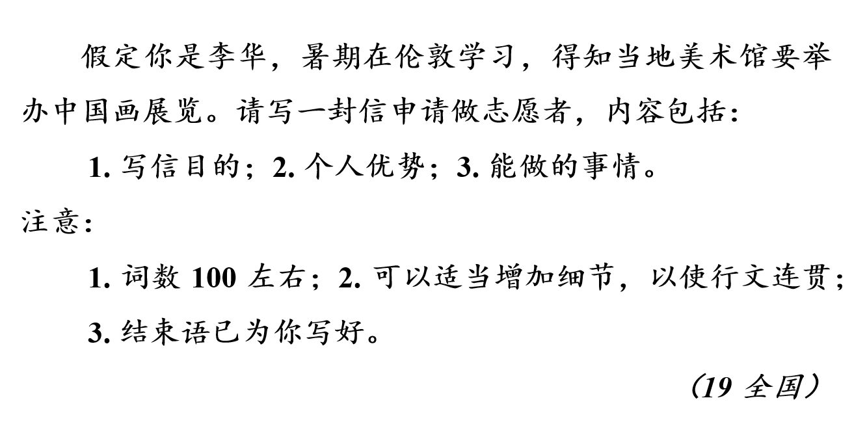
写作提纲
开头：表达写信目的（自我介绍、得知信息、表明
申请的内容）
主体：陈述申请 / 应征理由（个人优势、能做的事情）
结尾：表达期待（感谢、自我推荐等）
Yours,
Li Hua

Slide 19
参考词块
1. 有两年做某事的经验
have two years’ experience of doing sth
2. 有勇气承担任何工作
have the courage to take on any job
have the courage to undertake any job
3. 符合该职位的要求
meet the requirements for this position
meet the requirements for this post

Slide 20
参考词块
4. 胜任……
be qualified for
5. 有幸被录用
be lucky to get the job
be lucky to be hired
be lucky to be accepted
6. 与某人合作
cooperate with sb
7. 负责；主管
take charge of
(be) in charge of
8. 对……负责
take responsibility for
be responsible for

Slide 21
实用句式
1. 看到你们在网上刊登的招聘英语助理的广告，我感到非常高兴。
I am extremely pleased to see your advertisement for an English assistant (which you have posted) on the Internet.
v（在网站上）发布

Slide 22
实用句式
2. 我对这份工作特别感兴趣，因为我想进一步提高英语口语和人际沟通能力。 （18 浙江书面表达）
I’m particularly interested in this job because I want to ______ ________________________ and interpersonal communication skills.
further
improve my oral English
Notes:
treasure 名词动化

Slide 23
实用句式
3. 使我从其他竞争者中脱颖而出的是，我从六岁就开始学习中国画。（since）
what 引导的主语从句
What makes me stand out from other competitors is that I have been learning Chinese painting since I was six.
Notes:
treasure 名词动化

Slide 24
实用句式
4. 同样重要的是，我精通英语，所以我毫不犹豫地向您推荐我自己。（grasp / command n）
= have a good command of
Equally importantly, I have a good grasp of English, so I recommend myself to you without hesitation.
recommend sb / sth to sb 把某人 / 某物推荐给某人
Notes:
treasure 名词动化

Slide 25
实用句式
5. 我对中国艺术和文化有很好的了解，能够带领游客充分探索本次展览的独特魅力。
【例 1】
With good mastery of Chinese art and culture, I am able to guide / am capable of guiding the visitors to fully explore the unique charm of this exhibition.
【例 2】
I have a good understanding of Chinese art and culture, so I am able to guide / am capable of guiding the visitors to fully explore the unique charm of this exhibition.
Notes:
treasure 名词动化

Slide 26
实用句式
6. 如果您能给我这次机会，我将不胜感激，并预祝这项活动取得圆满成功。
be grateful
I would appreciate it if you could offer me the opportunity and I wish the event a complete success.
Notes:
treasure 名词动化

Slide 27
下笔成文 —— 范文
表达写信目的
Dear Sir / Madam,
I’m Li Hua, a high school student aged 17. I am writing to apply to be a volunteer for the Chinese Painting Exhibition which will be held in your art gallery.
I think I am qualified for this job, because I have learned Chinese painting since childhood. Equally importantly, I have a good grasp / command of both Chinese and English, so I have no difficulty in communicating with others. If I am lucky enough to be hired as a volunteer, I can show visitors around the gallery and answer their questions about the paintings after some proper training.
I would be very grateful / I would appreciate it if you could offer me the opportunity. I’m looking forward to your reply.
Yours,
Li Hua
陈述应征理由
表达期待和感谢
Notes:
treasure 名词动化

Slide 28
下笔成文
自我介绍
提出申请
表达写信目的
Dear Sir / Madam,
I’m Li Hua, a high school student aged 17. I am writing to apply to be a volunteer for the Chinese Painting Exhibition which will be held in your art gallery.
I think I am qualified for this job, because I have learned Chinese painting since childhood. Equally importantly, I have a good grasp / command of both Chinese and English, so I have no difficulty in communicating with others. If I am lucky enough to be hired as a volunteer, I can show visitors around the gallery and answer their questions about the paintings after some proper training.
I would be very grateful / I would appreciate it if you could offer me the opportunity. I’m looking forward to your reply.
Yours,
Li Hua
个人优势
陈述应征理由
能做的事情
表达期待与感谢
Notes:
treasure 名词动化

Slide 29
下笔成文
which 引导的定语从句
Dear Sir / Madam,
I’m Li Hua, a high school student aged 17. I am writing to apply to be a volunteer for the Chinese Painting Exhibition which will be held in your art gallery.
I think I am qualified for this job, because I have learned Chinese painting since childhood. Equally importantly, I have a good grasp / command of both Chinese and English, so I have no difficulty in communicating with others. If I am lucky enough to be hired as a volunteer, I can show visitors around the gallery and answer their questions about the paintings after some proper training.
I would be very grateful / I would appreciate it if you could offer me the opportunity. I’m looking forward to your reply.
Yours,
Li Hua
话语标记语
have no difficulty (in) doing sth 毫不费力地做某事
Notes:
treasure 名词动化

