Slide 1



Unit 12 社交礼仪
介绍信
Notes:
treasure 名词动化

Slide 2
类型解读
介绍信：介绍信是向收信人介绍详细事物（可包含事件、物品、文化、项目、活动等）、人物的书信。
常考
话题
介绍人物（自己、朋友、家人等）
介绍风俗习惯、文化等
介绍活动或组织（社团等）情况

Slide 3
写作框架
介绍信
开头
主体
结尾
寒暄+表明介绍目的
介绍具体内容
寒暄+期盼回复

Slide 4
开头：寒暄+表明介绍目的
句式 1：I’m glad / delighted / pleased to hear from you and know about your interest in ...
【例】我很高兴收到你的来信，并得知你对中国的社交礼仪感兴趣。
__________________________________________________
__________________________________________________.
I’m glad / delighted / pleased to hear from you and know about your interest in Chinese social manners.

Slide 5
开头：寒暄+表明介绍目的
句式 2：Knowing that you are enthusiastic about …, I’m delighted to give you a short / brief introduction.
【例】得知你对书法很感兴趣，我很高兴为你做一个简短的介绍。
______________________________________________________
______________________________________________________.
Knowing that you are enthusiastic about Chinese calligraphy, I’m delighted to give you a short / brief introduction

Slide 6
开头：寒暄+表明介绍目的
句式 3：I take pleasure in introducing ... to you.
【例】我非常荣幸能向你介绍中国传统文化。
__________________________________________________
__________________________________________________.
I take pleasure in introducing traditional Chinese culture to you.

Slide 7
开头：寒暄+表明介绍目的
【拓展】亮点句式：
Learning / Hearing that you take a great interest in …, I am writing to brief you on it.
I feel greatly honored to be asked to contact you, informing you of …
I would like to introduce ... to you in detail / briefly.
In reply to your letter about ..., I would like to inform you of some details about it.

Slide 8
主体：介绍具体内容
句式 1：… was founded in …, aiming to …
【例】该社团于 2018 年成立，旨在普及心理健康知识并帮助学生解决青少年时期的问题。
The club was founded in 2018, aiming to
_____________________________________ popularize knowledge of mental health and help students handle adolescent problems.

Slide 9
主体：介绍具体内容
句式 2：When it comes to ... , the one I have to mention is ...
【例】说到乌镇的名吃，不得不提的就是姑嫂饼（ Gusao cake ）。
When it comes to Wuzhen’s famous food, the one I have to mention is Gusao cake.

Slide 10
主体：介绍具体内容
【拓展】亮点句式：
To start with / Firstly ... Next / Secondly ... Last but not least / Finally ...
There are a variety of activities, ranging from … to …
What I intend to stress is that …
The reasons why I recommend ... to you are as follows. / I recommend ... for the following reasons. First of all, ... Besides, ... Last but not least, ...
First and foremost, … What’s more, ... In addition, ...

Slide 11
主体：介绍具体内容
【拓展】亮点句式：
6. This time I will introduce poetry of the Tang dynasty to
you in detail, which is popular among Chinese people. 这
次我要给你详细介绍深受中国人喜爱的唐诗。
7. As a time-honored art form, Chinese painting enjoys a
high reputation at home and abroad. 作为一种历史悠久
的艺术形式，国画在国内外享有很高声誉。

Slide 12
结尾：寒暄+表示期待回复
句式 1：I hope the information I gave you will be ...
【例 1】希望我提供的信息能够有帮助。
__________________________________________________.
I hope the information I gave you will be helpful

Slide 13
结尾：寒暄+表示期待回复
句式 2：If you need more …, don’t hesitate to ...
【例 2】如果你还需要更多的信息，请不要犹豫给我写信。
____________________________________________________.
If you need more information, don’t hesitate to write to me

Slide 14
结尾：寒暄+表示期待回复
【拓展】亮点句式：
I sincerely hope that my recommendation is of great help to you.
So you are sure to have a wonderful time in XXX, and I hope all of you will enjoy yourselves.
If you have any other questions, please let me know freely / without hesitation.
If any further information is required, please don’t hesitate to drop me a line.

Slide 15
结尾：寒暄+表示期待回复
【拓展】亮点句式：
5. If interested, register for it before January 20. Looking forward to your participation! 如果有兴趣，请在 1 月 20 日前报名。期待您的参与!
6. I do hope you can consider my recommendation / take my recommendation into consideration and whenever you need help, don’t hesitate to let me know. 我真的希望你能考虑我的建议，无论何时你需要帮助，尽管告诉我。

Slide 16
实战演练
假定你是李华，你的外国笔友 Jane 打算七月来中国，特来信了解中国的社交习俗。请你用英语回一封信，从以下几个方面作具体介绍：
1. 见面时的问候方式； 2. 对赞美的回答方式；3. 接收礼物时的回应方式；4. 餐宴礼节。
注意：
1. 词数 80 左右，信的开头和结束语已为你写好（不计入总词数）；
2. 可根据内容要点适当增加细节，以使行文连贯。

Slide 17
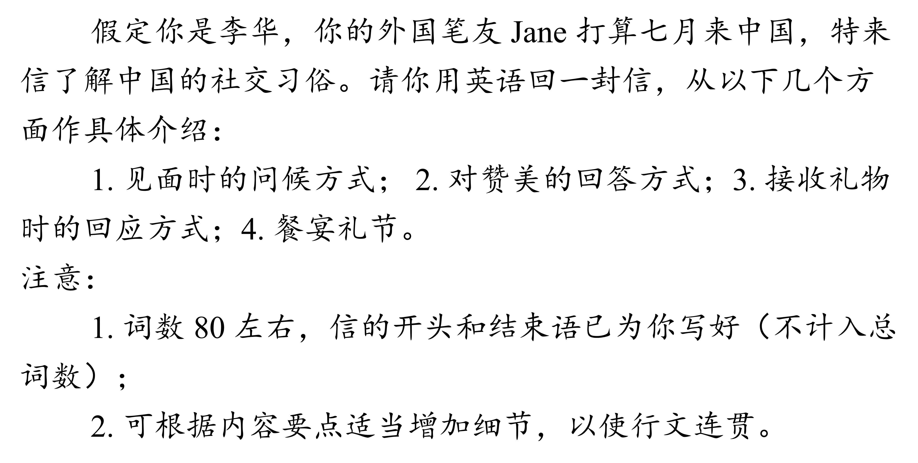
写作提纲
Dear Jane,
开头：寒暄+表明介绍目的
主体：介绍的具体内容：1. 见面时的问候方式（点头致意；微笑着打招呼；握手等）；2. 对赞美的回答方式（回答“过奖了”“惭愧”“谢谢”等）；3. 接收礼物时的回应方式（表示感谢；回礼等）；4. 餐宴礼节（请客人 / 长辈先入席 / 动筷子；吃饭尽量不发出声音等）
结尾：寒暄+期待回复
Yours sincerely,
Li Hua
Notes:
treasure 名词动化

Slide 18
参考词块
1. 微笑着向某人打招呼
2. 对……有礼貌
greet sb with a smile
show good manners to
show good politeness to
be polite to
Notes:
treasure 名词动化

Slide 19
参考词块
express one’s thanks
3.表示感谢
4.作为对……的回应
5.守约
爽约
show one’s thanks
extend one’s thanks
in response to
keep one’s appointment
break one’s appointment
Notes:
treasure 名词动化

Slide 20
参考词块
6. 为某事向某人道歉
7. 正式场合
8. 当众
apologize to sb for (doing) sth
make an apology to sb for (doing) sth
formal occasions
in public
Notes:
treasure 名词动化

Slide 21
参考词块
pay attention to table manners
9. 注意餐桌礼仪
10. 为某人 / 某事干杯
drink a toast to sb / sth
drink to sb / sth
Notes:
treasure 名词动化

Slide 22
【拓展】其他表达
give one’s regards / respects to sb 问候某人
pick up your seat 选择座位
pick the dishes up 夹菜
stare sb up and down 上下打量某人
to show good hospitality 为了表示热情
be casual about 对……随便
treat sb to 用……招待某人；以……款待某人
treat sb with / as / like 以……态度 / 方式对待某人
Lazy Susan 餐桌转盘（方便取食）

Slide 23
实用句式
1. 得知你要来我家做客，我很开心，随时欢迎你的到来。
= Delighted / Pleased to
Glad to know you will visit my home and you are welcome to visit us anytime you want.
Notes:
treasure 名词动化

Slide 24
实用句式
2. 按照中国的传统，你应该向每个人友好地打招呼说“你好！”。（greet）
= According to
By Chinese tradition, you are supposed to greet each person with a friendly “Hello!”.
greet … with 以……欢迎……
Notes:
treasure 名词动化

Slide 25
实用句式
3. 应邀参加晚宴时，你最好早点到，以示对主人的尊重。（状语从句的省略；turn up）
When (you are) invited to
When invited to a dinner party, you’d better turn up early to show your respect to the host.
When (we are) traveling to
【时间状语从句中的省略 】e.g. In a word, when traveling abroad, we should follow local habits.
Notes:
treasure 名词动化

Slide 26
实用句式
4. 在一些国家，人们用筷子吃饭，而在另一些国家，人们用刀叉吃饭。（while） （14 福建单选改）
In some countries, people eat with chopsticks, while in others, knives and forks.
(people eat with ) knives and forks
Notes:
treasure 名词动化

Slide 27
实用句式
5. 吃饭时，避免在咀嚼食物时发出声音。
= (you need to) avoid
When enjoying the meal, avoid making noises while chewing food.
Notes:
treasure 名词动化

Slide 28
实用句式
6. 满嘴食物时说话是不礼貌的。
= It’s rude to
= It’s impolite to
It’s bad manners to talk with your mouth full.
Notes:
treasure 名词动化

Slide 29
实用句式
7. 只要记住：入乡随俗，你就能在那里过得很愉快！
入乡随俗
Just remember: when in Rome, do as the Romans do, and you will be able to enjoy your stay there!
Notes:
treasure 名词动化

Slide 30
下笔成文
开头：寒暄+表明介绍目的
主体：介绍具体内容
Dear Jane,
Glad to hear from you and you’re welcome to China in July. The following are some Chinese customs.
Firstly, we greet each other by saying “Hello!” or asking such questions as “Where are you going?” or “Are you busy?” to express our care. Secondly, when praised, we reply with “Oh, no!” or “I’m overpraised.” to show good manners. Next, when receiving a gift, we usually say “It’s unnecessary.” besides “Thanks!” to show politeness and then put it away. Finally, at dinner parties, we talk loudly and touch glasses when drinking toasts to / drinking to someone’s health or success to show that we’re warm.
Anyhow, different cultures, different customs. If you “do as the Romans do when in Rome”, you’ll enjoy more of your stay here.
I hope what’s mentioned above might be helpful and wish you a good journey.
Yours sincerely,
Li Hua
结尾：寒暄+表示期待回复

Slide 31
下笔成文
要点2：对赞美的回答方式
要点1：见面时的问候方式
Dear Jane,
Glad to hear from you and you’re welcome to China in July. The following are some Chinese customs.
Firstly, we greet each other by saying “Hello!” or asking such questions as “Where are you going?” or “Are you busy?” to express our care. Secondly, when praised, we reply with “Oh, no!” or “I’m overpraised.” to show good manners. Next, when receiving a gift, we usually say “It’s unnecessary.” besides “Thanks!” to show politeness and then put it away. Finally, at dinner parties, we talk loudly and touch glasses when drinking toasts to / drinking to someone’s health or success to show that we’re warm.
Anyhow, different cultures, different customs. If you “do as the Romans do when in Rome”, you’ll enjoy more of your stay here.
I hope what’s mentioned above might be helpful and wish you a good journey.
Yours sincerely,
Li Hua
要点3：接收礼物时的回应方式
要点4：餐宴礼节

Slide 32
下笔成文
承上启下总述句
话语标记词，使介绍更有层次
Dear Jane,
Glad to hear from you and you’re welcome to China in July. The following are some Chinese customs.
Firstly, we greet each other by saying “Hello!” or asking such questions as “Where are you going?” or “Are you busy?” to express our care. Secondly, when praised, we reply with “Oh, no!” or “I’m overpraised.” to show good manners. Next, when receiving a gift, we usually say “It’s unnecessary.” besides “Thanks!” to show politeness and then put it away. Finally, at dinner parties, we talk loudly and touch glasses when drinking toasts to / drinking to someone’s health or success to show that we’re warm.
Anyhow, different cultures, different customs. If you “do as the Romans do when in Rome”, you’ll enjoy more of your stay here.
I hope what’s mentioned above might be helpful and wish you a good journey.
Yours sincerely,
Li Hua
［合成词］过度夸奖
［词块］放好
［习语］入乡随俗
［词块］为……干杯
［词块］对……有礼貌

