Slide 2

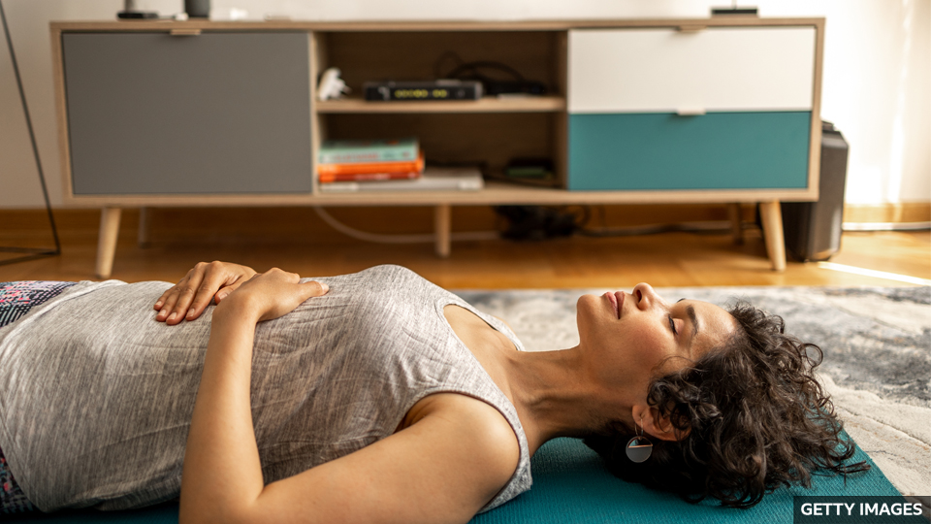
Benefits of__________________(breathe) Exercises 呼吸训练的好处
Breathing
doing
Experts suggest ____________(do) breathing exercises to help deal with ______________ (anxious), stress and insomnia, because ________________(regulate) breathing can divert attention and relax the body, thus reducing anxiety. The principles and benefits of breathing exercises ___________ ________________(explain) in this episode of English on the go.
anxiety
regulating
are
explained
专家建议可以通过做呼吸训练来帮助应对焦虑、压力和失眠等问题，因为调节呼吸可以让人转移注意力、放松身体，从而减少焦虑。本期 “随身英语” 节目介绍呼吸训练的原理和益处。

Slide 3
Vocabulary
fight-or-flight response
战斗或逃跑反应
rapid breathing 呼吸急促
parasympathetic nervous system
副交感神经系统
rest-and-digest state （身体的）“休息和消化” 状态
breathing technique 呼吸技巧
diaphragm （横）隔膜
inhale 吸气
hold someone's breath 屏住呼吸
exhale 呼气
nostril 鼻孔
insomnia 失眠
anxiety 焦虑，不安
breathing exercise 呼吸训练
oxygen 氧气
instinctively 本能地
flow 供应，流动
lung 肺，肺部
shallow （呼吸）浅的
breath 气息
breathing rate 呼吸频率
sympathetic nervous system
交感神经系统

Slide 4
______________________(与......斗争）insomnia? Worried by anxiety? The first piece of advice that you ____________________(可能） see is to try breathing exercises. From ancient yoga practitioners to modern health professionals, experts have _________________________________ (提出了这一建议). But how can simple breathing activities have such a significant effect on __________________________ (我们的身心健康）?
Struggling with
are likely to
made this recommendation
our mental and physical health
Reading-vocabulary

Slide 5

Once we consider how _______________ oxygen is for life, it might seem ______________ that focusing on this can help our health. Our _______________ system instinctively regulates the flow of oxygen into our ____________. Possibly because of body ___________ concerns, many people hold in their stomachs, taking ______________ breaths. This can lead our body to ______________ our breathing rate to compensate.
Our breathing also gets faster when we're _____________ or anxious. When this happens, our _________________ nervous system triggers a fight-or-flight ______________. As well as affecting breathing, this increases our __________ rate and produces adrenaline to prepare our _______________ for action. Stress and anxiety can thus be linked with _____________ breathing.
essential
obvious
nervous
lungs
image
shallow
increase
stressed
sympathetic
response
heart
muscles
Listening
rapid
除了影响呼吸，这还会增加我们的心率，产生肾上腺素，让我们的肌肉为行动做好准备。 因此，压力和焦虑可能与呼吸急促有关。

Slide 6
from
To recover ___________ a threat, our parasympathetic nervous system can put our body into a rest-and-digest state _______________(allow) us to relax and be calm. _______ this state, breathing and heart rates slow. ______________, it appears slow, deep breathing can also make this ______________(happen). It's also _____________(note) that when we focus on breathing techniques, we can __________________(distract) from the issues that __________________(cause) us stress.
allowing
In
However
happen
notable
be distracted
are causing
为了从威胁中恢复过来，我们的副交感神经系统可以让我们的身体进入休息和消化状态，让我们放松和平静。 在这种状态下，呼吸和心率缓慢。 然而，似乎缓慢的深呼吸也可以使这种情况发生。 值得注意的是，当我们专注于呼吸技巧时，我们可能会从给我们带来压力的问题上分心。
Reading-grammar

Slide 7
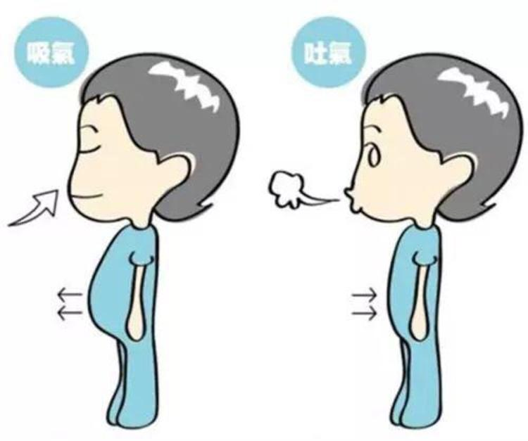
Experts recommend using our diaphragm to inhale（吸气） —__________, filling our lungs completely and then holding our breath for a few ___________ before exhaling（呼气）. Other ________________ techniques include breathing through alternating nostrils. So next time you feel anxious or _________ , why not try some breathing techniques to help you ________?
deeply
seconds
recommended
stressed
relax
Reading-meaning

Slide 8
阅读理解：请在读完上文后，回答下列问题。
1. Which experts are mentioned in the article?
2. Why might people hold in their stomachs when breathing, according to the article?
3. True or False? Taking shallow breaths decreases our breathing rate.
4. What substance helps to prepare our muscles?
5. Which muscle are we recommended to use to breathe deeply?

Slide 9
阅读课文并回答问题。
1. Which experts are mentioned in the article?
The article mentions ancient yoga practitioners and modern health professionals.
2. Why might people hold in their stomachs when breathing, according to the article?
According to the article, this may be due to body image concerns.
3. True or False? Taking shallow breaths decreases our breathing rate.
False. Taking shallow breaths can lead our body to increase our breathing rate to compensate.
4. What substance helps to prepare our muscles?
Adrenaline is produced to prepare our muscles for action.
5. Which muscle are we recommended to use to breathe deeply?
Experts recommend that we use our diaphragm to breathe deeply.

Slide 10
选择意思恰当的单词或词组来完成下列句子。
1. All mammals need ____________ to breathe.
stress oxygen insomnia anxiety
2. If we act ___________________, we don't control our actions.
anxiously carefully thoughtfully instinctively
3. A cold can cause blocked _____________.
anxiety nostrils insomnia diaphragms
4. We absorb oxygen in our ____________.
lungs diaphragm nostrils flow
5. When we are in danger, we often have a ___________________ response.
rest-and-digest shallow flow fight-or-flight
oxygen
instinctively
nostrils
lungs
fight-or-flight

Slide 11
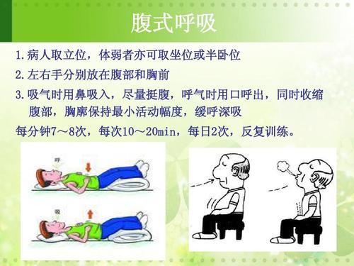
大声朗读
1. All mammals need oxygen to breathe.
2. If we act instinctively, we don't control our actions.
3. A cold can cause blocked nostrils.
4. We absorb oxygen in our lungs.
5. When we are in danger, we often have a fight-or-flight response.

