Slide 2
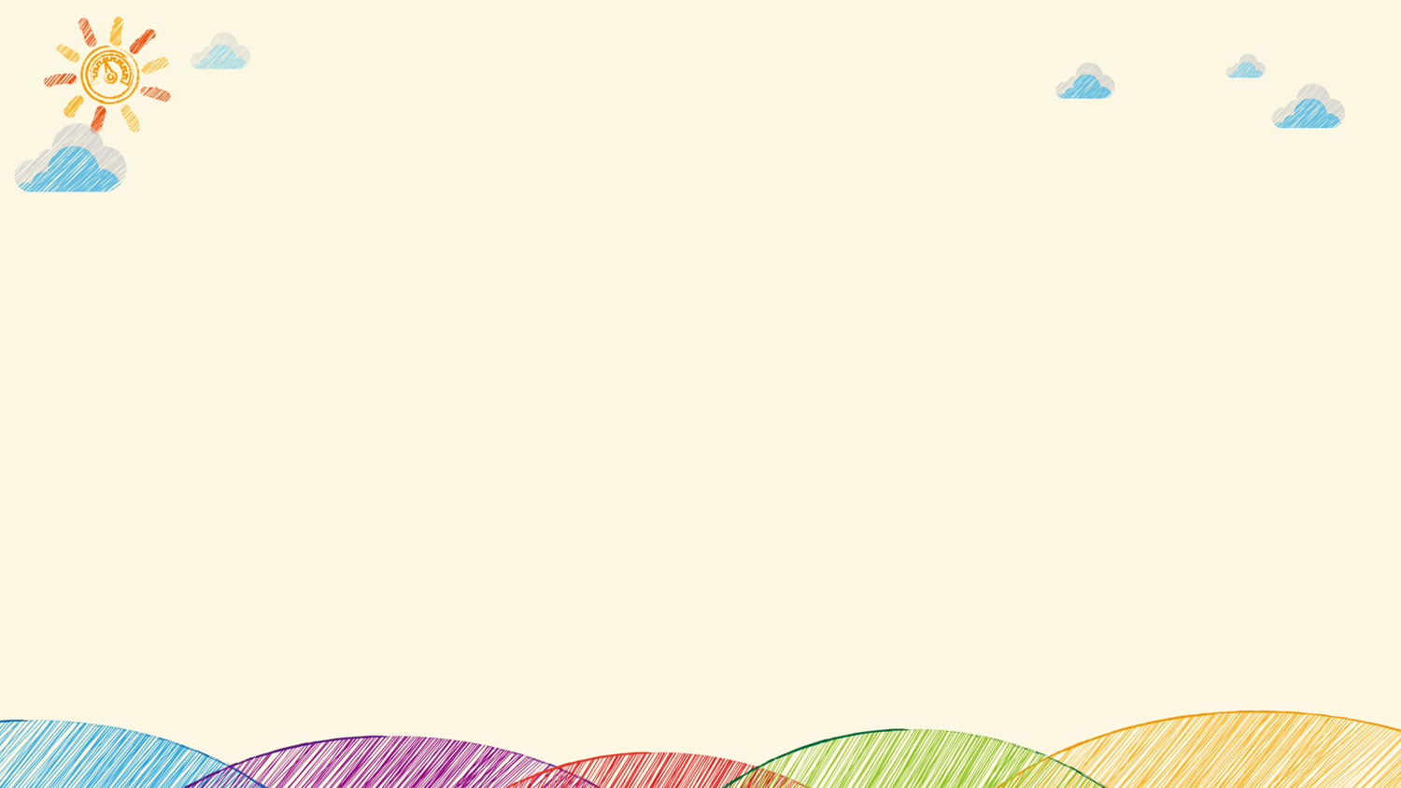
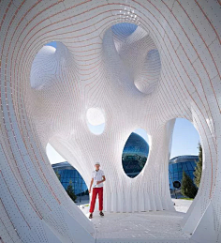
How
_______ architecture makes us feel建筑设计对人心理健康的影响
Studies have found that poor building design is more likely ________________(cause) stress and affect people's mental health. Some cities in the world have required the ________________(integrate) of natural landscape around buildings in urban planning. A British designer thinks that buildings in Britain are too ___________(bore) and wants architects to make changes. ________________, the construction experience of London's Intercom Building proves that ______________(make) buildings interesting is not easy. This paper discusses the influence of architectural design ________ people's mental health.
to cause
integration
boring
However
making
on
研究发现糟糕的建筑设计更容易给人带来压力，从而影响人们的心理健康。世界上有些城市已经在城市规划中要求建筑周围要融入自然景观。一位英国设计师认为英国的建筑物过于乏味，希望建筑师们对此作出改变。然而，伦敦 “对讲机大楼” 的建筑经验证明，让建筑物变得有趣并非易事。本文讨论建筑设计对人心理健康的影响。

Slide 3
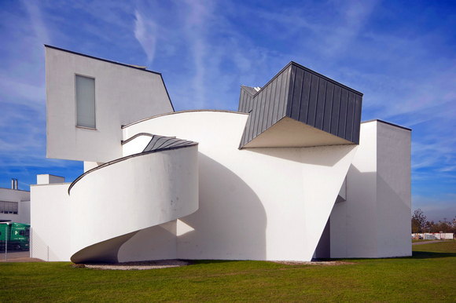
Vocabulary
dweller 居民
architect 建筑师
architecture 建筑物
design 设计
urban planning 城市规划
erect 建造
strategic 有策略的，经过悉心规划的
downtown 市中心的
resident 居民
soulless 毫无生趣的
interestingness 有趣之处，趣味性
lack of depth 缺乏深度（此处指建筑表面缺乏起伏变化）
surface （建筑的）表面
line 线条
monotonous 一成不变的，单调乏味的
storey 楼层
skyscraper 摩天大楼
curved 曲面的，有弧线的
exterior wall 建筑外墙
screen 隔挡，挡板

Slide 4
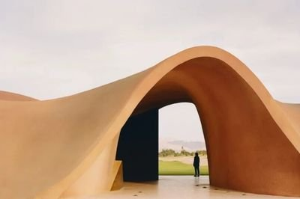
More than _________________________________(世界一半的人口）are city dwellers, and, by 2050, the United Nations predicts that __________________________ (十分七的人）will be. With that in mind, architects are having to consider how architecture ____________________________________________(影响我们的情绪健康）in urban settings.
half the world's population
seven in ten people
influences our emotional wellbeing
Reading-vocabulary

Slide 5

According to Colin Ellard, a research psychologist at Waterloo University, Canada, there is a lot of _________________ which shows "the profound ______________ that the design of buildings has on how we feel, how we __________ one another, and our overall __________________ well-being". A study from the University of Heidelberg ________________ that people raised in the countryside are _________ likely to have mental ______________ than those raised in the city. The city of Vancouver in Canada, which is _________________ by mountains and ocean, ________________ this need to connect with nature. It has included protecting ocean and mountain views in its __________ planning guidelines. For example, tall buildings are erected in strategic locations that don't ___________ scenic views for downtown residents.
evidence
impact
treat
psychological
concluded
less
disorders
surrounded
recognises
urban
block
例如，高层建筑建在战略位置，不会阻挡市中心居民的风景。
Listening

Slide 6
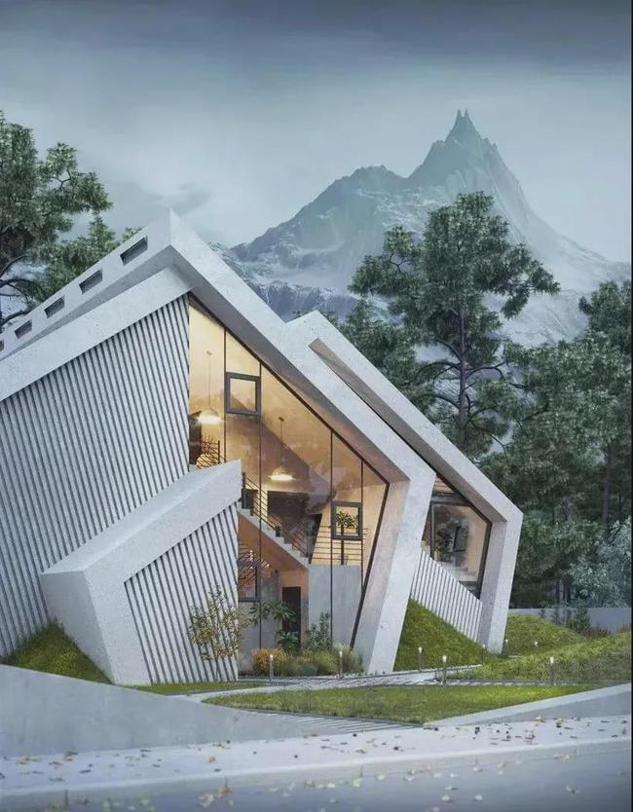
The British designer Thomas Heatherwick wants to make architecture _________(little) soulless and boring. He told the Guardian newspaper, "We need to fearlessly demand _____________________ …and make buildings that nourish our _____________(sense)." He has written a new book, Humanise, ___________ he lists seven characteristics of _____ boring building. These include ___________(be) too flat and straight. He says lack of __________(deep) means light and shadow cannot play on surfaces, ___________ straight lines are at odds __________ nature and make buildings monotonous.
less
interestingness
senses
where
a
being
depth
while
with
他说，缺乏深度意味着光和阴影不能在表面上发挥作用，而直线与自然格格不入，使建筑物单调。
Reading-grammar

Slide 7
However, making buildings ______________ is not always easy, as architect Rafael Vinoly found out in 2013 when he ___________ the 37-storey skyscraper known as the Walkie Talkie in London. The building was ___________ for its curved exterior walls covered in reflective glass. However, it acted like a magnifying glass and reflected light which melted nearby cars and almost set ______ to a carpet. A screen had to be added to prevent the building causing further ___________.
interesting
created
admired
fire
damage
这座建筑因其覆盖着反光玻璃的弧形外墙而受到赞赏。 然而，它就像一个放大镜，反射的光融化了附近的汽车，几乎点燃了地毯。
wellbeing
So, for your own ___________, surround yourself with buildings that bring you joy, and ideally a view of nature.
Reading-meaning

Slide 8
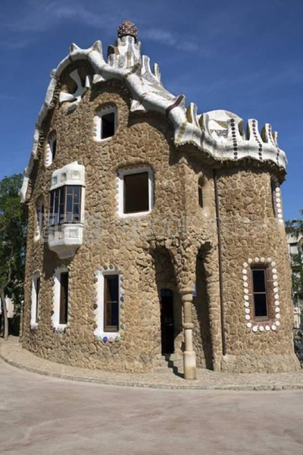
阅读理解：请在读完上文后，回答下列问题。
1.What did the University of Heidelberg study conclude?
2.What has Vancouver included in its urban planning guidelines?
3.What does Heatherwick think buildings should do to our senses?
4.True or False? Heatherwick believes buildings should have a lack of depth.
5.What was the problem with the Walkie Talkie?

Slide 9
阅读课文并回答问题。
1.What did the University of Heidelberg study conclude?
People raised in the countryside are less likely to have mental disorders than those raised in the city.
2.What has Vancouver included in its urban planning guidelines?
Vancouver has included protecting ocean and mountain views in its urban planning guidelines.
3.What does Heatherwick think buildings should do to our sense?
He told the Guardian newspaper, "We need to … make buildings that nourish our senses."
4.True or False? Heatherwick believes buildings should have a lack of depth.
False. He says lack of depth means light and shadow cannot play on surfaces.
5.What was the problem with the Walkie Talkie?
It acted like a magnifying glass and reflected light which melted nearby cars and almost set fire to a carpet.

Slide 10
选择意思恰当的单词或词组来完成下列句子。
1.In his studio, he's put a ______________ up between the kitchen and bedroom.
nature dweller surface screen
2.I couldn't live in the countryside. I prefer _____________ living.
curved soulless urban bland
3.Anna dislikes the architecture of the town. She says the buildings are _____________.
exterior strategic monotonous downtown
4.Craig's been working as an _________________ for many years now.
dweller architecture architect urban planning
5.The building has _____________. It almost changes shape depending on the sunlight.
well-being depth skyscrapers line
screen
urban
monotonous
architect
depth

Slide 11
大声朗读
1. In his studio, he's put a screen up between the kitchen and bedroom.
2. I couldn't live in the countryside. I prefer urban living.
3. Anna dislikes the architecture of the town. She says the buildings are monotonous.
4. Craig's been working as an architect for many years now.
5. The building has depth. It almost changes shape depending on the sunlight.

