Slide 1
Unit 2 Numbers
Writing

Slide 2
学习目标：
1. 理解曲线图表达数据变化的信息；
2. 能用be，rise和fall等动词及相应的时态描述曲线图中数据的变化；
3. 能根据曲线图写出简单的段落，描述数据的变化。

Slide 3
01
Lead-in

Slide 4
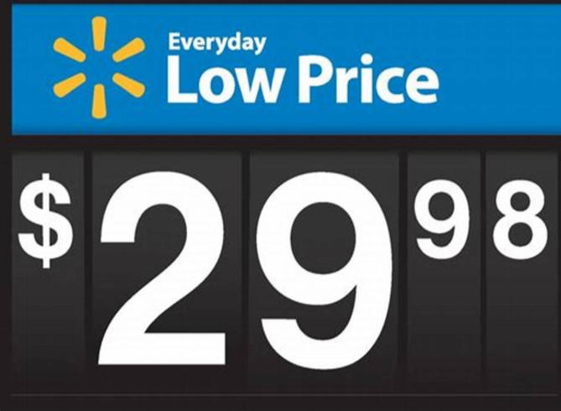
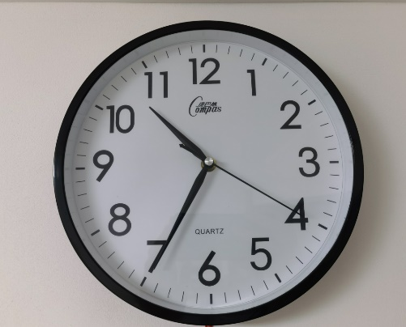
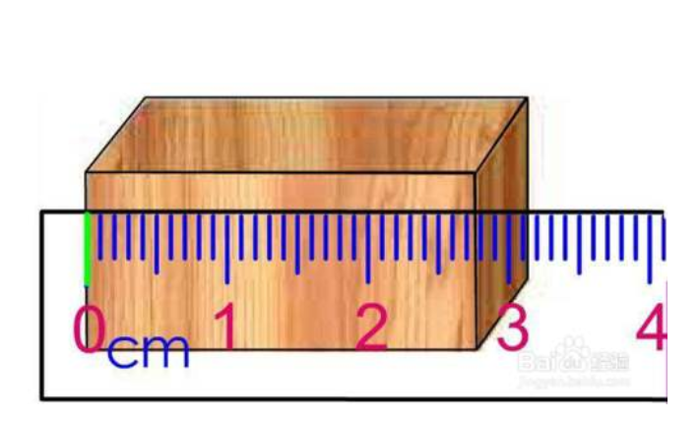
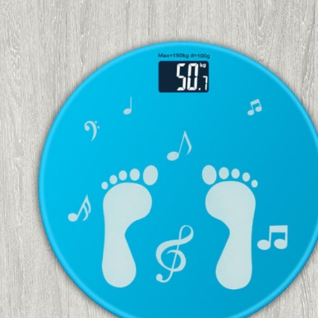
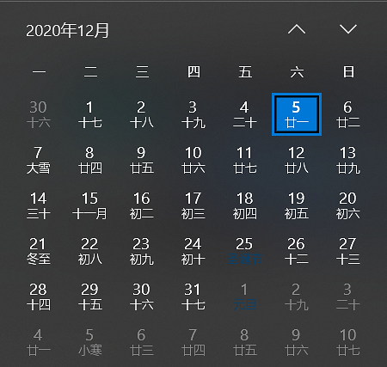

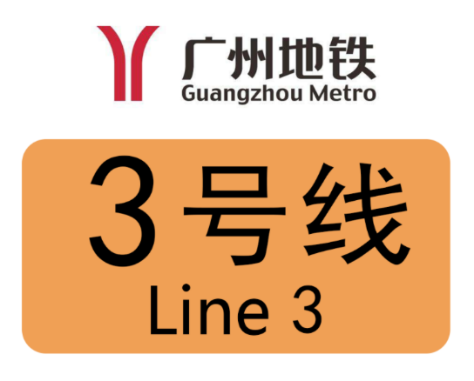
Numbers in our daily life
price
time
length
weight
…
date
room number
bus or metro

Slide 5
We use numbers to…
We need to collect a lot of numbers and analyze(分析) them.
Find the problems and try to solve them.
Know the changes.
Help us know the world better.

Slide 6
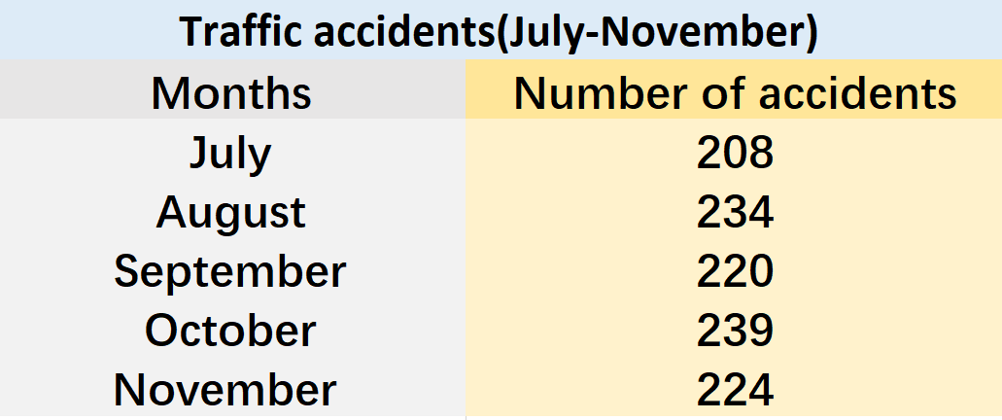

Can you help May?
[ˈfɪɡəz]
Changes?
[ˈtræfɪk]
[ˈæksɪdənts]
May found some figures about traffic accidents.
n. 数字
n. 交通
n. 事故

Slide 7
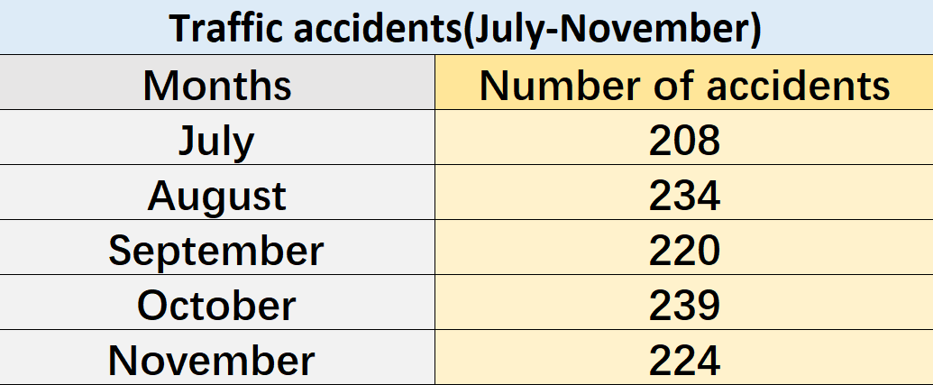
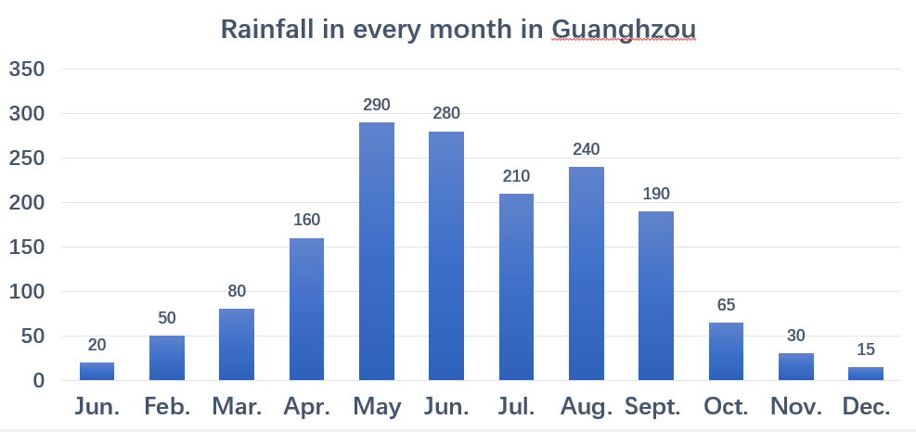
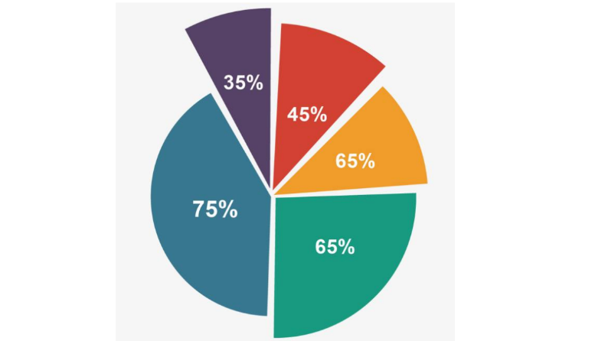
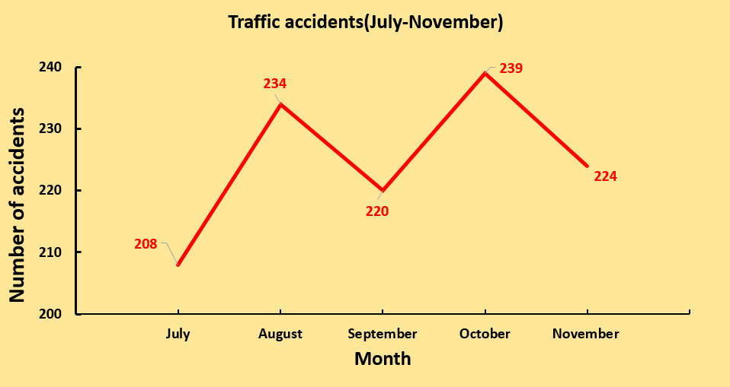
Which of the following can help May?
Table(表格)
Bar chart(柱状图)
Find the information quickly.
Compare numbers clearly and directly.
Pie chart(饼状图)
Line graph(折线图)
Show the percentage(~%).
Show the changes.

Slide 8
What are the advantages (优势)of a line graph?
How can we draw a line graph?
It can clearly show the changes and the tendency.
[ˈtendənsi]
n. 趋势
Line graph(折线图)

Slide 9
02
Before-writing

Slide 10
How can we draw a line graph?
Table(表格)
Line graph(折线图)
How can we read a line graph?
July
August
September
October
November
Title：
Traffic accidents(July-November)
[ˈvɜːtɪkl]
240
230
220
210
200
the vertical axis(纵轴)
Month
Number of accidents
208
Number of accidents
234
220
[ˌhɒrɪˈzɒntl]
[ˈæksɪs]
the horizontal axis(横轴)
239
224
July August September October November

Slide 11
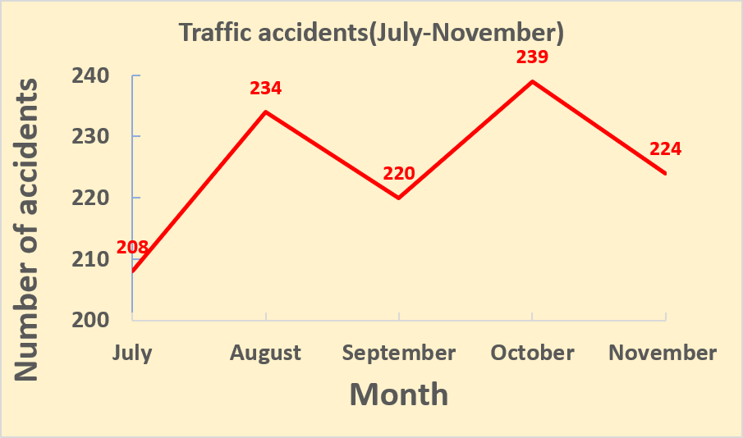
How can we read a line graph?
1. What is the line graph about?
It is about traffic accidents.
2. What does the vertical axis(纵轴) stand for?
the title
the numbers
It stands for the number of accidents.
3. What does the horizontal axis(横轴) stand for?
It stands for the months.
4. How many accidents were there in August?
There were 234 accidents.

Slide 12
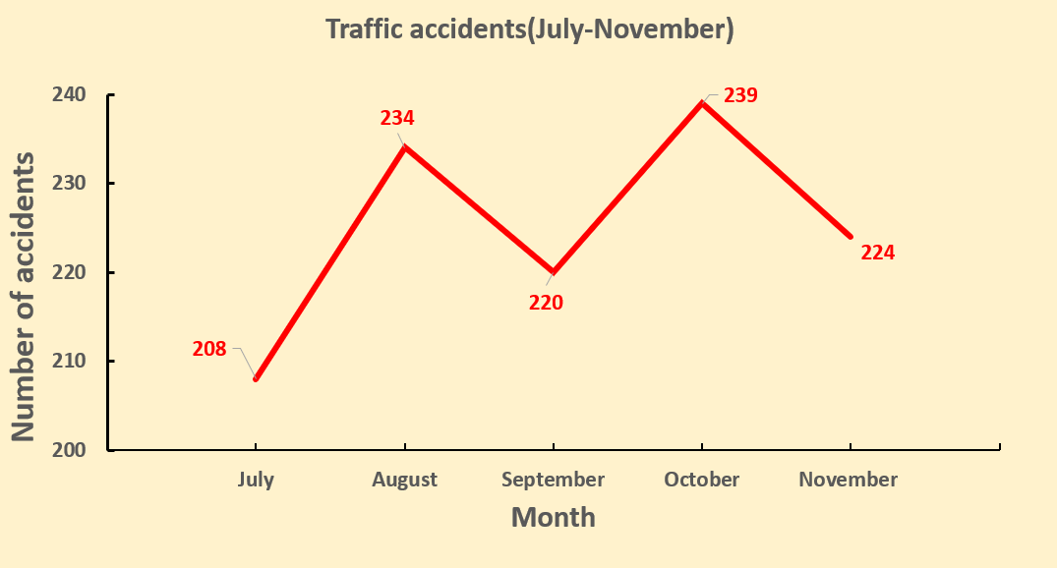
How can we read a line graph?
The highest point
The lowest point
The highest point: _________.
The lowest point: __________.
In October
In July

Slide 13
How can we read a line graph?
There are _______ accidents in August.
There are 224 accidents __________.
234
in November

Slide 14
How can we read a line graph?
Changes of number
1. rise to ...
2. go up to ...
3. rise from… to...
fall to ...
go down to ...
fall from...to...
The number ______ ____ 234/239 and then _____ ____ 220/224.
rises to
falls to

Slide 15
How can we read a line graph?
1. rise to ...
2. go up to ...
3. rise from... to...
How can we describe a line graph?
fall to ...
go down to ...
fall from...to...
1. The number ______ ____ ____234 and then _____ _______ ______220.
2. The number _____ _____ 208 _____234.
3. The number _____ _____234 ______220.
goes up to
goes down to
rises from
to
falls from
to

Slide 16
How can we describe a line graph?
Tense! (时态！)
Traffic accidents (July --November)
The graph shows that there were ______ traffic accidents in our city in July. In ________, the number ____ to ______ and then ______ to ______ in _________. In _______, the number ____________ again to _____. It ____________ to ______ in _________.
239
234
224
rose
fell
220
September
October
208
rose/went up
August
fell/went down
November

Slide 17
How can we describe a line graph?
present-- shows…
past-- rose/fell…in…
Tense
上升：
1. rise to …
2. go up to …
rise from … to...
下降：
fall to …
go down to …
fall from ... to ...
Description of the numbers & the changes

Slide 18
03
While-writing

Slide 19
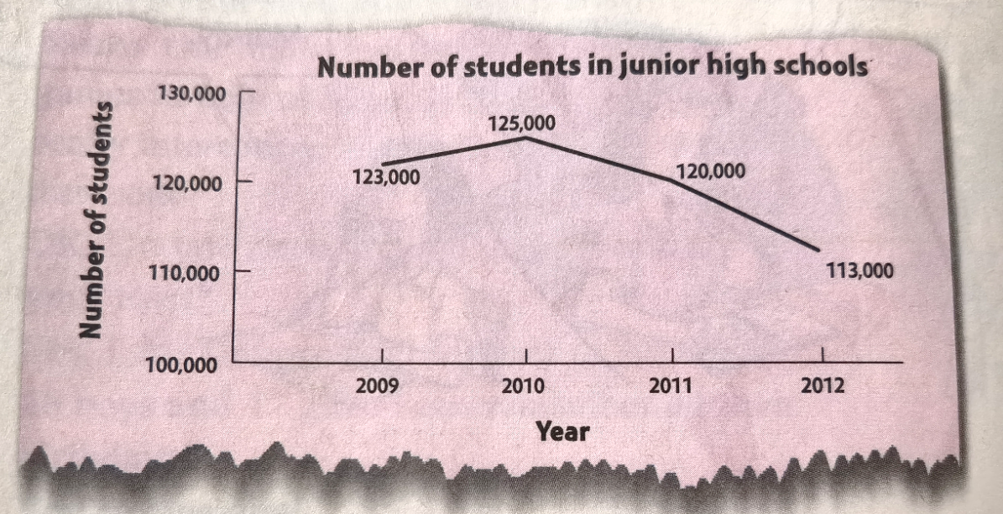
Have a try! Describe the line graph.
1. What is the line graph about?
The line graph shows…
2. What does the vertical axis(纵轴) stand for?
It stands for…
3. What does the horizontal axis(横轴) stand for?
It stands for…
4. How many students were there in 2010?
Page 28
There were…students.

Slide 20
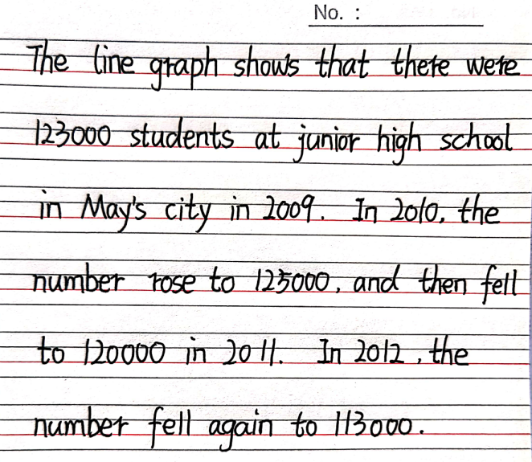
Have a try! Describe the line graph.

Slide 21
04
Post-writing

Slide 22
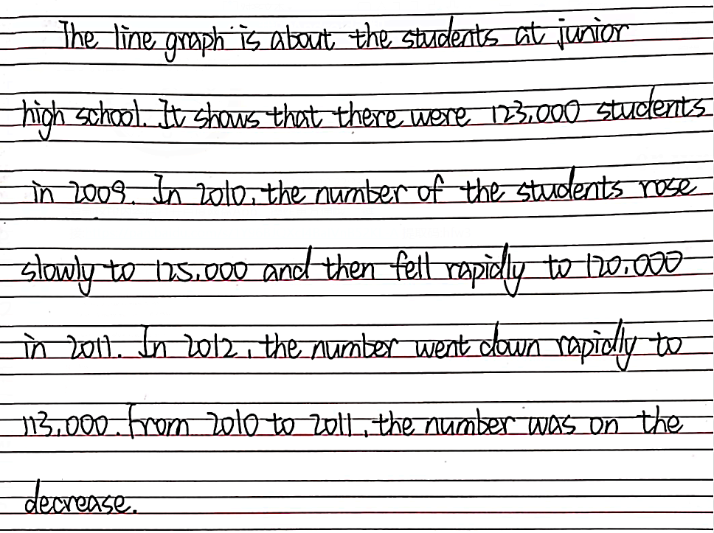
Can you help May to improve her writing ?

Slide 23
Can you help May to improve her writing ?
General introduction
Topic sentence:
Some adverbs:
n. 副词
rise/fall
go up/down
rapidly/
sharply/
slowly
Clearer &
more precise
Phrases:
n. 短语
…on the rise/decrease

Slide 24
Summary: How to describe a line graph
Tense
present--the graph shows…
past--the number rose/fell…in…
Topic sentence
The line graph is about…/It shows that …
上升：
rise to
go up rapidly/sharply/slowly.. to
rise from... to...
on the rise
下降：
fall to
go down rapidly/sharply/slowly… to
fall from...to...
on the decrease
Description of the numbers & the changes
Conclusion?
?

Slide 25
05
Homework

Slide 26
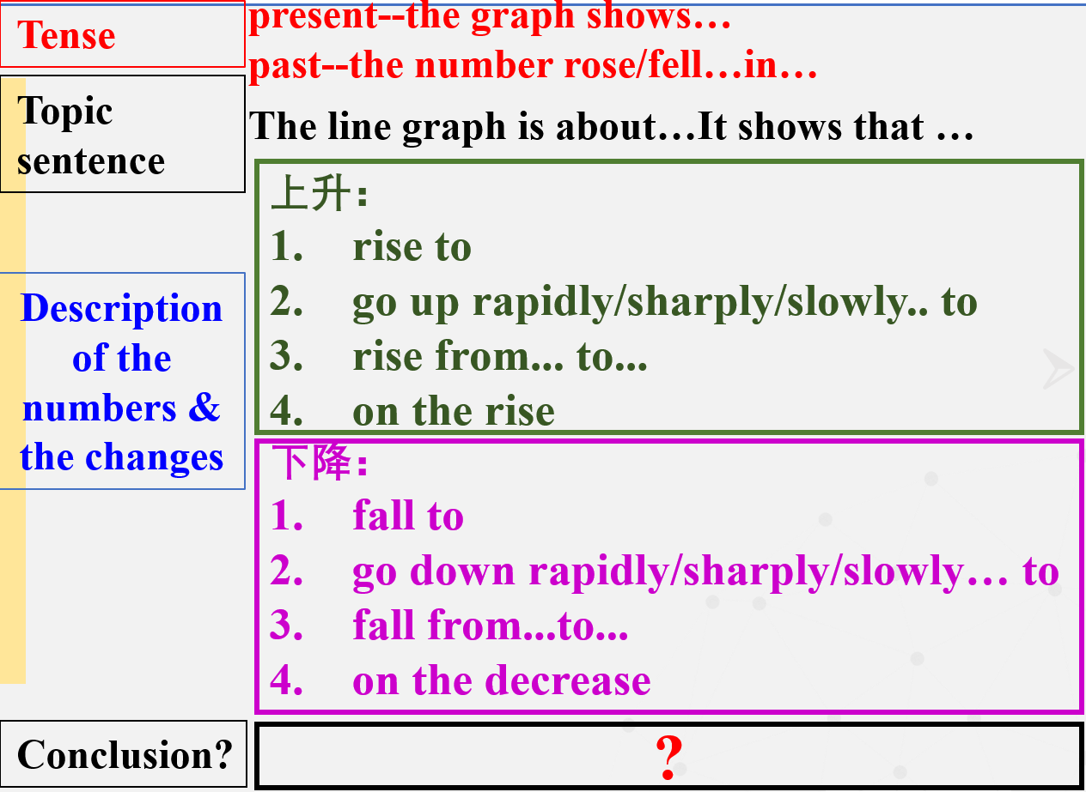
Homework：
Do a survey about how much money your family spent in the past six months. Make a line graph and write a report about it.
Money spent in the past six months
Month | The amount of money(yuan)
Money spent in the past six months
tips
The amount of money(yuan)
Month

Slide 27
Thank you!

