Slide 1
版权提示
本课件已在中国版权保护中心登记作品著作权，
未经许可，禁止商用、分享、转载！

Slide 2

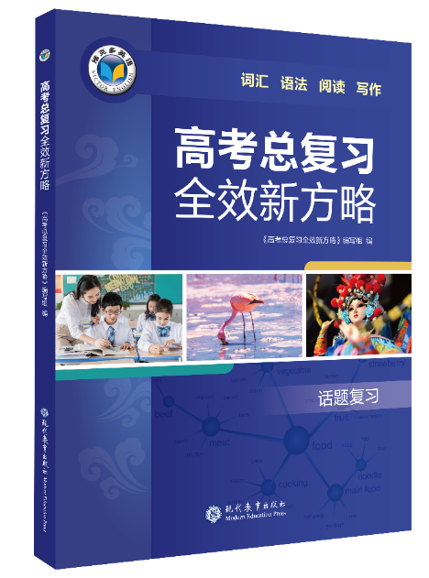

Unit 18 文娱
话题写作

Slide 3
写作
你校英文报 Youth 正在庆祝创刊十周年。请你写一篇短文投稿，内容包括：
1. 读报的经历；2. 喜爱的栏目；3. 期望和祝福。
注意：写作词数应为 80 左右。
（21 新高考Ⅰ卷）

Slide 4
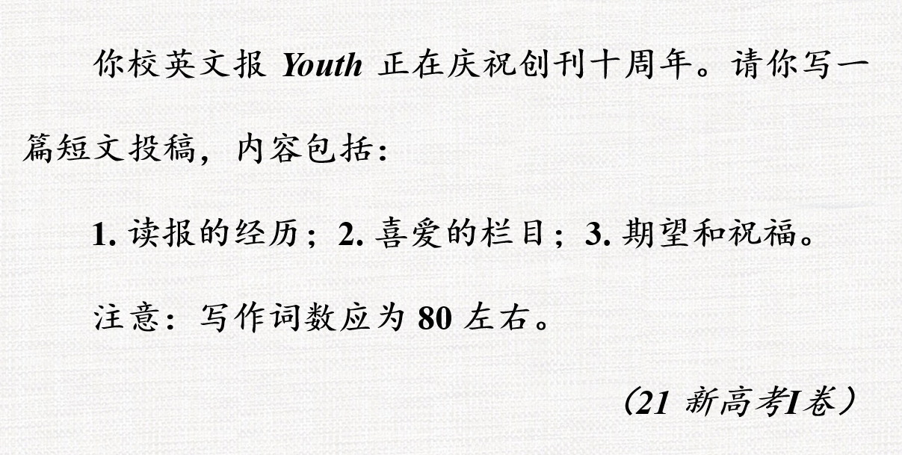
写作提纲
Youth and Me
要点一：读报的经历（开始读报的时间、读报过程、
读报收获等）
要点二：喜爱的栏目（喜爱原因、阅读感悟等）
要点三：期望和祝福（表达期待发展的愿景、继续阅
读的心愿等）

Slide 5
参考词块
1.出版
come out
2.时事
current affairs
3.报道国内外新闻
cover / report national and international news
cover / report news at home and abroad
cover / report domestic and foreign news

Slide 6
参考词块
4.体育专栏
the sports section
the sports column
5.传播中国文化
spread Chinese culture
6.有价值的内容
valuable content

Slide 7
【拓展】高级词块——文娱
get up-to-date information easily 轻松获取最新信息
feature stories 专题报道；新闻特写
a feature on 关于……的专题节目
media coverage 媒体报道
the travel section 旅游专栏
make a hit 大受欢迎
be on the edge of one’s seat 看得聚精会神；极为激动
be met with mixed reviews from the audience 受到观众褒贬不一的评论
a catchy tune / slogan 朗朗上口的乐曲 / 口号

Slide 8
实用句式
1. 众所周知，阅读可以开阔我们的视野，丰富我们的生活。
It is common knowledge that reading can broaden our horizons and enrich our life.
表达“众所周知”
as we all know, it is well known that ..., as is well known, as everyone knows, it is common knowledge that ...

Slide 9
实用句式
2. 新闻媒体在形成社会舆论方面起着重要的作用。（role，public opinion）
The news media ______________________ in forming public opinion.
plays an important role

Slide 10
实用句式
3. “异域文化”专栏刊登外国友人写的关于他们国家文化的文章。 （15 全国书面表达）
v 刊登；登载；报道
分词作定语
The “Foreign Cultures” section carries articles written by foreign friends about the cultures of their home countries.

Slide 11
实用句式
4. 我真希望自己的文章有朝一日能见报。 （16 上海句子翻译）
I really hope that my article will come out in a newspaper someday.
appear / be published / be printed

Slide 12
实用句式
5. 作为贵报的忠实读者，我建议刊登一些文章来指导我们的英语学习，并且希望它会变得更受欢迎。
loyal / regular
As a faithful reader of your newspaper, I suggest carrying some articles / that it (should) carry articles to guide us in our English learning, and I hope that it will become even more popular.
suggest 表达“建议”
suggest doing sth
suggest (that) ... (should) do sth 建议……做某事

Slide 13
【拓展】高级句式——文娱
The article spoke words of encouragement to the deepest part of my being. 这篇文章使我的内心深受鼓舞。
The story took me through the twists and turns of a classic story. 这个故事带我经历了一个跌宕起伏的经典故事。
The past decades have witnessed the rapid development of online news media. 过去几十年来，网络新闻媒体迅速发展。
As media channels have grown in number and type, so have advertisements. 随着媒体渠道数量和类型的增加，广告也在增加。

Slide 14
下笔成文— 范文一
开头用感叹句引入
Youth and Me
Time flies in the blink of an eye! It is ten years since Youth first came out.
As a faithful reader, whenever I read it, I feel greatly inspired. It gives me a lot of power to read how other young people live their lives. The section I like most is the sayings from famous people. These sayings reflect their wisdom of life and spread positive energy, which encourage me to become a better person.
I sincerely wish Youth would become increasingly popular and hope it carries more valuable articles and wonderful content.
读报感悟和收获
要点一：读报的经历

Slide 15
下笔成文— 范文一
Youth and Me
Time flies in the blink of an eye! It is ten years since Youth first came out.
As a faithful reader, whenever I read it, I feel greatly inspired. It gives me a lot of power to read how other young people live their lives. The section I like most is the sayings from famous people. These sayings reflect their wisdom of life and spread positive energy, which encourage me to become a better person.
I sincerely wish Youth would become increasingly popular and hope it carries more valuable articles and wonderful content.
喜爱的原因
要点二：喜爱的栏目
要点三：期望和祝福

Slide 16
下笔成文 — 范文一
Youth and Me
Time flies in the blink of an eye! It is ten years since Youth first came out.
As a faithful reader, whenever I read it, I feel greatly inspired. It gives me a lot of power to read how other young people live their lives. The section I like most is the sayings from famous people. These sayings reflect their wisdom of life and spread positive energy, which encourage me to become a better person.
I sincerely wish Youth would become increasingly popular and hope it carries more valuable articles and wonderful content.
表达“时光飞逝” ：
How time flies! 光阴似箭！
How time has passed! 时间过得真快！
The years have just flown by. 岁月匆匆而过。
感叹句：充分表达情感，奠定全文感情基调
定语从句

Slide 17
下笔成文 — 范文一
Youth and Me
Time flies in the blink of an eye! It is ten years since Youth first came out.
As a faithful reader, whenever I read it, I feel greatly inspired. It gives me a lot of power to read how other young people live their lives. The section I like most is the sayings from famous people. These sayings reflect their wisdom of life and spread positive energy, which encourage me to become a better person.
I sincerely wish Youth would become increasingly popular and hope it carries more valuable articles and wonderful content.
非限制性定语从句
翻译句子：我衷心祝愿Youth 越来越受欢迎，希望能刊登更多有价值的文章和精彩的内容。

Slide 18
下笔成文 — 范文二
Youth and Me
Congratulations on the tenth anniversary of the launch of Youth.
Youth has sparked my interest in English and broadened my horizons. It covers the latest news both at home and abroad, which enables me to keep pace with / get up-to-date information of the world. Of all the Youth columns, I like Western World most. Written in simple but authentic English, the articles introduce me to western society and culture. Amazingly, they also inspire me to appreciate my own culture more.
I hope to continue benefiting from reading it and may Youth stay in youth forever.
开门见山，点明主旨
spark somebody’s interest / hope / curiosity etc 激起某人的兴趣 / 希望 / 好奇心等
开拓视野

Slide 19
下笔成文 — 范文二
Youth and Me
Congratulations on the tenth anniversary of the launch of Youth.
Youth has sparked my interest in English and broadened my horizons. It covers the latest news both at home and abroad, which enables me to keep pace with / get up-to-date information of the world. Of all the Youth columns, I like Western World most. Written in simple but authentic English, the articles introduce me to western society and culture. Amazingly, they also inspire me to appreciate my own culture more.
I hope to continue benefiting from reading it and may Youth stay in youth forever.
非限制性定语从句
adj 地道的
话语标记词:
令人惊奇的是
翻译句子：愿 Youth 青春永驻！

Slide 20
版权提示
本课件已在中国版权保护中心登记作品著作权，
未经许可，禁止商用、分享、转载！

