Slide 1
版权提示
本课件已在中国版权保护中心登记作品著作权，
未经许可，禁止商用、分享、转载！

Slide 2


专题一 高考动词
Part I 基础训练
Notes:
更多模板请关注：https://haosc.taobao.com

Slide 3
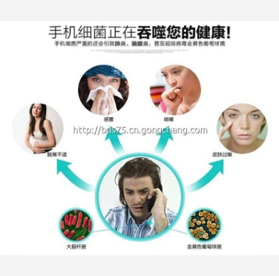
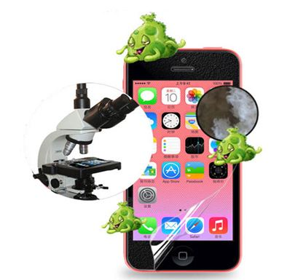
Warm up: wash, hold, remain, grow
remembers to wash
Everyone always _________________ (记得洗) his or her hands and body at the end of the day, but many times neglect (忽视) their phone screen. The reason why your phone _____ (有) so many germs (细菌) is that it _____________ (都是热的) throughout the day because of how often you use it. The warm environment allows bacteria _________ (grow) very easily and puts you at a greater risk of getting infected (感染).
holds
remains warm
to grow

Slide 4
此页为隐藏页
Teaching Guide
教学重难点词总览
get, have, make, do, mind, remind, pretend, suggest, expect, permit, imagine, offer, remain, risk; grow, appear, go, keep, turn, fall, stay

Slide 5
get

Slide 6
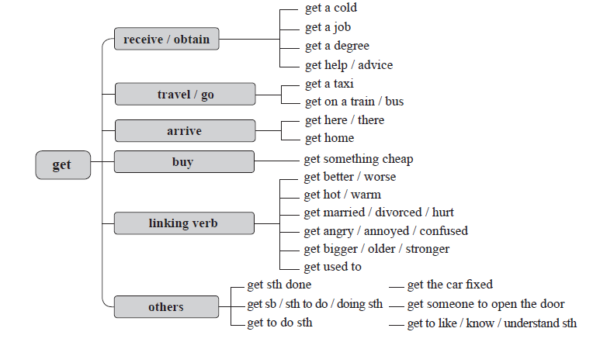

Slide 7
❶
get a taxi
travel / go
数字的“形状”
get on a train / bus
get
get here / there
arrive
get home
buy
get something cheap

Slide 8


■ v
We are going to be late — let’s _____________________.
我们要迟到了，打车吧。
I couldn’t wait to _______________________________.
我迫不及待地要看这本书的结尾。
Did you __________________________________________
_____________? 你给母亲买礼物了吗？
get a taxi
get to the end of the book
get your mother a present / get a present for
your mother

Slide 9
❷
get better / worse
数字的“形状”
get hot / warm
get married / divorced / hurt
get
linking verb
get angry / annoyed /
confused
get bigger / older / stronger
get used to

Slide 10
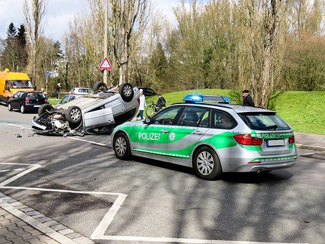
■ get + adj / done
They _____________________ and went home.
他们变得灰心丧气，回家了。
His father ____________________ in a car accident.
他的父亲在一起车祸中丧生。
_____________________________
结婚 / 受伤 / 疲惫
got discouraged
got killed
get married / hurt / tired

Slide 11
❸
get sth done
get the car fixed
数字的“形状”
get sb to do / doing sth
get someone to open the door
get
others
get to do sth
get to like / know / understand sth

Slide 12
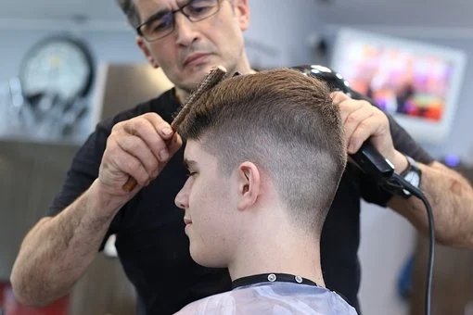
■ v
① get sb / sth doing sth:
A stressful journey to work _________________________________.
紧张的上班路途会让你的血压升高。
② get sth done:
Go and _________________________.
去理发去。
gets your blood pressure climbing
get your hair cut

Slide 13
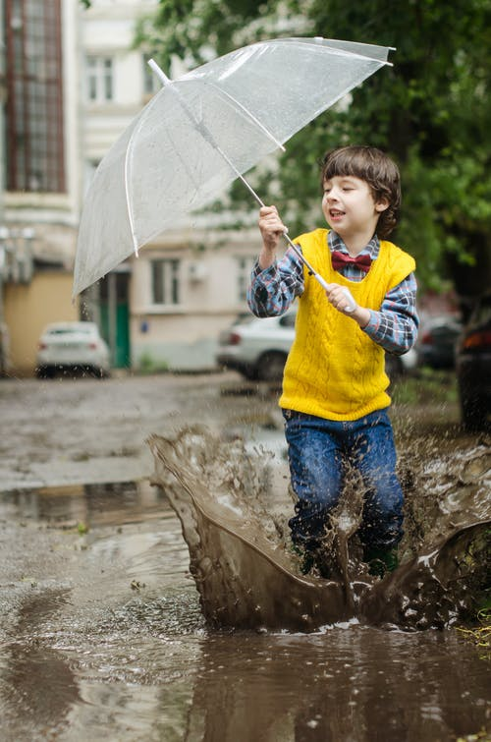
he limited edition watch is worth about 5,000 dollars.
③ get sth + adj:
He ____________________________.
他把衣服弄湿了。
④ get sb / sth to do sth:
You’ll never __________________________.
你绝不可能使她同意。
⑤ get to do sth:
It’ll take some time for you to ___________________________.
你得过段时间才能了解每一个人。
got his clothes wet
get her to agree
get to know everyone

Slide 14
have

Slide 15
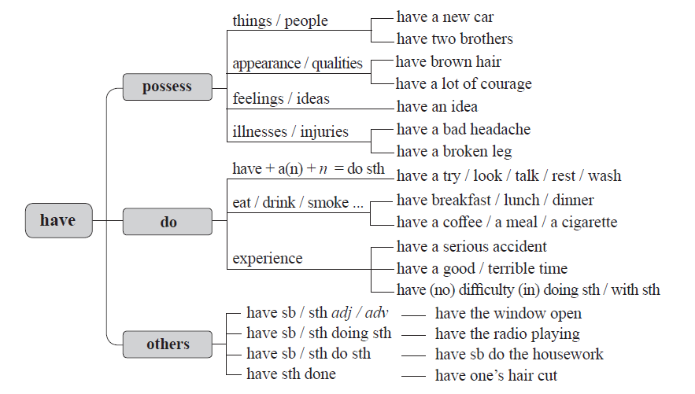

Slide 16
❶
have a new car
things / people
数字的“形状”
have two brothers
appearance /
qualities
have brown hair
have
possess
have a lot of courage
feelings / ideas
have an idea
have a bad headache
illnesses /
injuries
have a broken leg

Slide 17
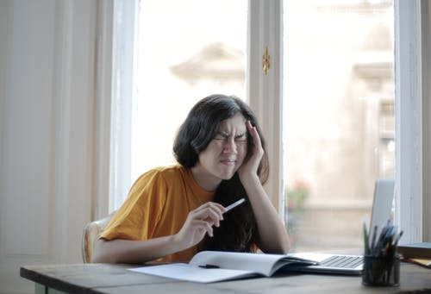
■ v
The limited edition watch is worth about 5,000 dollars.
_____________________ we’ll have a new teacher soon.
有传言称，不久我们这里将会来一名新老师。
I ___________________________ .
我头很疼。
I expect he ___________________ from his father.
我估计他得到了他父亲的一些帮助。
Rumor has it that
had a bad headache
had some help

Slide 18
❷
have + a(n) + n = do sth
have a try / look /
talk / rest / wash
数字的“形状”
have breakfast /
lunch / dinner
eat / drink / smoke ...
have
do
have a coffee / a meal / a cigarette
have a serious accident
experience
have a good / terrible time
have (no) difficulty (in) doing sth / with sth

Slide 19
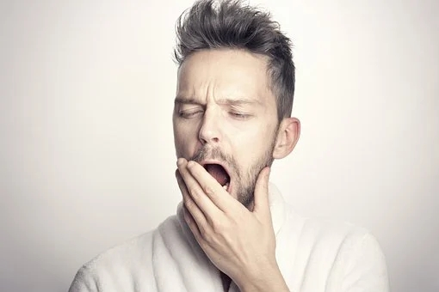
■ v
I _____________________ to cool down.
我游了泳，凉快凉快。
I ___________________________________________ .
我正困得睁不开眼。
had a swim
was having difficulty in staying awake

Slide 20
❸
have sb / sth adj / adv
have the window open
数字的“形状”
have sb / sth doing sth
have the radio playing
have
others
have sb / sth do sth
have sb
do the housework
have sth done
have one’s hair cut

Slide 21
■ v
① have … do / doing sth：
Joe ___________________________.
乔让我给他找辆车。
② have sth done：
You’d better _______________________________________.
你最好把那颗坏牙拔了。
③ have … adj / adv：
I want to _________________________ in time.
我想把一切都及时准备好。
had me find a car for him
have that bad tooth pulled out
have everything ready

Slide 22
make

Slide 23
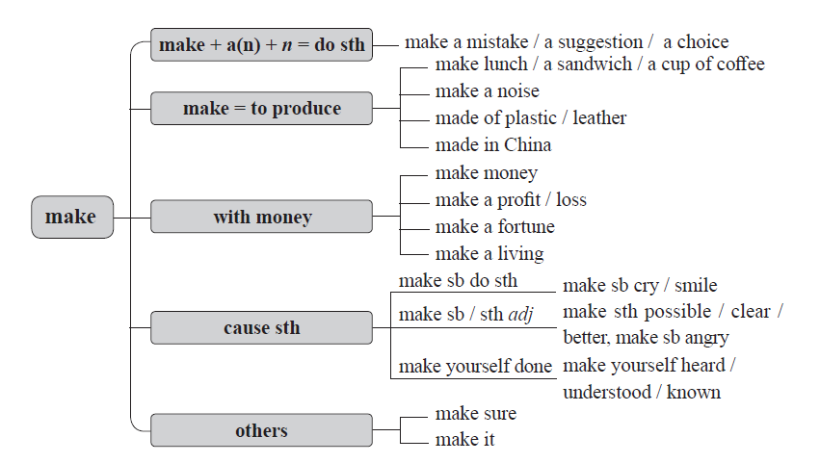

Slide 24
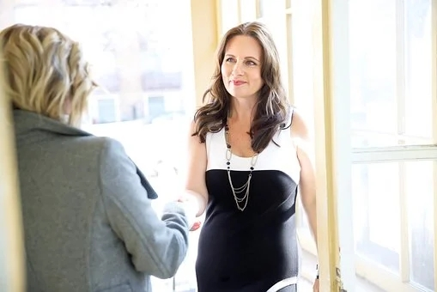
❶
The limited edition watch is worth about 5,000 dollars.
She tried to ________________________
on the interviewer.
她努力给主持面试者留个好印象。
make
make + a(n) + n = do sth
make a mistake / a suggestion / a choice
make a good impression

Slide 25
❷
make lunch / a sandwich / a cup of coffee
make
to produce
make a noise
made of plastic / leather
made in China

Slide 26
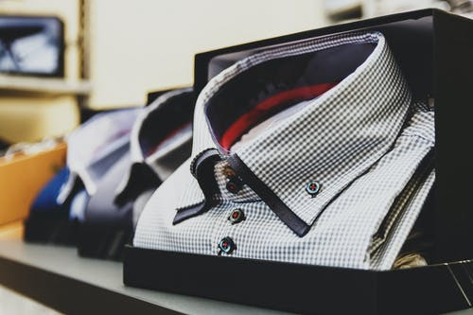
What’s your shirt _______________ ?
你的衬衣是用什么做的？
made of

Slide 27
❸
make money
make a profit / loss
make
with money
make a fortune
make a living

Slide 28
■ vThe
We need to think of ways to ________________________.
我们需要想办法挣钱。
He ___________________________ on the stock market.
他在股票市场发了大财。
He ______________________ as a stand-up comic.
他靠说单口相声为生。
make money
made a fortune
makes a living

Slide 29
❹
make sb do sth
make sb cry / smile
数字的“形状”
make sth possible / clear / better
make sb / sth adj
make
cause sth
make sb angry
make yourself done
make yourself heard / understood / known

Slide 30
■ v
① make sb do sth:
She let me see that ___________________________ made me feel
good, too.
她让我明白了使他人开心也会使自己开心。
② make sb / sth done：
She tried to ____________________________ while giving her talk.
演讲时，她尽量表达清楚自己的意思。
making others feel good
make herself understood

Slide 31
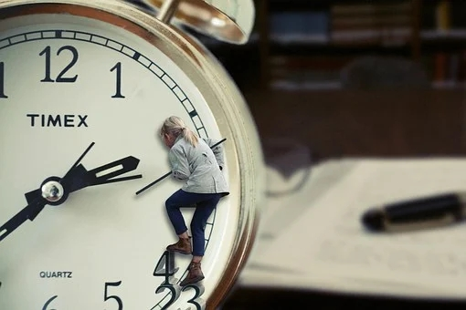
③ make sb / sth + adj / prep / n：
________________________________________, because you’re trading a day of your life for it.
重视你今天正在做的事，因为你正在为此付出生命中的一天。
Make what you’re doing today important

Slide 32
❺
数字的“形状”
make sure
make
others
make it

Slide 33
■ vThe
As long as you have a dream, keep trying and you’ll _____________.
只要你有梦想，不断努力就一定会成功。
The flight leaves in twenty minutes — _______________________.
再过20分钟飞机就要起飞，我们无论如何也赶不上了。
_______________________________________ and died that winter.
杰克没有熬到第二年夏天，他在那个冬天就去世了。
make it
we’ll never make it
Jack didn’t make it to another summer

Slide 34
make it
“做到”事情
做到；成功
数字的“形状”
（尤指在困难情况下）准时到达；赶上
做到
（基本义）
“做到”准时
“做到”克服困难
渡过难关
“做到”参加活动
（口语）能参加；能出席

Slide 35
do

Slide 36
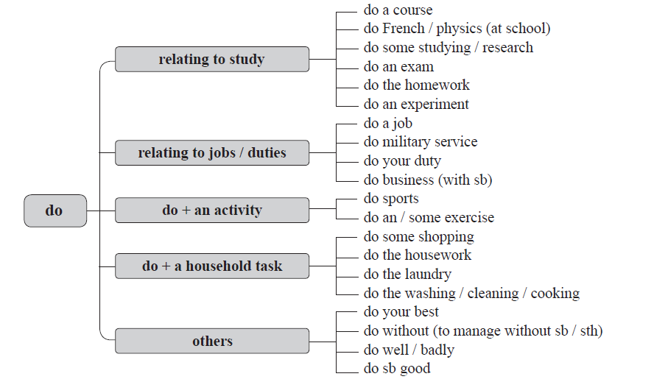

Slide 37
■ v
What does he _______________________?
他做什么工作谋生？
I’m ________________________________________________ .
我在学习物理、生物和化学。
I’m not accustomed to this, but I will try to ________________.
我还不习惯这样，但我会尽量按照你说的去做。
do for a living
doing physics, biology and chemistry
do as you say

Slide 38
grow, appear, go, keep,
turn, remain, fall, stay

Slide 39


选词填空（grow, appear, go, keep, turn, remain, fall, stay）
He is anxious to _______ a gentleman.
appear
If it _________cold, cover the plants.
turns

Slide 40
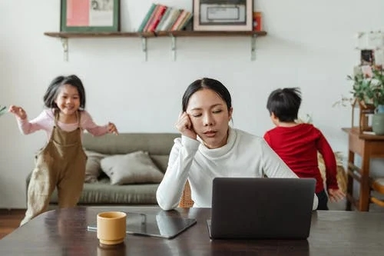
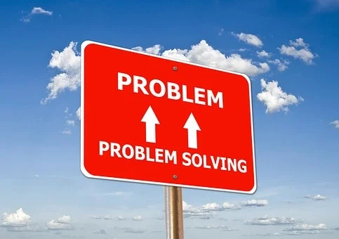
选词填空（grow, appear, go, keep, turn, remain, fall, stay）
The noise_______ her awake.
kept
The wider problem _________.
remains

Slide 41
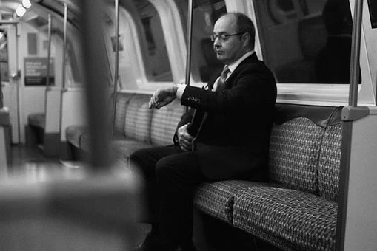
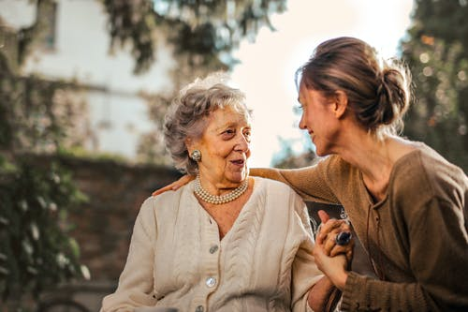
选词填空（grow, appear, go, keep, turn, remain, fall, stay）
grew
As time went on, he ______ more and more impatient.
Her hair is _________ grey.
going

Slide 42
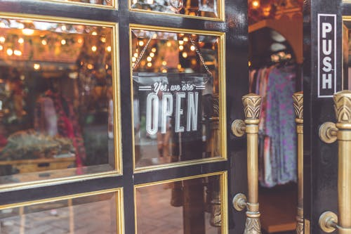
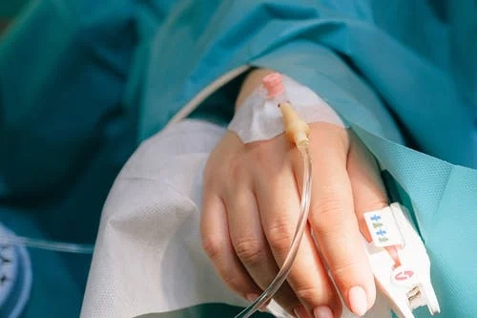
选词填空（grow, appear, go, keep, turn, remain, fall, stay）
stays / remains
The store ____________ open until late on Thursday.
She _______ ill soon after and did not recover.
fell

Slide 43
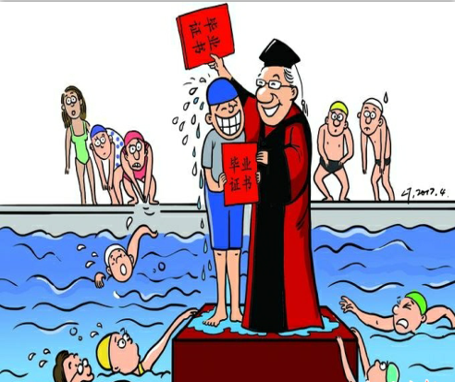
选词填空（earn, allow, cover, fail, make）
Tsinghua University has _____ swimming a compulsory course for all students. Those who are not able to swim will not be _______ to graduate. The new regulation states that all students must pass a swim test, and those who ____ must take a swimming course. Students can take the swimming course any time in the latter three years of their university experience. A “pass” can be ______ by ________ 50 meters using breaststroke (蛙泳), butterfly, freestyle or backstroke (仰泳).
made
allowed
fail
earned
covering

