Slide 1
Unit 5 Water
牛津广州版七年级下册
Grammar

Slide 2
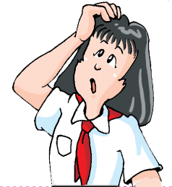
请观察下列句子，并找出句子中的名词。
1. They added some chemicals to me.
2. It stayed there for a few days.
3. I can speak a little French.
4. There isn't enough water in this bottle.
5. He made many mistakes in the exam.
6. There are no eggs or juice in the fridge.
7. I can't sleep because there is too much noise.
可数名词
countable nouns
不可数名词
uncountable nouns

Slide 3

再观察：请找出修饰可数名词和不可数名词的量词。
1. They added some chemicals to me.
2. It stayed there for a few days.
3. I can speak a little French.
4. There isn’t enough water in this bottle.
5. He made many mistakes in the exam.
6. There are no eggs or juice in the fridge.
7. I can't sleep because there is too much noise.
你能归纳一下它们的用法吗？

Slide 4
Talk about quantities
We can use a lot of, a little, a few, (not) much, (not) many and no to talk about quantities.
There is/’s | a lot of/a little/not much/no | water in this bottle.
There are | a lot of/many/a few/not many/no | bottles of water in the fridge.
We use how many and how much to ask about quantities.
How much water is there in this bottle?
How many bottles of water are there in the fridge?

Slide 5
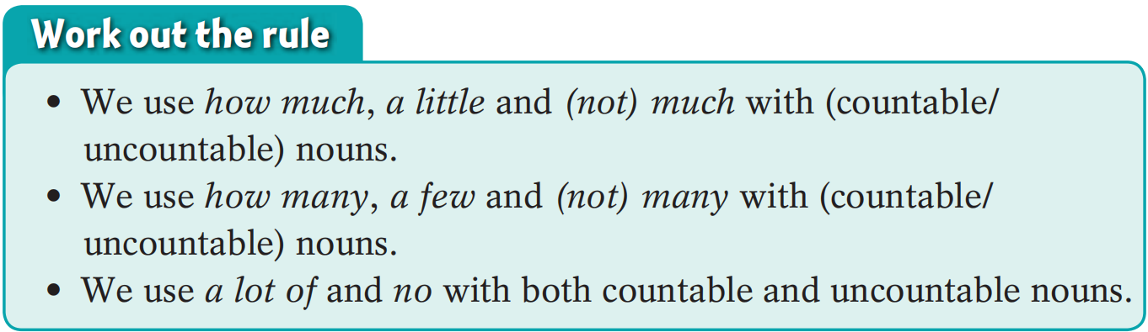
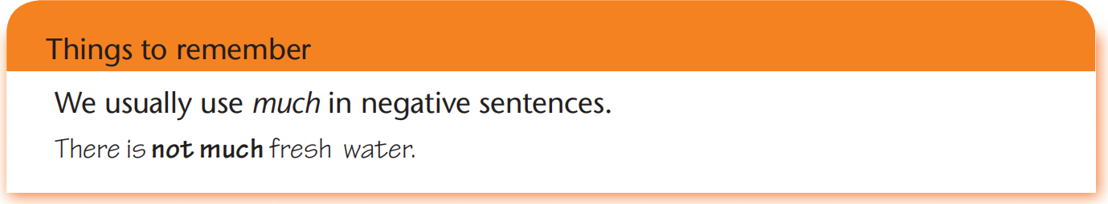

how much, a little和(not) much修饰不可数名词
how many, a few和(not) many修饰可数名词
a lot of 和 no修饰可数和不可数名词
much通常出现在否定句中。

Slide 6

注 意
在非正式文体中，肯定句中常用 a lot of 而非 much 或 many。 例如:
I have much bread.(语法上没有问题但是听起来感觉很古怪。) I have a lot of bread.(这是比较常用的说法。)
在非正式文体中，疑问句或否定句中常使用 much 来修饰不可数名词；使用many 来修饰复数可数名词。
Do you have much bread? I don’t have much bread. Are there many apples in the basket? There aren’t many apples in the basket.

Slide 7
扩 展
修饰可数名词的词或词组：
修饰不可数名词的词或词组：
既可修饰可数名词又可修饰不可数名词的词或词组：
few, a few, many, a large number of 等
little, a little, much, a small amount of, a great deal of等
a lot of, lots of, no, some, any, enough, plenty of 等

Slide 8
当对数量提问时，用“How many+ 可数名词的复数形式”或“How much+ 不可数名词”。
例如:
—How much sugar is there in the cupboard?
—There’s none./There is/There’s a lot of/a little/not much/no sugar.
—How many peaches are there on the plate?
—There are none./There are a lot of/a few/not many/no peaches.

Slide 9
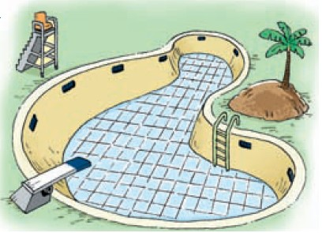
A Look at the pictures below and on page 64. Then complete the questions and answers.
Q: Is there a lot of water in the pool?
A: No, there’s ⁽¹⁾_________________.
no water in the pool

Slide 10
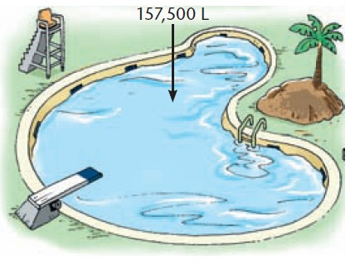
Q: Is there a lot of water in the pool?
A: Yes, there’s ⁽²⁾
_____________________.
Q: ⁽³⁾ __________ water is there in the pool?
A: There are 157,500 litres of water in the pool.
a lot of water in the pool
How much

Slide 11
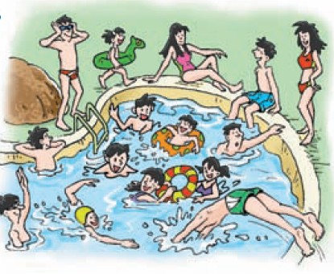
Q: Are there many people in the pool?
A: Yes, ⁽⁴⁾_________
____________________.
Q: ⁽⁵⁾____________ people are there in the pool?
A: There are 10 people in the pool.
there are
many people in the pool
How many

Slide 12
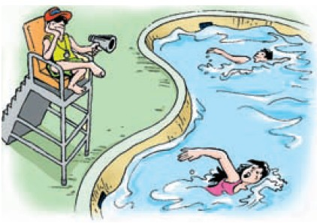
Q: Are there many people in the pool?
A: ⁽⁶⁾___________________
___________________.
Q: ⁽⁷⁾_______________________
________________________
A: There are only two people in the pool.
No, there aren’t many
people in the pool
How many people
are there in the pool?

Slide 13
We can use too much, too many, too little, too few and (not) enough to talk about quantities.
Quantities | Examples
more than enough太多 | too much water | too many oranges
not enough不够 | too little milk | too few eggs
just right刚刚好 | enough salt | enough onions

Slide 14
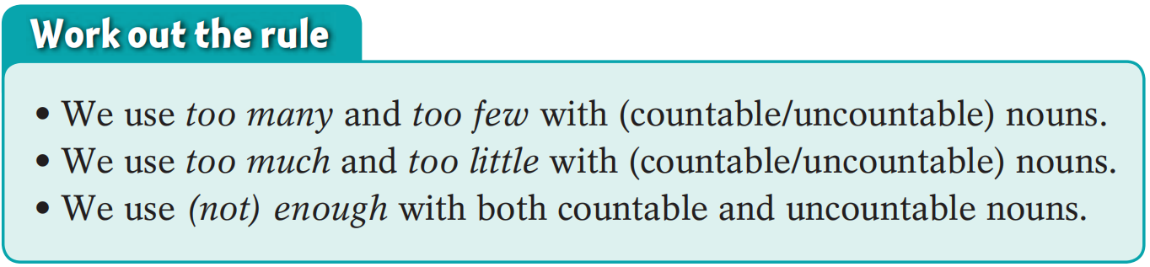
too many和too few修饰可数名词
too much和too little修饰不可数名词
not enough修饰可数和不可数名词

Slide 15
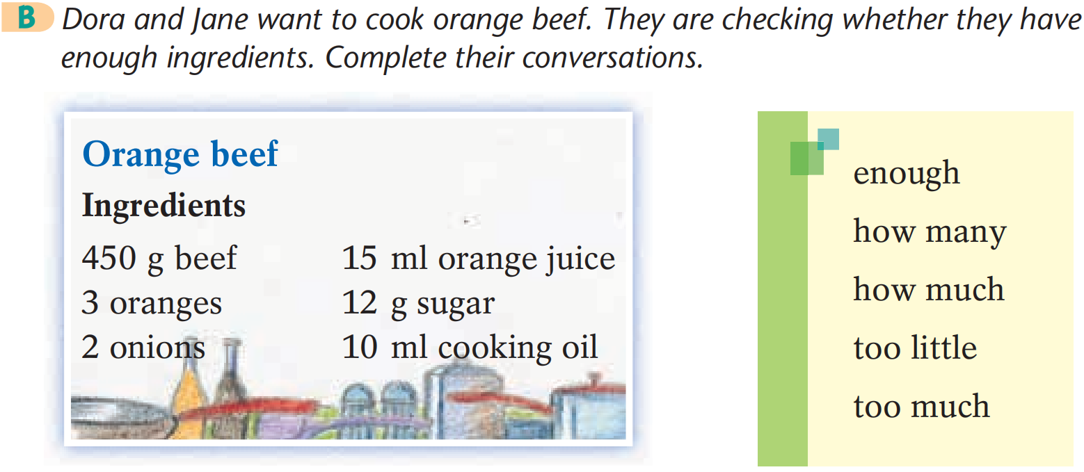

Slide 16
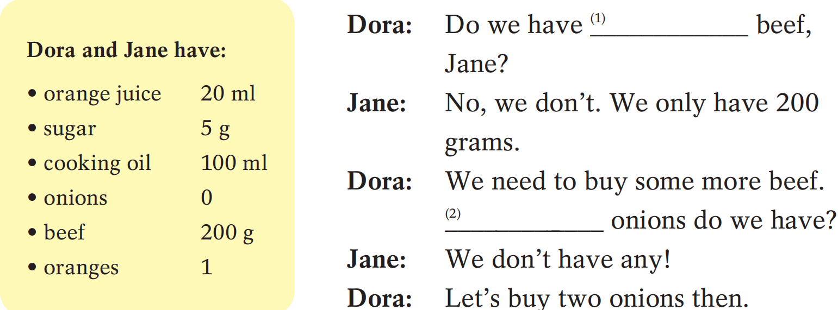
enough
How many

Slide 17
How much
Dora: ⁽³⁾____________ cooking oil do we have?
Jane: We have 100 millilitres. That’s more than
enough. We shouldn’t add ⁽⁴⁾__________
cooking oil.
Dora: Do we need to buy any sugar?
Jane: Yes, we do. We only have five grams. The dish
will be too sour if we add ⁽⁵⁾__________ sugar.
By the way, we have ⁽⁶⁾_________ orange juice.
Dora: Great! Let’s go to the supermarket now!
Dora and Jane have:
orange juice 20 ml
sugar 5 g
cooking oil 100 ml
onions 0
beef 200 g
oranges 1
too much
too little
enough

Slide 18
a few，few，a little 和little 描述数量的差别主要是主观上的，而不是实际数据上的。具体用法区别如下：
 | 表示肯定 | 表示否定
意义 | “一些；少许的” | “几乎没有的”
修饰可数名词 | a few | few
修饰不可数名词 | a little | little
There are a few people in the room.
房间里有几个人。（强调还有一些人）
There are few people in the room.
房间里没有几个人。（强调几乎没有人）
I have a little money. 我有一点点钱。（强调还有少许钱）
I have little money. 我快没钱了。（强调几乎没有钱）

Slide 19
too many，too few，too much，too little 和enough 描述数量是否足够。具体用法区别如下：
意义 | “太多的” | “足够的” | “太少的”
修饰可数名词 | too many |  | too few
修饰不可数名词 | too much |  | too little
既可修饰可数名词， 也可修饰不可数名词 |  | enough
如：架子上有太多书了。
There are too many books on the shelf.
她的冰箱里面包太少了。
There is too little bread in her fridge.
她没有足够的钢笔。
She doesn’t have enough pens.

Slide 20
enough 意为“足够的；足够地”，可用于可数名词复数形式或不可数名词之前，也可用于动词、形容词或副词之后。
如:
足够的钱
吃得足够多
足够深
足够快
enough money
eat enough
deep enough
fast enough

Slide 21
some和any用在不同的句型中。具体用法区别如下：
some | 接可数名词复数形式或不可数名词 | 一般用于肯定句或表建议，请求，邀请的疑问句子中
any |  | 一般用于否定句或疑问句中
如：你想要些牛奶吗？
Would you like some milk?
我从来不做任何承诺。
I never make any promises.

Slide 22
Practice makes perfect！
Notes:
单击“同步练习”字样，可打开Language points同步练习的Word文档超链接。

Slide 23
I. 选用much、many、few、a few、little或a little填空。
1. There are ________ buses in London.
2. I have _______ time to study. Tomorrow is the final exam.
3. Please don’t make so ________noise.
4. There is still _________ eggs in the bottle. It’s enough.
5. There are just very ________ films of this sort.
6. Bob said that he had ________ money, so he could still buy me a gift.
many
little
much
a few
few
a little

Slide 24
II. 请就划线部分提问。
1. There is five glasses of milk in the fridge.
2. There is 100 yuan on the table.
3. Mary has hundreds of books in her room.
4. He wants two pieces of bread.
How much milk is there in the fridge?
How much money is there on the table?
How many books does Mary have in her room?
How much bread does he want?

Slide 25
III. 选择最佳答案填空。
( )1. Drinking ____ tea is bad for your health.
A. too much B. too many
C. a few D. a little
( )2. You spent ____ time on the meanings of the words so that
you couldn’t understand the whole passage.
A. too many B. too much
C. enough D. too little
( )3. Would you like ____water?
A. some B. many C. any D. much
A
B
A

Slide 26
( )4. Positive (积极的) thinking alone is ____ to turn your life
around and you should do it at the same time!
A. too much B. too many
C. enough D. not enough
( )5. There are ____ posts for so many people this year!
We must fire some people.
A. too little B. too many
C. too few D. too much
( )6. They don’t have ＿＿idea!
A. some B. many C. any D. a few
D
C
C

Slide 27
Summary
 | 描述数量 | 提问数量
修饰可数 名词
修饰不可 数名词
既可修饰可数名词，也可修饰不可数名词
(not) many， a great / large / small number of，a few，few，
too many，too few
how many
(not) much，a great deal of，a
great / large / small amount of，a
little，little，too much，too little
how much
a lot of，lots of，plenty of，some, any，no，(not) enough

Slide 28



Self-assessment
How well do you know about this lesson? Tick the boxes.
① I can use quantities with countable nouns correctly.口 口 口
② I can use quantities with uncountable nouns correctly.
口 口 口
③ I can use quantities with both countable and uncountable nouns correctly. 口 口 口

Slide 29


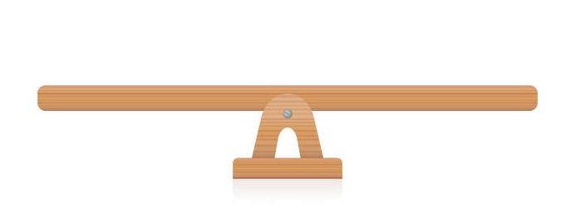
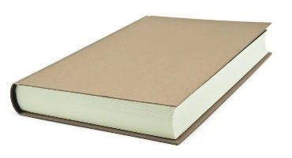


“双减”背景下，作业如何合理分层
Notes:
单击“同步练习题”字样，即可打开本课时同步练习题的Word文档。

Slide 30

⭐可参考作业布置如下：
Homework
Samples:
书面作业（可选） | 创新探究性作业（可选）
1.完成《双语报》N2版Grammar跟踪练习。 | 1.小组合作，用思维导图将本节课语法的用法总结出来，比比哪一组做得最好。
2.完成《双语报》N4版第四课时Grammar练习。 | 2.整理错题本，将仍存在疑惑的地方以及易错点记入错题本。
3.完成《阳光学业评价》Grammar部分练习。

Slide 31
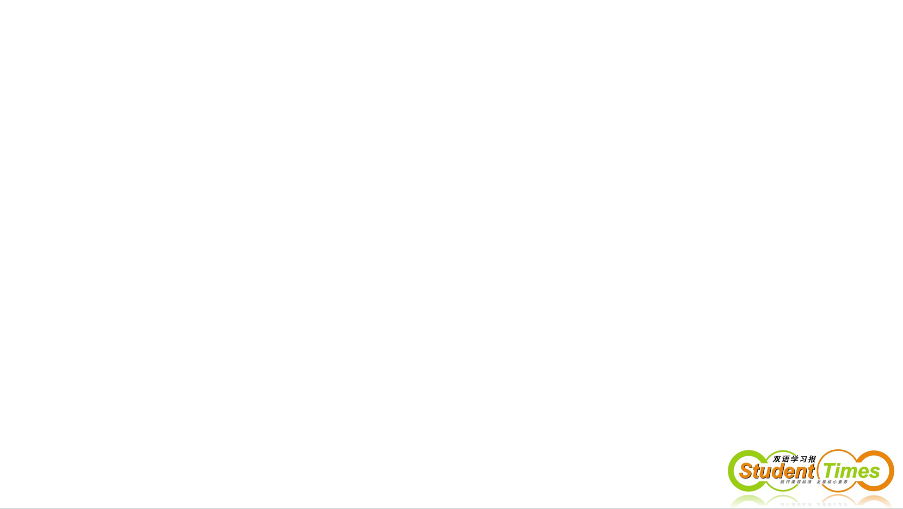
THANKS

