Slide 1
Unit 5 Water
牛津广州版七年级下册
Words and expressions

Slide 2
Content
A
Words & expressions
B
Exercise time
C
Homework

Slide 3

Read the words loudly and say their Chinese meanings.
drop
journey
quantity
experiment
fresh
salt
on
voice
*reservoir
add
chemical
n.滴；v.掉下；落下
n.旅行；旅程
n.数量
n.实验；试验
adj.淡的；无盐的
n.盐
adv.（表示处于工作状态或使用中）
n.嗓音；说话声
n.水库
v.增加；添加
n.化学品

Slide 4
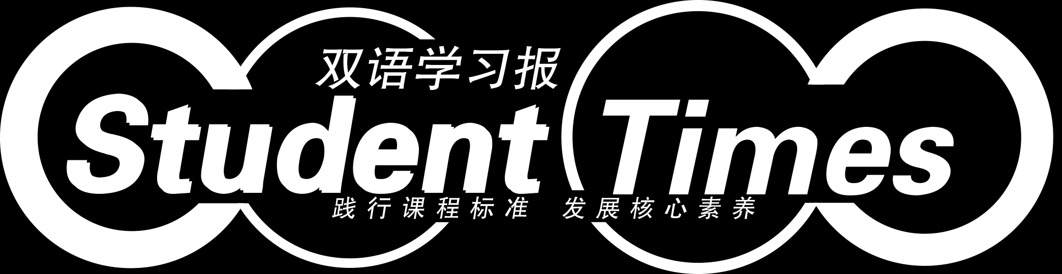
through
pipe
valuable
bit
bank
change
return
*vapour
form
*stir
continue
*crystal
prep.通过；穿过
n.管道
adj.宝贵的；很有用的
n.有点；一点
n.银行
n.找给的零钱；找头
v.归还
n.蒸气；雾气
v.形成；构成
v.搅拌
v.继续
n.结晶（体）

Slide 5
Match the phrases with their Chinese meaning.
turn off
add…to…
a bit
part of
pocket money
(be) made up of
dry up
有点；一点
关掉
由……组成
把……加入……
干涸
……的一部分
（父母给孩子的）零花钱

Slide 6
a drop of water
travel through
come out of
turn into
have a bath
take/have a shower
instead of
洗盆浴
从……出来
一滴水
而不是……
经过
（使）变成
淋浴

Slide 7
Exercise time.
语篇填词
Jim is very sad because he can’t find his watch. The watch is not very expensive but it is very (1) v_______ to him. It is a gift from his grandpa. Jim can’t remember where he lost it yesterday. Suddenly, he remembers that he ran (2) t_______ a narrow alley (巷子)quickly yesterday afternoon. He probably (3) d_______ his watch in the alley. Then he decides to look for his watch there. When he gets there, he sees a cleaner. Jim tells the cleaner about his watch. The cleaner takes out a watch from his pocket and (4) r_______ it to Jim. That is Jim’s watch. Jim is very cheerful and he shows his thanks to the kind cleaner. Then, the cleaner (5)c________ to clean the floor.
aluable
hrough
ropped
eturns
ontinues

Slide 8
完成句子
1.大卫经常用他的零花钱去帮助穷人。
David often uses his ______ ______ to help the poor.
2.我们篮球队是由十二名成员组成的。
Our basketball team_____ _____ _____ _____ twelve members.
3.玛丽关了电灯，上床睡觉了。
Mary ______ _____ the lights and went to bed.
4.今天我只能完成部分工作。
I can only finish _____ _____ the work today.
5.你应该多留在家里，而不是每天晚上都跑出去玩。
You should spend more time at home ______ _____ going out.
pocket money
is made up of
turned off
part of
instead of

Slide 9
6.Sam喜欢打完篮球后洗个淋浴。
Sam likes ______ _____ ______ after he plays basketball.
7.每个冬季这条河都会干涸。
This river _____ _____ every winter.
8.吃了那条鱼后，我的肚子感觉有点不舒服。
After I ate the fish, my stomach feels _____ _____ strange.
9.你能给我的牛奶里加一点糖吗？
Can you _____ some sugar _____ my milk?
10.Lucy朝上看，感觉一滴雨落在她的脸上。
Lucy looked up and felt _____ _____ _____ rain fall on her face.
taking a shower
dries up
a bit
add to
a drop of

Slide 10


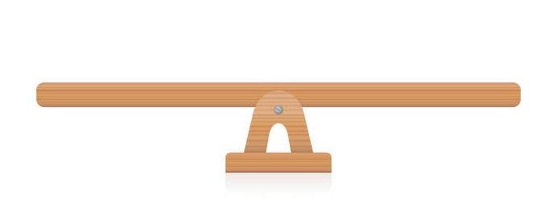
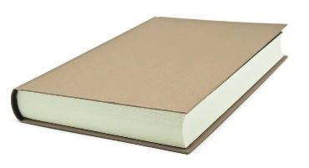


“双减”背景下，作业如何合理分层
Notes:
单击“同步练习题”字样，即可打开本课时同步练习题的Word文档。

Slide 11

⭐可参考作业布置如下：
Homework
Samples:
基础作业 | 拓展作业
1.完成《双语报》单元配套N3版配套第一课时Ⅰ、Ⅱ练习； | 1.完成《双语报》单元配套N3版第一课时Ⅲ、Ⅳ练习；
2.抄写并背默《阳光学业评价》高频词和高频词组各6个； | 2.抄写并背默《阳光学业评价》高频词和高频词组；
3.跟录音读单词两遍，注意单词发音和重读音节。 | 2.使用以下所给单词或词组造句。 drop, through, return, a bit，(be) made up of
Notes:
单击“同步练习题”字样，即可打开本课时同步练习题的Word文档。

Slide 12
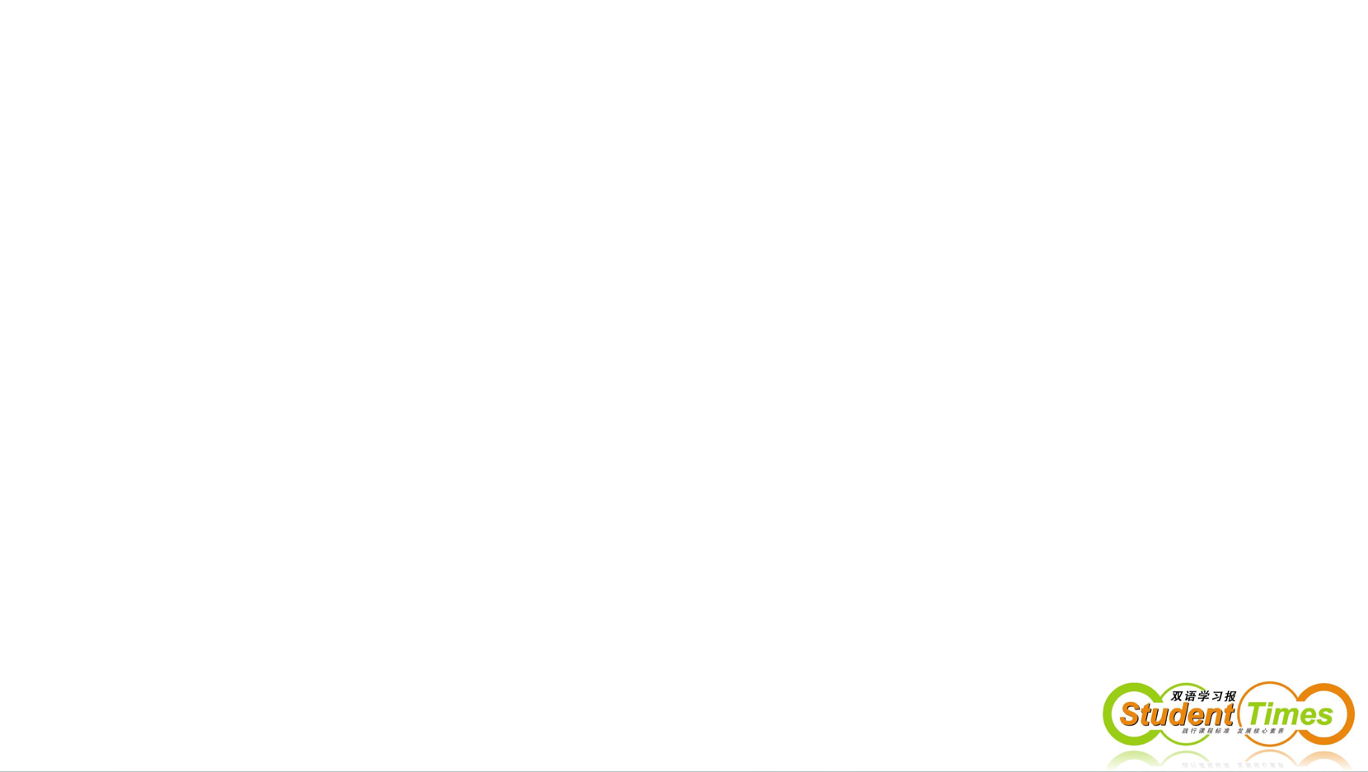
THANKS

