Slide 1
Unit 6 Electricity
牛津广州版七年级下册
Words and expressions

Slide 2
Content
A
Words & expressions
B
Exercise time
C
Homework

Slide 3

Read the words loudly and say their Chinese meanings.
electricity
conversation
*identify
rule
anyone
reply
foolish
wire
connect
n.电
n.谈话
v.确认；认出
n.规则
pron.任何人
v.回答
adj.愚蠢的
n.电线
v.（使）连接

Slide 4

*cable
moment
battery
cooker
fridge
*bulb
lock
test
tidy
touch
n.电缆
n.瞬间；片刻
n.电池
n.厨灶；炉具
n.冰箱
n.电灯泡
v.（用锁）锁上
v.测试
v.使整洁；使整齐
v.触摸；碰

Slide 5
Match the phrases with their Chinese meaning.
a packet of
in a way
(be) connected to
power station
washing machine
switch off
tidy up
air conditioner
连接到
一袋
关（点灯、机器等）
在某种程度上
收拾妥；整理好
空调
发电站
洗衣机

Slide 6
solar/water/wind power
a moment later
rice cooker
safety tips
electrical appliance
switch on
start a fire
make sure
电器
电饭煲
太阳能/水能/风能
确保
过了一会
安全提示
开（电灯，机器等）
引起火灾

Slide 7
Exercise time.
语篇填词
What is the most important invention in our life? I think electricity maybe the most important in a way. Can (1) a______ in modem society live without electricity? Surely not! When the electricity goes off, almost everything stops. Electrical appliances can’t work; food in the (2) f______ goes bad; traffic lights are dead; many workers have to (3) s______ working. Electricity is so important, but still some people are wasting it. So we must make (4) r______ to save electricity. For example, we can increase (提高) the price of electricity when someone uses too much electricity in a month. We should also call on people to (5) s______ off lights and other electrical appliances when they don’t use them.
nyone
ridge
top
ules
witch

Slide 8
完成句子
1.在某种程度上，我认为我们都赢了。
_____ _____ _____, I think we both won.
2.妈妈，你能给我买一袋炸薯片吗？
Mom, can you buy me _____ _____ _____ potato chips?
3.Peter把自己的脏衣服都塞进了洗衣机里。
Peter stuffed his dirty clothes into the ________ ________.
4.是时候整理你的房间了，它太乱了。
It’s time to _____ _____ your room. It’s too messy.
5.天快黑了，汤姆打开灯，拉上了窗帘。
It was getting dark so Tom _______ _____ the light and drew the curtains.
In a way
a packet of
washing machine
tidy up
switched on

Slide 9
6.确保你能在午夜前回到家。
_____ _____ you can be home by midnight.
7.这座小镇明年将有一个新的发电站。
There will be a new ______ ______ in this small town next year.
8.这里有一些关于本次旅行的安全提示。
Here are some _____ _____ for this trip.
9.你必须小心使用取暖器，否则将可能引起火灾。
You must be careful with the heater, or it might_____ ____ _____.
10.这款玩具汽车使用太阳能驱动，而不是电池。
This toy car runs on _____ _____ instead of batteries.
Make sure
power station
safety tips
start a fire
solar power

Slide 10


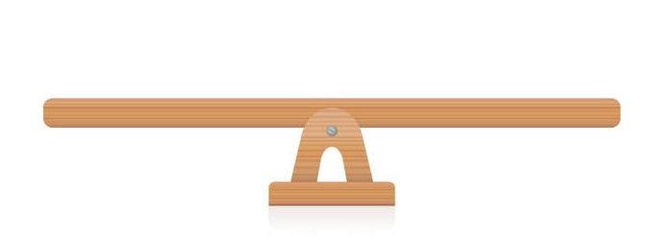
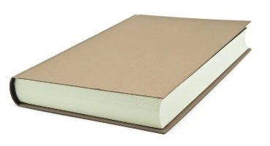


“双减”背景下，作业如何合理分层
Notes:
单击“同步练习题”字样，即可打开本课时同步练习题的Word文档。

Slide 11

⭐可参考作业布置如下：
Homework
Samples:
基础作业 | 拓展作业
1.完成《双语报》单元配套N3版配套第一课时Ⅰ、Ⅱ练习； | 1.完成《双语报》单元配套N3版第一课时Ⅲ、Ⅳ练习；
2.抄写并背默《阳光学业评价》高频词和高频词组各6个； | 2.抄写并背默《阳光学业评价》高频词和高频词组；
3.跟录音读单词两遍，注意单词发音和重读音节。 | 2.使用以下所给单词或词组造句。 anyone, moment, lock, in a way，tidy up
Notes:
单击“同步练习题”字样，即可打开本课时同步练习题的Word文档。

Slide 12
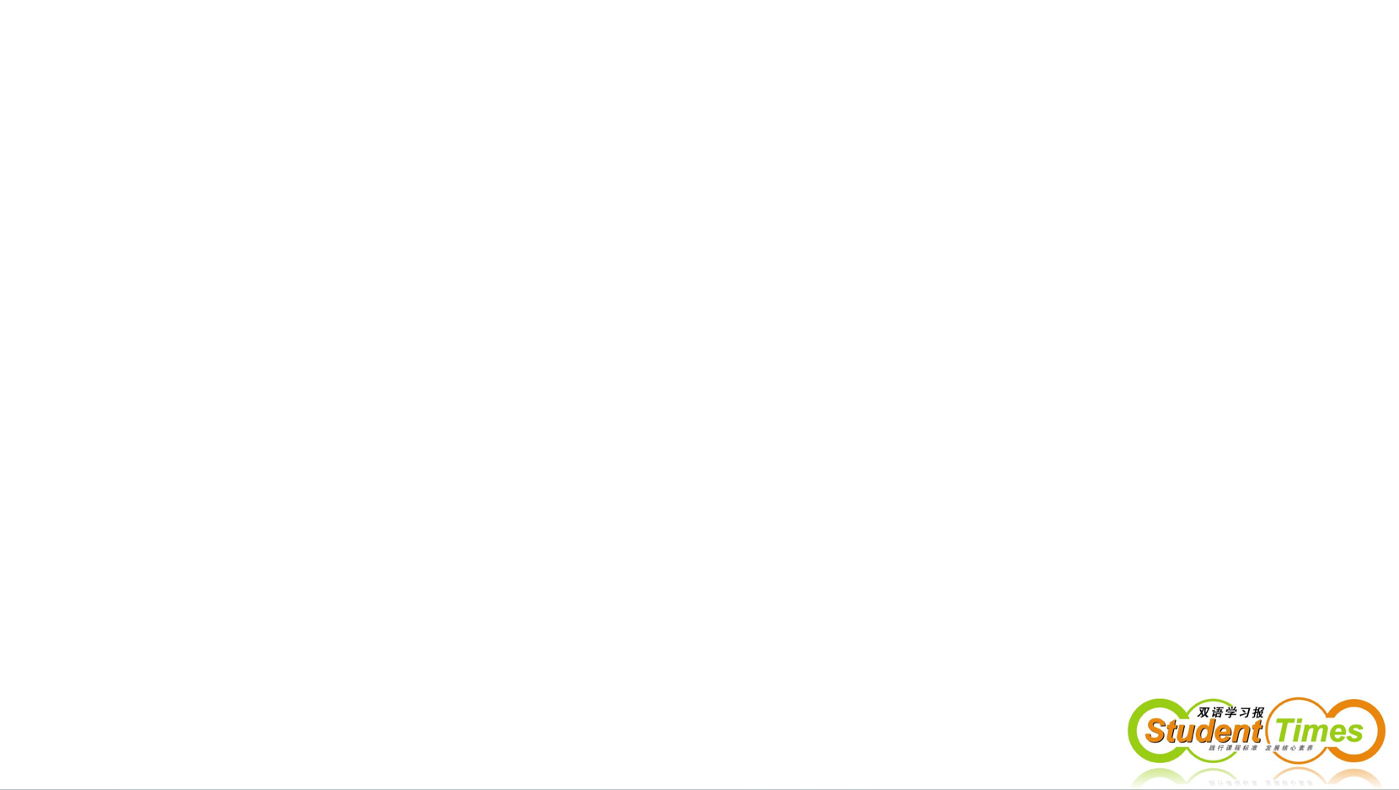
THANKS

