Slide 1
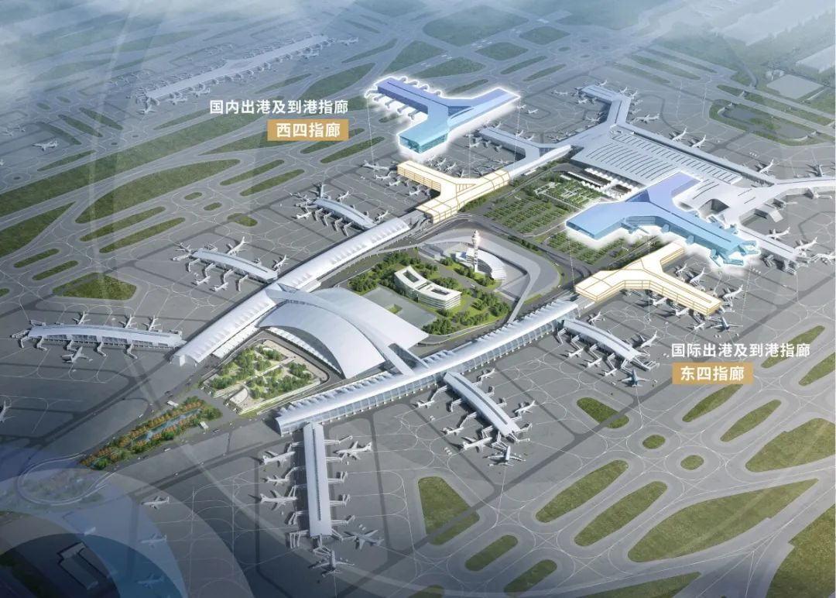
白云机场诞生全球最大单体航站楼

Slide 2
Guangzhou Baiyun International Airport has become the world's 1. ______(large) single-building airport terminal(航站楼) as the East 4 and West 4 corridors(指廊) were put into 2. ____________(operate) on December 31, 2023.
So far, Terminals 1 and 2 of Baiyun Airport are connected, 3. ___________(bring) the total area of the airport terminals to 1.561 million square meters.
4. ___________(locate) between T1 and T2, the East 4 and West 4 corridors are 5. _____ important part of the Phase III expansion project of Baiyun Airport. The two corridors are connected to T1 on the south and T2 on the north. 6. ______ a total length of 507 meters from south to north and 256 meters from east to west, they form a "T" shape.
largest
operation
bringing
Located
an
With

Slide 3
The opening of the two new corridors adds 35 new boarding gates and 25 contact stands, 7. _______ enhances the efficiency of the existing terminals and 8. __________(improve) the operational capacity of Baiyun Airport.
As of the end of 2023, with resumed and new flight routes, Baiyun Airport has been opened for over 100 international and 9. _________(region) routes, including routes to Los Angeles, Rome, Paris, London, Sydney, and Port Moresby, operating more than 1,000 flights every week. 10. __________(additional), Baiyun Airport has added seven international cargo(货物) route carriers and opened 14 cargo routes in 2023.
which
improves
regional
Additionally

